Slide 1
Environmental Solutions, Water Quality Standards and Assessment Section
EQC Action Item: Water Quality Standards Revisions For Freshwater Ammonia Criteria
January 7-8, 2014
Portland
Debra Sturdevant, Manager | Andrea Matzke, WQ Standards Specialist
Notes:
Deb will introduce herself and then Andrea

Slide 2
DEQ’s recommendation
DEQ recommends that the EQC adopt proposed amendments to OAR 340, Division 41 as shown in Attachment A. These amendments:
  Adopt EPA’s latest 2013 national recommendations for freshwater ammonia criteria
  Correct an error in the pH rule language for the main stem Snake River
  Amend the Umatilla Basin-specific standards to align with EPA’s partial disapproval
  Add notes to state’s natural conditions criterion and natural conditions criterion for temperature to reflect EPA’s disapproval
  Incorporate plain language into the amended rules consistent with the Oregon Administrative Procedures Act
Notes:
Correction Amendments: We are correcting a pH error on the mainstem Snake Ri. The other clarifications deal w/ several EPA disapproval actions and getting those disapprovals reflected correctly in our rules. Debra will cover these clarifications in more detail at the end of the presentation. In addition, DEQ is proposing plain English revisions to its rules. These revisions are not substantive.
The following slides will focus on the ammonia amendments

Slide 3
Why is DEQ proposing revisions?
To address EPA disapproval of Oregon’s criteria by proposing ammonia criteria based on the latest science
EPA’s latest recommendations are based on the sensitivity of ammonia to mussels, snails and other aquatic life
Notes:
-Last year, EPA disapproved OR’s ammonia criteria that were adopted 10 yrs. ago in 2004. Since 2004, new toxicity data on the effects of ammonia to freshwater mussels and snails have become available and EPA has developed new recommendations for ammonia to protect mollusks and other aquatic life. These recommendations were finalized in 2013. DEQ intends to address EPA’s disapproval by adopting these recommendations based on the latest science.
-Ammonia is a pollutant commonly found in waste products and fertilizers

Slide 4
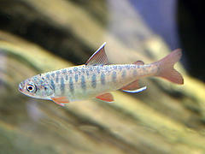
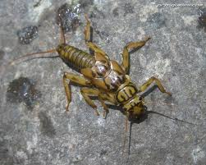
What are the aquatic life toxics criteria?
Concentrations of a pollutant at which aquatic life (such as fish, shellfish and aquatic insects) are protected
Toxics criteria are used in wastewater discharge permits, water quality assessments (303(d) list), TMDLs and the Cleanup Program
Beneficial use protected: fish and aquatic life
Notes:
-NH3 is one of the aquatic life toxic pollutants. OR has a total of 41 aquatic life pollutants. These criteria, including NH3, apply in waterbodies where the beneficial use is for fish and aquatic life. Although OR has a number of beneficial uses, the protection of fish and aquatic life is usually the most sensitive beneficial use to protect. Most waterbodies in OR have fish and aquatic life as a beneficial use.
-Toxics criteria are used in a number of CWA programs, so the criteria serve as a foundation for other programs. For example, wastewater and industrial facilities which discharge wastes to rivers could also be affected by changes to WQS, including NH3.

Slide 5
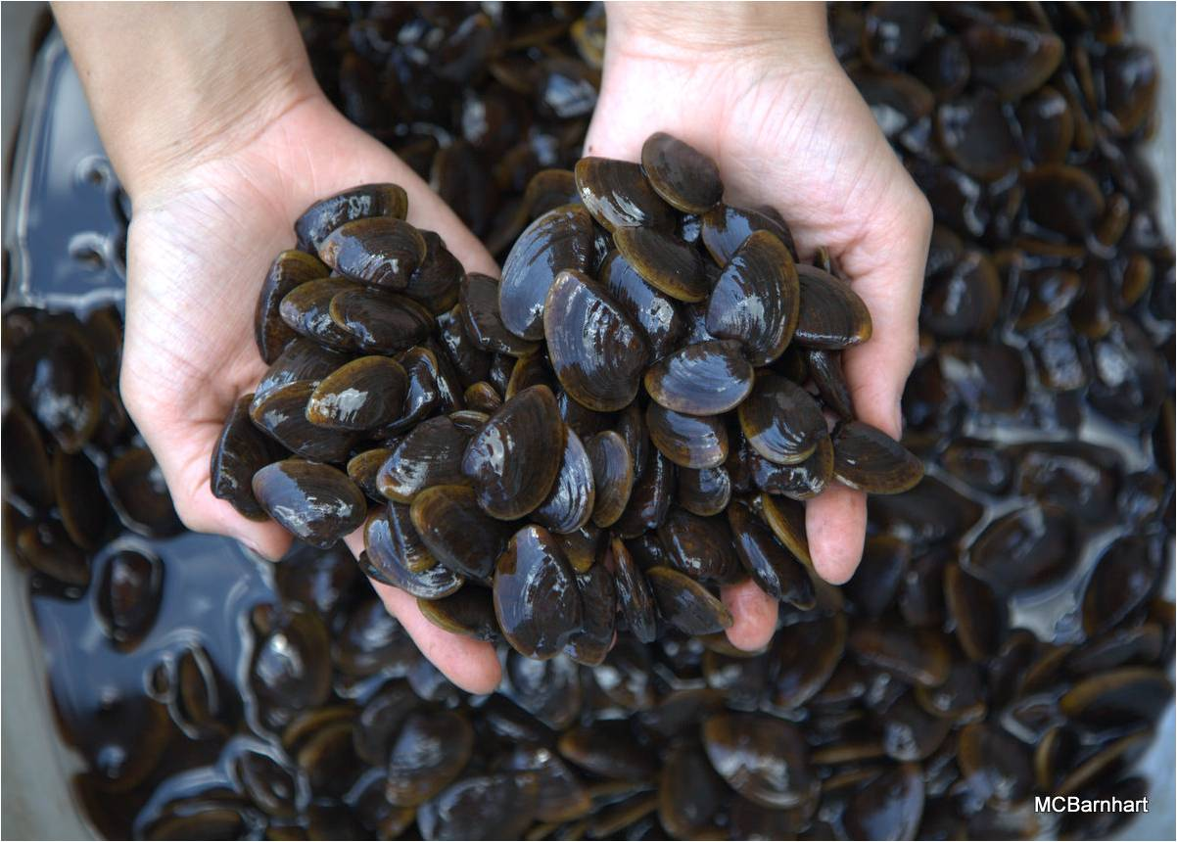
What Comprises the Aquatic Life Toxics Criteria?
Magnitude
(µg/L)
Duration
(short and long term)
Frequency
(not to exceed more than once every 3 years)
Notes:
Magnitude = concentration of the pollutant
Duration = the time period over which the concentration value is calculated (averaged) to protect against short and long term impacts to aquatic life
acute 1-hr: lethal effects
chronic 4-day: reproductive, growth or survival effects
Frequency = how often the concentration value can be exceeded. So, for the majority of ALC, the magnitudes/concentrations associated w/ short and long term exposure periods, cannot be exceeded more than once every 3 years.

Slide 6
2004 aquatic life toxics adoption
In 2013 EPA disapproved the following pollutants adopted in 2004:
11 pesticides, selenium
copper
cadmium (acute)
aluminum
ammonia
Notes:
-This slide gives the EQC an opportunity to see where the ammonia rulemaking fits in w/ the other list of pollutants EPA disapproved in 2004 , as well as DEQ’s status in addressing the disapprovals

Slide 7
2004 ammonia standards adoption
EQC adopted ammonia criteria based on EPA’s 1999 recommendations—these criteria have never been effective
EPA must approve state revisions to water quality standards before being effective
  REQUIRED: Endangered Species Act (ESA) consultation with National Marine Fisheries Service and U.S. Fish & Wildlife Service for criteria affecting threatened and endangered (T&E) species
Notes:
-Any revisions to state WQS must then be approved by the EPA to be effective for CWA purposes.
-The Endangered Species Act requires federal agencies, including EPA, to consult with the U.S. Fish and Wildlife Service and National Marine Fisheries Service to ensure that its actions, such as approval of DEQ water quality standards, are not likely to jeopardize the existence of threatened or endangered species or their critical habitats

Slide 8
2004 ammonia standards disapproval
Aug. 2012: NMFS ESA consultation indicated that Oregon’s ammonia criteria would cause harm to T&E species
Jan. 2013: EPA disapproved ammonia (and other pollutants):
  1999 ammonia criteria are not protective of freshwater mussels and snails and according to NMFS would cause jeopardy to T&E species in OR
  Therefore, Oregon’s effective criteria continue to be based on EPA’s 1985 recommendations
Oregon needs to respond to disapprovals in a timely manner
Notes:
-It took almost 8 yrs. to complete ESA consultation given technical issues and eventually litigation to get EPA and the Services to complete their analyses.
-The CWA requires EPA to propose criteria for OR if OR doesn’t adopt the changes specified in the disapproval w/in 90 days of action. (not realistic given a state’s rulemaking process)
BACKPOCKET: FWS also issued a BiOp on OR’s ALC (July 30, 2012), but did not find jeopardy with OR’s 1999 ammonia criteria (based on effects to bull trout, OR chub, Lost River sucker, shortnose sucker, vernal pool fairy shrimp, marbled murrelet)

Slide 9
EPA’s Aug. 2013 recommendations
DEQ proposes to adopt EPA’s 2013 ammonia criteria recommendations
EPA used 27 years of toxicity data—largest dataset of all aquatic life criteria
  Invasive species removed
  Mussels (Unionid family— “pearly mussels”) and gill-bearing (non-pulmonate) snails are some of the most sensitive species
  14 T&E species (5 are mussels) included in toxicity data
Ammonia toxicity depends on pH and temperature
  As pH and temperature increases, criteria become more stringent
Notes:
-EPA conducted literature reviews from 1985 through October 2012 (27 yrs.) and have been working on developing updated NH3 criteria since their 1999 rec’s (13 yrs.)
-no invasive species included in either the acute or chronic datasets (e.g. Asiatic clams). EPA had received concerns during public comment on the draft 2009 ammonia criteria (resulted in slightly less stringent criteria)
-- first explicit analysis of T&E species in an EPA criteria doc—14 T&E species OR species: Coho salmon, Rainbow trout (OR-steelhead), Chinook salmon, Lost River sucker, Lahontan cutthroat trout, Sockeye salmon
Topeka shiner, Shortnose sturgeon, Atlantic salmon
BACKPOCKET: Data met EPA’s guidelines for developing ALC--All 8 families are represented in the dataset:
Eight families:
1.Salmonid 4.Planktonic Crustacean—daphnia, copepods, amphipods
2.Second Fish Family 5.Benthic Crustacean—crabs, lobster
3.Chordata—salamanders, frogs 6.Insect—mayflies, stoneflies, dragonflies
7.Rotifer, Annelida, Mollusca 8.Other Insect or Mollusca

Slide 10
Proposed ammonia revisions
Acute/CMC criteria (1-hr. average)
  Expressed as mg/L TAN—Total Ammonia Nitrogen (NH3 and NH4)
  Generally, more stringent than Oregon’s current criteria
  Temp > 15.7˚C mussels more sensitive
  Temp < 15.7˚C salmonids more sensitive
Therefore, two sets of acute criteria apply based on the presence or absence of salmonids
Notes:
-CMC: Criterion Maximum Concentration
-EPA has rec’d TAN expression since 1999. OR’s criteria based on 1985 rec’s expresses the criteria as unionized ammonia
-15.7 C = 60 F
-the majority of OR waterbodies support salmonid use, so the more stringent criteria would apply in most waterbodies here in OR
(other waterbodies support cool water species or Borax Lake chub (i.e. include highly alkaline and saline lakes in Goose and Summer Lake subbasin, the lower portions of the Klamath, Malheur and Owyhee Rivers and a few other stream reaches)
BACKPOCKET: The four species and the genus mean acute value (GMAV) associated with each tested species from most to least sensitive are:
1. Lasmigona subviridis, Green Floater (GMAV= 23.41 mg TAN/L)
2. Epioblasma capsaeformis, Oyster mussel (GMAV= 31.14 mg TAN/L)
3. Villosa iris, Rainbow Mussel (GMAV= 34.23 mg TAN/L)
4. Lampsilis sp. (GMAV=46.63 mg TAN/L)

Slide 11
Comparison between current and proposed acute criteria
Notes:
-This graph shows a comparison between OR’s current acute criteria and the proposed (EPA) criteria at pHs of 6.5, 7 and 8
-As indicated earlier, ammonia toxicity is dependent on pH and temperature
-as pH and temperature increases, the amount of unionized ammonia, the more toxic form of ammonia, predominates. Therefore, the criteria are more stringent as pH and temperature rise.
Solid lines are EPA’s acute criteria (OR’s proposed criteria), while the dotted lines are OR’s currently effective criteria based on EPA’s 1985 rec’s (1985 acute criteria also depend on the presence or absence of salmonids)
At higher temps, the proposed criteria are more stringent, while at lower temps, the proposed criteria are less stringent than OR’s current criteria

Slide 12
Table 1: Ammonia Acute Criteria Values (One-hour Average)—Salmonid Species Present Temperature and pH-Dependent and expressed as Total Ammonia Nitrogen (mg/L TAN)
Criteria cannot be exceeded more than once every three years
Temperature (ºC)
pH | 0-14 | 15 | 16 | 17 | 18 | 19 | 20 | 21 | 22 | 23 | 24 | 25 | 26 | 27 | 28 | 29 | 30
6.5 | 33 | 33 | 32 | 29 | 27 | 25 | 23 | 21 | 19 | 18 | 16 | 15 | 14 | 13 | 12 | 11 | 9.9
6.6 | 31 | 31 | 30 | 28 | 26 | 24 | 22 | 20 | 18 | 17 | 16 | 14 | 13 | 12 | 11 | 10 | 9.5
6.7 | 30 | 30 | 29 | 27 | 24 | 22 | 21 | 19 | 18 | 16 | 15 | 14 | 13 | 12 | 11 | 9.8 | 9.0
6.8 | 28 | 28 | 27 | 25 | 23 | 21 | 20 | 18 | 17 | 15 | 14 | 13 | 12 | 11 | 10 | 9.2 | 8.5
6.9 | 26 | 26 | 25 | 23 | 21 | 20 | 18 | 17 | 15 | 14 | 13 | 12 | 11 | 10 | 9.4 | 8.6 | 7.9
7.0 | 24 | 24 | 23 | 21 | 20 | 18 | 17 | 15 | 14 | 13 | 12 | 11 | 10 | 9.4 | 8.6 | 8.0 | 7.3
7.1 | 22 |  | 21 | 20 | 18 | 17 | 15 | 14 | 13 | 12 | 11 | 10 | 9.3 | 8.5 | 7.9 | 7.2 | 6.7
7.2 | 20 | 20 | 19 | 18 | 16 | 15 | 14 | 13 | 12 | 11 | 9.8 | 9.1 | 8.3 | 7.7 | 7.1 | 6.5 | 6.0
7.3 | 18 | 18 | 17 | 16 | 14 | 13 | 12 | 11 | 10 | 9.5 | 8.7 | 8.0 | 7.4 | 6.8 | 6.3 | 5.8 | 5.3
7.4 | 15 | 15 | 15 | 14 | 13 | 12 | 11 | 9.8 | 9.0 | 8.3 | 7.7 | 7.0 | 6.5 | 6.0 | 5.5 | 5.1 | 4.7
7.5 | 13 | 13 | 13 | 12 | 11 | 10 | 9.2 | 8.5 | 7.8 | 7.2 | 6.6 | 6.1 | 5.6 | 5.2 | 4.8 | 4.4 | 4.0
7.6 | 11 | 11 | 11 | 10 | 9.3 | 8.6 | 7.9 | 7.3 | 6.7 | 6.2 | 5.7 | 5.2 | 4.8 | 4.4 | 4.1 | 3.8 | 3.5
7.7 | 9.6 | 9.6 | 9.3 | 8.6 | 7.9 | 7.3 | 6.7 | 6.2 | 5.7 | 5.2 | 4.8 | 4.4 | 4.1 | 3.8 | 3.5 | 3.2 | 3.0
7.8 | 8.1 | 8.1 | 7.9 | 7.2 | 6.7 | 6.1 | 5.6 | 5.2 | 4.8 | 4.4 | 4.0 | 3.7 | 3.4 | 3.2 | 2.9 | 2.7 | 2.5
7.9 | 6.8 | 6.8 | 6.6 | 6.0 | 5.6 | 5.1 | 4.7 | 4.3 | 4.0 | 3.7 | 3.4 | 3.1 | 2.9 | 2.6 | 2.4 | 2.2 | 2.1
8.0 | 5.6 | 5.6 | 5.4 | 5.0 | 4.6 | 4.2 | 3.9 | 3.6 | 3.3 | 3.0 | 2.8 | 2.6 | 2.4 | 2.2 | 2.0 | 1.9 | 1.7
8.1 | 4.6 | 4.6 | 4.5 | 4.1 | 3.8 | 3.5 | 3.2 | 3.0 | 2.7 | 2.5 | 2.3 | 2.1 | 2.0 | 1.8 | 1.7 | 1.5 | 1.4
8.2 | 3.8 | 3.8 | 3.7 | 3.5 | 3.1 | 2.9 | 2.7 | 2.4 | 2.3 | 2.1 | 1.9 | 1.8 | 1.6 | 1.5 | 1.4 | 1.3 | 1.2
8.3 | 3.1 | 3.1 | 3.1 | 2.8 | 2.6 | 2.4 | 2.2 | 2.0 | 1.9 | 1.7 | 1.6 | 1.4 | 1.3 | 1.2 | 1.1 | 1.0 | 0.96
8.4 | 2.6 | 2.6 | 2.5 | 2.3 | 2.1 | 2.0 | 1.8 | 1.7 | 1.5 | 1.4 | 1.3 | 1.2 | 1.1 | 1.0 | 0.93 | 0.86 | 0.79
8.5 | 2.1 | 2.1 | 2.1 | 1.9 | 1.8 | 1.6 | 1.5 | 1.4 | 1.3 | 1.2 | 1.1 | 0.98 | 0.90 | 0.83 | 0.77 | 0.71 | 0.65
8.6 | 1.8 | 1.8 | 1.7 | 1.6 | 1.5 | 1.3 | 1.2 | 1.1 | 1.0 | 0.96 | 0.88 | 0.81 | 0.75 | 0.69 | 0.63 | 0.59 | 0.54
8.7 | 1.5 | 1.5 | 1.4 | 1.3 | 1.2 | 1.1 | 1.0 | 0.94 | 0.87 | 0.80 | 0.74 | 0.68 | 0.62 | 0.57 | 0.53 | 0.49 | 0.45
8.8 | 1.2 | 1.2 | 1.2 | 1.1 | 1.0 | 0.93 | 0.86 | 0.79 | 0.73 | 0.67 | 0.62 | 0.57 | 0.52 | 0.48 | 0.44 | 0.41 | 0.37
8.9 | 1.0 | 1.0 | 1.0 | 0.93 | 0.85 | 0.79 | 0.72 | 0.67 | 0.61 | 0.56 | 0.52 | 0.48 | 0.44 | 0.40 | 0.37 | 0.34 | 0.32
9.0 | 0.88 | 0.88 | 0.86 | 0.79 | 0.73 | 0.67 | 0.62 | 0.57 | 0.52 | 0.48 | 0.44 | 0.41 | 0.37 | 0.34 | 0.32 | 0.29 | 0.27
Notes:
-This is the table of ammonia criteria based on salmonids present. DEQ is proposing to add ammonia look up tables to Table 30 which is the table for all our toxics criteria to protect aquatic life.
-There would be one table based on the presence of salmonids and another table based on salmonids absent.

Slide 13
Proposed ammonia revisions
EPA chronic/CCC criteria
  Must meet both a 30-day rolling average AND a highest 4-day average (not more than 2.5X the CCC)
    4-day example: CCC @pH 7.4 and temp 22˚ C = 1.3 mg/L, then 1.3 X 2.5 = 3.3 mg/L TAN
    * Oregon’s current chronic criteria duration is 4-days
  Generally, less stringent than Oregon’s current criteria
  Not necessary to account for early life stages of fish, since mussels are more sensitive than any early life stage of fish, regardless of temperature
    * Oregon’s chronic criteria are based on presence and absence of salmonids or other sensitive coldwater species
Notes:
-CCC: Criterion Continuous Concentration
-30 day averaging period began in EPA’s 1999 criteria rec’s
BACKPOCKET: The four most sensitive species from most to least sensitive are:
1. Lampsilis spp, Wavy-rayed lamp mussel and Fatmucket (GMCV=2.126 mg TAN/L)
2. Villosa iris, Rainbow mussel (GMCV= 3.501 mg TAN/L)
3. Lepomis spp., Bluegill and Green sunfish (GMCV= 6.920 mg TAN/L)
4. Musculium transversum, Long fingernailclam (GMCV= 7.547 mg TAN/L)
*Pebblesnail is #5

Slide 14
Comparison between current and proposed chronic criteria
Note: The graph above shows Oregon’s ammonia chronic criteria at pH of 6.5 and 7.0 on one line because they are almost identical. The graph shows Oregon’s criteria based on salmonid presence. Presence or absence of salmonids is not applicable for the proposed chronic criteria.
Notes:
-This is a comparison graph of the proposed chronic criteria using the 4-day statistic against OR’s current chronic criteria which is based on a 4-day average.
-The solid lines are the proposed criteria, while the dotted lines are OR’s current criteria. Again, criteria become more stringent as temp and pH increase
-The proposed chronic criteria are less stringent than OR’s chronic criteria, particularly at lower temps
-There will also be a look up table attached to Table 30 for the chronic criteria

Slide 15
NMFS and EPA discussions
NMFS and EPA are currently discussing whether EPA’s 2013 criteria are protective of T&E salmonids in Oregon
  A “no jeopardy” decision from NMFS would likely lead to EPA approval of Oregon’s proposed ammonia criteria
Notes:
-EPA and NMFS are evaluating how EPA’s latest 2013 recommendations are consistent with the Reasonable and Prudent Alternatives in NMFS’s jeopardy opinion. If NMFS determines that EPA’s criteria derivation method generally followed the Reasonable and Prudent Alternatives, then NMFS can conclude that EPA’s 2013 ammonia criteria protect threatened and endangered species in Oregon, thus satisfying Endangered Species Act consultation requirements. A no jeopardy opinion would likely lead to EPA approval of OR’s proposed criteria.
-EPA has been working w/ NMFS since this summer. EPA had anticipated completing this additional analyses prior to adoption
Backpocket only: NMFS believes EPA’s 2013 chronic criterion would likely be protective because the value is so close to Oregon’s 1985 criterion which was a value stated in the BiOp. EPA needs to show how the acute criteria are consistent with the “specific process” NMFS specified in the BiOp.

Slide 16
Why adopt ammonia revisions now?
EPA is optimistic that its criteria are protective of T&E salmonids
Under the CWA, DEQ is obligated to address disapprovals in a timely manner
Submittal of state adopted criteria encourages EPA and NMFS to act in a timely manner
  If Oregon’s adoption of EPA’s 2013 recommended criteria not approvable, DEQ would seek guidance from EPA on acceptable alternatives.
Notes:
DEQ received one public comment questioning why we propose to adopt revisions now, rather than wait for NMFS’s opinion

Slide 17
Proposed revisions to Toxics Rule OAR 340-041-0033
Toxics Substances
DEQ is proposing to move Tables 30 (Aquatic Life Criteria), 31 (Guidance Values for Aquatic Life) and 40 (Human Health Criteria) to a separate rule in OAR 340-041-8033.
  Table 30: edits to ammonia criteria and addition of three ammonia criteria tables
  Minor non-substantive edits to Table 31 and no amendments to Table 40.
Incorporate plain language into -0033 consistent with the Oregon Administrative Procedures Act.
Notes:
-DEQ is proposing changes to its regulations in Chapter 340 in the Toxic Substances rule. This is where the toxics WQ criteria are found.
-DEQ’s intention is to begin moving all tables to the rule 8000 series for every division to make it easier for the public to find all the tables associated with a division.
-Plain English: should not be substantive changes (e.g. department to DEQ)

Slide 18
Implementing revised criteria
Integrated Report
2010:15 waterbodies impaired for ammonia—5 need TMDLs, 10 approved TMDLs
2012: 1 additional impaired ammonia listing needing a TMDL
Following EPA approval of ammonia criteria, DEQ will re-assess listings in the next cycle of the Integrated Report
  DEQ may de-list waterbodies impaired for ammonia
Notes:
-Every two years, EPA requires states to assess water quality and report on the condition of Oregon's waters. DEQ prepares an Integrated Report that meets the requirements of the CWA for section 305(b) and section 303(d). Section 305(b) requires a report on the overall condition of Oregon's waters, while section 303(d) requires identifying waters that do not meet water quality standards and where DEQ needs to develop a Total Maximum Daily Load, TMDL, pollutant load limit.
-DEQ’s Integrated Report staff use the chronic criteria for ammonia to evaluate whether waterbodies are meeting state water quality standards. The chronic criteria are expected to be less stringent than Oregon’s criteria.

Slide 19
Implementing revised criteria
Total Maximum Daily Loads (TMDLs)
If a waterbody is listed for ammonia, DEQ must develop a TMDL
DEQ may need to re-assess current TMDL wasteload and load allocations that DEQ developed for existing ammonia TMDLs
Notes:
-A TMDL is a calculation of the maximum amount of a pollutant that a waterbody can receive and still safely meet water quality standards.
-Could be based on the chronic 30-day rolling average, the 2.5 times the chronic criterion four-day average within the 30-day rolling average, or even the acute criteria duration based on a one-hour average—hasn’t been determined yet.

Slide 20
Implementing revised criteria
Wastewater and Industrial Dischargers
Generally, the proposed chronic criteria are less stringent than current criteria
  Do not anticipate significantly more effluent limits for ammonia
  Due to anti-backsliding rules, in cases where the proposed ammonia criteria result in effluent limits that are less stringent than the current limits, DEQ would typically preserve the more stringent limit
Some facilities may need to update mixing zone studies or collect more monitoring data to characterize effluent based on the new 30-day chronic average (rather than the current 4-day average)
Could result in revised waste load allocations for facilities with existing ammonia TMDLs
Notes:
-Antideg exceptions: (1) approved TMDL results in less stringent effluent limits; (2) EQC-approved pollutant load; (3) exceptions in CWA 402(o)(2) (e.g. technical mistakes, new info available, etc.)
-MZs: DEQ has the option to use 30Q5 (lowest 30 day ave. Q based on a 5 yr. interval) or 30Q10 design flows to determine compliance w/ chronic criteria. 30Q5 is what dischargers use for the human health toxics criteria
-monitoring and TMDL considerations will be addressed following adoption of criteria
BACKPOCKET: Currently, the amount of monitoring required is based upon a facility’s flow capacity
larger facilities (4 per month) require more monitoring than smaller facilities (1-2 per month)

Slide 21
Implementing revised criteria
Wastewater and Industrial Dischargers
Mixing Zones
  Allowed in DEQ regulations
  Generally not allowed when receiving waterbody impaired (303d listed) for that discharged pollutant
  One public commenter stated concern in allowing mixing zones
    Sensitive, non-mobile species, such as mussels cannot move out of the toxic zone like fish can
  DEQ is not proposing revisions to its mixing zone policy as a part of this rulemaking—DEQ will evaluate concern as part of implementation(?).
Notes:
-DEQ generally addresses the concern of mixing zone impacts upon non-mobile shellfish communities by limiting the size and extant of the mixing zones in accordance with state rules (OAR 340-041-0053) and current guidance (Regulated Mixing Zone IMD Vol. 1).

Slide 22
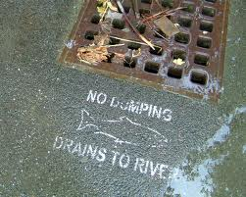
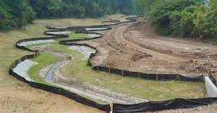
Implementing revised criteria
General Permits, Stormwater Permits, Construction Permits, MS4s, or 401 certifications
Would likely not be impacted by the proposed ammonia criteria because they generally do not require ammonia monitoring
Photo: Columbia Riverkeeper
Notes:
-MS4: Municipal Separate Storm Sewer System; A MS4 permit could be affected indirectly in waterbodies where there is an ammonia TMDL if DEQ determines that a MS4 permit must have an ammonia waste load allocation to meet a TMDL. If a MS4 permit holder needs a waste load allocation, DEQ does not anticipate a change in ammonia criteria would significantly affect a permittee’s workload when compared to the currently effective ammonia criteria.
-401 certifications: Water quality parameters of interest in 401 activities, such as fill and removal projects in a stream or hydropower projects are typically conventional pollutants, such as dissolved oxygen, turbidity, and temperature—not ammonia.
-1200Z industrial SW permit: In the situation where a 1200Z permit is discharging to a stream impaired for ammonia, DEQ would base the benchmark on the state water quality standard. DEQ staff may need to evaluate options in developing an appropriate ammonia benchmark for discharges to ammonia impaired waterbodies, given that the ammonia criteria are dependent on pH and temperature.

Slide 23
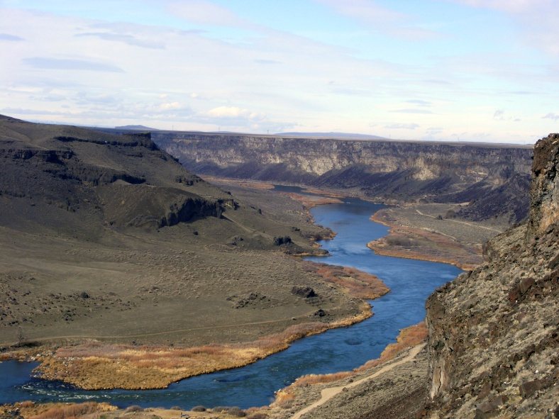
Other proposed rule clarifications
Snake River pH Rule
In 2003, DEQ inadvertently identified only certain river miles of Snake River for the pH criteria.
Amending rule to correctly identify the entire main stem Snake River as DEQ has been implementing in practice.
Notes:
HAND OVER TO DEBRA
(OAR 340-041-0124) –
Standard is 7.0 – 9.0
Had previously been divided into different basins (Grand Ronde, Owyhee, Powder, Malheur)

Slide 24
Other proposed rule clarifications
West Division Main Canal Clarifications
In 2012, EQC removed certain designated uses and adopted basin-specific criteria for irrigation canal in Umatilla Basin.
EPA partially disapproved amendments for lower portion of canal.
Revisions remove disapproved sections and reinstate designated uses and clarify those sections that only apply to upper canal.
Also removed “modified aquatic habitat” from definitions section of standard.
Notes:
Where appropriate, indicate where sections apply to upper (constructed channel) portion or lower portion only. Changes to OAR 340-041-0315, Table 315 and Table 310A.

Slide 25
Other proposed rule clarifications
Natural Conditions Criteria Clarifications
In 2013, EPA disapproved the natural conditions criterion of the temperature standard and statewide natural conditions criterion.
Adding notes clarifying that these rules are no longer effective for Clean Water Act purpose (e.g., permitting, TMDLs).
One public commenter believes the addition of these notes are ambiguous, while several other commenters supported the notes.
Notes:
-As a result of litigation
-Not amending any rules, but only adding clarifying notes, so DEQ is not taking public comment on these clarifications.
-DEQ did not remove the disapproved portions of the statewide natural conditions criterion and the natural conditions criterion for temperature because the agency has not yet determined how it proposes to address EPA’s disapproval of these standards. DEQ will consider how to address natural variability in stream temperature and other situations in which water quality criteria are unattainable due to natural conditions, and expects to make recommendations to the EQC for revising these water quality standards. As a result, the natural conditions provisions are still part of EQC’s policy, even though they are not effective for Clean Water Act purposes. As part of the standards review and rulemaking process, DEQ will provide an opportunity to comment on the proposed revisions to the temperature standard.

Slide 26
Public input
Stakeholder discussions prior to rulemaking
No advisory committee—DEQ did not anticipate significant fiscal impacts or controversy
DEQ webinar on Sept. 10 prior to public comment period
Public comment: Sept. 16 – Oct. 30
  Five commenters
One public hearing in Portland: Oct. 15
  One attendee
Notes:
-Prior to initiating rulemaking, DEQ sent an invitation to Oregon tribes and to a wide range of stakeholders to discuss and provide input to DEQ on rulemaking priorities to address EPA disapproved criteria for aluminum, ammonia, cadmium (acute) and copper. During these meetings, DEQ also shared information about EPA’s updated criteria for freshwater copper and ammonia. Several stakeholders indicated that an advisory committee was not needed and that DEQ should initiate rulemaking as quickly as possible
-DEQ did not convene an advisory committee. DEQ did not anticipate the proposed rules will have a significant fiscal or economic impact or would be controversial.
-5 public comments received: Generally, commenters either supported the ammonia rule revisions or were neutral

Slide 27
When will the proposed rules become effective?
The ammonia revisions will become effective after EQC adoption and subsequent EPA approval
Other revisions, unrelated to water quality standards revisions, will become effective upon EQC adoption and filing with Secretary of State.
Notes:
-EPA has 90 days to take action on OR’s revised criteria.

Slide 28
DEQ’s recommendation
DEQ recommends that the EQC adopt proposed amendments to OAR 340, Division 41 as shown in Attachment A. These amendments:
  Adopt EPA’s latest 2013 national recommendations for freshwater ammonia criteria
  Correct an error in the pH rule language for the main stem Snake River
  Amend the Umatilla Basin-specific standards to align with EPA’s partial disapproval
  Add notes to state’s natural conditions criterion and natural conditions criterion for temperature to reflect EPA’s disapproval
  Incorporate plain language into the amended rules consistent with the Oregon Administrative Procedures Act
Notes:
-This is the conclusion of DEQ’s formal presentation on this proposed rule. We would be happy to answer any questions the commissioners may have.

Slide 29
Extra Slides

Slide 30

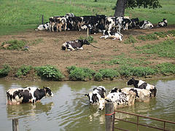
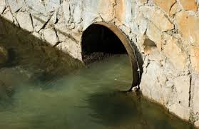
Sources of Ammonia
Pollutant found in fertilizers and waste products:
Municipal and industrial waste
Septic systems seepage and landfill leachate
Fertilizer runoff from agricultural and urban sources
Manure application
Aquaculture

Slide 31
Effects to Aquatic Life
Fish
Gill damage and increased ventilation rates
Reduction in blood oxygen capacity
Disruption of osmoregulation (cell function/excretion)
Invertebrates (mussels)
Reduced opening of valve for respiration and feeding
Impairs secretion of the byssus or “anchoring threads” in bivalves
Reduced ciliary action on gills

Slide 32
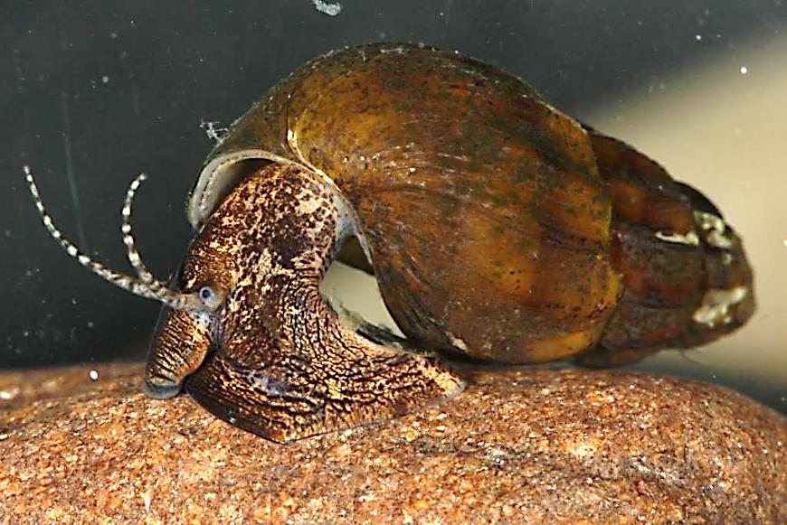
Mollusks—Freshwater Sentinels
Diverse- there are over 1000 North American freshwater taxa
Broadly distributed in benthic habitats (especially snails)
Long-lived and sedentary
(especially mussels)
Sensitive e.g. ammonia, chlorine, Cu
Protected species 118 federally listed
(88 mussels, 30 snails)
Photo Credit: Chris Barnhart
Photo Credit: Chris Barnhart
Notes:
-Borrowed this slide from Chris Barnhart at Missouri State Univ. who has done quite a bit of research on mussel toxicity
-Mussels and snails are important to food webs, water quality, nutrient cycling and habitat quality in freshwater systems.
-much higher diversity of mussels in the eastern part of the U.S. (AL, TN, GA, KY, MS)

Slide 33
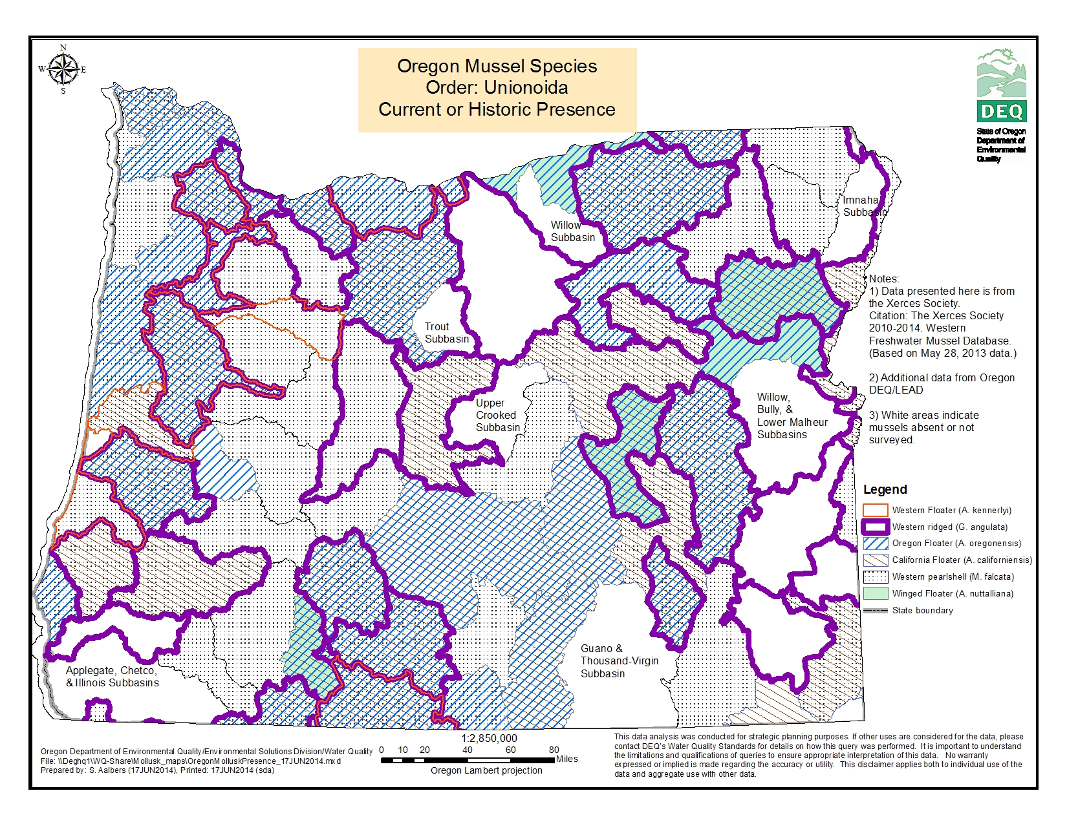
Notes:
-DEQ worked with the Xerces Society to locate mussel data in OR. Data indicates there are 6 species of mussels in Oregon. None of these species are federally listed. ussels are pretty widespread across the state, although just because the subbasin shows mussels present, it doesn’t necessarily mean ALL waterbodies in that basin have mussels.
-The majority of N.A. freshwater mussels are in the Unionidae family
-Unionid families in OR: Gonidia and Anodonta (“floaters”)
-We also have the Western Pearlshell which is in the Margaritifera family (pearl mussels)
-The 6 subbasins don’t necessarily reflect absence of mussels, but more likely that specific mussel surveys have not been done there

Slide 34
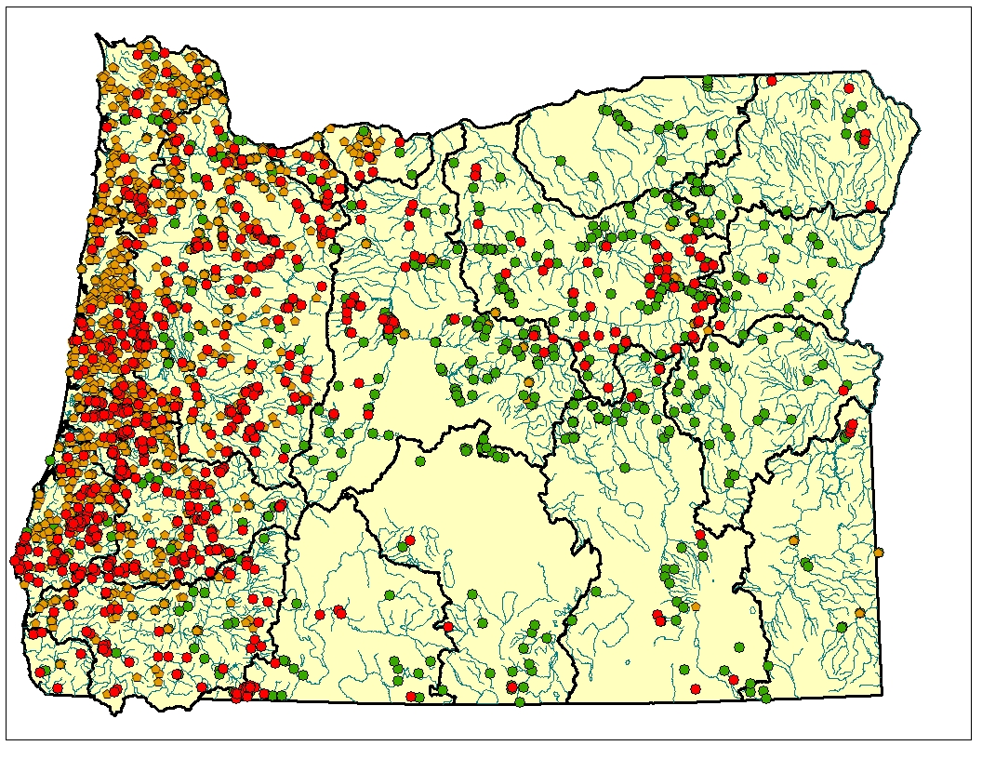
Pulmonate and Non-Pulmonate Snail Presence in Oregon
Pulmonate snails
DEQ database
WMC database
Non-pulmonate (gilled) snails
DEQ database
WMC database
Notes:
-DEQ and Western Monitoring Center (UT state univ.) data sources indicate there are approximately 16 species or taxa of snails in Oregon (probably more though). As you can see from this map, snails are widespread across OR.

