Slide 1
Action Item: Clean Water State Revolving Fund Longer-term Financing EQC Special Conference Call January 23, 2014
Katie Foreman, DEQ
Notes:
Deb will introduce herself and then Andrea

Slide 2
DEQ’s recommendation
DEQ recommends that the EQC adopt proposed amendments to OAR 340, Division 54 as shown in Attachment A.
Allow public agencies a longer-term option for financing treatment works projects, applicable to all new borrowers for treatment works projects and a small set of existing borrowers

Slide 3
What is the Clean Water State Revolving Fund?
Oregon’s CWSRF program provides funding to public agencies for water quality protection and improvement projects. Projects include wastewater treatment facility construction and upgrades, stormwater controls, sewer improvements and replacement, irrigation improvements and stream restoration.
Low-interest rates and loan terms up to 20 years make this program an attractive alternative to borrowing from higher-interest bond markets.
Notes:
-quick review of ALC

Slide 4
Why is DEQ proposing this rulemaking?
Current administrative rules limit the use of the fund for loans with terms up to 20 years.
For some communities, loan terms associated with shorter repayment periods present a hardship for ratepayers.
Notes:
EPA Disapproval: Correct several aquatic life toxics criteria that EQC adopted in 2004 but disapproved on Jan. 31, 2013
-The Endangered Species Act requires EPA to consult with the U.S. Fish and Wildlife Service and the National Marine Fisheries Service before taking action on state WQS to ensure that the criteria OR proposed do not harm threatened & endangered species or their critical habitats.
-Consultation was very long—9 yrs!: Lengthy discussions between NMFS, USFWS, and EPA about the technical aspects of the consultation and reasonable and prudent alternative
Typos, Errors, Clarifications: correct typos and errors from past toxics rulemakings and to propose additional clarifications
Consolidate Tables: To consolidate three aquatic life toxics tables into one table. There is no longer any need to have separate tables.
**more details on these actions in the following slides

Slide 5
Process

Slide 6
Allowing longer-term financing on water quality pollution prevention and improvement projects will make projects more affordable for Oregon communities.

Slide 7
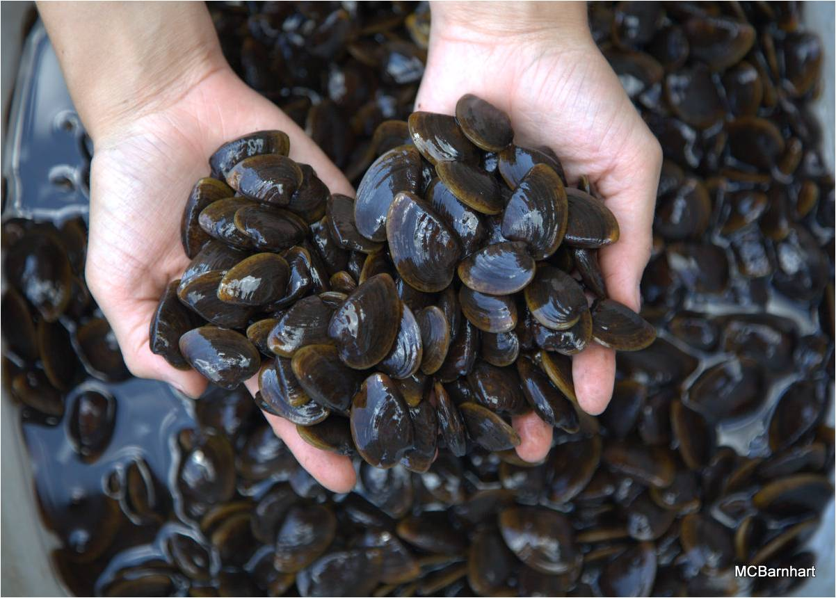
What are aquatic life toxics criteria?
Magnitude
(µg/L)
Frequency
(not to exceed more than once every 3 years)
Duration
(short and long term)
Notes:
Magnitude = concentration of the pollutant
Duration = the time period over which the concentration value is calculated (averaged) to protect against short term (acute) and long term (chronic) impacts to aquatic life
Frequency = how often the concentration value can be exceeded

Slide 8
What criteria did EPA disapprove?
Correct now
11 pesticides
Selenium (freshwater criteria)
Copper (freshwater criteria)
Cadmium (freshwater acute criterion)
Aluminum (freshwater criteria)
Ammonia (freshwater criteria)
Incorrect footnotes and other errors
Correct now
Correct now
Notes:
-For this rulemaking, DEQ decided to address the straight-forward corrections first and combine the rulemaking with other corrections and clarifications that were needed. The other pollutants will be addressed in subsequent rulemakings given the complexities associated with developing revised criteria (e.g. NMFS jeopardy decisions). It is likely that DEQ will begin a review of Cu and NH3 criteria next year. If any criterion is disapproved, the criterion reverts back to the criterion last approved by EPA (i.e. Table 20). Clean Water Act requires OR to fix the disapprovals or EPA is required to set criteria for Oregon
Incorrect footnotes and other errors: A few of the pollutants were footnoted incorrectly
[On Aug. 15, 2012, NMFS found jeopardy to T&E species from Cd, Cu, and NH3. The U.S. Fish and Wildlife Service (USFWS) completed their Biological Opinion on DEQ’s 2004 aquatic life criteria on July 30, 2012 and did not find jeopardy with OR’s toxics criteria.]

Slide 9
Proposed revisions of disapproved criteria
Pesticides
Revise language in Table 30 to clarify criteria duration and frequency for 11 pesticides
Selenium
Apply conversion factors to express the freshwater criteria as dissolved
The change in criteria is very small
Notes:
Pesticides: Frequency and duration components of most of the pesticide criteria are different than the other aquatic pollutants (i.e. acute can’t be exceeded any time and the chronic can’t be exceeded based on a 24 hr. average). DEQ correctly footnoted these pesticides, but by adding the general frequency and duration to the intro paragraph of the toxic tables, EPA determined that this addition effectively changed the frequency and duration of the pesticides despite the existing footnote. DEQ proposes to clarify language in the intro paragraph noting the pesticide frequency and duration exception. Will also revise the pesticide footnote to read more clearly. This is not change from how we have interpreted the criteria, but it will now be more clear to the reader.
Selenium: In 2004, DEQ erred in calculating the FW criteria by omitting the conversion factors that express the freshwater criteria as dissolved. The conversion factors convert a total recoverable result to a dissolved expression as intended in 2004. The proposed Se criteria now correctly reflect dissolved criteria (filtered sample). [CMC CF=0.996 and CCC CF=0.922]

Slide 10
What other actions is DEQ proposing?
Consolidate toxics criteria tables
Typos, errors, and clarifications
Correct miscellaneous errors, clarifications, formatting changes to toxics tables, and minor corrections to the 2011 human health toxics rulemaking
Re-adopt arsenic and chromium VI criteria
Delete aluminum from criteria table
No replacement criteria
Notes:
Consolidate Toxics Criteria Tables: Consolidate 3 aquatic life toxics criteria tables into 1 table (Table 30) and delete references to Tables 20, 33A, and 33B in DEQ toxics, bacteria and groundwater rules.
Therefore, the last 9 years has been challenging for OR and other users of the aquatic life toxics criteria to figure out which criteria are the correct ones to use
➔ GOOD NEWS!
[-Table 33A contains criteria more stringent or remained the same as previous criteria and became effective for NPDES permitting Feb. 15, 2005.
-Table 33B contains criteria less stringent than previous criteria and therefore, would only be effective after EPA approval.
-Table 20 contains criteria effective before the 2004 rulemaking and remained effective for all CWA programs, such as 303(d) reporting ]
Arsenic and Chromium VI -FW and SW As criteria and SW Cr VI criteria were inadvertently left off Table 33B as part of a 2007 rulemaking. The As and Cr VI criteria reinstate the same criteria that the EQC adopted in 2004. These criteria underwent Endangered Species Act consultation by the U.S. Fish and Wildlife Service and the National Marine Fisheries Service and were not found to create jeopardy for any ESA-listed species. EPA did not take action on these criteria as part of its action, but noted that the omitted criteria are consistent with EPA’s 304(a) recommendations and recommended that Oregon re-adopt these criteria.
HHC Rulemaking: Table 40: typos, clarified arsenic footnote, corrected a criterion to two significant digits (bis 2 Chloroethyl Ether). Also, corrected reference typos in Arsenic Reduction Policy
Table 33C: renamed Table 33C to Table 31; corrected a reference in the intro language; and removed arsenic guidance values—regulatory aquatic life criteria already exist
-Al: Propose to delete Al because the disapproval renders the criteria ineffective and there are no previous criteria for aluminum.

Slide 11
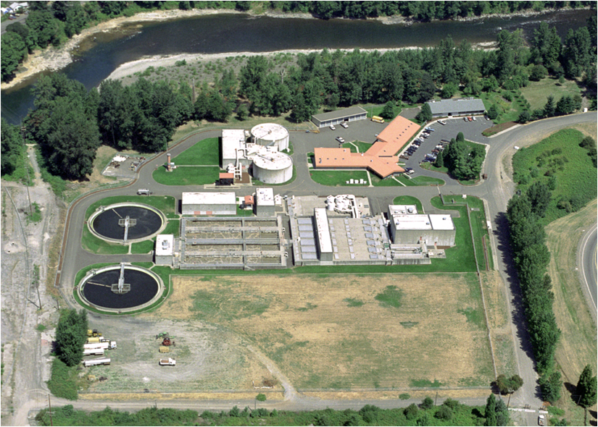
Who’s potentially affected?
Large dischargers required to monitor for toxics
“Primary” industrial dischargers
“Major” municipal dischargers
Generally, DEQ does not expect any significant fiscal or economic effects from revisions proposed in this rulemaking
Notes:
-Industrial permits have a complex process to determine monitoring requirements based on the industrial category and the potential for toxicity in the receiving waterbody. The monitoring requirements at a specific facility are determined based upon factors such as industrial category, pre-existing permit status, hazardous material present, new source performance standards or permit writer discretion.
-Most, if not all, major wastewater treatment facilities must comply with toxic pollutant monitoring requirements.
-The proposed rules address the pesticide criteria disapprovals by additional clarification of the frequency and duration components of the criteria (i.e. did not change); revisions to the associated numeric values were not required.
-The proposed rules include a correction to the selenium criteria that is slightly more stringent (change from a total recoverable form to the dissolved form), but the fiscal impacts of that change were covered in the 2004 rulemaking.
-This proposal would also readopt freshwater and saltwater criteria for arsenic and saltwater criteria for chromium VI originally adopted by EQC in 2004. DEQ inadvertently omitted these criteria in Table 33B during the 2007 water quality standards rulemaking. Despite this omission, these re-proposed criteria are not considered new water quality criteria for the protection of aquatic life and do not need to undergo an economic analysis because these criteria, like the selenium criteria revisions, were accounted for as part of the 2004 fiscal analysis.
-Some affected parties may need to conduct minor recordkeeping activities to correctly reference the effective aquatic life toxics criteria
Benefits: DEQ anticipates these changes will provide a benefit to DEQ, the public and to entities subject to toxics water quality criteria by reducing confusion about which criteria are effective and by consolidating all effective aquatic life toxics criteria into one table, rather than in the current three tables. Correcting errors that occurred in 2004, 2007 and 2011 rulemakings will also provide greater clarification to users.

Slide 12
Who helped DEQ develop this rulemaking?
Advisory Committee Member | Affiliation
1. Curtis Barton | Clackamas Water Environment Services
2. Dianne Barton | Columbia River Inter-Tribal Fish Commission
3. Kathleen Collins | EPA, Region 10
4. Heath Curtiss | Oregon Forest Industries Council
5. Mike Freese | Oregon Farm Bureau
6. Kathryn VanNatta | NW Pulp and Paper Association
7. Travis Williams | Willamette Riverkeeper
Notes:
-DEQ established an advisory committee in January 2013 to provide input on this rulemaking’s potential fiscal impacts and benefits. The rulemaking was delayed and then re-initiated in May 2013. DEQ met with the advisory committee on June 25 and July 11, 2013. The committee included eight members representing industrial, municipal, tribal and environmental organizations with an interest in actions related to developing or revising water quality standards for toxic pollutants.

Slide 13
Public comments
30-day public comment period (Sept. 1 – Sept. 30)
DEQ convened one hearing in Portland on Sept. 18
No attendees
Received two public comments—both supportive
EPA
NW Pulp and Paper Association
One concern was whether EPA would take action on ALL the aquatic life criteria again
NO, only the criteria that change.
Notes:
-EPA’s action on non-substantive changes to previously approved WQS would not constitute an action on the underlying previously approved WQS.
-EPA will review all proposed changes, but not all revisions are considered WQS

Slide 14
When will these proposed revisions become effective?
All proposed revisions to the Toxics Rule will become effective on April 18, 2014 (and after EPA approval)
EPA anticipates reviewing and approving the adopted revisions before April 18.
Proposed cross-reference revisions to Oregon’s Bacteria and Groundwater Rules become effective upon EQC adoption and filing with the Secretary of State.
Notes:
-If EPA fails to act on all the criteria by April 18, DEQ can extend the effective date for an additional 180 days by temporary rule.

Slide 15
DEQ’s recommendation
DEQ recommends that the EQC adopt proposed amendments to OAR 340, Divisions 54 as shown in Attachment A.
Notes:
This is the conclusion of DEQ’s formal presentation on this proposed rule. We would be happy to answer any questions the commissioners may have.

