Slide 1
Action Item: Clean Water State Revolving Fund Longer-term Financing
EQC
Special Conference Call
January 23, 2014
Katie Foreman, DEQ

Slide 2
DEQ’s recommendation
DEQ recommends that the EQC adopt proposed amendments to OAR 340, Division 54 as shown in Attachment A.
Allow public agencies a longer-term financing option in the Clean Waters State Revolving Fund
  Applicable to all new borrowers and a small set of existing CWSRF borrowers for treatment works projects

Slide 3
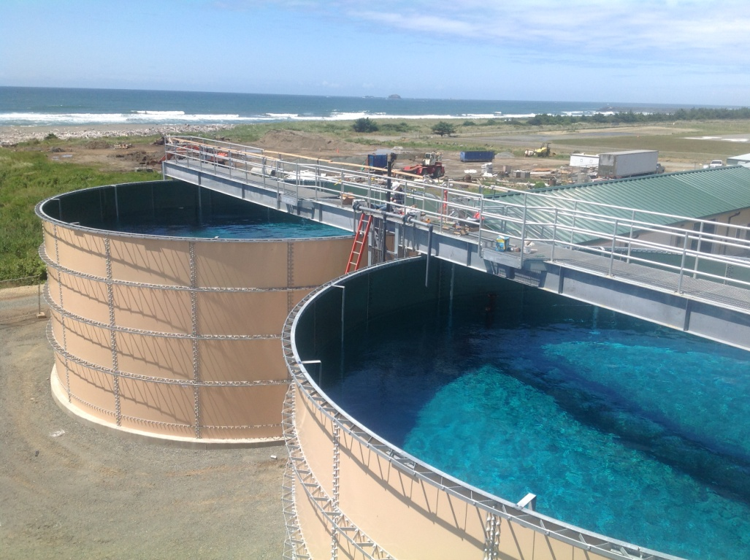
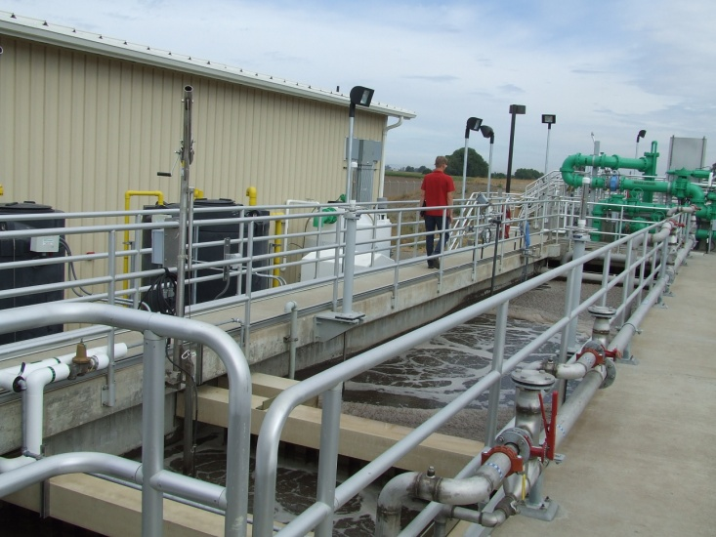
What is the Clean Water State Revolving Fund?
Oregon’s CWSRF program provides funding to public agencies for water quality protection and improvement projects.
Low-interest rates and loan terms up to 20 years make this program an attractive alternative to borrowing from higher-interest bond markets.
Since 1990, these DEQ-administered loans have provided more than $1 billion to assist 149 Oregon communities with water quality improvement projects.
Notes:
Projects include wastewater treatment facility construction and upgrades, stormwater controls, sewer improvements and replacement, irrigation improvements and stream restoration.
Low-interest rates and loan terms make this program an attractive alternative to borrowing from higher-interest bond markets.
Allowing longer-term financing would make the program even more attractive.
Our rates are 2% less than municipal bond market rates.

Slide 4
Why is DEQ proposing this rulemaking?
The federal Clean Water Act and state statute allow the use of the Clean Water State Revolving Fund for various purposes, including loans with terms not to exceed 20 years after project completion.
For some communities, loan terms associated with shorter repayment periods present a hardship for ratepayers.

Slide 5
Benefits to smaller and lower income communities
The federal Clean Water Act and state statute do allow use of the fund for the purchase or refinance of debt obligations for treatment works projects in the form of revenue bonds for terms up to 30 years.
An option for longer-term financing would especially benefit smaller and lower-income communities by spreading the loan repayment over a longer period of time, thereby decreasing the financial burden on residents when communities increase utility rates to cover debt repayments.
15 other states in the nation allow longer-term financing in their CWSRF programs
Notes:
The process for selling a revenue bond may require more effort and upfront costs to communities than is required for a traditional loan
An option of a combination of the two types of financing on new projects will not be available. Non-treatment works projects (such as stream restoration and irrigation improvements) would not be eligible for long-term financing.
Savings is that semi-annual payments are less – for instance:
For a $1 Million on a 20 year at 1.89% (lowest interest rate), the semi – annual repayment is $30,775; on a 30 year loan, same interest rate the repayments are $22,189, so will pay $16K less a year in repayments. However, will pay more in interest over the life of the loan. They will pay $331K interest on 30 years vs. $212K or $119,000 more in interest than for 20 years.

Slide 6
Process
Internal group
Advisory committee
Noticing
Letting those that can refi know
Process + epa involvement
EPA approval

Slide 7
Proposal
Under the proposal, all new borrowers and a small group of existing borrowers for treatment works projects would have the option of the traditional CWSRF loan for terms up to 20 years or the new financing option of a bond purchase agreement with terms up to 30 years
Notes:
Proposal details
-All new borrowers for treatment works projects should be eligible for longer-term financing.
-Eligibility should be very limited for existing borrowers to refinance their current CWSRF loans for treatment works. The most disadvantaged communities should be allowed to refinance as specified by economic status and loan characteristic criteria. Refinancing should be a one-time offer and available only for a finite period of time.
-Interest rate premiums should be added to current base rates to protect the CWSRF fund’s perpetuity.
-Premiums should be added in a three-tiered structure based on borrowers’ economic status, with the most disadvantaged communities paying the lowest rates and least disadvantaged paying the highest rates. These premium rates should apply to new and existing borrowers eligible to refinance their CWSRF loans, and range from 0 to 0.5 percent.
-The amount of CWSRF funds allocated for longer-term financing should not be limited.
-Prioritization should not be considered in allocating the new financing option other than what is stated in current rules.
-Allocation and priority setting for incentives such as the green project and small community reserves and principal forgiveness should not change from current rules.

Slide 8
Refinancing
14 existing CWSRF borrowers
  Most disadvantaged communities as specified by economic status and loan characteristic criteria.
One time, limited period offer
Extend loan terms and in many cases decrease interest rates
Notes:
Refinancing criteria
Median household income is less than 70 percent of the Oregon statewide median household income (Statewide Median Household Income (MHI) is $49,850),
• Loan term remaining is 10 years or greater,
• Loan repayments are currently not in default,
• Loan does not include American Recovery and Reinvestment Act or principal forgiveness funding,
• When the department purchases a debt obligation to replace an existing CWSRF loan or debt obligation, the amortization period of the debt obligation may not exceed the lesser of: 1) The useful life of the asset, or 2) Thirty years minus the number of years that the existing CWSRF loan or debt obligation has been in repayment.

Slide 9
Eligible Borrowers for Refinancing

Slide 10
Treatment works
Treatment works is defined to include wastewater treatment plants, their conveyors, and their equipment, also included are industrial and stormwater treatment, storing disposing of and abatement.
No irrigation projects, or nonpoint source like stream restoration.
Notes:
“ (3) “Treatment works” means:
(a) The devices and systems used in the storage, treatment, recycling and reclamation of municipal sewage or industrial wastes of a liquid nature, necessary to recycle or reuse water at the most economical cost over the estimated life of the works. “Treatment works” includes:
(A) Intercepting sewers, outfall sewers, sewage collection systems, pumping power and other equipment, and any appurtenance, extension, improvement, remodeling, addition or alteration to the equipment;
(B) Elements essential to provide a reliable recycled water supply including standby treatment units and clear well facilities; and
(C) Any other acquisitions that will be an integral part of the treatment process or used for ultimate disposal of residues resulting from such treatment, including but not limited to land used to store treated waste water in land treatment systems prior to land application.
(b) Any other method or system for preventing, abating, reducing, storing, treating, separating or disposing of municipal waste, storm water runoff, industrial waste or waste in combined storm water and sanitary sewer systems.
(c) Any other facility that the Environmental Quality Commission determines a public agency must construct or replace in order to abate or prevent surface or ground water pollution.”

Slide 11
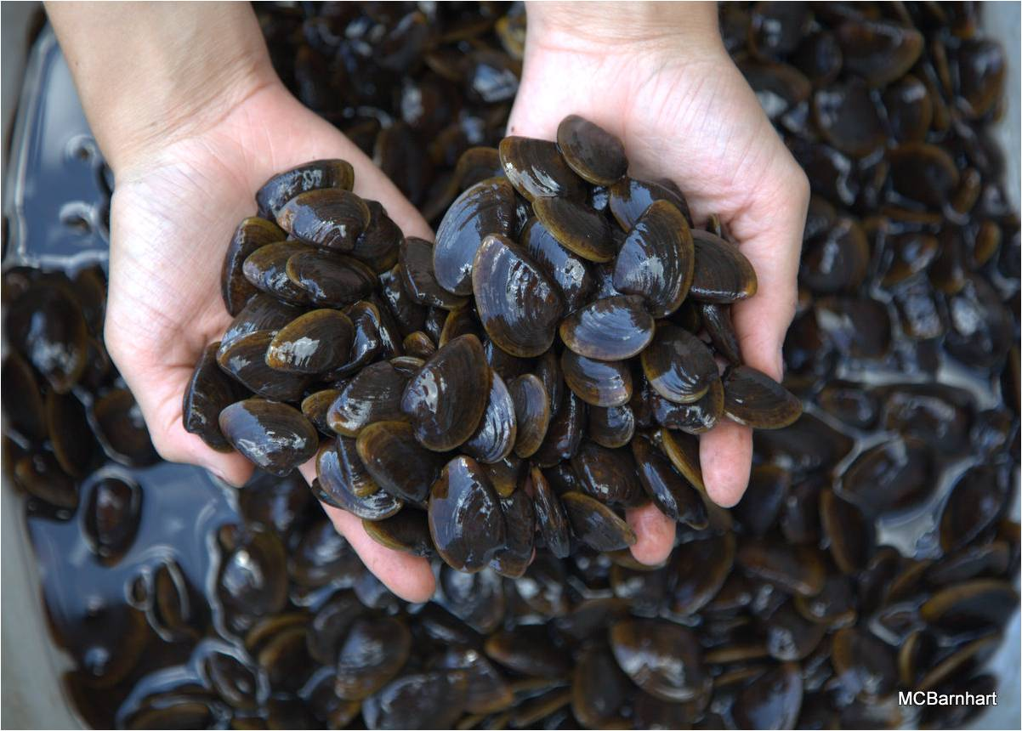
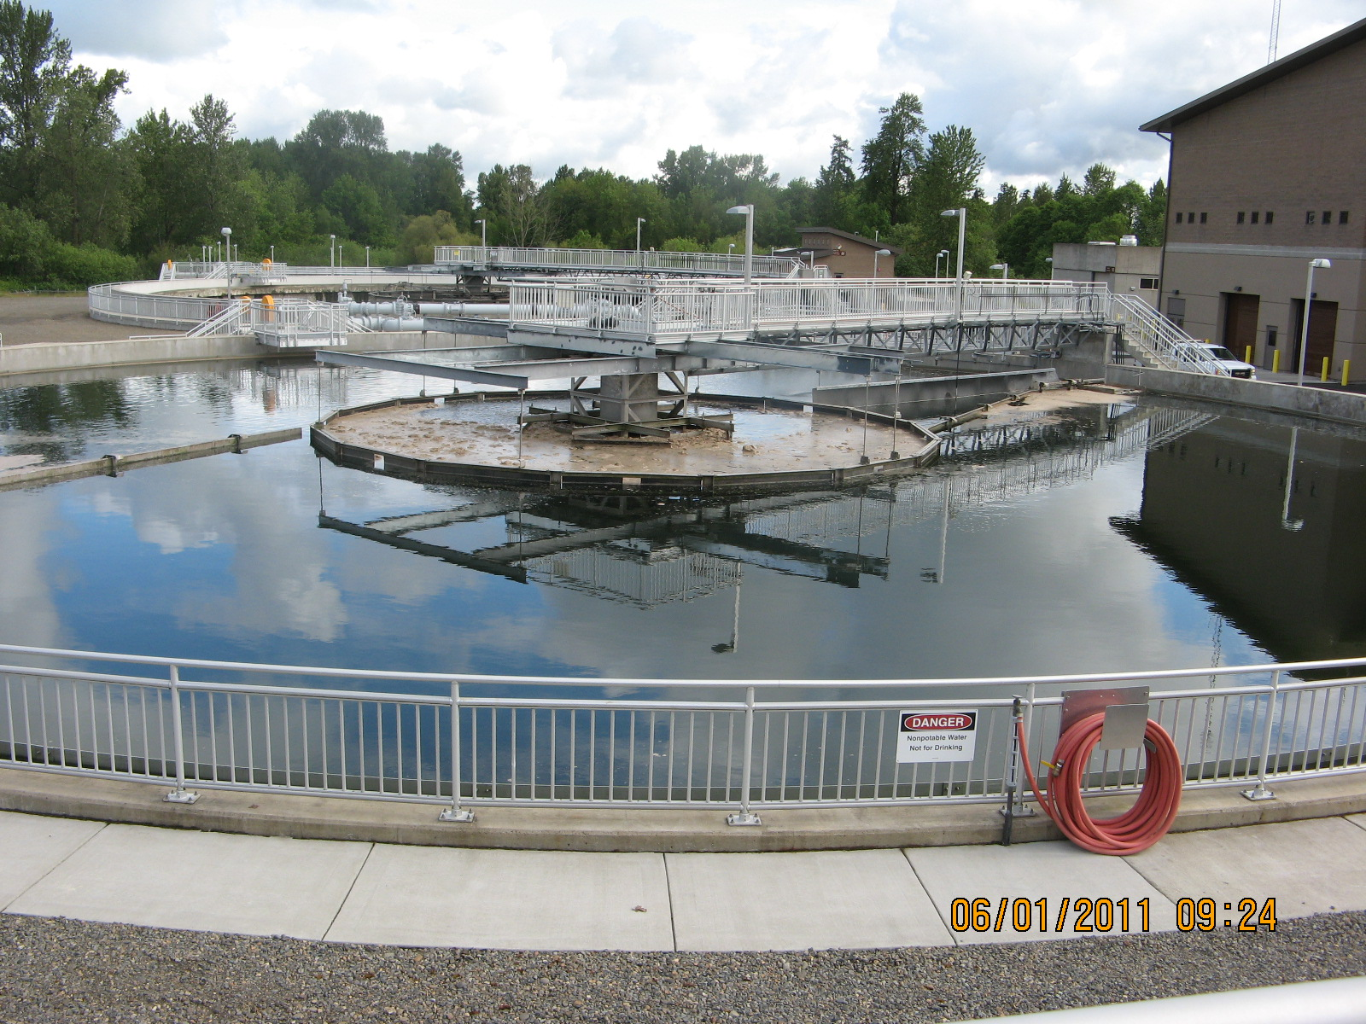
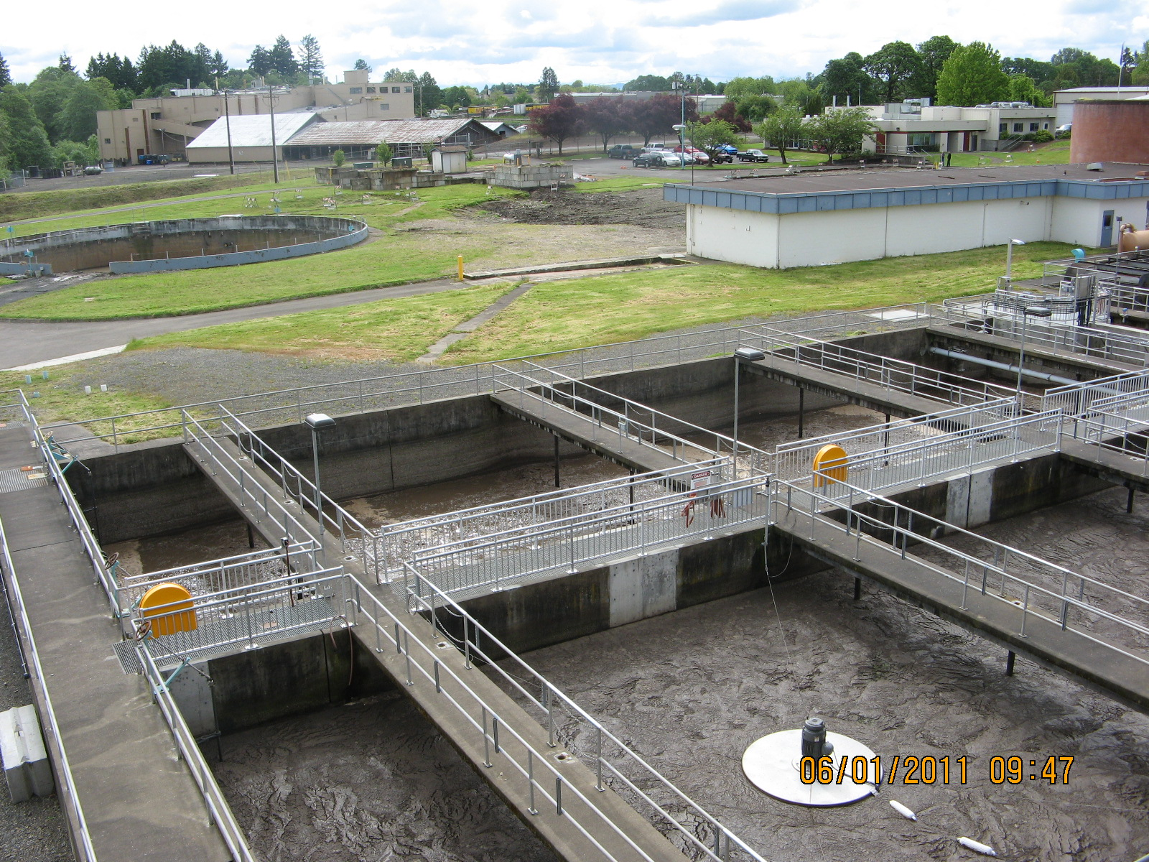
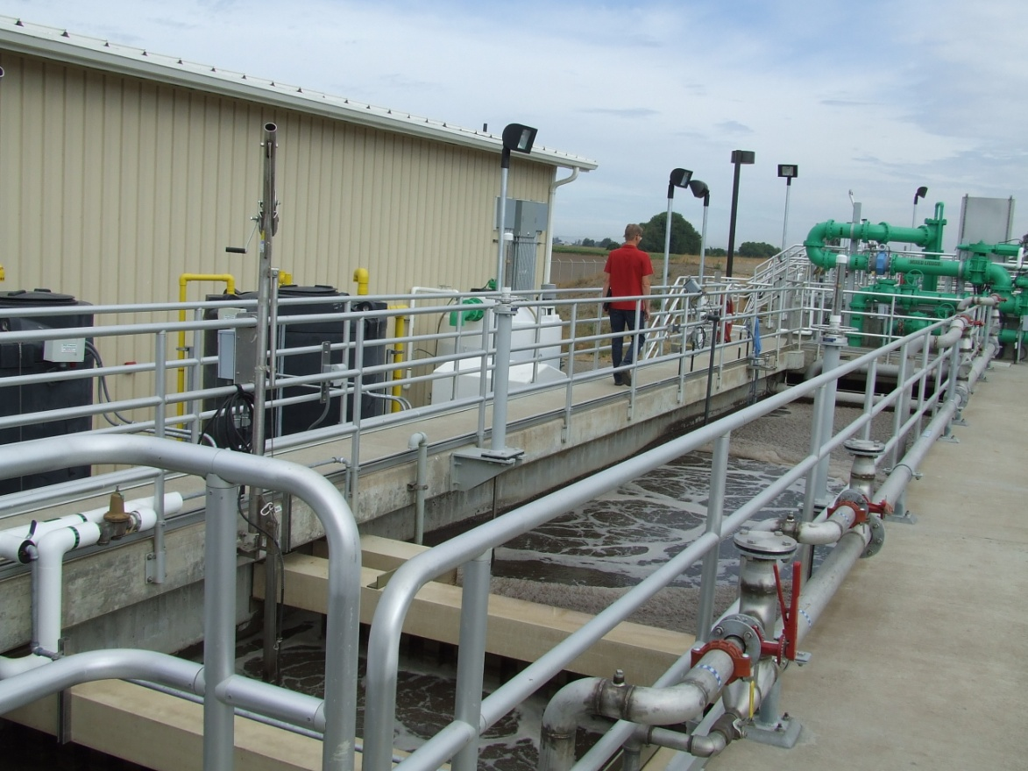
What are aquatic life toxics criteria?

Slide 12
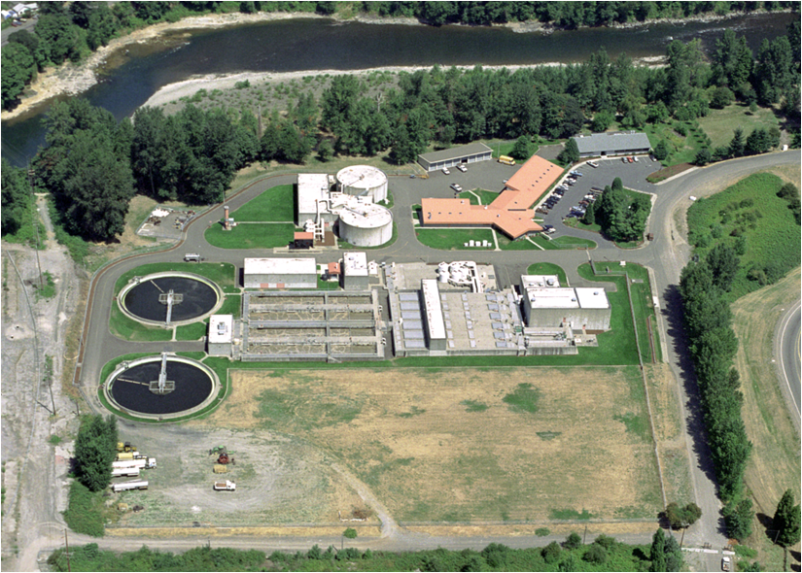
Who’s potentially affected?
Benefit to communities
Generally, DEQ does not expect any significant fiscal or economic effects from revisions proposed in this rulemaking
Notes:
-Industrial permits have a complex process to determine monitoring requirements based on the industrial category and the potential for toxicity in the receiving waterbody. The monitoring requirements at a specific facility are determined based upon factors such as industrial category, pre-existing permit status, hazardous material present, new source performance standards or permit writer discretion.
-Most, if not all, major wastewater treatment facilities must comply with toxic pollutant monitoring requirements.
-The proposed rules address the pesticide criteria disapprovals by additional clarification of the frequency and duration components of the criteria (i.e. did not change); revisions to the associated numeric values were not required.
-The proposed rules include a correction to the selenium criteria that is slightly more stringent (change from a total recoverable form to the dissolved form), but the fiscal impacts of that change were covered in the 2004 rulemaking.
-This proposal would also readopt freshwater and saltwater criteria for arsenic and saltwater criteria for chromium VI originally adopted by EQC in 2004. DEQ inadvertently omitted these criteria in Table 33B during the 2007 water quality standards rulemaking. Despite this omission, these re-proposed criteria are not considered new water quality criteria for the protection of aquatic life and do not need to undergo an economic analysis because these criteria, like the selenium criteria revisions, were accounted for as part of the 2004 fiscal analysis.
-Some affected parties may need to conduct minor recordkeeping activities to correctly reference the effective aquatic life toxics criteria
Benefits: DEQ anticipates these changes will provide a benefit to DEQ, the public and to entities subject to toxics water quality criteria by reducing confusion about which criteria are effective and by consolidating all effective aquatic life toxics criteria into one table, rather than in the current three tables. Correcting errors that occurred in 2004, 2007 and 2011 rulemakings will also provide greater clarification to users.

Slide 13
Public comments
30-day public comment period (Sept. 1 – Sept. 30)
DEQ convened one hearing in Portland on Sept. 18
  No attendees
Received two public comments—both supportive
  EPA
  NW Pulp and Paper Association
One concern was whether EPA would take action on ALL the aquatic life criteria again
  NO, only the criteria that change.
Notes:
-EPA’s action on non-substantive changes to previously approved WQS would not constitute an action on the underlying previously approved WQS.
-EPA will review all proposed changes, but not all revisions are considered WQS

Slide 14
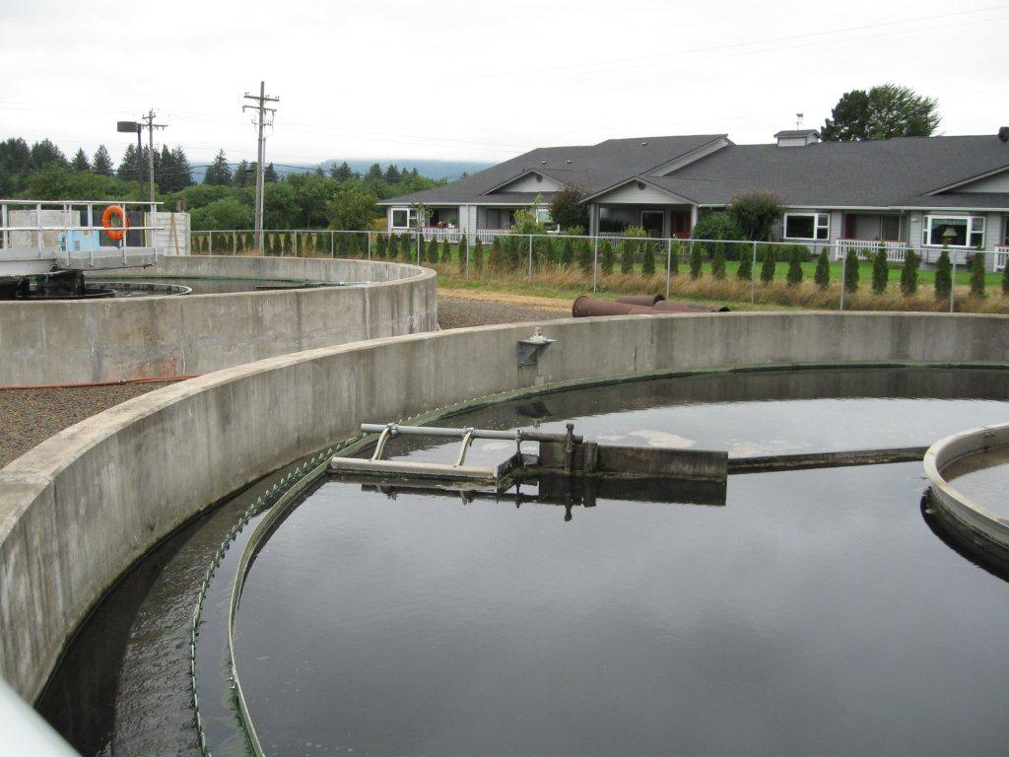
Next steps
Statutory Change to include all non-treatment works
Implementaiton plan for new rule and refi notices, etc., talking points for new ototion etc.

Slide 15
DEQ’s recommendation
DEQ recommends that the EQC adopt proposed amendments to OAR 340, Divisions 54 as shown in Attachment A.
Notes:
This is the conclusion of DEQ’s formal presentation on this proposed rule. We would be happy to answer any questions the commissioners may have.

