Slide 1
Action Item: Clean Water State Revolving Fund Longer-term Financing EQC Special Conference Call January 23, 2014
Katie Foreman, DEQ

Slide 2
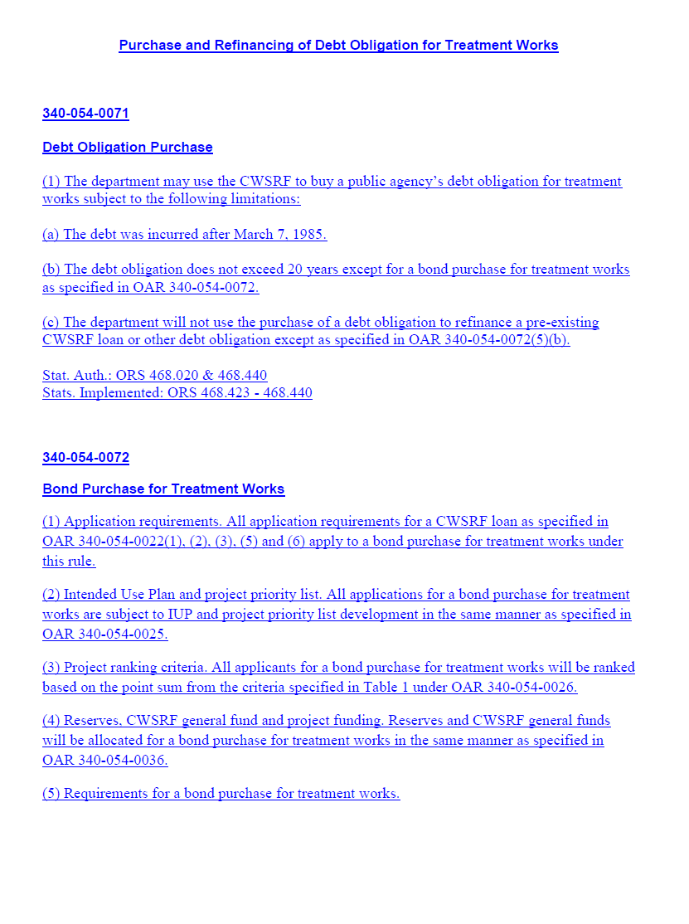
DEQ’s recommendation
DEQ recommends that the EQC adopt proposed amendments to OAR 340, Division 54 as shown in Attachment A.
Allow public agencies a longer-term financing option in the Clean Waters State Revolving Fund
Applicable to all new borrowers and a small set of existing CWSRF borrowers for treatment works projects
Notes:
Introduction, include a statement of why the need for a special session.

Slide 3
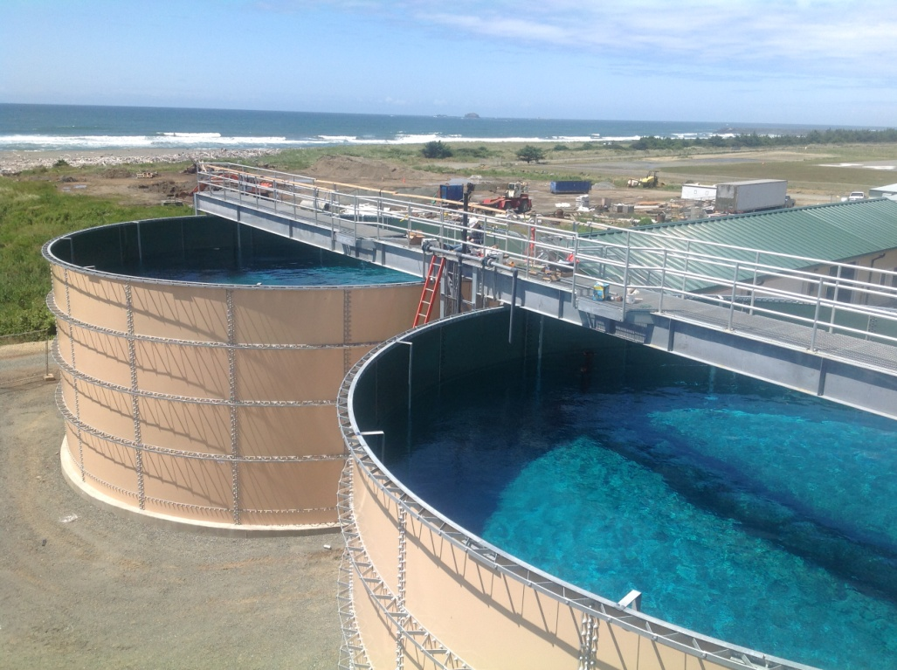
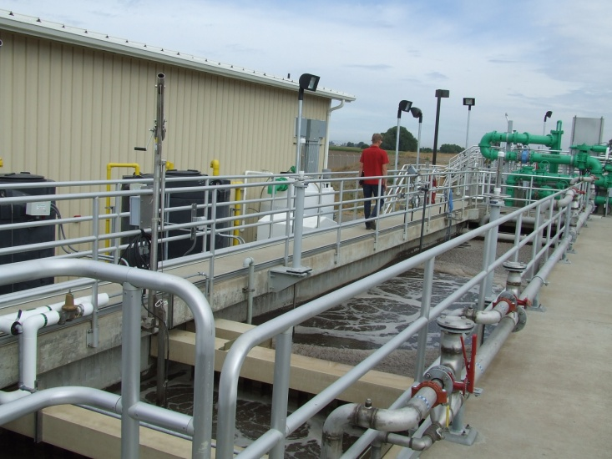
What is the Clean Water State Revolving Fund?
Oregon’s CWSRF program provides funding to public agencies for water quality protection and improvement projects.
Low-interest rates and loan terms up to 20 years make this program an attractive alternative to borrowing from higher-interest bond markets.
Since 1990, these DEQ-administered loans have provided more than $1 billion to assist 149 Oregon communities with water quality improvement projects.
Notes:
Projects include wastewater treatment facility construction and upgrades, stormwater controls, sewer improvements and replacement, irrigation improvements and stream restoration.
Low-interest rates and loan terms make this program an attractive alternative to borrowing from higher-interest bond markets.
Allowing longer-term financing would make the program even more attractive.
Our rates are 2% less than municipal bond market rates.

Slide 4
Why is DEQ proposing this rulemaking?
The federal Clean Water Act and state statute allow the use of the Clean Water State Revolving Fund for various purposes, including loans with terms not to exceed 20 years after project completion.
For some communities, loan terms associated with shorter repayment periods present a hardship for ratepayers.

Slide 5
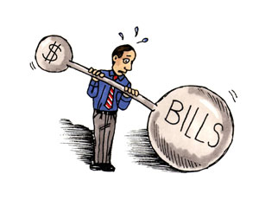
Benefits to smaller and lower income communities
The federal Clean Water Act and state statute do allow use of the fund for the purchase or refinance of debt obligations for treatment works projects in the form of revenue bonds for terms up to 30 years.
An option for longer-term financing would especially benefit smaller and lower-income communities by spreading the loan repayment over a longer period of time, thereby decreasing the financial burden on residents when communities increase utility rates to cover debt repayments.
15 other states in the nation allow longer-term financing in their CWSRF programs
Recommended during the 2012 rulemaking
Notes:
The process for selling a revenue bond may require more effort and upfront costs to communities than is required for a traditional loan
An option of a combination of the two types of financing on new projects will not be available. Non-treatment works projects (such as stream restoration and irrigation improvements) would not be eligible for long-term financing.
DEQ updated Oregon’s Clean Water State Revolving Fund rules in 2012 with input from the CWSRF Advisory Committee. The 2012 rules made the CWSRF loan program more affordable to communities by reducing loan interest rates and annual fees and offering further incentives for smaller communities. During the 2012 rulemaking, the advisory committee identified the option of offering a financing term longer than 20 years as a way to help make water quality improvements more affordable.
Savings is that semi-annual payments are less – for instance:
For a $1 Million on a 20 year at 1.89% (lowest interest rate), the semi – annual repayment is $30,775; on a 30 year loan, same interest rate the repayments are $22,189, so will pay $16K less a year in repayments. However, will pay more in interest over the life of the loan. They will pay $331K interest on 30 years vs. $212K or $119,000 more in interest than for 20 years.

Slide 6
Process: Advisors
Internal rulemaking group
Advisory committee
Standing committee 14 members
Met 4 times in 2013
Recommendations report
EPA Region 10 and HQ
Concurrence required
Approved on December 5, 2013
Notes:
Advisory Committee
Oregon established the Clean Water State Revolving Fund Advisory Committee in 2011 to address program issues and provide input to DEQ for the 2012 rulemaking. After the committee last met in 2012, DEQ’s director appointed a 14-member standing CWSRF Advisory Committee that includes many of the original members. Current members represent CWSRF interests from federal and state agencies, local governments, water and wastewater districts and utilities, watershed organizations, environmental advocacy groups, local conservation districts, and the financial sector.
DEQ staff provided information to the committee about potential demand for, and benefits of, longer-term financing to existing and new borrowers including: Characteristics of Oregon CWSRF borrowers and loans, Oregon community demographics, impact of longer-term financing on community sewer rates for existing and potential new borrowers, and other CWSRF state programs and infrastructure funding agencies that have implemented longer-term financing. Based on the committee's discussion of different eligibility, interest rate and priority-setting criteria, DEQ presented modeling scenarios reflecting the impact of those criteria on the fund’s perpetuity. The committee used this information to develop a report detailing its recommendations

Slide 7
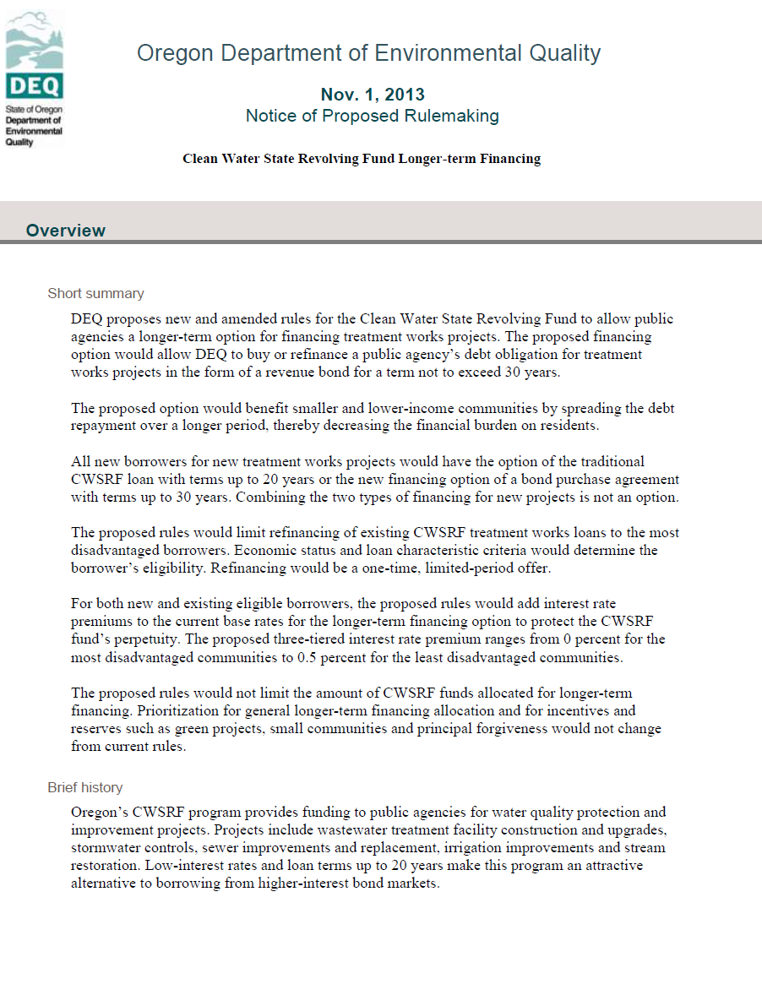
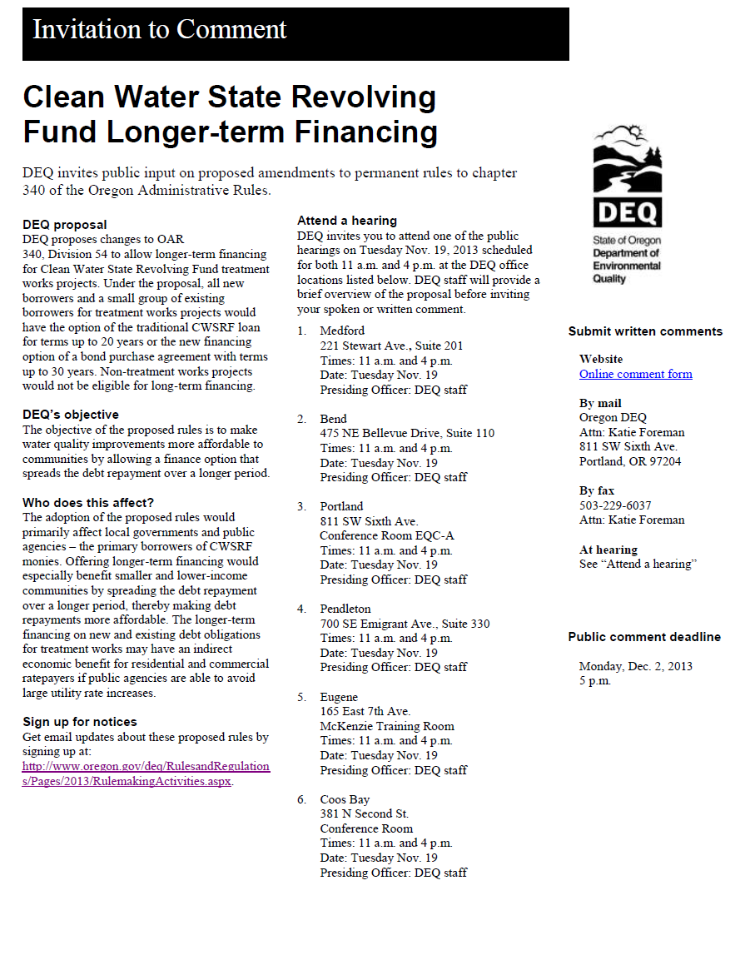
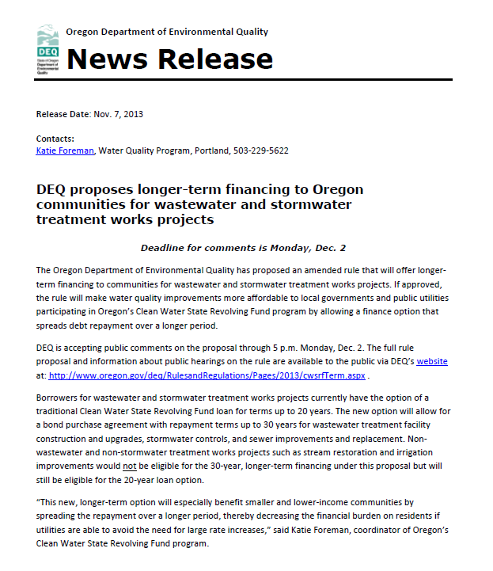
Process: Noticing
30 day public comment period Dec – Nov. 1-Dec. 2, 2013
12 public meetings across the state in Nov. 19, 2013
No attendees
Noticing to interested parties, legislators, EPA, general public, LOC
4 supportive comment and one comment asking for more lower cost treatment works projects
No changes in proposed rules

Slide 8
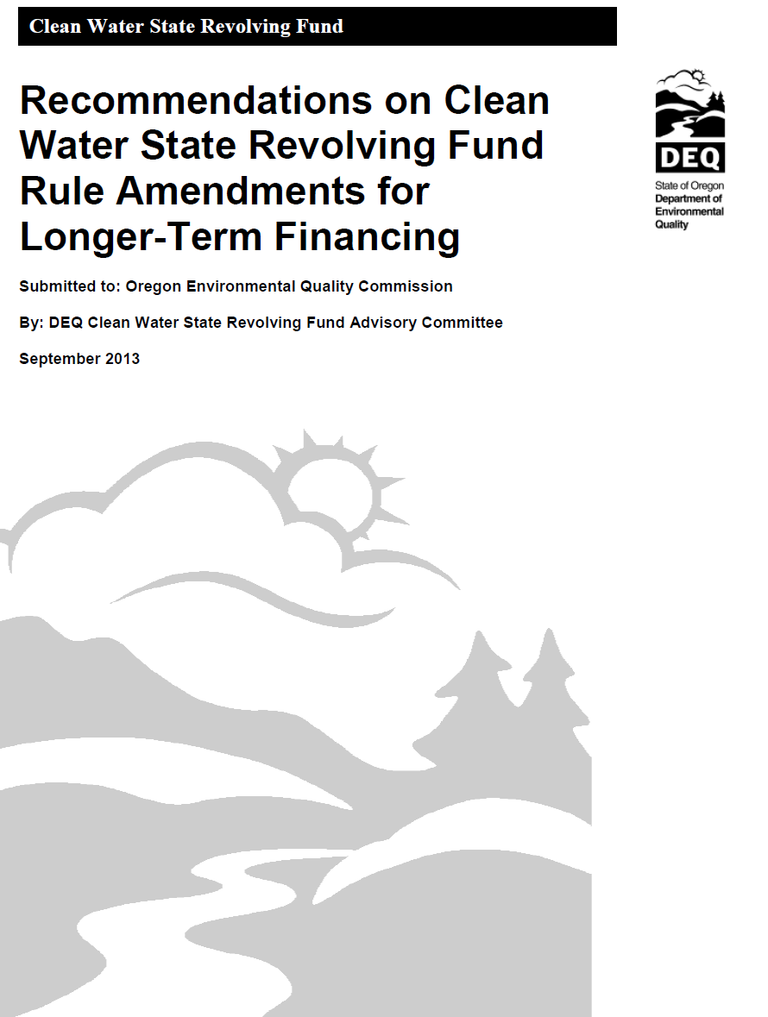
Proposal
Under the proposal, all new borrowers and a small group of existing borrowers for treatment works projects would have the option of the traditional CWSRF loan for terms up to 20 years or the new financing option of a bond purchase agreement with terms up to 30 years (life of asset)
Interest rate premiums will be added in a three-tiered structure based on borrowers’ economic status ranging 0-0.5%.
No limit on the amount of funds allocated and no change in prioritization of projects or allocation of incentives
Notes:
Based on recommendations from the advisory committee report
Proposal details
-All new borrowers for treatment works projects should be eligible for longer-term financing.
-Eligibility should be very limited for existing borrowers to refinance their current CWSRF loans for treatment works. The most disadvantaged communities should be allowed to refinance as specified by economic status and loan characteristic criteria. Refinancing should be a one-time offer and available only for a finite period of time.
-Interest rate premiums should be added to current base rates to protect the CWSRF fund’s perpetuity.
-Premiums should be added in a three-tiered structure based on borrowers’ economic status, with the most disadvantaged communities paying the lowest rates and least disadvantaged paying the highest rates. These premium rates should apply to new and existing borrowers eligible to refinance their CWSRF loans, and range from 0 to 0.5 percent.
-The amount of CWSRF funds allocated for longer-term financing should not be limited.
-Prioritization should not be considered in allocating the new financing option other than what is stated in current rules.
-Allocation and priority setting for incentives such as the green project and small community reserves and principal forgiveness should not change from current rules.

Slide 9
Refinancing
14 existing CWSRF borrowers (10.5 percent of fund)
Most disadvantaged communities as specified by economic status and loan characteristic criteria.
One time, limited period offer
Extend loan terms, less paid annually
In many cases a smaller interest rate than current loan
Notified in October 2013 of their eligibility
Notes:
Refinancing criteria
Median household income is less than 70 percent of the Oregon statewide median household income (Statewide Median Household Income (MHI) is $49,850),
• Loan term remaining is 10 years or greater,
• Loan repayments are currently not in default,
• Loan does not include American Recovery and Reinvestment Act or principal forgiveness funding,
• When the department purchases a debt obligation to replace an existing CWSRF loan or debt obligation, the amortization period of the debt obligation may not exceed the lesser of: 1) The useful life of the asset, or 2) Thirty years minus the number of years that the existing CWSRF loan or debt obligation has been in repayment.
Savings is that semi-annual payments are less – for instance:
For a $1 Million on a 20 year at 1.89% (lowest interest rate), the semi – annual repayment is $30,775; on a 30 year loan, same interest rate the repayments are $22,189, so will pay $16K less a year in repayments. However, will pay more in interest over the life of the loan. They will pay $331K interest on 30 years vs. $212K or $119,000 more in interest than for 20 years.

Slide 10
Eligible Borrowers for Refinancing

Slide 11
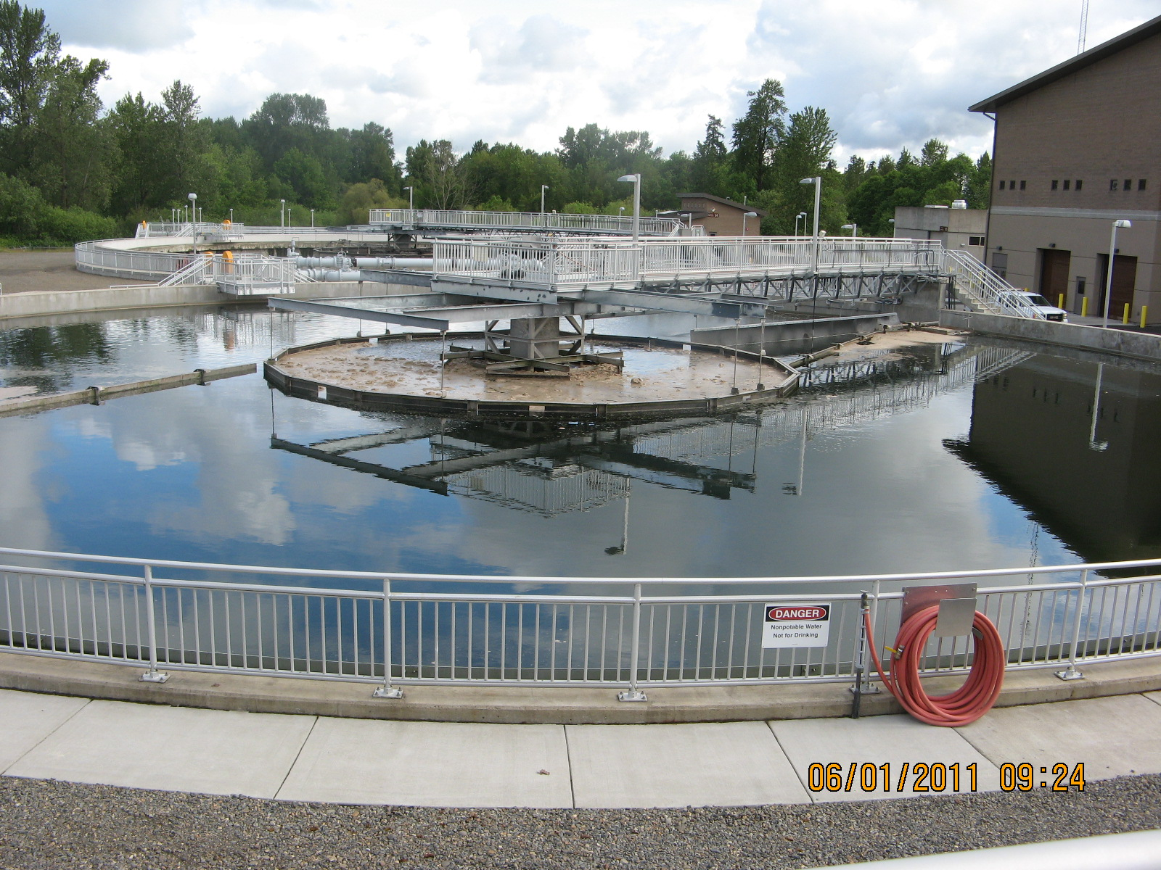
Treatment works
State statute limits use of longer-term financing to treatment works projects
Treatment works is defined to include wastewater treatment plants, their conveyors, and their equipment, also included are industrial and stormwater treatment, storing disposing of and abatement.
No irrigation projects, or nonpoint source like stream restoration.
Potential to change statute in the 2015 session
Notes:
Oregon law currently limits extended term financing to treatment works projects. DEQ is not proposing to change state law at this point but hopes to in the future.
“ (3) “Treatment works” means:
(a) The devices and systems used in the storage, treatment, recycling and reclamation of municipal sewage or industrial wastes of a liquid nature, necessary to recycle or reuse water at the most economical cost over the estimated life of the works. “Treatment works” includes:
(A) Intercepting sewers, outfall sewers, sewage collection systems, pumping power and other equipment, and any appurtenance, extension, improvement, remodeling, addition or alteration to the equipment;
(B) Elements essential to provide a reliable recycled water supply including standby treatment units and clear well facilities; and
(C) Any other acquisitions that will be an integral part of the treatment process or used for ultimate disposal of residues resulting from such treatment, including but not limited to land used to store treated waste water in land treatment systems prior to land application.
(b) Any other method or system for preventing, abating, reducing, storing, treating, separating or disposing of municipal waste, storm water runoff, industrial waste or waste in combined storm water and sanitary sewer systems.
(c) Any other facility that the Environmental Quality Commission determines a public agency must construct or replace in order to abate or prevent surface or ground water pollution.”

Slide 12
Who’s potentially affected?
Indirect benefit to communities and potentially small businesses
More upfront costs for the longer-term option to communities
Generally, DEQ does not expect any significant fiscal or economic effects from revisions proposed in this rulemaking
Slight decrease in binding commitments over time that is healthly over the long term
Notes:
The longer-term financing option requires a public agency to sell debt obligations in the form of revenue bonds to DEQ. The process of selling a revenue bond may require more effort and upfront costs to communities than required for a traditional loan. However, local governments would still have the option of pursuing a 20-year loan if they determine the economic costs of the new process of selling a revenue bond outweighs the economic benefits of the longer-term financing.
The proposed rules could increase administrative costs for the Oregon Department of Land Conservation and Development as well as DEQ if the proposed longer-term financing option results in additional funded and refinanced projects requiring more administrative time for application requirements such as environmental review. Financial impacts to the Clean Water State Revolving Fund will result in a slight decrease in the binding commitments, which is the total amount of money lent from the program, over a long period.
There are positive environmental benefits for Oregon resulting from projects that protect and improve water quality for human health, wildlife and aquatic life in Oregon’s watersheds.
The proposed rules would have no direct economic impact on the public. There may be indirect economic impacts to individuals located in a service area where the CWSRF funds a public agency project that affects sewer or other service rates. The proposed longer-term financing on new and existing debt obligations for CWSRF treatment works projects may indirectly benefit individual ratepayers if the public agency is able to avoid rate increases.
The difference in binding commitments is a 7 percent decrease if all borrowers used extended term financing versus no extended term financing. This is below EPA’s 10 percent threshold. This result is displayed as a graph in Exhibit D3 that compares the percent change in binding commitments over a 60 year projection period for the above scenario and for the scenario where extended term financing is not utilized.

Slide 13
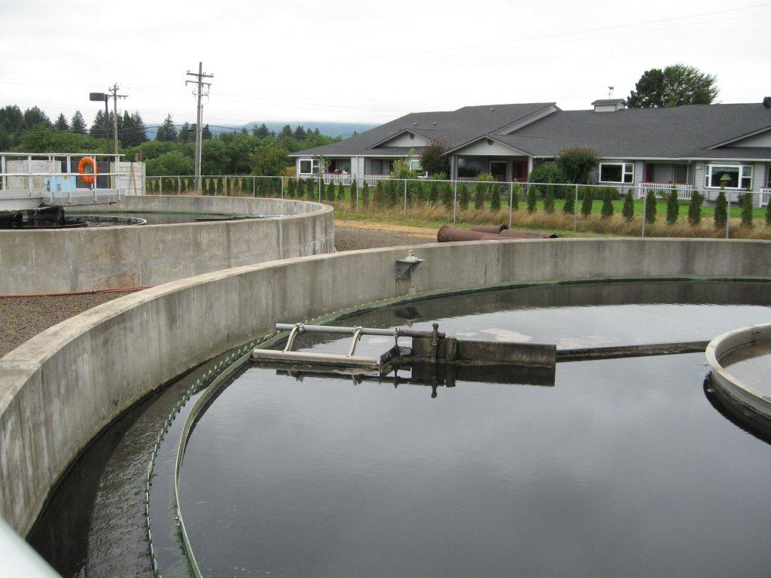
Next steps
Implementation plan for new rule
Communication strategy
Refinancing
New option
Statutory Change to include all non-treatment works

Slide 14
DEQ’s recommendation
DEQ recommends that the EQC adopt proposed amendments to OAR 340, Divisions 54 as shown in Attachment A.
Notes:
This is the conclusion of DEQ’s formal presentation on this proposed rule. We would be happy to answer any questions the commissioners may have.

