Slide 1
Action Item: Clean Water State Revolving Fund Longer-term Financing Environmental Quality Commission Special Conference Call January 23, 2014
Katie Foreman, DEQ

Slide 2
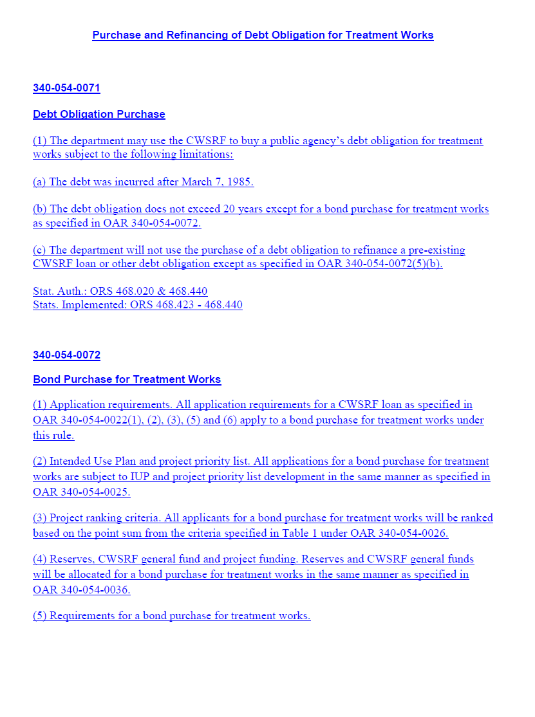
DEQ’s recommendation
DEQ recommends that the EQC adopt proposed amendments to OAR 340, Division 54 as shown in Attachment A.
Longer-term financing option in the Clean Water State Revolving Fund (CWSRF) program
Notes:
Introduction - include a statement of the fact that this rulemaking was deemed a priority. This rulemaking benefits communities and water quality. DEQ wanted to have a special session with EQC early in the year so this did not have to wait until the March 2014 EQC meeting.
Option is for terms in the CWSRF for longer than the rule-allowable 20 year terms.

Slide 3
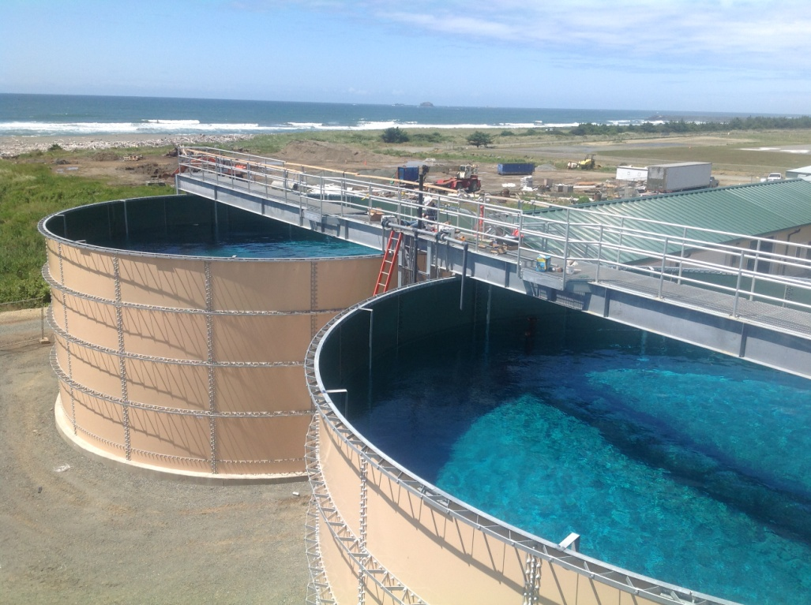
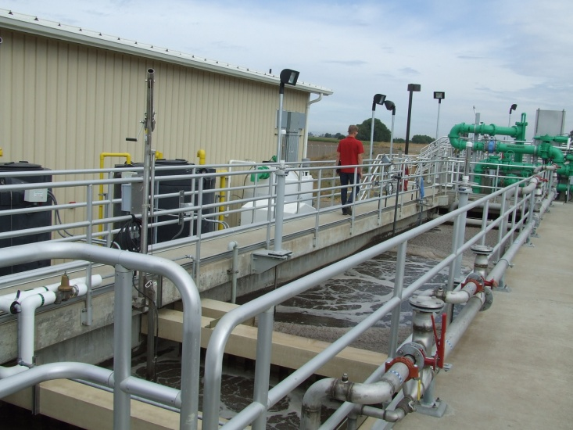
The Oregon CWSRF provides affordable funding to communities
Funding to public agencies for water quality protection and improvement projects
Lower than market interest rates
Loan terms up to 20 years
Loaned $1 billion to 149 communities since 1990
Enormous water quality benefits
Notes:
Eligible projects include wastewater treatment facility construction and upgrades, stormwater controls, sewer improvements and replacement, irrigation improvements and stream restoration.
Low-interest rates and loan terms make this program an attractive alternative to borrowing from higher-interest bond markets. Our rates are 2% less than municipal bond market rates.

Slide 4
Longer-term financing is possible with amendments to CWSRF rules
The federal Clean Water Act and state statute
limit CWSRF loan terms to up to 20 years
allow a bond purchase agreement with repayment terms up to 30 years for treatment works projects (i.e. longer-term financing)
Notes:
Allowing longer-term financing would make the program even more attractive.
State statute only allows treatment works to be eligible for longer-term financing.
Emphasize: Longer-term financing means the selling of a revenue bond to fund a treatment works project. This means that a public agency would sell DEQ a revenue bond. Difference is that it would not be a loan, but a bond purchase agreement.

Slide 5
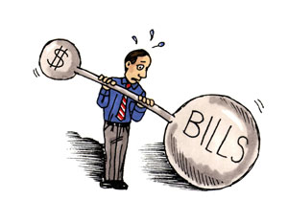
Longer terms will enhance the CWSRF program
Loan terms associated with shorter repayment periods can present a hardship for ratepayers
Longer-term financing would especially benefit smaller and lower-income communities
15 other state CWSRF programs allow longer-term financing
Recommended during the 2012 CWSRF rulemaking
Notes:
Emphasize: Longer-term financing spreads debt repayment over a longer period of time, thereby decreasing the financial burden on residents when communities increase utility rates to cover debt repayments.
Savings is that semi-annual payments are less – for instance:
For a $1 Million on a 20 year at 1.89% (lowest interest rate), the semi – annual repayment is $30,775; on a 30 year loan, same interest rate the repayments are $22,189, so will pay $16K less a year in repayments. However, will pay more in interest over the life of the loan. They will pay $331K interest on 30 years vs. $212K or $119,000 more in interest than for 20 years.
The process for selling a revenue bond may require more effort and upfront costs to communities than is required for a traditional loan, however, a community can decide if the costs outweigh the benefits.
DEQ updated Oregon’s Clean Water State Revolving Fund rules in 2012 with input from the CWSRF Advisory Committee. The 2012 rules made the CWSRF loan program more affordable to communities by reducing loan interest rates and annual fees and offering further incentives for smaller communities. During the 2012 rulemaking, the advisory committee identified the option of offering a financing term longer than 20 years as a way to help make water quality improvements more affordable.

Slide 6
Input from many to develop recommendations for the proposed rules
Internal rulemaking workgroup
Met monthly May-Oct. 2013
CWSRF Advisory Committee
Standing 14 member committee
Met monthly from June-Sept. 2013
Developed recommendations report
EPA Region 10 and HQ
Provided input as their concurrence was required
Approved proposal on December 5, 2013
Notes:
Internal rulemaking workgroup included the Regional Division Administrators, Deputy Director (Joni Hammond) and the Water Quality Division Administrator (Greg Aldrich), and key CWSRF program staff and manager.
Advisory Committee
Oregon established the Clean Water State Revolving Fund Advisory Committee in 2011 to address program issues and provide input to DEQ for the 2012 rulemaking. After the committee last met in 2012, DEQ’s director appointed a 14-member standing CWSRF Advisory Committee that includes many of the original members. Current members represent CWSRF interests from federal and state agencies, local governments, water and wastewater districts and utilities, watershed organizations, environmental advocacy groups, local conservation districts, and the financial sector.
DEQ staff provided information to the committee about potential demand for, and benefits of, longer-term financing to existing and new borrowers including: Characteristics of Oregon CWSRF borrowers and loans, Oregon community demographics, impact of longer-term financing on community sewer rates for existing and potential new borrowers, and other CWSRF state programs and infrastructure funding agencies that have implemented longer-term financing. Based on the committee's discussion of different eligibility, interest rate and priority-setting criteria, DEQ presented modeling scenarios reflecting the impact of those criteria on the fund’s perpetuity. The committee used this information to develop a report detailing its recommendations.
EPA
Concurrence required that required a formal proposal for what they call “Extended Term Financing”. This proposal required modeling that shows that the impacts of the new rule would not negatively impact the perpetuity of the CWSRF.

Slide 7
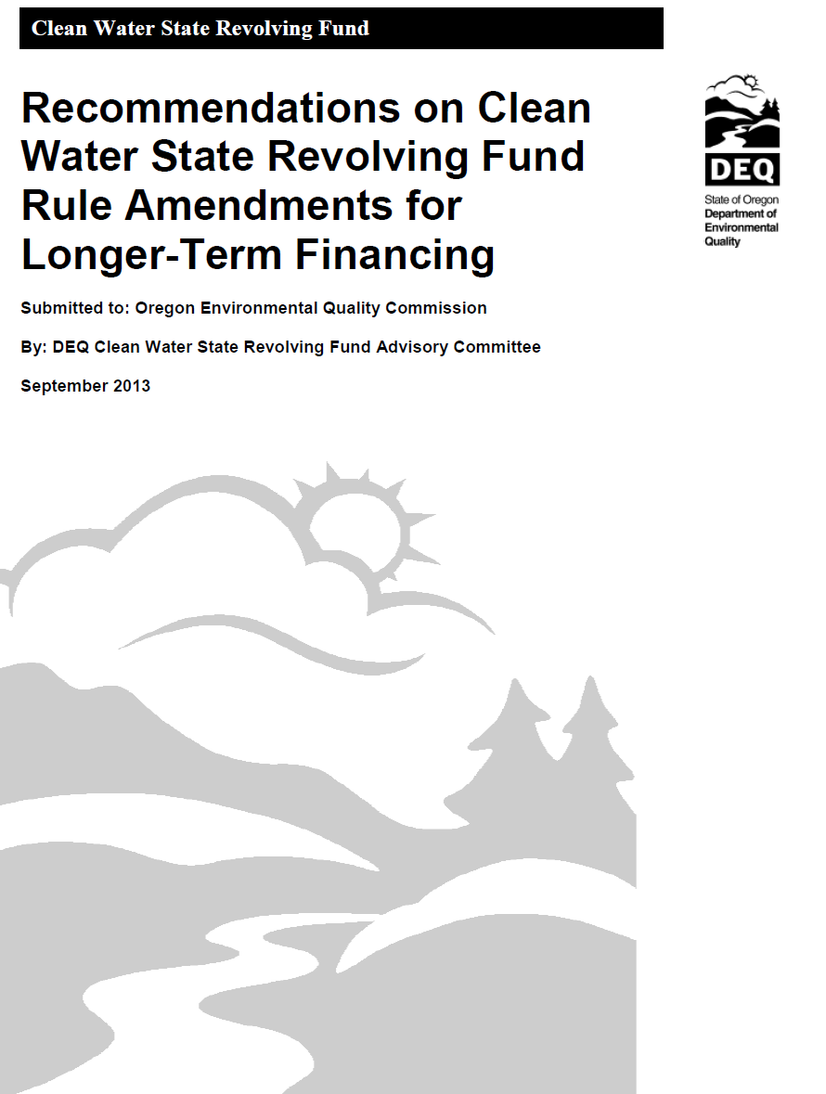
Proposed conditions for CWSRF longer-term financing
Option of the traditional CWSRF loan for terms up to 20 years or longer-term financing including the following conditions
A revenue bond purchase agreement with terms up to 30 years
All new borrowers eligible
Small group of existing CWSRF borrowers can refinance
Interest rate premiums added in a tiered structure
No limit on amount of funds allocated
No change in prioritization of projects or allocation of incentives
No combination of the two types of funding
Applies only to treatment works projects
Notes:
Based on recommendations from the advisory committee report
Emphasize the new option it is a different funding mechanism from a loan
Proposal details
-All new borrowers for treatment works projects should be eligible for longer-term financing.
-Eligibility should be very limited for existing borrowers to refinance their current CWSRF loans for treatment works. The most disadvantaged communities should be allowed to refinance as specified by economic status and loan characteristic criteria. Refinancing should be a one-time offer and available only for a finite period of time.
-Interest rate premiums should be added to current base rates to protect the CWSRF fund’s perpetuity.
-Premiums should be added in a three-tiered structure based on borrowers’ economic status, with the most disadvantaged communities paying the lowest rates and least disadvantaged paying the highest rates. These premium rates should apply to new and existing borrowers eligible to refinance their CWSRF loans, and range from 0 to 0.5 percent.
-The amount of CWSRF funds allocated for longer-term financing should not be limited.
-Prioritization should not be considered in allocating the new financing option other than what is stated in current rules.
-Allocation and priority setting for incentives such as the green project and small community reserves and principal forgiveness should not change from current rules.

Slide 8
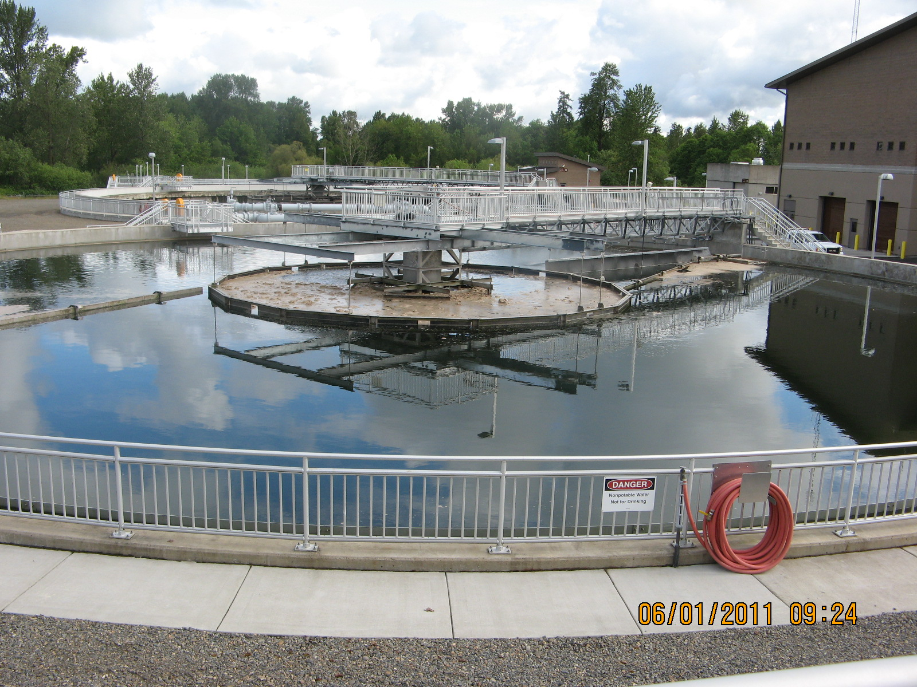
Longer-term financing limited by state law to “treatment works” projects
“Treatment works”
Wastewater, industrial and stormwater storage, treatment, plants and equipment
No nonpoint source projects such as stream restoration and irrigation
Federal law allows longer-term financing for non-treatment works projects
Could amend statute in future
Notes:
Oregon law currently limits extended term financing to treatment works projects. DEQ is not proposing to change state law at this point but hopes to in the future.
Currently state statute limits the longer-term financing option to only “treatment works” projects as defined in ORS 468.423:
“ (3) “Treatment works” means:
(a) The devices and systems used in the storage, treatment, recycling and reclamation of municipal sewage or industrial wastes of a liquid nature, necessary to recycle or reuse water at the most economical cost over the estimated life of the works. “Treatment works” includes:
(A) Intercepting sewers, outfall sewers, sewage collection systems, pumping power and other equipment, and any appurtenance, extension, improvement, remodeling, addition or alteration to the equipment;
(B) Elements essential to provide a reliable recycled water supply including standby treatment units and clear well facilities; and
(C) Any other acquisitions that will be an integral part of the treatment process or used for ultimate disposal of residues resulting from such treatment, including but not limited to land used to store treated waste water in land treatment systems prior to land application.
(b) Any other method or system for preventing, abating, reducing, storing, treating, separating or disposing of municipal waste, storm water runoff, industrial waste or waste in combined storm water and sanitary sewer systems.
(c) Any other facility that the Environmental Quality Commission determines a public agency must construct or replace in order to abate or prevent surface or ground water pollution.”

Slide 9
Small group of existing borrowers can refinance loans
14 existing CWSRF borrowers (10.5 % of fund)
Most disadvantaged communities as specified by economic status and loan characteristic criteria
One time, limited period offer
Cost savings
Extend debt terms, less paid annually
Potential to avoid increases in utility rates
In many cases, smaller interest rate than current loan
Notified in October 2013 of their eligibility
Notes:
Refinancing criteria:
Median household income is less than 70 percent of the Oregon statewide median household income (Statewide Median Household Income (MHI) is $49,850),
Loan term remaining is 10 years or greater,
Loan repayments are currently not in default,
Loan does not include American Recovery and Reinvestment Act or principal forgiveness funding,
When the department purchases a debt obligation to replace an existing CWSRF loan or debt obligation, the amortization period of the debt obligation may not exceed the lesser of: 1) The useful life of the asset, or 2) Thirty years minus the number of years that the existing CWSRF loan or debt obligation has been in repayment.
Savings is that semi-annual payments are less – for instance:
For a $1 Million on a 20 year at 1.89% (lowest interest rate), the semi – annual repayment is $30,775; on a 30 year loan, same interest rate the repayments are $22,189, so will pay $16K less a year in repayments. However, will pay more in interest over the life of the loan. They will pay $331K interest on 30 years vs. $212K or $119,000 more in interest than for 20 years.

Slide 10
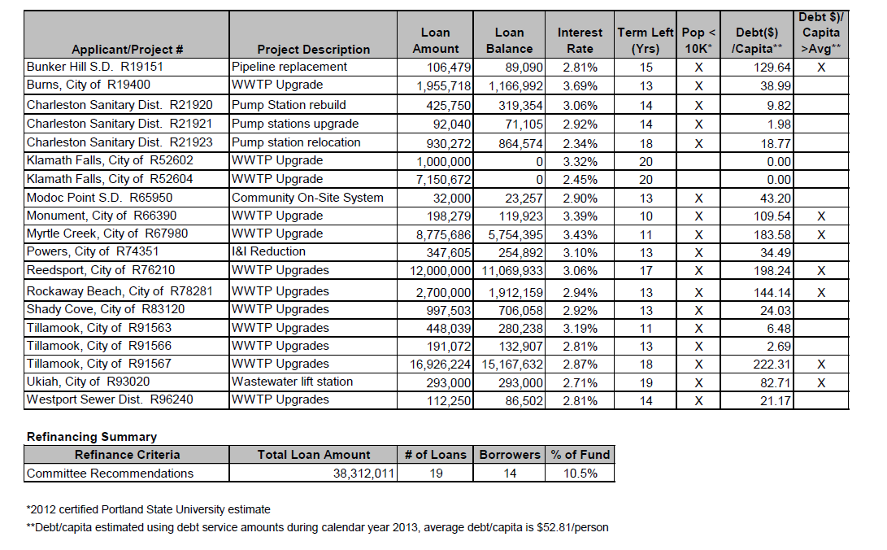
14 eligible existing CWSRF borrowers for refinancing
Notes:
Most borrowers were interested in refinancing when notified of their eligibility.

Slide 11
Proposal provides many benefits with limited costs
Indirect benefit to communities and businesses
More upfront costs to communities
No significant DEQ fiscal or economic effects
Slight decrease in CWSRF binding commitments over time
Improved water quality across Oregon
Notes:
The proposed rules would have no direct economic impact on the public. There may be indirect economic impacts to individuals located in a service area where the CWSRF funds a public agency project that affects sewer or other service rates. The proposed longer-term financing on new and existing debt obligations for CWSRF treatment works projects may indirectly benefit individual ratepayers if the public agency is able to avoid rate increases.
The longer-term financing option requires a public agency to sell debt obligations in the form of revenue bonds to DEQ. Emphasize: The process of selling a revenue bond may require more effort and upfront costs to communities than required for a traditional loan. However, local governments would still have the option of pursuing a 20-year loan if they determine the economic costs of the new process of selling a revenue bond outweighs the economic benefits of the longer-term financing.
The proposed rules could minimally increase administrative costs for the Oregon Department of Land Conservation and Development as well as DEQ if the proposed longer-term financing option results in additional funded and refinanced projects requiring more administrative time for application requirements such as environmental review. Internal processes will not change so much that it will be burdensome to DEQ staff, already have rules in place for loan-secured by revenue bonds, this will have very similar rules. Most time will be extra DEQ staff time for refinance details.
Financial impacts to the Clean Water State Revolving Fund will result in a slight decrease in the binding commitments, which is the total amount of money lent from the program, over a long period. The difference in binding commitments is a 7 percent decrease if all borrowers used extended term financing versus no extended term financing. This is below EPA’s 10 percent threshold. This result is displayed as a graph in that compares the percent change in binding commitments over a 60 year projection period for the above scenario and for the scenario where extended term financing is not utilized.
There are positive environmental benefits for Oregon resulting from projects that protect and improve water quality for human health, wildlife and aquatic life in Oregon’s watersheds.

Slide 12
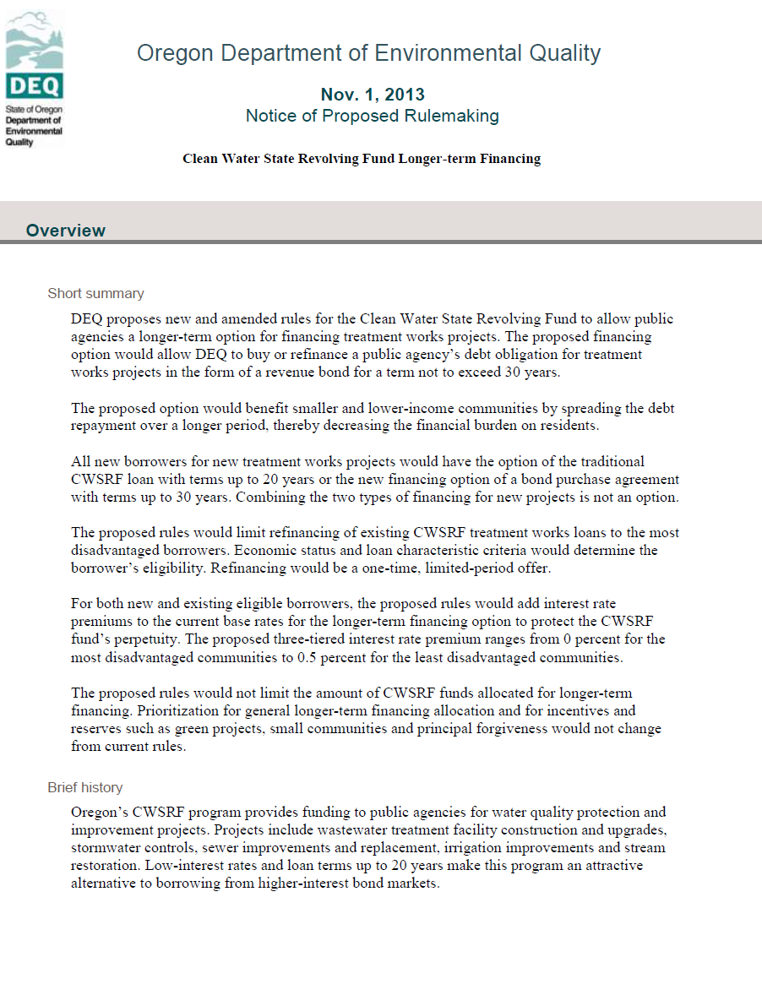
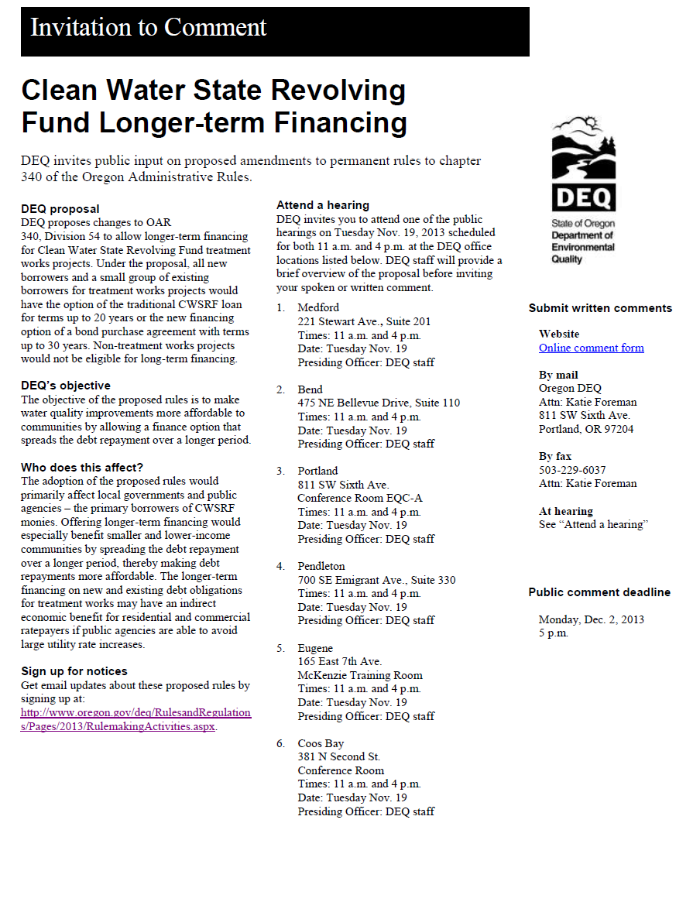
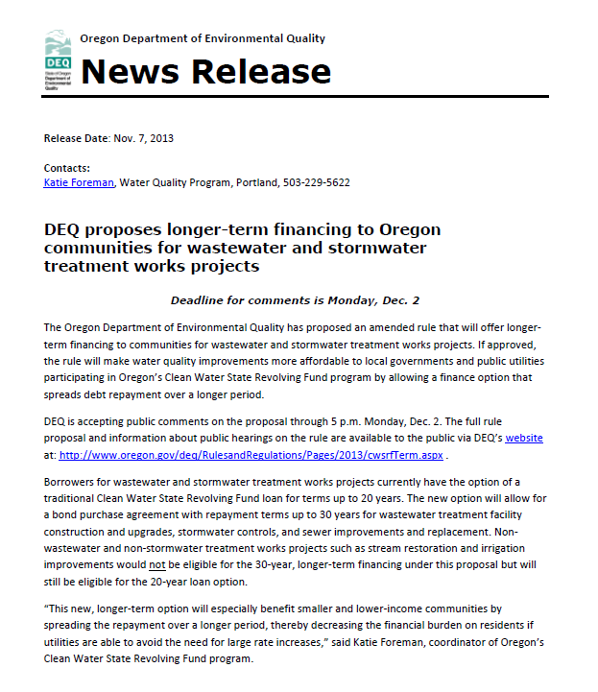
Stakeholder and public feedback was encouraged on proposal
30 day public comment period
Nov. 1-Dec. 2, 2013
12 public meetings across the state on Nov. 19, 2013
No attendees
Noticing to interested parties
Legislators, EPA, general public, public agencies
4 supportive comments,1 comment beyond scope
Proposal approved by EPA
No changes warranted to proposed rules
Notes:
DEQ held public hearings on Tuesday, Nov. 19, 2013 in six different DEQ office locations across the state at two different times of the day, totally 12 public hearing sessions.
Hearings were held in DEQ offices in Portland, Bend, Eugene, Coos Bay, Medford and Pendleton. DEQ staff were the presiding officers at each site, with Larry McAllister as the presiding officer at DEQ Headquarters in Portland
Hearings were at 11 am and then again at 4 p.m.
Comments
-City of Springfield, League of Oregon Cities, Special Districts Association of Oregon and the Oregon Association of Clean Water Agencies were supportive.
-Senator Doug Whitsett was generally supportive of the proposed rules but thinks that they are not addressing the root of the problem. Commenter thinks that lower cost, regionally-specific options for water treatment projects are needed.

Slide 13
DEQ’s recommendation
DEQ recommends that the EQC adopt proposed amendments to OAR 340, Divisions 54 as shown in Attachment A

Slide 14
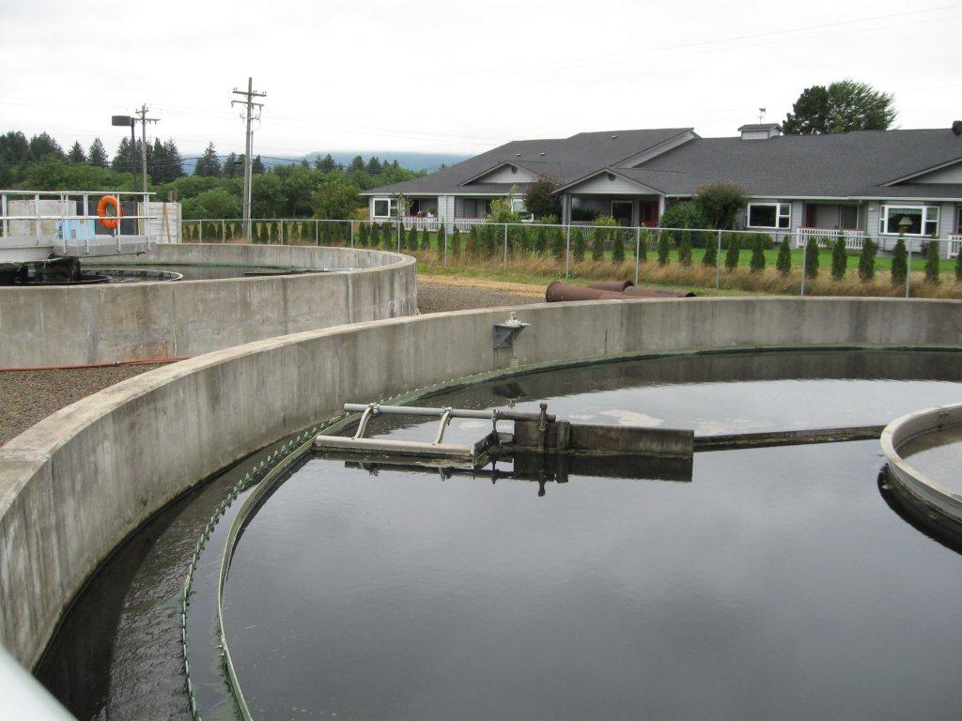
Next steps if approved
Implementation plan
Communication strategy
Potential, new, and existing borrowers
Possible statutory change for longer-term financing to include all non-treatment works
Notes:
This is the conclusion of DEQ’s formal presentation on this proposed rule. We would be happy to answer any questions the commissioners may have.

