Slide 1
Action Item: Clean Water State Revolving Fund Longer-term Financing
Environmental Quality Commission
Special Meeting
Jan. 24, 2014
Katie Foreman, DEQ
Notes:
Say “For the record” and restate name
Make sure to mention the slide numbers
Introduction – Greg will include a statement of the fact that this rulemaking was deemed a priority. This rulemaking benefits communities and water quality. DEQ wanted to have a special session with EQC early in the year so this did not have to wait until the March 2014 EQC meeting.

Slide 2
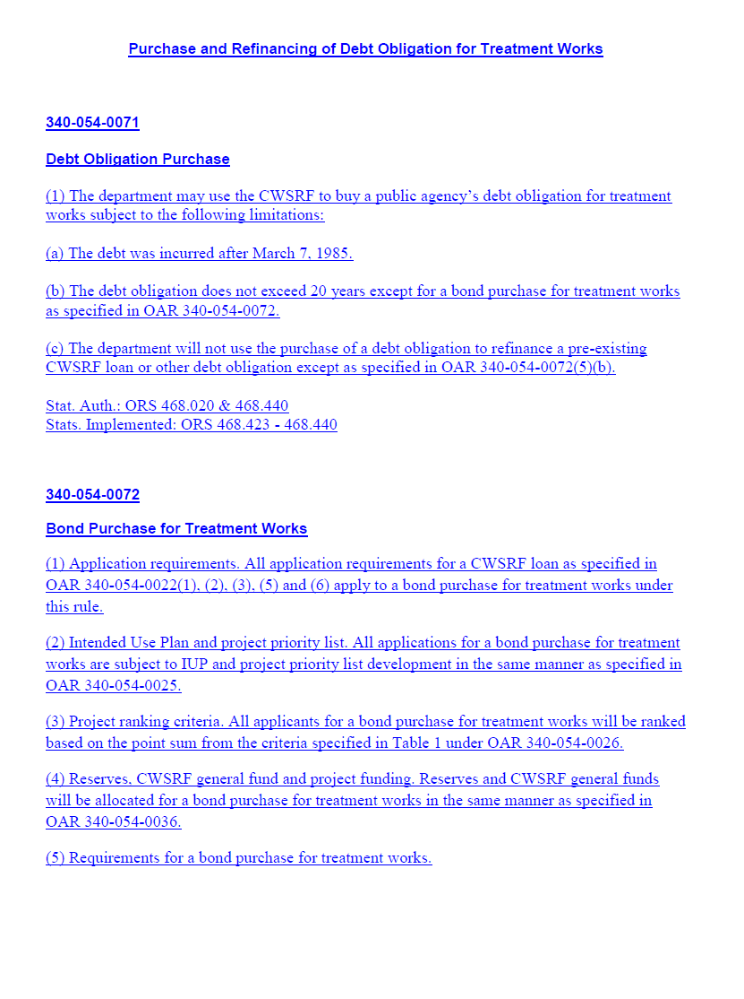
DEQ’s recommendation
DEQ recommends that EQC adopt proposed amendments to OAR 340, Division 54 as shown in Attachment A
  Longer-term financing option in the Clean Water State Revolving Fund program
Notes:
Option is for terms in the CWSRF for longer than the rule-allowable 20 year terms.

Slide 3
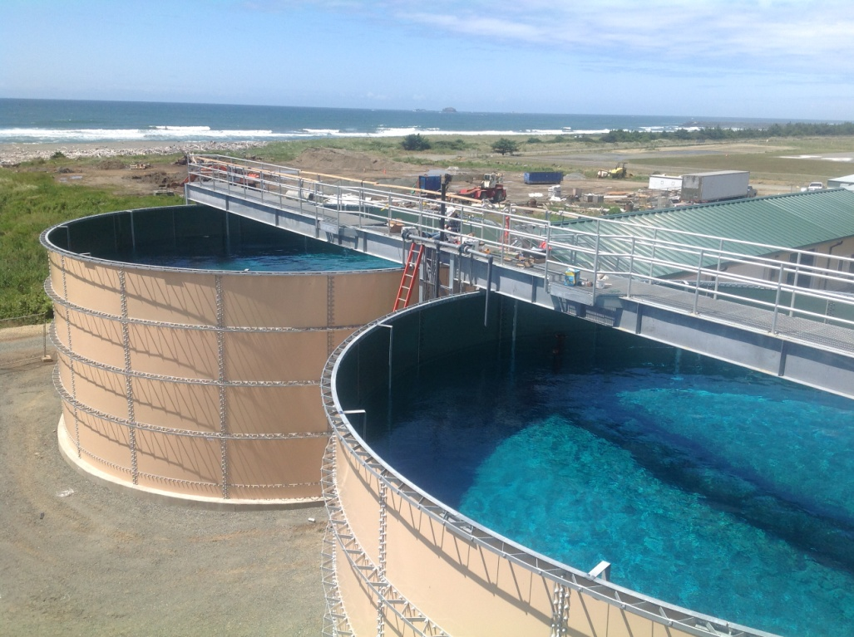
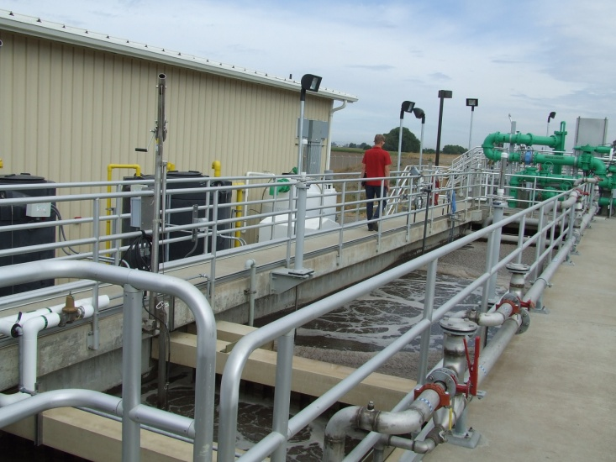
The program provides affordable funding to communities
Loans to public agencies for water quality protection and improvement projects
  Low interest rates
  Terms up to 20 years
  $1 billion to 149 communities since 1990
  Water quality benefits
Notes:
Eligible projects include wastewater treatment facility construction and upgrades, stormwater controls, sewer improvements and replacement, irrigation improvements and stream restoration.
Low-interest rates and loan terms make this program an attractive alternative to borrowing from higher-interest bond markets. Our rates are 2% less than municipal bond market rates.

Slide 4
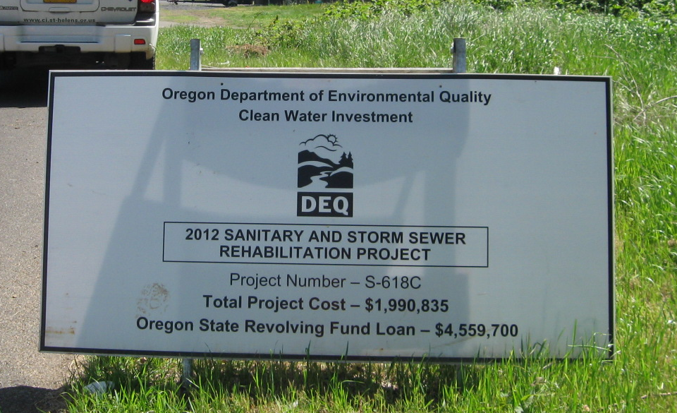
Shorter repayment period can lead to economic hardships
Large project costs can strain finances
  Especially small and lower-income communities with a small rate base
  Utility rates can increase by over $10/mo.
Notes:
Sewer rates are key, lots of large project decisions are made on sewer rates, which tend to fund these kinds of projects
Astoria project sign

Slide 5
Longer terms will enhance the program and help communities
Recommended during the 2012 program rulemaking
15 other state Clean Water State Revolving Fund programs allow longer-term financing
Spreading debt over longer period creates more affordable repayment terms
  Especially benefit smaller and lower-income communities
  Decreased burden on utility ratepayers
Will make the program more attractive
Could increase number of water quality projects
Notes:
2012 rules
DEQ updated Oregon’s Clean Water State Revolving Fund rules in 2012 with input from the CWSRF Advisory Committee. The 2012 rules made the CWSRF loan program more affordable to communities by reducing loan interest rates and annual fees and offering further incentives for smaller communities. During the 2012 rulemaking, the advisory committee identified the option of offering a financing term longer than 20 years as a way to help make water quality improvements more affordable.
Emphasize: Longer-term financing spreads debt repayment over a longer period of time, thereby decreasing the financial burden on residents when communities increase utility rates to cover debt repayments.
Savings is that semi-annual payments are less – for instance:
For a $1 Million on a 20 year at 1.89% (lowest interest rate), the semi – annual repayment is $30,775; on a 30 year loan, same interest rate the repayments are $22,189, so will pay $16K less a year in repayments. However, will pay more in interest over the life of the loan. They will pay $331K interest on 30 years vs. $212K or $119,000 more in interest than for 20 years.

Slide 6
Longer-term financing is allowable with amendments to rules
The federal Clean Water Act and state statute
  Limit loan terms to up to 20 years
  Allow a public agency to sell DEQ a revenue bond with repayment terms up to 30 years or life of asset for treatment works projects (i.e. longer-term financing)
Rule amendments are necessary to implement longer-term financing
  Details for eligibility, terms, etc. needed to be determined
Notes:
This not a loan, different from a loan, it is a bond purchase agreement
Mention treatment works projects – they are wastewater treatment and stormwater treatment projects
Process for determining the details were informed by recommendations from AC

Slide 7
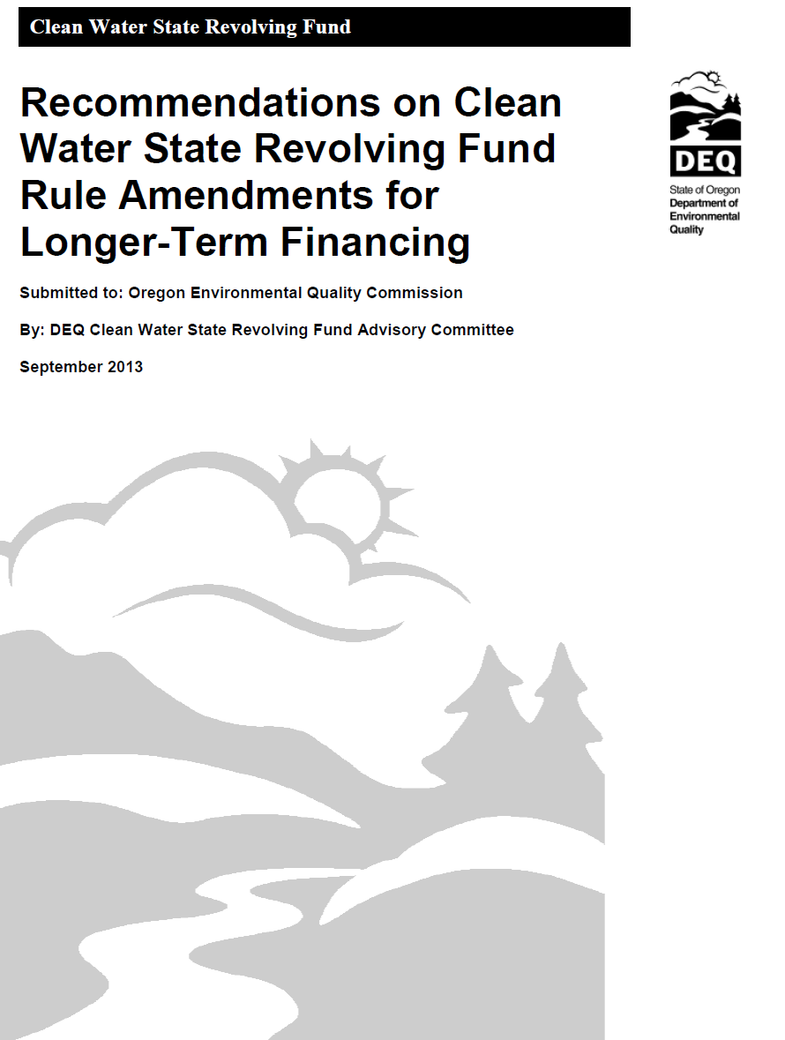
Input from many to develop recommendations for the proposed rules
Advisory Committee
  Standing, diverse committee
  June-Sept. 2013
  Recommendations report (Attachment B)
EPA Region 10 and EPA HQ
  Longer-term financing requirements
  Approved Dec. 5, 2013
Notes:
They saw attachment B on Oct. 17th during directors dialog
Mention written approval by EPA
Mention that the meetings were discussions about possible scenarios for the details of longer-term financing and the impacts on borrowers and impacts to the financial viability of the program. Recommendations were made to maximize the benefits to borrowers and program
Advisory Committee
Oregon established the Clean Water State Revolving Fund Advisory Committee in 2011 to address program issues and provide input to DEQ for the 2012 rulemaking. After the committee last met in 2012, DEQ’s director appointed a 14-member standing CWSRF Advisory Committee that includes many of the original members. Current members represent CWSRF interests from federal and state agencies, local governments, water and wastewater districts and utilities, watershed organizations, environmental advocacy groups, local conservation districts, and the financial sector.
Mention process: Major decision points were to determine eligibility, interest rates necessary, allocation details. Information on current programs, other programs options informed scenarios for conditions for LTF that included financial modeling on the impact of the details on fund and communities to inform AC recommendations.
MORE DETAIL:
DEQ staff provided information to the committee about potential demand for, and benefits of, longer-term financing to existing and new borrowers including: Characteristics of Oregon CWSRF borrowers and loans, Oregon community demographics, impact of longer-term financing on community sewer rates for existing and potential new borrowers, and other CWSRF state programs and infrastructure funding agencies that have implemented longer-term financing. Based on the committee's discussion of different eligibility, interest rate and priority-setting criteria, DEQ presented modeling scenarios reflecting the impact of those criteria on the fund’s perpetuity. The committee used this information to develop a report detailing its recommendations.
EPA
Concurrence required that required a formal proposal for what they call “Extended Term Financing”. This proposal required modeling that shows that the impacts of the new rule would not negatively impact the perpetuity of the CWSRF. They have many requirements to be sure this is protective of the fund.

Slide 8
Details for the new funding option
Additional financing option to the traditional 20- year loan
    Not a loan
    Public agencies sell revenue bond to DEQ
    Repayment terms up to 30 years
    Details optimize fund protection and benefits to borrowers
      All new borrowers eligible
      Small group of existing borrowers can refinance
      Interest rates, prioritization and allocation of funding
    Applies only to treatment works projects
Notes:
Based on recommendations from the advisory committee report – emphasize that the report was part of the director’s dialog in Oct. 2013 EQC meeting
Proposal details
-All new borrowers for treatment works projects should be eligible for longer-term financing.
-Eligibility should be very limited for existing borrowers to refinance their current CWSRF loans for treatment works. The most disadvantaged communities should be allowed to refinance as specified by economic status and loan characteristic criteria. Refinancing should be a one-time offer and available only for a finite period of time.
-Interest rate premiums should be added to current base rates to protect the CWSRF fund’s perpetuity.
-Premiums should be added in a three-tiered structure based on borrowers’ economic status, with the most disadvantaged communities paying the lowest rates and least disadvantaged paying the highest rates. These premium rates should apply to new and existing borrowers eligible to refinance their CWSRF loans, and range from 0 to 0.5 percent.
-The amount of CWSRF funds allocated for longer-term financing should not be limited.
-Prioritization should not be considered in allocating the new financing option other than what is stated in current rules.
-Allocation and priority setting for incentives such as the green project and small community reserves and principal forgiveness should not change from current rules.

Slide 9
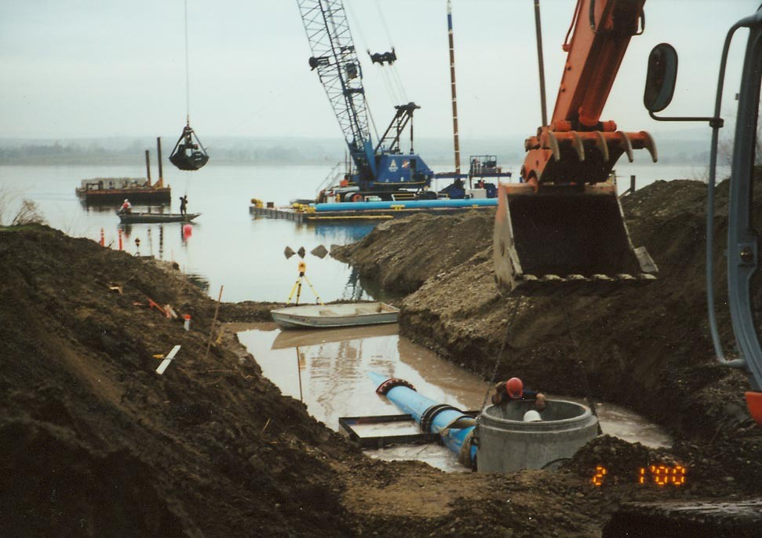
Example of benefit to longer terms
$10 Million project,
20 vs. 30 year
Pay $79K less a year in repayments
$ 3+ savings/mo. in utility rates
  $9 vs. $12 rate increase
Pay $1.3M more in interest over life of debt
Notes:
Similar to extending the terms of your home mortgage from 15 to 30 years
Example for a city such as Reedsport
Large WWTP upgrades
Assumes 5,000 pop., 2000 connection $10M debt, $12.46/mo rate increase vs. 9.17/ mo rate increase
Assume interest rates more 1.58% for 20 and higher, 1.83% for 30 year
$43K more in interest over the life of the loan, still a good deal.

Slide 10
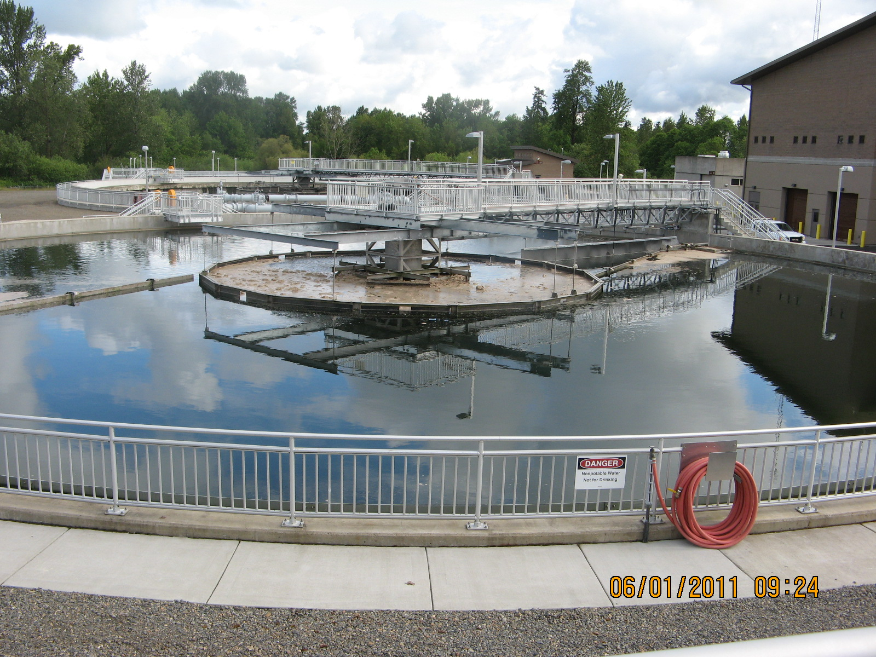
Longer-term financing limited by state law to “treatment works” projects
“Treatment works”
  Wastewater, industrial and stormwater treatment plants, equipment, and collection systems
  No nonpoint source projects (i.e. stream restoration and irrigation)
Federal law allows longer-term financing for non-treatment works projects
  Could amend statute in future
Notes:
Treatment works are currently 92% of our projects that are funded
Oregon law currently limits extended term financing to treatment works projects. DEQ is not proposing to change state law at this point but hopes to in the future.
Currently state statute limits the longer-term financing option to only “treatment works” projects as defined in ORS 468.423:
“ (3) “Treatment works” means:
(a) The devices and systems used in the storage, treatment, recycling and reclamation of municipal sewage or industrial wastes of a liquid nature, necessary to recycle or reuse water at the most economical cost over the estimated life of the works. “Treatment works” includes:
(A) Intercepting sewers, outfall sewers, sewage collection systems, pumping power and other equipment, and any appurtenance, extension, improvement, remodeling, addition or alteration to the equipment;
(B) Elements essential to provide a reliable recycled water supply including standby treatment units and clear well facilities; and
(C) Any other acquisitions that will be an integral part of the treatment process or used for ultimate disposal of residues resulting from such treatment, including but not limited to land used to store treated waste water in land treatment systems prior to land application.
(b) Any other method or system for preventing, abating, reducing, storing, treating, separating or disposing of municipal waste, storm water runoff, industrial waste or waste in combined storm water and sanitary sewer systems.
(c) Any other facility that the Environmental Quality Commission determines a public agency must construct or replace in order to abate or prevent surface or ground water pollution.”

Slide 11
Small group of existing borrowers can refinance loans
14 existing borrowers
  Most disadvantaged communities
Cost savings
  Lower repayments
  Avoid larger utility rate increases
  Lower interest rates
One time, limited period offer
Notified in October 2013 of their eligibility
Notes:
Criteria determined at one period of time, b/c you might change over time.
Refinancing criteria:
To balance helping the most disadvantaged communities but still be protective of the fund’s long-term financial viability
Median household income is less than 70 percent of the Oregon statewide median household income (Statewide Median Household Income (MHI) is $49,850),
Loan term remaining is 10 years or greater,
Loan repayments are currently not in default,
Loan does not include American Recovery and Reinvestment Act or principal forgiveness funding,
When the department purchases a debt obligation to replace an existing CWSRF loan or debt obligation, the amortization period of the debt obligation may not exceed the lesser of: 1) The useful life of the asset, or 2) Thirty years minus the number of years that the existing CWSRF loan or debt obligation has been in repayment.
Savings is that semi-annual payments are less – for instance:
For a $1 Million on a 20 year at 1.89% (lowest interest rate), the semi – annual repayment is $30,775; on a 30 year loan, same interest rate the repayments are $22,189, so will pay $16K less a year in repayments. However, will pay more in interest over the life of the loan. They will pay $331K interest on 30 years vs. $212K or $119,000 more in interest than for 20 years.

Slide 12
14 eligible existing borrowers for refinancing
Applicant | Project Description | Loan Amount ($)
Bunker Hill S.D. | Pipeline replacement | 106,479
Burns, City of | WWTP Upgrade | 1,955,718
Charleston Sanitary Dist. | Pump Station rebuild | 425,750
Charleston Sanitary Dist. | Pump stations upgrade | 92,040
Charleston Sanitary Dist. | Pump station relocation | 930,272
Klamath Falls, City of | WWTP Upgrade | 1,000,000
Klamath Falls, City of | WWTP Upgrade | 7,150,672
Modoc Point S.D. | Community On-Site System | 32,000
Monument, City of | WWTP Upgrade | 198,279
Myrtle Creek, City of | WWTP Upgrade | 8,775,686
Powers, City of | I&I Reduction | 347,605
Reedsport, City of | WWTP Upgrades | 12,000,000
Rockaway Beach, City of | WWTP Upgrades | 2,700,000
Shady Cove, City of | WWTP Upgrades | 997,503
Tillamook, City of | WWTP Upgrades | 448,039
Tillamook, City of | WWTP Upgrades | 191,072
Tillamook, City of | WWTP Upgrades | 16,926,224
Ukiah, City of | Wastewater lift station | 293,000
Westport Sewer Dist. | WWTP Upgrades | 112,250
Notes:
10.5% of fund
$38,312,011
19 loans, 14 borrowers
Most borrowers were interested in refinancing when notified of their eligibility.

Slide 13
Proposal provides many benefits with limited costs
More affordable terms
More water quality protection and improvement projects implemented
Slight decrease in CWSRF money lent over time, but still fund-protective
No significant state fiscal or economic effects
More upfront costs to communities for bond process
Notes:
Mention it benefits communities and ratepayers
Idea is if make it more affordable to especially smaller/low income communities there would be more projects funded that might not otherwise be or more larger projects too, leading to increased water quality across the state.
See note on bond related costs.
The longer-term financing option requires a public agency to sell debt obligations in the form of revenue bonds to DEQ. Emphasize: The process of selling a revenue bond may require more effort and upfront costs to communities than required for a traditional loan. However, local governments would still have the option of pursuing a 20-year loan if they determine the economic costs of the new process of selling a revenue bond outweighs the economic benefits of the longer-term financing. A note on the bond related costs, this is very difficult to know what that might be as every borrower’s situation is going to be different. We are reluctant to offer any estimated costs even with a disclaimer. It will be communicated to the borrowers that there will be costs involved and what the borrower will need to consider.
It was suggested that we notify the RST folks by email about our efforts to contact the existing borrowers. We will follow-up with the RST folks and send an email with the talking points.
Notes: A revenue bond is much easier to get than a General Obligation Bond. It only has to go through a governing body to get resolution, not to vote. Easiest kind of revenue bond, don’t go to the market or have to negotiate. It’s 1 bond, 1 borrower. Cost as little for bonds as far as revenue bonds are concerned. Rural development requires it and they roll it into eligible costs for the debt, could be as low as thousands of dollars.
General interest is high, even with the upfront costs, can save thousands of dollars a year. AC members who are potential borrowers were interested in spite of the costs. Risks are same for us and for borrowers. We have a pledge of security which is the same, the sewer revenues. Bonds see to be more secure, borrowers may want to be sure not to hurt their credit-worthiness
The proposed rules could minimally increase administrative costs for the Oregon Department of Land Conservation and Development as well as DEQ if the proposed longer-term financing option results in additional funded and refinanced projects requiring more administrative time for application requirements such as environmental review. Internal processes will not change so much that it will be burdensome to DEQ staff, already have rules in place for loan-secured by revenue bonds, this will have very similar rules. Most time will be extra DEQ staff time for refinance details.
Financial impacts to the Clean Water State Revolving Fund will result in a slight decrease in the binding commitments, which is the total amount of money lent from the program, over a long period. The difference in binding commitments is a 7 percent decrease if all borrowers used extended term financing versus no extended term financing. This is below EPA’s 10 percent threshold. This result is displayed as a graph in that compares the percent change in binding commitments over a 60 year projection period for the above scenario and for the scenario where extended term financing is not utilized.
There are positive environmental benefits for Oregon resulting from projects that protect and improve water quality for human health, wildlife and aquatic life in Oregon’s watersheds.

Slide 14
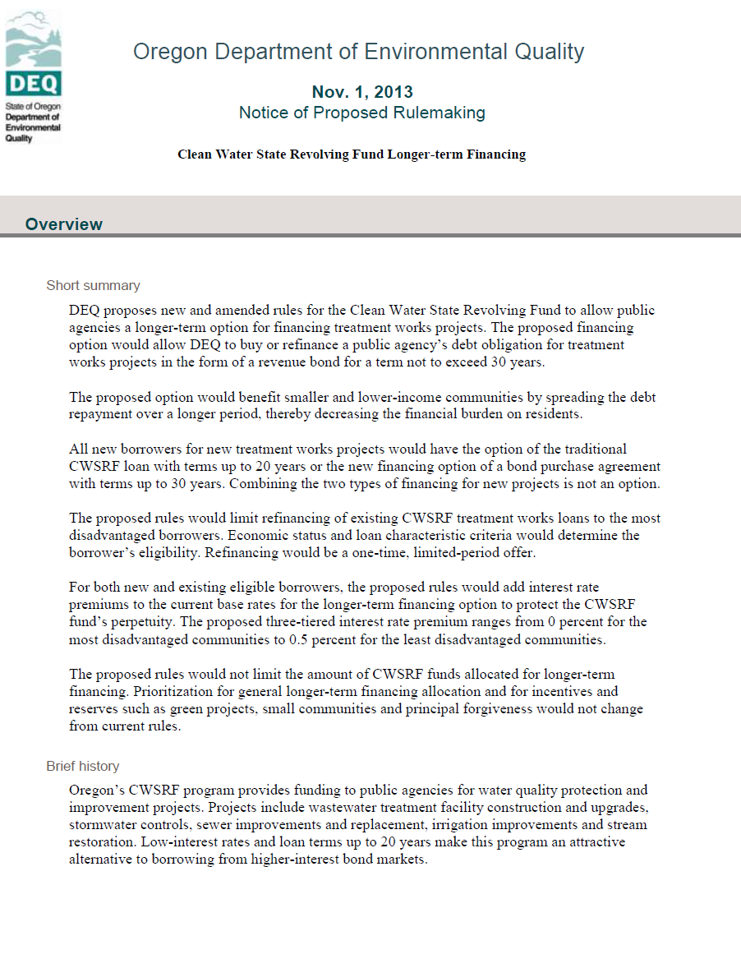
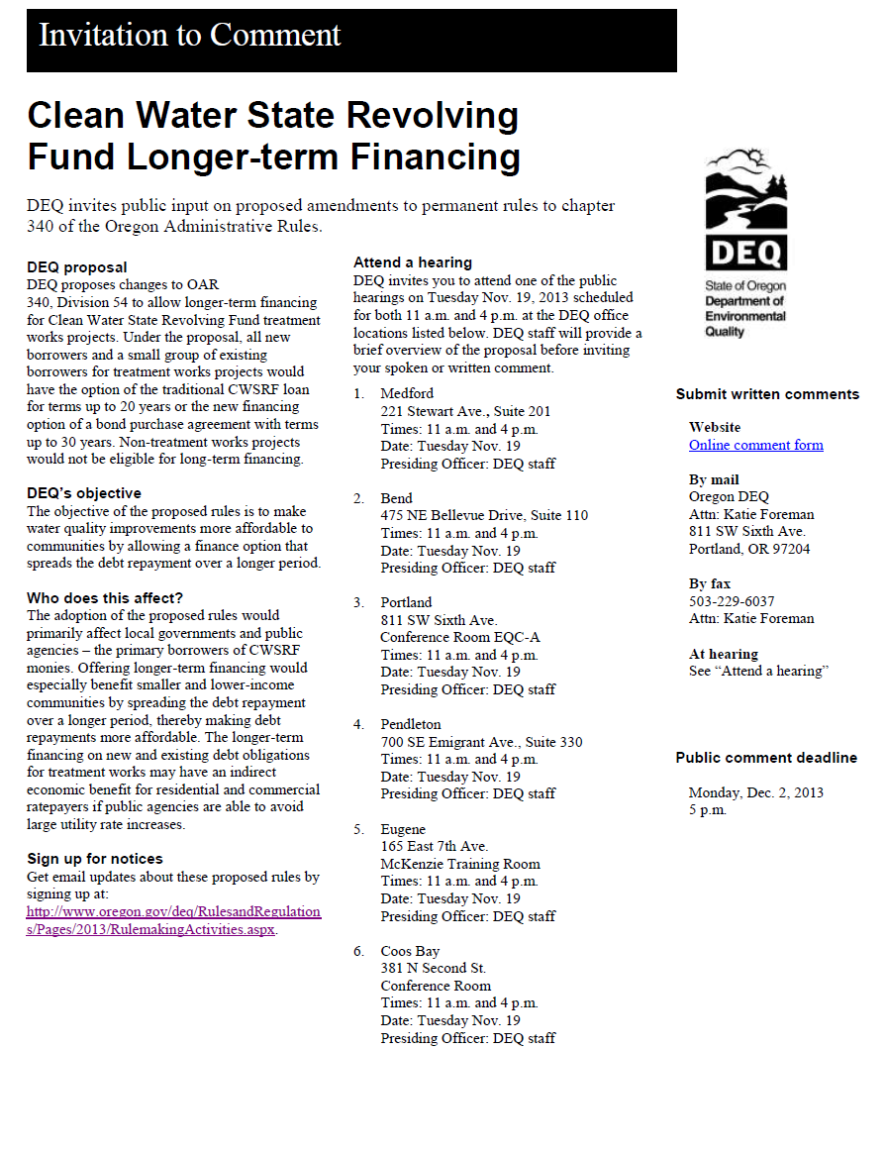
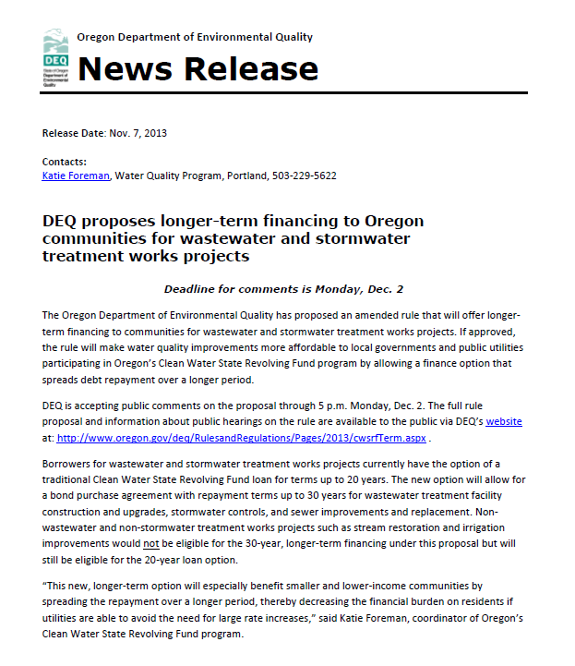
Stakeholder and public feedback was solicited on proposal
    30-day public comment period (Nov. 1-Dec. 2, 2013)
    12 public hearings, six locations (Nov. 19, 2013)
          No attendees
    Four supportive comments, one comment beyond scope
  Proposal approved by EPA
Notes:
Note that there were no changes to the rules based on public comment.
DEQ held public hearings on Tuesday, Nov. 19, 2013 in six different DEQ office locations across the state at two different times of the day, totally 12 public hearing sessions.
Hearings were held in DEQ offices in Portland, Bend, Eugene, Coos Bay, Medford and Pendleton. DEQ staff were the presiding officers at each site, with Larry McAllister as the presiding officer at DEQ Headquarters in Portland
Hearings were at 11 am and then again at 4 p.m.
Comments
-City of Springfield, League of Oregon Cities, Special Districts Association of Oregon and the Oregon Association of Clean Water Agencies were supportive.
-Senator Doug Whitsett was generally supportive of the proposed rules but thinks that they are not addressing the root of the problem. Commenter thinks that lower cost, regionally-specific options for water treatment projects are needed.

Slide 15
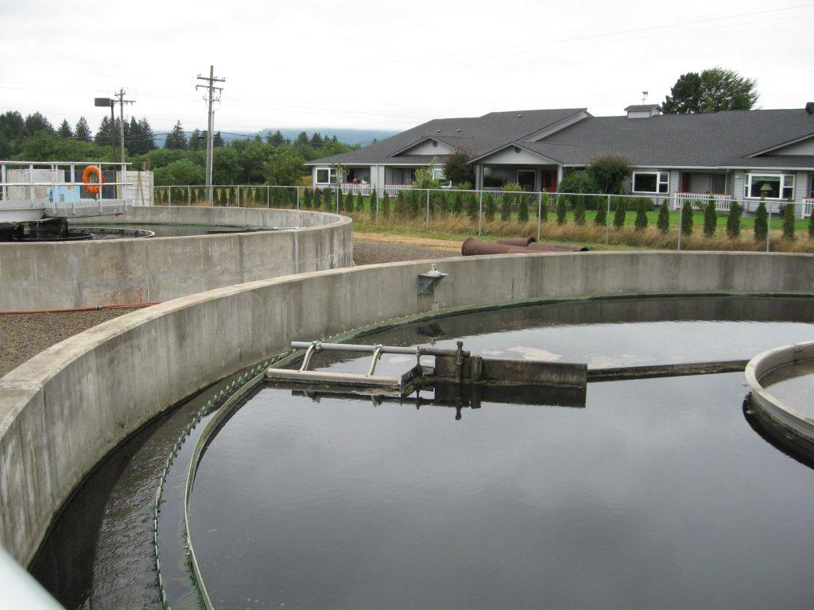
Next steps
Rule effective
  Feb. 3, 2014
Implementation plan
Communication strategy
  Feb. - May 2014
Consider legislative concept for 2015 to broaden eligible projects
Notes:
Communication strategy includes new and existing borrowers. Will include regions and RST to communicate about existing borrowers (their time frame to commit is by May 1, 2014 and sell us a bond by Feb. 1, 2016.)
It's on our list of potential Legislative concepts at this point, but there's a ways to go before DEQ, and then the Governor's Office, make a decision about whether to go forward with it. We may not know for sure until summer/fall.
Note, advisory committee will be reconvened if pursue statutory change.

Slide 16
DEQ’s recommendation
DEQ recommends that EQC adopt proposed amendments to OAR 340, Division 54 as shown in Attachment A
Notes:
This is the conclusion of DEQ’s formal presentation on this proposed rule. We would be happy to answer any questions the commissioners may have.

