Slide 1
Information Item
Division 12 Rulemaking
Leah Feldon, Manager, OCE
Les Carlough, Senior Policy Advisor, OCE
Jenny Root, Environmental Law Specialist & Division 12 Rules Coordinator
Notes:
Good morning, Chair O’Keefe, Commissioners.
My name is Leah Feldon and I am the manager for the Office of Compliance and Enforcement.
With me today are Les Carlough, Senior Policy Advisor with our office and Jenny Root, Environmental Law Specialist and the Division 12 Rules Coordinator with our office.
This agenda item is a preview to the Division 12 rulemaking that we will bring to you at your December meeting.
We wanted to give you a preview of what that rulemaking will be about.
But, we also wanted to take this opportunity to give you an overview of the enforcement process for your information and so you can see how this rulemaking fits into the overall enforcement scheme.

Slide 2
Topics for Today
General overview of the enforcement process
Senate Bill 105A (2009)
Our Div 12 rulemaking process
Overview of the expected proposed changes
Notes:
The topics we will cover today are:
The general overview of the enforcement process, which I will cover,
and the next three topics, Senate Bill 105A, the Division 12 rulemaking process and the overview of expected proposed changes which Les and Jenny will cover.
I encourage you to feel free to stop me throughout the presentation for any questions you may have.

Slide 3
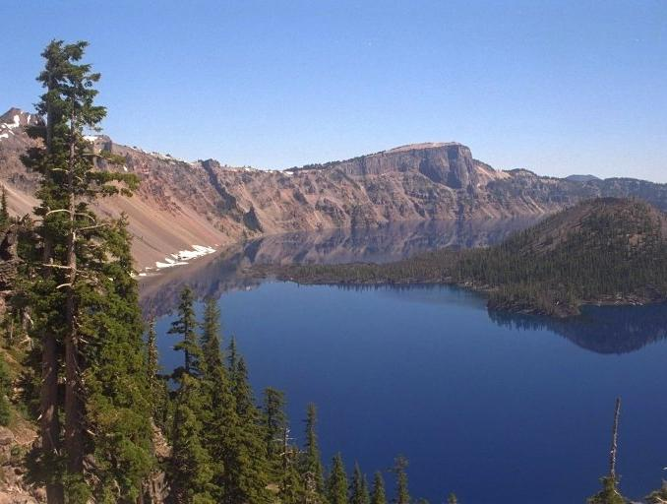
The 35,000-foot View
DEQ's mission is to be a leader in restoring, maintaining and enhancing the quality of Oregon's air, land and water.
Tools for achieving the mission:
  Permitting & rulemaking
  Public outreach and education
  Technical assistance
  Informal enforcement
  Penalties & orders
Notes:
So, starting at the 35,000 foot level,…
The Office of Compliance and Enforcement supports DEQ’s overall mission in restoring, maintaining and enhancing Oregon’s environmental quality.
DEQ uses many types of tools to achieve the goal including . . . Read slide

Slide 4
Enforcement Goals
Correct the current violations
Deter future noncompliance
Encourage voluntary initiative
Ensure economic fairness
Notes:
• To correct the current violations
• To deter future noncompliance – increasing the costs of noncompliance with penalties and thereby discourage those who might consider noncompliance a viable business decision.
• To encourage voluntary initiative – encouraging busy people and businesses to prioritize environmental compliance and to take advantage of the assistance offered by DEQ.
• To ensure economic fairness – ensuring that those who do undertake the costs of compliance are not economically disadvantaged by those who do not. We want to create a level playing field for the regulated community.

Slide 5

Compliance Monitoring Actions
DEQ inspectors are located primarily in the regions. They identify violations through three primary means:
Reviewing self-monitoring reports
Inspecting facilities
Investigating complaints
Notes:
So, how does DEQ find violations?
We have a few means of monitoring compliance:
1. One is the review of self-monitoring reports – most of DEQ’s regulatory programs require permittees to monitor their own compliance and to submit results of the monitoring to DEQ for evaluation.
Examples include Discharge monitoring reports in the water permitting programs, semi-annual reports in the air permitting programs, and Hazardous waste generator annual reports.
2. Another is facility inspection
3. A third is through complaint follow-up.

Slide 6
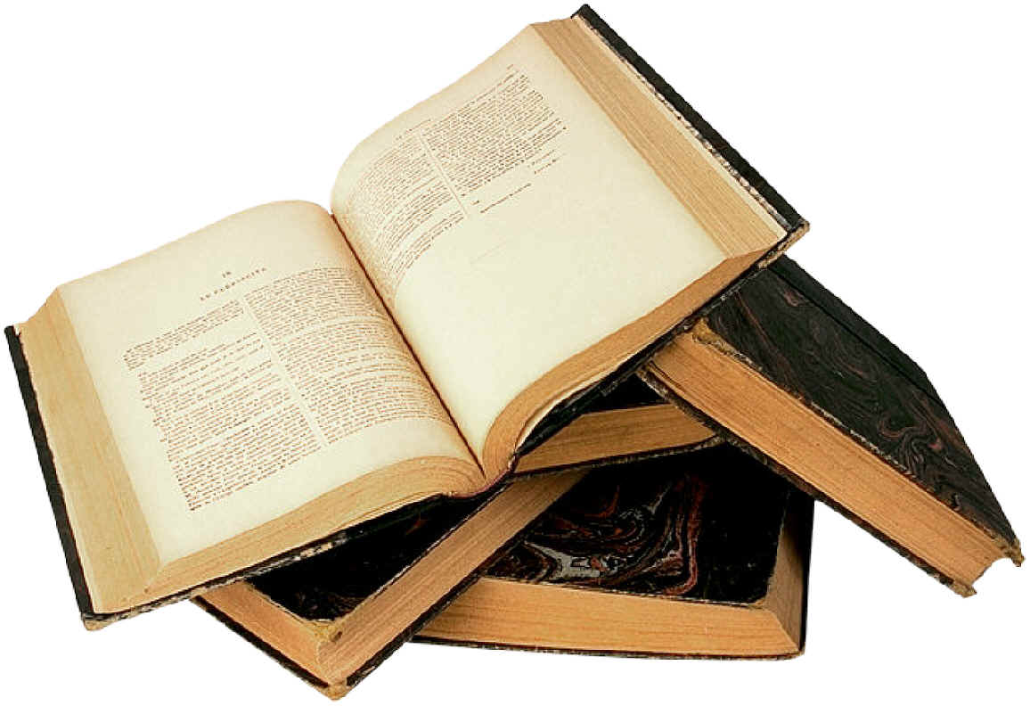
Three related authorities that guide what are violations, what penalties are associated with them, and whether to assess penalties:
Program substantive statutes & rules
Division 12 rules
Enforcement Guidance
Notes:
The Program substantive statutes and rules set out the requirements for the regulated public.
(e.g., a generator of haz. waste must make a waste determination)
OAR 340: Division 12 – The Enforcement rules classify violations of the program rules – the classifications identify which are the most important violations (major), which are moderate and which are minor.
That determination is one of the pieces of the penalty formula that we’ll talk about in a bit. The classifications in Div. 12 are also the basis for the Enforcement Guidance.
(e.g., failure to do a haz. waste determination is a Class I violation)
Enforcement Guidance – Directs staff as to when a violation will be referred for formal enforcement versus when it will receive a warning letter.
(e.g., failure to do a haz. waste determination is referred for formal enforcement on the first occurrence)

Slide 7

Enforcement Guidance
Creates consistency in:
  informal warning letters
  which cases will be referred for civil penalty
Allows for reasonable flexibility to consider mitigating or aggravating circumstances
Criminal
Penalty
Warning
Notes:
The enforcement guidance is a tool for inspectors to use when they determine a violation has occurred.
Most violations that are first time occurrences for the particular entity are handled with warning letters. Warning letters tell the responsible party what the violation is, how to correct it, and that they are not being referred for formal enforcement.
If a violation is being referred for formal enforcement, the responsible party receives a pre-enforcement notice. This letter similarly explains the violation, the corrective action, but it also states that they are being referred for formal enforcement.
Violations most likely to be referred are:
Violations that had a greater likelihood of impacting public health or the environment.
The law violated is particularly important to the operation of the regulatory program.
The violation was chronic or repeated.
The violator had a higher mental state (acted on purpose) or obtained an economic benefit.
As you see, one route on this slide refers to criminal enforcement. DEQ staff do not investigate crimes, but we cooperate with Oregon State Police and EPA CID.
Cases we typically refer to criminal investigators are those in which the violations appear deliberate, deceitful, or dishonest.

Slide 8
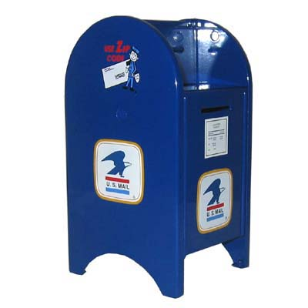
Initiation of formal enforcement
Inspectors prepare and send a “referral” to OCE.
OCE’s Environmental Law Specialists evaluate the evidence and law, and draft the formal enforcement action.
The OCE Manager signs and mails the documents to the responsible party or parties, that is, the “Respondent(s).”
Notes:
Inspectors prepare and send a “referral” to OCE.
Referrals are assigned to OCE staff. Each of the ELS are assigned to be subject-matter experts and generally receive the most complicated cases in that area. The ELSs also serve as liaisons with the programs and assist in enforcement issues like access for inspection and rulemaking.
The ELSs review and evaluate the evidence and put together the documents for a formal enforcement action. The documents are circulated for review and then come to me for review and signature.
The documents are mailed to the party which we refer to as the respondent. After we receive the certification that the party has received the documents, we have processes for issuing news releases , which is important to our goal of deterrence.
During 2011 and 2012, OCE issued 355 enforcement actions of a wide variety of types.

Slide 9

Appeal Process
The Respondent has 20 days in which to send in payment or make a written Request for Hearing.
During this time DEQ may be in contact with the Respondent, working on corrective action or other issues.
According to DOJ rules, failure to timely appeal results in a default order.
Notes:
Once the respondent has received the notice, they have 20 days to appeal or they may submit payment.
If they do not appeal the notice, the notice becomes a final order meaning the penalty becomes due and the compliance order is final.

Slide 10

Informal Discussion
The ELS, inspector and Respondent meet to:
Review the facts and evidence;
Hear and weigh any new mitigating information;
Explain the enforcement process and answer questions; and
Discuss the compliance order to resolve any issues with the required actions and timelines.
Notes:
Over 90% are paid or settled after the informal.

Slide 11

Settlement
Reasons could include:
  Change the required actions or deadlines in the compliance order
  Modify the factual allegations or penalty factors based on new information
  Include a payment plan plus interest
  Reduce the penalty because of financial hardship
  Consider “litigation risk”
  Supplemental Environmental Project (SEP)
Settlements are incorporated into a Mutual Agreement & Order.
Notes:
After the informal, involved staff evaluate the new information and a make a recommendation about whether settlement is advisable. Reasons for settlement include:
Changes in the compliance order – Perhaps the respondent needs additional time to complete the order requirements or perhaps the respondent has a different – but acceptable – response plan
Modifications in the factual allegations
Inclusion of a payment plan plus interest. Sometimes the only issue is time of payment. DEQ may settle the contested case with a payment plan plus statutory 9% interest.
Penalty reduction because of financial hardship. In some cases DEQ may evaluate whether the Respondent can pay any of the penalty and may – under some circumstances – agree to accept a lower penalty.
“Litigation risk” The contested case process is a legal process based on weight of evidence. Regardless of the seriousness of the situation, DEQ must be confident that the evidence is sufficiently strong
Supplemental Environmental Projects (SEP)

Slide 12
Contested Case Hearing
Conducted by an administrative law judge (ALJ) from the Office of Administrative Hearings.
Similar to a court trial, but less formal.
The ALJ is required to render neutral and objective findings of fact in the Proposed Order.
The Respondent may pay according to the Proposed Order, or DEQ and the Respondent may settle.
The Respondent and/or DEQ may appeal the Proposed Order to the EQC.
Notes:
DEQ and the Respondent may make argument, enter evidence, examine and cross examine witnesses.
DEQ has the burden of proof on most issues.
During 2011 an 2012, a total of 32 cases were set for contested case hearing. In five of these cases, the respondent failed to appear.
DEQ may appeal to the EQC, considering precedent or the possible impact of decision on program operations.

Slide 13

Appeal to the EQC
Filing of an appeal
Briefing
Calendaring
Submission of documents to you
Argument and questioning
Final Order
Possible appeal to the Court of Appeals
Notes:
5 cases reviewed by EQC in 2011 & 2012
Filing of an appeal – Either DEQ or the Respondent may appeal to you.
DEQ may appeal to the EQC, considering precedent or the possible impact of decision on program operations.
Briefing – After an appeal is made, there is a schedule for submission of briefs that outline the issues to be appealed and responses from DEQ and the Respondent.
Calendaring – Once the briefing is complete, the case is put on your calendar for a upcoming EQC meeting.
You will be given copies of the file for your review.
Argument and questioning – During your hearing, both sides will present short argument. You may ask questions, though your ability to accept new evidence is limited. Your attorney from the Department of Justice will help with the process.
Final Order – Your decision about whether to reverse the ALJ’s decision, uphold the ALJ’s Proposed Order, Uphold the ALJ’s decision with different reasoning, remand the case to the ALJ for a further proceeding regarding new evidence
Appeal to the Court of Appeals, which the Respondent – but not DEQ – may appeal to the Court of Appeals.
SOME SORT OF CLOSING STATEMENT HERE TO TRANSITION TO LES’S PRESENTATION.

Slide 14

Senate Bill 105A (2009)
Increases maximum penalties for:
Most violations from $10,000 to $25,000 per day.
Negligent or intentional spills of oil or hazardous materials into waters of the state, or failure to clean up such spills, to $100,000 per day.
Violations causing extreme damage done intentionally from $100,000 to $250,000 per day.
Notes:
The rules we want to talk to you about today stem from legislation that was adopted in 2009.
The primary reason for the bill was to increase the maximum penalties DEQ may assess for violations of environmental laws.
Before the bill, the maximum penalty DEQ could assess for most violations was $10,000.
This statutory cap was set in 1973 and our current penalty rules aim the penalties to be distributed under that cap.
Considering inflation, the value of a penalty assessed today is less than a quarter of the potency it would have been in 1973.
Because our research showed that our penalties were among the lowest in the country for many of our programs, we were concerned that penalties might not always be taken seriously.
The most important aspects of the bill for this rulemaking are:
Other things the bill did:
Increased penalties did not affect dry cleaner fee penalty or tank citations
Eliminated lower penalty for bilge water dumping.
Adopted ODFW wildlife damage penalties by reference.
Increased misdemeanor penalties. Made corporations liable for the same maximum criminal sanctions as any other person.
Corrected citation reference errors.
Clarified that the EQC must consider economic benefit.

Slide 15
Rulemaking Plan
Spill Advisory Committee
Division 12 Advisory Committee
Notice & Comment
__________________
EQC
DEQ Program Teams
Division 11 changes
Notes:
There are several parts to this rulemaking.
First, we convened a rulemaking advisory committee to review and advise us on spill enforcement and spill penalties alone.
Second, staff from our OCE began working with DEQ program teams in AQ, WQ and LQ to evaluate whether the rules adequately reflect current program priorities – that is, whether the violation classifications in the rules impose the highest penalties for the most important violations and lesser penalties for less significant violations.
We took recommendations and proposals from these two groups to our primary rulemaking advisory committee. This Division 12 committee primarily considered how to configure penalties under the revised $25,000 statutory cap, including a review of all the penalty factors, and also reviewed all the proposals from the other two efforts.
Also, there were a few minor changes needed to align DEQ procedural rules in Division 11 w/ DOJ ‘s procedural rules and some other minor changes and housekeeping which Jenny will tell you about in a few moments.
I’m going to tell you a little bit about the work on spill enforcement and then turn it over to Jenny Root to talk about the rest of our proposals.

Slide 16
Spill Advisory Committee
Name Organization .
Jess Brown ODOT Motor Carrier Division
Brian Doherty Western States Petroleum Assn.
Debra Dunn Oregon Trucking Association
Jeff Fishel Washington DOE Spill Enforcement
Bob Salinger Audubon Society of Portland
Kate Spaulding EPA Spills Compliance
Nick Teeter Hexion Specialty Chemicals, Inc.
Capt. Jim Townley Columbia River Steamship Operators Assn.
Derek White Columbia County Emergency Response
Notes:
The first step of our rulemaking was to convene an initial meeting with our spill advisory group. We tried to get members with a stake in spills with a diversity of interests. These are the participants in our first meeting.
Esther Westbrook from our OCE staff was our lead staff person on this and we had a very good meeting. I won’t say that there was uniform agreement on everything, but there was not a lot of disagreement either. We had a very good discussion about what spill enforcement is, how DEQ does it, and what changes DEQ should consider to strengthen its spill enforcement program.
We had further communications via email and a second meeting with the committee in January. Additional representation was provided from
Miles Johnson, attorney, Columbia Riverkeeper
Tim Parker, owner, Northwest Green Products/BioBlend
Richard Vincent, Vice President, Port of Portland
Derek White, had become Hydro Emergency Services Manager, PacifiCorp (2013).

Slide 17
Spill Advisory Committee
Comments & Suggestions
DEQ is not issuing sufficient penalties in number or size.
DEQ should consider a ticketing program to increase the number of penalties it assesses.
DEQ should consider additional factors and circumstances in calculating a penalty.
Notes:
The group was surprised by how little spill enforcement DEQ does, which was 2 cases in the year preceding our meeting, While the group understood our resource constraints, they largely thought there should be more enforcement and suggested some ways that could be done.
They talked about their experiences with ticketing programs like those used by the coast guard and Washington DOE for spills. They suggested we look at ticketing as a way to do more enforcement with creating a lot more process and resource drain.
In fact, several DEQ programs use a ticket-like process by issuing documents called Expedited Enforcement Offers (EEO in our lingo) or a similar document called a Field Citation for the underground storage tank program. These documents can be delivered on site or from the inspectors desk. Basically the document is a notice that a penalty will be assessed combined with an offer to settle for a lesser penalty through the expedited process. We have rules and guidance about which violations can be handled this way and what penalty would apply..
After our first meeting with the spill advisory group, we adopted an Expedited Enforcement Offer program for spills. It’s been very effective with 11 EEOs issued since last March..

Slide 18

Spill Penalty Proposal
Penalty considerations:
  Existing factors
  Type of entity
  Mental state
  Volume spilled
  Hazardous substance
  Impacted especially sensitive area
  Special mitigation for having taken advance precautionary measures
Notes:
The group examined the existing penalty factors which apply to all our program areas and suggested some changes and additions to enhance factors that should relate to spills in particular. We will bring specific details of the proposals to you when we ask for rule adoption in December. But the areas of enhanced penalties are:
Type of responsible entity – highest penalties for ships or large on-shore storage facilities and those involved in manufacturing, storing or transporting. Medium penalties for any spills occurring during a commercial activity. Other spills would receive smaller penalties
Mental state – Negligent, recklessly; or intentional with actual knowledge that a violation would occur
Volume – How much spilled.
Whether the material is or contains any constituent listed as a “hazardous substance” or “extremely hazardous substance” under cleanup rules
impacted an area of particular environmental value such as impact to drinking water sources, and cultural sites.
Whether the spiller took precautionary steps to avoid spills or to be prepared for spills before it occurred.
These concepts were incorporated in to a proposed draft that was then presented to our Division 12 rulemaking committee, which Jenny will tell you about.

Slide 19
Division 12 Advisory Committee
Name Organization .
Aubrey Baldwin Earthrise Law Center
Matthew Criblez Portland Bureau of Environmental Services
Don Haagensen Associated Oregon Industries
Merlyn Hough Lane Regional Air Protection Agency
Phil Houk Mayor of Pendleton
Courtney Johnson Crag Law Center
Paul Koprowski EPA Oregon Operations
Gerald P. Linder Clean Water Services & Oregon Association of Clean Water Agencies
David Misel Rejuvenation Inc.
Mike O’Connor Continental Cleaners
Christopher Rich Perkins Coie law firm
Notes:
Next step in our rulemaking process was to put together our primary Division 12 Advisory Committee.
Reminder
Division 12 is DEQ civil penalty process rules
Incorporate both the spills penalties and penalties for all of DEQ’s other environmental programs.
We tried to create an advisory committee that would represent a wide variety of backgrounds and perspectives. Some of the members had never before been on a DEQ advisory committee.
Committee included representatives from:
large and small businesses
large and small municipalities
environmental and environmental justice advocates.
The advisory committee’s task was:
to review our current Division 12 rules and
to provide suggestions for ways DEQ could implement the increased penalty maximums in SB 105A.

Slide 20
Penalty Calculation Formula
Penalty = BP + ((0.1 x BP) x (P + H + O + M + C)) + EB
Class
I
II
III
Magnitude
Major
Moderate
Minor
BP from Matrix
$8,000
$6,000
$2,500
$1,000
Aggravating and Mitigating Factors
Prior significant actions (P)
History of correction (H)
Occurrences (O)
Mental state (M)
Correction efforts (C)
Economic
Benefit (EB)
Delayed
Avoided
Determine Class
Determine Magnitude
Determine base penalty (BP) from the applicable matrix
Calculate aggravating and mitigating factors
Add the economic benefit
Notes:
This is the penalty formula and the considerations that go into developing a penalty.
Classifications:
Designations by rule of the importance of the rule to protect human health or the environment
Rules most important to the regulatory structure of the given environmental program
Class I violations have the highest likelihood of harm; Class III violations have the least likelihood
Magnitudes:
Based on the actual or threatened impact to human health and the environment resulting from the particular violation.
Major magnitude violations are those which had the most impact according to the specific facts of the case. Minor magnitude violations had the least impact.
Once we have the class and magnitude, we find the appropriate matrix, which I’ll describe in a moment.
Base penalties are derived by finding the class and magnitude in the applicable matrix.
Next we apply the aggravating and mitigating factors.
Economic benefit:
An estimated dollar value of the benefit a person gained through delaying or avoiding costs of compliance.
Once these numbers are developed, they are computed according to the formula to determine the penalty.
Calculation of per violation, per day.

Slide 21
$8,000 Matrix (proposed $12,000)
 | Class I | Class II | Class III
Major | $8000 | $4000 | $750
Moderate | $4000 | $2000 | $750
Minor | $2000 | $1000 | $750
Examples in matrix:
Biggest air contaminant sources and critical permits
Biggest sewage plants, industrial wastewater dischargers, major vegetable or fruit processing facilities, large mines
Persons owning more than 10 underground storage tanks; tank service providers
Used oil handlers, burners or marketers
Large quantity generators of hazardous waste
Solid waste violations by a large municipality of >25,000 population
Notes:
Applies to the largest, most environmentally-sophisticated sources.
-- Exception, negligent or intentional spills

Slide 22
$6,000 Matrix (proposed $8,000)
 | Class I | Class II | Class III
Major | $6000 | $3000 | $500
Moderate | $3000 | $1500 | $500
Minor | $1500 | $750 | $500
Examples in matrix:
Air violations by a person needing a state air contaminant discharge permit
Violation of asbestos requirements, except homeowners
Auto repair facility violations of vehicle inspection program requirements
Water quality violations by municipal facilities with capacity of 2,000,000 to 5,000,000 gal/day; minor industrial source permittees; and most persons on general permits
Underground storage tank violations by a person with 5 to 9 tanks
Solid waste violations by a person needing a waste tire permit or a municipality with a population of 5,000 to 25,000
Small quantity generators of hazardous waste

Slide 23
$2,500 Matrix (proposed $3,000)
 | Class I | Class II | Class III
Major | $2500 | $1250 | $200
Moderate | $1250 | $625 | $200
Minor | $625 | $300 | $200
Examples in matrix:
Any violation by a person not listed in another matrix
Water quality violations by a municipal sewage facility with capacity of <2,000,000 gal/day; construction stormwater for 1-5 acres; municipality with a population of 10,000 or less; onsite sewage disposal service providers
Violation of onsite sewage disposal rules except by a homeowner
Underground storage tank violations by the owner of 2 to 4 tanks
Violations by used oil generators, except for spills and releases
Hazardous waste violations by conditionally exempt generator
Notes:
Increases to the base penalties are on a sliding scale, with proposed larger increases to larger, more environmentally-sophisticated entities and smaller increases to smaller, less environmentally-sophisticated entities.
Suggestion from the Div. 12 advisory committee
general agreement that DEQ should increase its penalties
we should lessen the impact of those increases on smaller communities and businesses

Slide 24
$1,000 Matrix (no change proposed)
 | Class I | Class II | Class III
Major | $1000 | $500 | $100
Moderate | $500 | $250 | $100
Minor | $250 | $125 | $100
Examples in matrix:
Open burning violations by homeowner
Asbestos violations by a homeowner
Onsite sewage violations by a homeowner
Underground storage tank violations by an owner of one tank
Any heating oil tank violations not listed elsewhere
Violations of the dry cleaning laws
Woodstove violations except sales or removal of uncertified stoves
Notes:
Smallest, less environmentally-sophisticated Respondents

Slide 25
Proposals for Division 12
Increase DEQ’s civil penalty statutory maximums:
  $8,000 matrix becomes $12,000
  $6,000 matrix becomes $8,000
  $2,500 matrix becomes $3,000
  $1,000 matrix remains $1,000
Align violation classification and magnitudes with DEQ program priorities
Create greater mitigating credit for correcting violations
Housekeeping that includes eliminating duplicative text
Notes:
So to put this all together….

Slide 26
Proposals for Division 11
Align DEQ contested-case procedural rules with the updated Oregon Attorney General Model Rules.
Establish a new fee for onsite septic system program public records requests.
Repeal OAR 340-011-0605 which became obsolete after Measure 49 (2007).
Minor housekeeping changes.
Notes:
Our rulemaking proposal also includes a few updates to Division 11.
Division 11 rules supplement Oregon Attorney General Model Rules that
Outline the contested case hearings process
Outline the process for filing and service of documents
Prescribe DEQ’s process for rulemaking and public records requests
DOJ updated the Attorney General Model Rules earlier this year.
Some of our division 11 rules no longer aligned with the AG model rules for contested cases and filing and service of documents.
Because of that, we are proposing to modify the rules to fix inconsistencies.
Since we are opening those rules and they include other DEQ processes, a few other proposals from other DEQ programs are included.
Meas 37- This rule relates to DEQ Director’s review of claims filed under Meas. 37 for compensation or exemption from environmental laws that reduced the value or use of one’s property. With the later passage of Meas. 49, this rule became obsolete.

Slide 27

Proposal for Division 200
Update the Oregon Clean Air Act State Implementation Plan with the new penalty rules as required by the EPA under the Clean Air Act
Notes:
Under the Clean Air Act, EPA considers changes to DEQ’s penalty rules to be an update to Oregon’s State Implementation plan under the federal Clean Air Act.
This is a non-substantive technical requirement under the Clean Air Act.

Slide 28
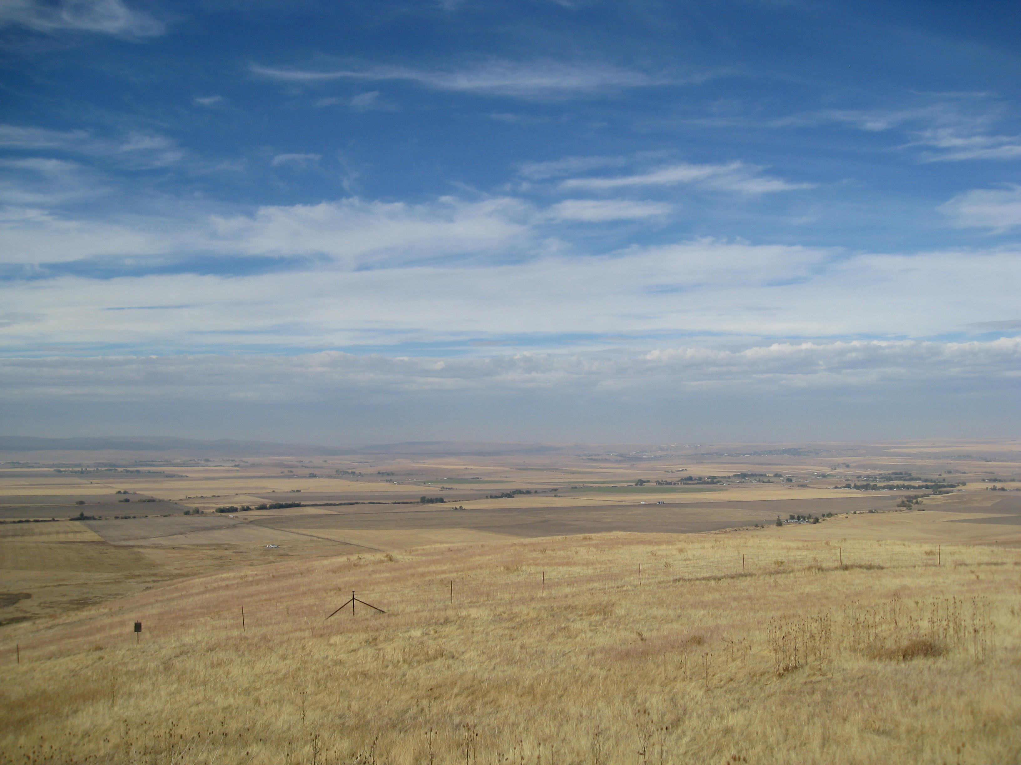
Questions or comments?

