Slide 1
Rule Adoption
Divisions 11, 12 & 200
Leah Feldon, Manager, OCE
Les Carlough, Senior Policy Advisor, OCE
Jenny Root, Environmental Law Specialist & Division 12 Rules Coordinator, OCE
Notes:
Good morning, Chair O’Keefe, Commissioners.
My name is Leah Feldon and I am the manager for the Office of Compliance and Enforcement.
With me today are Les Carlough, Senior Policy Advisor with our office and Jenny Root, Environmental Law Specialist and the Division 12 Rules Coordinator with our office.
This agenda item is a request that the EQC adopt rules related to our enforcement program.
You will remember that we presented an informational item about this rulemaking at your last meeting. At that time we gave you an overview of the enforcement process and explained how this rulemaking fits into the overall enforcement scheme. We also told you about the two advisory committees and public processes we used.
Today, we would like to explain a few of the more important details of the rule changes and will ask you to adopt the rules. First, Jenny will review the changes to parts of the penalty calculation in Divisions 11, 200, and 12. Then Les will go over the changes to the penalty calculations related to spills and three changes made to the proposal following the public notice.

Slide 2

Proposals for Division 11
Align DEQ contested-case procedural rules with the updated Oregon Attorney General Model Rules.
Establish a new fee for onsite septic system program public records requests.
Repeal OAR 340-011-0605 which became obsolete after Measure 49 (2007).
Minor housekeeping changes.
Notes:
Our rulemaking proposal also includes a few updates to Division 11.
Division 11 rules supplement Oregon Attorney General Model Rules that
Outline the contested case hearings process
Outline the process for filing and service of documents
Prescribe DEQ’s process for rulemaking and public records requests
DOJ updated the Attorney General Model Rules earlier this year.
Some of our division 11 rules no longer aligned with the AG model rules for contested cases and filing and service of documents.
Because of that, we are proposing to modify the rules to fix inconsistencies.
Since we are opening those rules and they include other DEQ processes, a few other proposals from other DEQ programs are included.
Meas 37- This rule relates to DEQ Director’s review of claims filed under Meas. 37 for compensation or exemption from environmental laws that reduced the value or use of one’s property. With the later passage of Meas. 49, this rule became obsolete.

Slide 3

Proposal for Division 200
Update the Oregon Clean Air Act State Implementation Plan (SIP) with the proposed new penalty rules as required by EPA under the Clean Air Act
Notes:
Under the Clean Air Act, EPA considers changes to DEQ’s penalty rules to be an update to Oregon’s State Implementation plan under the federal Clean Air Act.
This is a non-substantive technical requirement under the Clean Air Act.

Slide 4
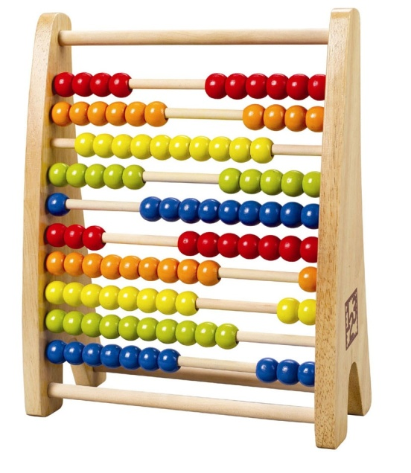
Proposals for Division 12
Increase DEQ’s civil penalties
Align violation classification & magnitudes with DEQ program priorities
Create greater mitigating credit for correcting violations
Adjust mental-state penalty factor
Housekeeping that includes eliminating duplicative text

Slide 5
Penalty Calculation Formula
Penalty = BP + ((0.1 x BP) x (P + H + O + M + C)) + EB
Class
I
II
III
Magnitude
Major
Moderate
Minor
BP from Matrix
$12,000
$8,000
$3,000
$1,000
Aggravating and Mitigating Factors
Prior significant actions (P)
History of correction (H)
Occurrences (O)
Mental state (M)
Correction efforts (C)
Economic
Benefit (EB)
Delayed
Avoided
Determine Class
Determine Magnitude
Determine base penalty (BP) from the applicable matrix
Calculate aggravating and mitigating factors
Add the economic benefit
Notes:
This is the penalty formula and the considerations that go into developing a penalty.
Classifications:
Designations by rule of the importance of the rule to protect human health or the environment
Rules most important to the regulatory structure of the given environmental program
Class I violations have the highest likelihood of harm; Class III violations have the least likelihood
We have added some details to the classification and redistributed some violations in some programs – this is to align the rules with current DEQ priorities
Magnitudes:
Based on the actual or threatened impact to human health and the environment resulting from the particular violation.
Major magnitude violations are those which had the most impact according to the specific facts of the case. Minor magnitude violations had the least impact.
DEQ is proposing minor changes to some of the specified magnitudes and to clarify how a respondent in a contested case could challenge DEQ’s findings on the magnitude.
Once we have the class and magnitude, we find the appropriate matrix. There are four different matrices. The largest, with a top penalty of $12,000 is for the largest and most significant sources. The $8,000 penalty matrix is for medium size entities. The $3,000 penalty matrix is for the smallest entities and the $1000 matrix is mostly for homeowners. Once we identify which matrix applies, we determine the base penalty.

Slide 6

Proposed Matrix Increases
$8,000 matrix increase 50% to $12,000
$6,000 matrix increase 33% to $8,000
$2,500 matrix increase 20% to $3,000
$1,000 matrix remains $1,000

Slide 7
E.g., Proposed $12,000 Matrix
 | Class I | Class II | Class III
Major | $12,000 | $6,000 | $1,000
Moderate | $6,000 | $3,000 | $1,000
Minor | $3,000 | $1,500 | $1,000

Slide 8
Penalty Calculation Formula
Penalty = BP + ((0.1 x BP) x (P + H + O + M + C)) + EB
Class
I
II
III
Magnitude
Major
Moderate
Minor
BP from Matrix
$12,000
$8,000
$3,000
$1,000
Aggravating and Mitigating Factors
Prior significant actions (P)
History of correction (H)
Occurrences (O)
Mental state (M)
Correction efforts (C)
Economic
Benefit (EB)
Delayed
Avoided
Determine Class
Determine Magnitude
Determine base penalty (BP) from the applicable matrix
Calculate aggravating and mitigating factors
Add the economic benefit
Notes:
Next we apply the aggravating and mitigating factors. These include: . . .[Describe PHOMC]
There are a few notable proposed changes to the factors.
Once these numbers are developed, they are computed according to the formula to determine the penalty.
Calculation of per violation, per day.

Slide 9

Mental State Factor
0 if insufficient information.
2 if respondent had constructive knowledge (reasonably should have known) of the requirement.
4 if the respondent was negligent.
8 if the respondent was reckless, or acted or failed to act intentionally with actual knowledge of the requirement.
10 if respondent acted flagrantly.

Slide 10
Efforts-to-Correct Factor
-5 if extraordinary efforts to correct or minimize the effects of the violation and extraordinary efforts to ensure the violation would not be repeated.
-4 if extraordinary efforts to ensure that the violation would not be repeated.
-3 if reasonable efforts to correct the violation or reasonable affirmative efforts to minimize the effects of the violation.
-2 if eventually made some efforts to correct, or to minimize the effects of, the violation.
-1 if reasonable efforts to ensure that the violation would not be repeated.
0 if there is insufficient information to make another finding.
2 if respondent did not address the violation.

Slide 11
Revised Statutory Spill Penalty Maximums
Spill into waters of the state | Pre-bill |  | Post-bill
 | Not Negligent | Negligent | Not Negligent | Negligent
Spill of oil | $10,000 | $20,000 | $25,000 | $100,000
Failure to clean up oil | $10,000 | $10,000 | $25,000 | $100,000
Spill of hazardous material | $10,000 | $10,000 | $25,000 | $100,000
Failure to clean up hazardous material | $10,000 | $10,000 | $25,000 | $100,000
Notes:
Before Senate Bill 105A (2009) any spill violation not caused through negligence or intention was subject to a maximum $10,000 penalty. If the material spilled was oil, and it was spilled into waters of the state, and it was caused negligently or intentionally, the statutes doubled the maximum penalty to $20,000.
The bill created much larger penalties for spills of oil or hazardous materials, and for failure to clean up spills of oil or hazardous materials. If these violations were caused negligently or intentionally, the statutory maximum penalty is now $100,000. This requires a new way of calculating those penalties.

Slide 12
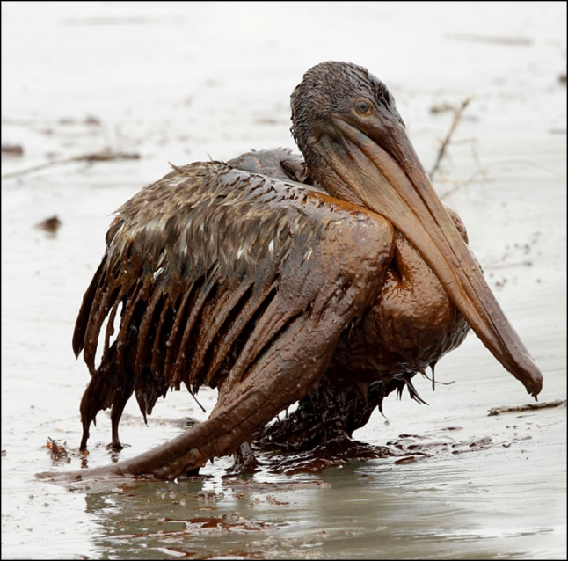
Special Spill Penalty Formula
Determine base penalty as previously described.
Determine multiplier by adding:
  Mental state: 2 points if negligent; 3 points if reckless; or 4 points if intentional with actual knowledge that a violation would occur.
  Hazardousness: 1 point if “hazardous substance” or 2 points if “extremely hazardous substance”
  Volume: 2 points if volume exceeds 1,000 gallons
  Impact: 1 point if impacted sensitive area.
Determine adjusted base penalty by multiplying base penalty by multiplier.
Determine final penalty by applying the formula in OAR 340-012-0045.
Apply additional 10% reduction if party exceeded required precautions.
Notes:
We worked with our advisory committees on a modification of the formula process
Determine base penalty as previously described, based on class and magnitude.
Determine multiplier by adding:
Mental state: 2 points if negligent; 3 points if reckless; or 4 points if intentional with actual knowledge that a violation would occur.
Hazardousness: 1 point if “hazardous substance” or 2 points if “extremely hazardous substance”
Volume: 2 points if volume exceeds 1,000 gallons
Impact: 1 point if impacted sensitive area (as defined in cleanup rules: an area of particular environmental value where a hazardous substance could pose a greater threat than in other non-sensitive areas. Sensitive environments include but are not limited to: ESA critical habitat for federally endangered or threatened species; National Park, Monument, National Marine Sanctuary, National Recreational Area, National Wildlife Refuge, National Forest Campgrounds, recreational areas, game management areas, wildlife management areas; designated federal Wilderness Areas; wetlands (freshwater, estuarine, or coastal); wild and scenic rivers; state parks; state wildlife refuges; habitat designated for state endangered species; fishery resources; state designated natural areas; county or municipal parks; and other significant open spaces and natural resources protected under Goal 5 of Oregon's Statewide Planning Goals.) and drinking water sources, and cultural sites.
Determine adjusted base penalty by multiplying base penalty by multiplier.
Determine final penalty by applying the formula in OAR 340-012-0045.
Apply additional 10% reduction if party exceeded required precautions. (exceeds all relevant DEQ regulations pertaining to spill preparation and takes all other reasonably expected precautions to prevent spills and be prepared for spill response: employee safety training, company policies designed to reduce spill risks, availability of spill response equipment or staff, or use of alternative non-toxic oils.

Slide 13
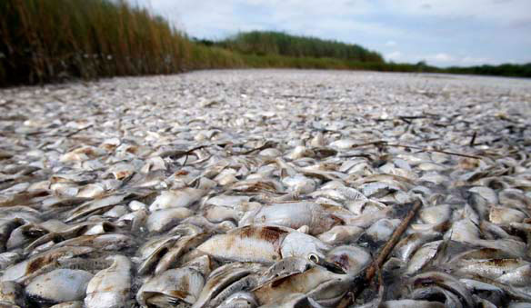
A violation that “creates the imminent likelihood for an extreme hazard to public health or that causes extensive damage to the environment”
1. Determine alternative base penalty:
  $100,000 if done intentionally
  $150,000 if done recklessly
  $200,000 if done flagrantly
2. Apply: BP + [(.1 x BP) (P + H + O + C)] + EB.
Notes:
Another penalty change I want to point out is the increase in penalties for violations that create an imminent likelihood for an extreme hazard to public health or that cause extensive damage to the environment. This penalty is for extraordinary violations only and is rarely used.
To determine these penalties, the rules establish an alternative base penalty which is plugged into this familiar formula.
Adopted before statutory increase of $250K for these violations, the current rules establish a base penalty of $50K if intentional, $75K if reckless, and $100K if flagrant. We are proposing to increase the base penalties to these:

Slide 14
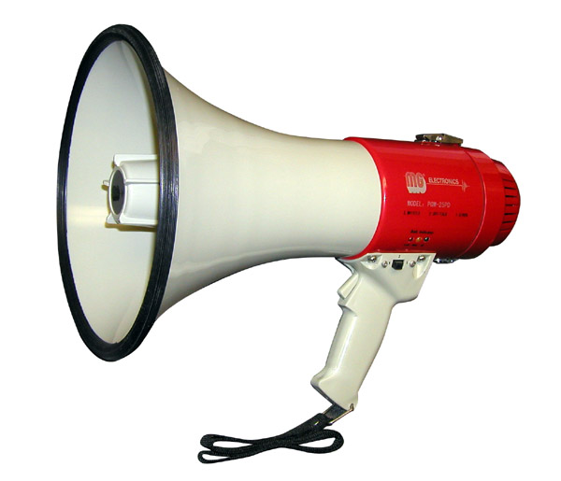
Post Public-Notice Changes
Response to comment – Spills from derelict vessels over 35 feet included in $8,000 matrix of Division 12.
Discussion with Department of Justice – Clarification of lay representative rule in Division 11.
Notes:
4 commentors submitted comments on 10 issues during public notice.
Those comments are summarized in the staff report.

Slide 15
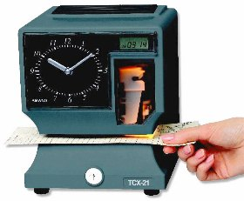
Implementation
Effective date
  – Rules effective upon filing with Secretary of State
  – Applies to occurring violations after filing
Implementation
  Notices to affected parties
  Modify Enforcement guidance
  Train staff

Slide 16
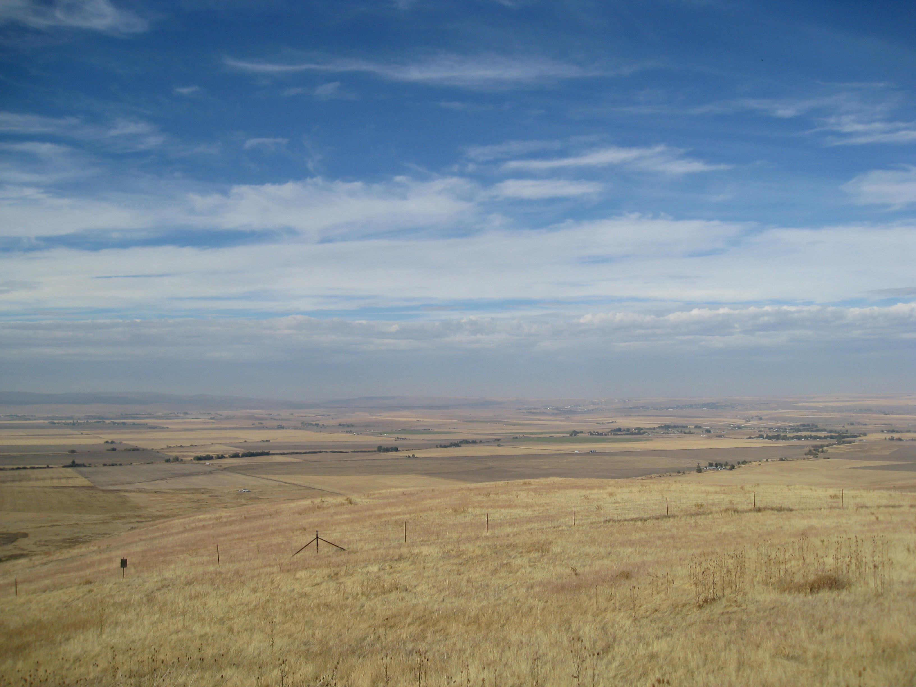
Questions ?

