Slide 1
Action Item: Corrections and Clarifications to Toxics Water Quality Standards Rulemaking EQC Portland Dec. 11-12, 2013
Andrea Matzke, DEQ
Notes:
For the record, my name is Andrea Matzke and I am a WQ Standards Specialist here at DEQ. With me is XXXXX

Slide 2
DEQ’s Recommendation
DEQ recommends that the EQC adopt proposed amendments to Divisions 40 and 41 in Chapter 340 as shown in Attachment A.
These revisions are corrections and clarifications only
They are consistent with DEQ’s current interpretation of how the criteria apply
They do not represent a change in policy.

Slide 3
Why is DEQ Proposing This Rulemaking?
EPA Disapproval: To correct several aquatic life toxics criteria that EQC adopted in 2004 but disapproved on Jan. 31, 2013
Focusing on the straight-forward corrections
Typos and Errors: To correct typos and errors from past toxics rulemakings and to propose additional clarifications
Consolidate Tables: To consolidate 3 aquatic life toxics tables into 1 table.
Notes:
-The Endangered Species Act requires federal agencies to ensure, in consultation with the U.S. Fish and Wildlife Service (USFWS) and the National Marine Fisheries Service (NMFS), depending on threatened & endangered species, that their actions (e.g. approval of DEQ water quality standards) are not likely to jeopardize the continued existence of endangered or threatened species or adversely modify or destroy their designated critical habitats.
-Consultation delays:
-Lengthy discussions between NMFS, USFWS, and EPA about the technical aspects of the consultation and reasonable and prudent alternative
-an environmental group also filed several notices of intent to sue EPA and NMFS over failing to consult in a timely manner
-On Aug. 15, 2012, NMFS found jeopardy to T&E species from Cd, Cu, and NH3
[The U.S. Fish and Wildlife Service (USFWS) completed their Biological Opinion on DEQ’s 2004 aquatic life criteria on July 30, 2012 and did not find jeopardy with OR’s toxics criteria].
-more details on this action in the following slides

Slide 4
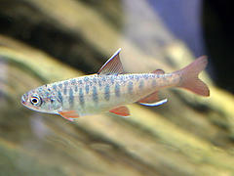
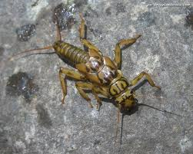
What Are Aquatic Life Toxics Criteria?
Concentrations of pollutant at which aquatic life (such as fish, shellfish and aquatic insects) are protected
Each pollutant can have up to 4 criteria values:
2 values to protect against acute and chronic effects in freshwater
2 values to protect against acute and chronic effects in saltwater
A water quality standard is comprised of a beneficial use, criteria to protect the use, and antidegradation protections
Beneficial Use Protected: Fish and Aquatic Life

Slide 5
What Are Aquatic Life Toxics Criteria?
Aquatic life criteria consist of the following 3 components:
1. Magnitude: numeric value (µg/L)
2. Duration:
Acute (CMC)—1 hour average
Chronic (CCC)—4 day average
3. Frequency: Both acute and chronic numeric values can’t be exceeded more than once every 3 years.
more stringent

Slide 6
Pollutant | Freshwater Acute Criterion (µg/L) CMC | Freshwater Chronic Criterion (µg/L) CCC | Saltwater Acute Criterion (µg/L) CMC | Saltwater Chronic Criterion (µg/L) CCC
PCBs | 2 ^{K} | 0.014^{K} | 10 ^{K} | 0.03 ^{K}
 | ^{K} This criterion applies to total PCBs (e.g. determined as Aroclors or congeners)
selenium | See C, L | 4.6^{C} | 290 ^{C} | 71 ^{C}
 | ^{C} Criterion is expressed in terms of “dissolved” concentrations in the water column. ^{L} The CMC=(1/[(f1/CMC1)+(f2/CMC2)]µg/L) * CF where f1 and f2 are the fractions of total selenium that are treated as selenite and selenate, respectively,and CMC1 and CMC2 are 185.9 μg/L and 12.82 μg/L, respectively. See expanded endnote F for the Conversion Factor (CF) for selenium.

Slide 7
What Criteria Did EPA Disapprove?
11 pesticides
Selenium (freshwater criteria)
Copper (freshwater criteria)
Cadmium (freshwater acute criterion)
Aluminum (freshwater criteria)
Ammonia (freshwater criteria)
Incorrect footnotes and other errors
If disapproved, criteria revert back to criteria last approved by EPA (i.e. Table 20)
Notes:
Cu, Al: EPA disapproved criteria due to inconsistencies associated with EPA’s nationally recommended criteria.
Cd: EPA disapproved the freshwater acute criterion for cadmium based on findings in the National Marine Fisheries Service’s August 2012 Biological Opinion.
Ammonia: EPA disapproved the ammonia criteria because new toxicity data showed that the criteria were not protective of mollusks.
We’re focusing on the straightforward corrections for this rulemaking--Cu, NH3 will likely be addressed next year
NOTE: Al: EPA anticipates publishing proposed criteria for public comment in 2014 (likely have correction factors for pH and hardness). Current EPA criteria from ‘88
Cd: EPA also updating Cd—maybe next year? Further out than Al.

Slide 8

What Other Actions is DEQ Proposing?
Consolidate 3 aquatic life toxics criteria tables into 1 table (and delete references to the 3 tables in DEQ toxics, bacteria and groundwater rules)
Correct miscellaneous errors, clarifications, and formatting changes to toxics tables
Re-adopt arsenic and chromium VI criteria
Correct typos associated with the 2011 human health toxics criteria rulemaking
Delete aluminum from criteria table
Notes:
Housekeeping Items:
-As: FW and SW criteria left off 2007 table. The As and Cr VI criteria re-proposed here are the same criteria that the EQC adopted in 2004.
-Cr VI: SW criteria left off
-Al: Propose to delete Al because the disapproval renders the criteria ineffective and there are no other criteria for aluminum.

Slide 9
Why is DEQ Proposing to Make These Changes Now?
EPA Disapproval Actions:
Clean Water Act requires OR to fix the disapprovals or EPA is required to set criteria for OR
Currently, DEQ has 3 effective toxics criteria tables—confusing to public and DEQ staff
Need to re-adopt the updated arsenic and chromium VI criteria DEQ inadvertently omitted (old criteria in effect now)
Correct typos from past rulemakings
New DEQ table formatting recommendations

Slide 10
Details of Proposed Rules

Slide 11
Correct Criteria for 11 Pesticides
Background:
Frequency and duration components of most of the pesticide criteria are different than the other aquatic pollutants
Most of the pesticide criteria were developed prior to the 1985 EPA Guidelines and were developed with an alternate frequency and duration (i.e. acute can’t be exceeded any time and the chronic can’t be exceeded based on a 24 hr. average)
Notes:
11 pesticides:
aldrin - endrin
BHC gamma (lindane) - heptachlor
chlordane - endosulfan alpha (new—no effective criteria now)
DDT 4,4 - endosulfan beta (new)
dieldrin - heptachlor epoxide (new)
endosufan

Slide 12
Correct Criteria for 11 Pesticides
Problem:
DEQ correctly footnoted these pesticides, but by adding the general frequency and duration to the intro paragraph of the toxic tables, EPA determined that this addition effectively changed the frequency and duration of the pesticides despite the existing footnote.
DEQ Proposes To:
Clarify language in the intro paragraph noting the pesticide frequency and duration exception
Revise the pesticide footnote to read more clearly
Notes:
The following two slides show the proposed revisions.

Slide 13
Excerpt From Intro Paragraph:
“…Unless otherwise noted in the table below, the acute criterion is the Criterion Maximum Concentration (CMC) applied as a one-hour average concentration, and the chronic criterion is the Criterion Continuous Concentration (CCC) applied as a 96-hour (4 days) average concentration. The CMC and CCC criteria should not be exceeded more than once every three years. Footnote A, associated with eleven pesticide pollutants in Table 30, describes the exception to the frequency and duration of the toxics criteria stated in this paragraph.”

Slide 14
Revised Footnote A:
This criterion is based on EPA recommendations issued in 1980 that were derived using guidelines that differed from EPA's 1985 Guidelines which update for minimum data requirements and derivation procedures. . For example, a “CMC” derived using the 1980 Guidelines was derived to be used as an instantaneous maximum. The CMC may not be exceeded at any time and the CCC may not be exceeded based on a 24-hour average. The CMC may be applied If assessment is to be done using anone hour averaging period for a CMC (i.e., a one hour average not to be exceeded more than once every three years, if the CMC values given in Table 30 areshould be divided by 2 to obtain a value that is more comparable to a CMC derived using the 1985 Guidelines.

Slide 15
Correct Selenium Criteria
Problem:
DEQ did not apply conversion factors to the freshwater criteria to convert a total recoverable result to a dissolved expression as intended in 2004
The dissolved form of metal is the more bioavailable or toxic form of a metal
DEQ Proposes To:
Apply the correct conversion factors
Notes:
-Note that EPA is developing new criteria for Se—likely fish tissue criterion and water column translator (expected to go out for public comment in summer 2014)

Slide 16
Re-adopt Arsenic and Chromium VI Criteria
Problem:
DEQ inadvertently omitted aquatic life criteria for arsenic and chromium VI from a toxics criteria table during a 2007 rulemaking.
DEQ proposes to:
Re-adopt freshwater and saltwater criteria for arsenic and saltwater criteria for chromium VI as originally proposed as part of the 2004 rulemaking
Notes:
-DEQ inadvertently omitted the criteria from Table 33B during a 2007 water quality standards rulemaking. The arsenic and chromium VI criteria re-proposed here as part of this rulemaking are the same criteria that the commission adopted in 2004.
- As: Dissolved vs. TR—FW magnitudes changed a bit.
- Cr VI: Dissolved vs. TR—magnitudes did not change
-These criteria underwent Endangered Species Act consultation by the U.S. Fish and Wildlife Service and the National Marine Fisheries Service and were not found to create jeopardy for any ESA-listed species. EPA did not take action on these criteria as part of its action, but noted that the omitted criteria are consistent with EPA’s 304(a) recommendations and recommended that Oregon re-adopt these criteria.

Slide 17
Consolidate Aquatic Life Toxics Tables
Problem:
Currently, there are 3 effective toxics criteria tables—confusing to implement
DEQ Proposes To:
Delete Tables 20, 33A and 33B which contain the aquatic life criteria and replace with consolidated new Table 30
Delete references to Tables 20, 33A and 33B in the Toxics Rule and in the Groundwater and Bacteria Rules, and instead reference aquatic life toxics criteria in Oregon’s Toxics Rule (OAR 340-041-0033) instead of a specific table.
Notes:
-Table 33A contains criteria more stringent or remained the same as previous criteria and became effective for NPDES permitting Feb. 15, 2005.
-Table 33B contains criteria less stringent than previous criteria and therefore, would only be effective after EPA approval.
-Table 20 contains criteria effective before the 2004 rulemaking and remained effective for all CWA programs, such as 303(d) reporting
Therefore, the last 9 years has been challenging for OR and other users of the aquatic life toxics criteria to figure out which criteria are the correct ones to use
➔ GOOD NEWS!

Slide 18
Other Corrections and Clarifications
Correct:
Footnote typos and clarifications in aquatic life criteria tables
Table 33C: Aquatic Life Guidance Values for Toxics
rename Table 33C to Table 31
correct a reference in the intro language
remove arsenic guidance values—regulatory aquatic life criteria already exist
Reference typos in Arsenic Reduction Policy
Table 40: Human Health Toxics
typos
clarified arsenic footnote
corrected a criterion to two significant digits
Formatting in Tables 30, 31 and 40 to reflect current DEQ guidelines
Notes:
Footnotes and Clarifications: included footnotes within table instead of just at end of table; include FW equations for NH3; and developed clearer footnotes for the hardness based FW metals and TR vs. dissolved
Table 33C: AL guidance values—guidance values that can be used in application of OR’s Narrative Toxics Criteria (corrected reference in intro language to toxics narrative). Values originated from EPA 1986 Red Book. [Because there was insufficient data to calculate criteria, the LOEL was used.]
As Reduction Policy: Adopted as part of the HHC rule revisions in 2011. The rule incorrectly references the Arsenic Reduction Policy as section 4, rather than section 7. This error occurred during preparation of the final rule when the Arsenic Reduction Policy was moved from section 4 in the proposed rule to section 7 in the final toxics rule.
Table 40: Corrected several typos for arsenic criteria and revised the estimated cancer risk from 2 significant digits to 1 significant digit per EPA guidance; Corrected bis 2 Chloroethyl Ether to reflect two significant digits to be consistent with the other human health criteria; corrected errors for several other pollutants which didn’t accurately reflect whether there was an ALC for that pollutant.

Slide 19
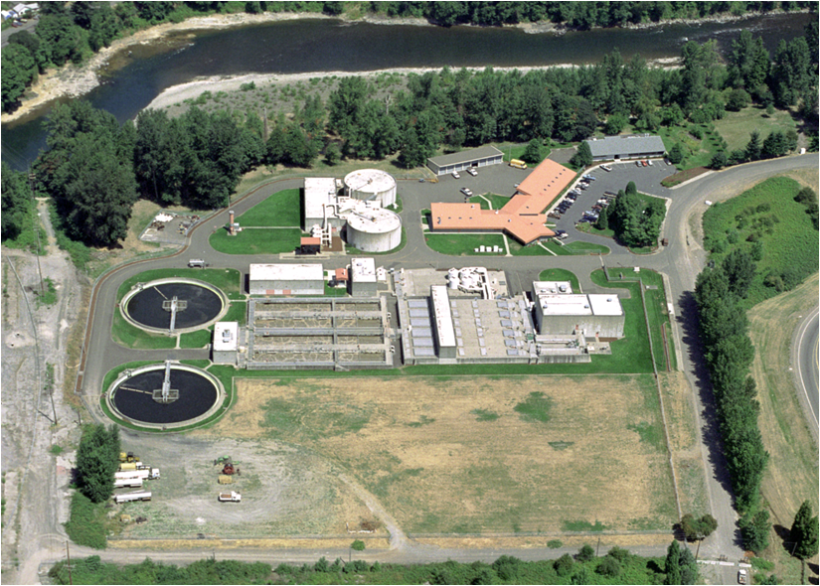
Who’s Potentially Affected?
Large dischargers required to monitor for toxics
“Primary” industrial dischargers
“Major” municipal dischargers
Generally, DEQ does not expect any significant effects from revisions proposed in this rulemaking
Notes:
-Industrial permits have a complex process to determine monitoring requirements based on the industrial category and the potential for toxicity in the receiving waterbody. The monitoring requirements at a specific facility are determined based upon factors such as industrial category, pre-existing permit status, hazardous material present, new source performance standards or permit writer discretion.
-Most, if not all, major wastewater treatment facilities must comply with toxic pollutant monitoring requirements.
-The proposed rules address the pesticide criteria disapprovals by additional clarification of the frequency and duration components of the criteria (i.e. did not change); revisions to the associated numeric values were not required.
-The proposed rules include a correction to the selenium criteria that is slightly more stringent (change from a total recoverable form to the dissolved form), but the fiscal impacts of that change were covered in the 2004 rulemaking.
-This proposal would also readopt freshwater and saltwater criteria for arsenic and saltwater criteria for chromium VI originally adopted by EQC in 2004. DEQ inadvertently omitted these criteria in Table 33B during the 2007 water quality standards rulemaking. Despite this omission, these re-proposed criteria are not considered new water quality criteria for the protection of aquatic life and do not need to undergo an economic analysis because these criteria, like the selenium criteria revisions, were accounted for as part of the 2004 fiscal analysis.
-Some affected parties may need to conduct minor recordkeeping activities to correctly reference the effective aquatic life toxics criteria
Benefits: DEQ anticipates these changes will provide a benefit to DEQ, the public and to entities subject to toxics water quality criteria by reducing confusion about which criteria are effective and by consolidating all effective aquatic life toxics criteria into one table, rather than in the current three tables. Correcting errors that occurred in 2004, 2007 and 2011 rulemakings will also provide greater clarification to users.

Slide 20
Who Helped DEQ Develop this Rulemaking?
Advisory Committee Member | Affiliation
1. Curtis Barton | Clackamas Water Environment Services
2. Dianne Barton | Columbia River Inter-Tribal Fish Commission
3. Kathleen Collins | EPA, Region 10
4. Heath Curtiss | Oregon Forest Industries Council
5. Mike Freese | Oregon Farm Bureau
6. John Ledger (did not attend) | Associated Oregon Industries
7. Kathryn VanNatta | NW Pulp and Paper Association
8. Travis Williams | Willamette Riverkeeper
Notes:
-DEQ established an advisory committee in January 2013 to provide input on this rulemaking’s potential fiscal impacts and benefits. The rulemaking was delayed and then re-initiated in May 2013. DEQ met with the advisory committee on June 25 and July 11, 2013. The committee included eight members representing industrial, municipal, tribal and environmental organizations with an interest in actions related to developing or revising water quality standards for toxic pollutants.

Slide 21
Public Comments
30-day public comment period (Sept. 1 – Sept. 30)
DEQ convened one hearing in Portland on Sept. 18
No attendees
Received two public comments—both supportive
EPA
NW Pulp and Paper Association
One concern was whether EPA would take action on ALL the aquatic life criteria again
NO, only the criteria that changed, as well as the other revisions.

Slide 22
When Will These Proposed Revisions Become Effective?
All proposed revisions to the Toxics Rule will become effective on April 18, 2014 (and after EPA approval)
EPA anticipates reviewing the adopted revisions before April 18.
Proposed revisions to Oregon’s Bacteria and Groundwater Rules would become effective upon EQC adoption and filing with the Secretary of State.
Notes:
-If EPA fails to act on all the criteria by April 18, DEQ can extend the effective date for an additional 180 days by temporary rule.

