Slide 1
Action Item: Corrections and Clarifications to Toxics Water Quality Standards Rulemaking EQC Portland Dec. 11-12, 2013
Andrea Matzke, DEQ
Notes:
Deb will introduce herself and then Andrea

Slide 2
DEQ’s recommendation
DEQ recommends that the EQC adopt proposed amendments to OAR 340, Divisions 40 and 41 in Chapter 340 as shown in Attachment A.
These revisions are corrections and clarifications only
They are consistent with DEQ’s current interpretation of how the criteria apply
They do not represent a change in policy.
DEQ does not anticipate any significant impacts to regulated parties or other stakeholders
Notes:
Potentially impacted: large dischargers
required to monitor for toxics

Slide 3
Why is DEQ proposing this rulemaking?
EPA disapproval of several 2004 aquatic life criteria
Focusing on the straight-forward corrections
Typos, errors, and clarifications
Consolidate toxics criteria tables
Notes:
EPA Disapproval: Correct several aquatic life toxics criteria that EQC adopted in 2004 but EPA disapproved on Jan. 31, 2013
-The Endangered Species Act requires EPA to consult with the U.S. Fish and Wildlife Service and the National Marine Fisheries Service before taking action on state WQS to ensure that the criteria OR proposed do not harm threatened & endangered species or their critical habitats.
-Consultation was very long—9 yrs!: Lengthy discussions between NMFS, USFWS, and EPA about the technical aspects of the consultation and reasonable and prudent alternative
Typos, Errors, Clarifications: correct typos and errors from past toxics rulemakings and to propose additional clarifications (for aquatic life and human health criteria)
Consolidate Tables: To consolidate three aquatic life toxics tables into one table. There is no longer any need to have separate tables.
I will provide **more details on these actions in the following slides, but first would like to provide a bit of background on aquatic life criteria.

Slide 4
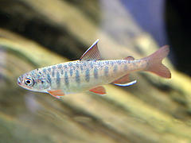
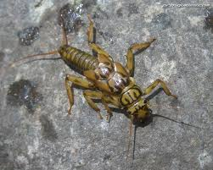
What are aquatic life toxics criteria?
Concentrations of a pollutant at which aquatic life (such as fish, shellfish and aquatic insects) are protected
Toxics criteria are used in wastewater discharge permits, water quality assessments (303(d) list), and the Clean-Up Program
Beneficial use protected: fish and aquatic life
Notes:
-quick review of ALC

Slide 5
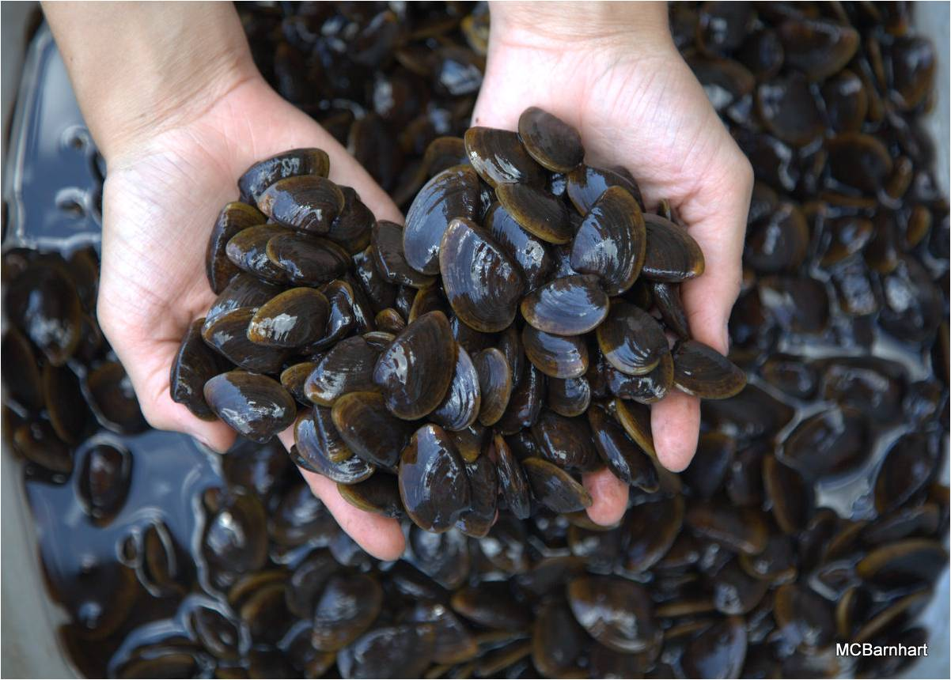
What are aquatic life toxics criteria?
Magnitude
(µg/L)
Frequency
(not to exceed more than once every 3 years)
Duration
(short and long term)
Notes:
Magnitude = concentration of the pollutant
Duration = the time period over which the concentration value is calculated (averaged) to protect against short term (acute) and long term (chronic) impacts to aquatic life
Frequency = how often the concentration value can be exceeded

Slide 6
What criteria did EPA disapprove?
Correct now
11 pesticides
Selenium (freshwater criteria)
Copper (freshwater criteria)
Cadmium (freshwater acute criterion)
Aluminum (freshwater criteria)
Ammonia (freshwater criteria)
Incorrect footnotes and other errors
Correct now
Correct now
Notes:
What EPA disapproved
-For this rulemaking, DEQ decided to address the straight-forward corrections first and combine the rulemaking with included other corrections and clarifications that were needed.
The other disapproved pollutants (those not circled), will be addressed in subsequent rulemakings given the complexities associated with developing revised criteria (e.g. NMFS jeopardy decisions). It is likely that DEQ will begin a review of the Cu and NH3 criteria will be addressed next year.
If any criterion is Because these criteria were disapproved, the criterion reverts back to the previous criteria for these pollutants on last approved by EPA continue to be effective (i.e. Table 20) until revised criteria are approved by EPA. Clean Water Act requires OR to fix the disapprovals or EPA is required to set criteria for Oregon
Put the following on the next slide – “Proposed revisions of disapproved criteria”:
Pesticides: EPA concluded that the frequency and duration associated with these criteria were not correctly, or at least not clearly, defined. Frequency and duration components of most of the pesticide criteria are different than the other aquatic pollutants (i.e. acute can’t be exceeded any time and the chronic can’t be exceeded based on a 24 hr. average). DEQ correctly footnoted these pesticides, but by adding the general frequency and duration to the intro paragraph of the toxic tables, EPA determined that this addition effectively changed the frequency and duration of the pesticides despite the existing footnote. DEQ proposes to clarify the language in the table in the intro paragraph noting the pesticide frequency and duration exception. Will also revise the pesticide footnote to read more clearly. This is not change from how we have interpreted the criteria, but it will now be more clear to the reader.
Selenium: In 2004, DEQ revised most of the metals criteria to be expressed as dissolved rather than total recoverable concentrations. forgot to DEQ erred in calculating factors to the conversion of the freshwater selenium criteria. The conversion factors convert a total recoverable result to a dissolved expression as intended in 2004 The proposed revisions correct this error.
Incorrect footnotes and other errors: EPA disapproved a few of the pollutants because they referred to footnotes that were incorrect. The proposed revisions correct the footnotes.
[On Aug. 15, 2012, NMFS found jeopardy to T&E species from Cd, Cu, and NH3. The U.S. Fish and Wildlife Service (USFWS) completed their Biological Opinion on DEQ’s 2004 aquatic life criteria on July 30, 2012 and did not find jeopardy with OR’s toxics criteria.]

Slide 7
Pesticides:
Revise language in Table 30 to clarify the duration and frequency for 11 pesticide criteria.
Selenium
Speaker note from previous slide
Incorrect footnotes and other errors
Speaker not from previous slide
Notes:
Title – Proposed revisions of disapproved criteria
What do you think?

Slide 8
What other actions is DEQ proposing?
Consolidate toxics criteria tables
Typos, errors, and clarifications
Correct miscellaneous errors, clarifications, and formatting changes to toxics tables
Re-adopt arsenic and chromium VI criteria
2011 human health toxics criteria rulemaking
Table 33C: aquatic life guidance values for toxics
Delete aluminum from criteria table
Notes:
Consolidate Toxics Criteria Tables: The proposed Table 30 consolidates 3 all the effective aquatic life toxics criteria, which are currently contained in 3 different tables, into 1 table (and delete revises the references to the tables in DEQ toxics, bacteria and groundwater rules).
Hopefully won’t need this – back pocket for questions: Table 33A contains criteria more stringent or remained the same as previous criteria and became effective for NPDES permitting Feb. 15, 2005.
-Table 33B contains criteria less stringent than previous criteria and therefore, would only be effective after EPA approval.
-Table 20 contains criteria effective before the 2004 rulemaking and remained effective for all CWA programs, such as 303(d) reporting
Therefore, the last 9 years has been challenging for OR and other users of the aquatic life toxics criteria to figure out which criteria are the correct ones to use
➔ GOOD NEWS!
Arsenic and Chromium VI -FW and SW As criteria and SW Cr VI left off 2007 table in error. The proposed As and Cr VI criteria reinstate re-proposed here are the same criteria that the EQC adopted in 2004. These criteria underwent Endangered Species Act consultation by the U.S. Fish and Wildlife Service and the National Marine Fisheries Service and were not found to create jeopardy for any ESA-listed species. EPA did not take action on these criteria as part of its action, but noted that the omitted criteria are consistent with EPA’s 304(a) recommendations and recommended that Oregon re-adopt these criteria.
HHC Rulemaking: Table 40: typos, clarified arsenic footnote, corrected a criterion to two significant digits (bis 2 Chloroethyl Ether). Also, corrected reference typos in Arsenic Reduction Policy
Table 33C: renamed Table 33C to Table 31; corrected a reference in the intro language; and removed arsenic guidance values—regulatory aquatic life criteria already exist
-Al: Propose to delete Al because the disapproval renders the criteria ineffective for CWA purposes and there were no previous other criteria for aluminum.

Slide 9
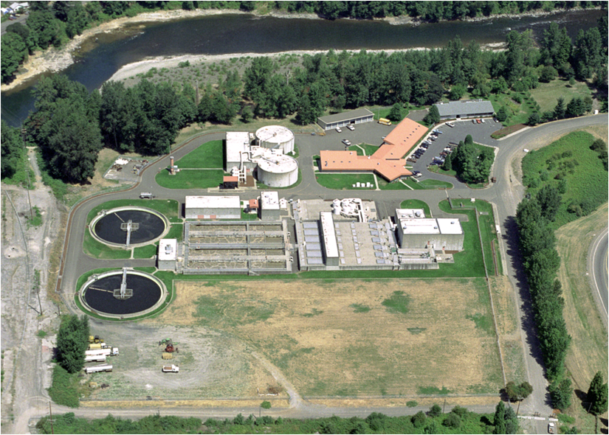
Who’s potentially affected?
Large dischargers required to monitor for toxics
“Primary” industrial dischargers
“Major” municipal dischargers
Generally, DEQ does not expect any significant fiscal or economic effects from revisions proposed in this rulemaking do we need to repeat this here?
how might they be affected?
Notes:
-Industrial permits have a complex process to determine monitoring requirements based on the industrial category and the potential for toxicity in the receiving waterbody. The monitoring requirements at a specific facility are determined based upon factors such as industrial category, pre-existing permit status, hazardous material present, new source performance standards or permit writer discretion.
-Most, if not all, major wastewater treatment facilities must comply with toxic pollutant monitoring requirements.
-The proposed rules address the pesticide criteria disapprovals by additional clarification of the frequency and duration components of the criteria (i.e. did not change); revisions to the associated numeric values were not required.
-The proposed rules include a correction to the selenium criteria that is slightly more stringent (change from a total recoverable form to the dissolved form), but the fiscal impacts of that change were covered in the 2004 rulemaking.
-This proposal would also readopt freshwater and saltwater criteria for arsenic and saltwater criteria for chromium VI originally adopted by EQC in 2004. DEQ inadvertently omitted these criteria in Table 33B during the 2007 water quality standards rulemaking. Despite this omission, these re-proposed criteria are not considered new water quality criteria for the protection of aquatic life and do not need to undergo an economic analysis because these criteria, like the selenium criteria revisions, were accounted for as part of the 2004 fiscal analysis.
-Some affected parties may need to conduct minor recordkeeping activities to correctly reference the effective aquatic life toxics criteria
Benefits: DEQ anticipates these changes will provide a benefit to DEQ, the public and to entities subject to toxics water quality criteria by reducing confusion about which criteria are effective and by consolidating all effective aquatic life toxics criteria into one table, rather than in the current three tables. Correcting errors that occurred in 2004, 2007 and 2011 rulemakings will also provide greater clarification to users.

Slide 10
Who helped DEQ develop this rulemaking?
Advisory Committee Member | Affiliation
1. Curtis Barton | Clackamas Water Environment Services
2. Dianne Barton | Columbia River Inter-Tribal Fish Commission
3. Kathleen Collins | EPA, Region 10
4. Heath Curtiss | Oregon Forest Industries Council
5. Mike Freese | Oregon Farm Bureau
6. Kathryn VanNatta | NW Pulp and Paper Association
7. Travis Williams | Willamette Riverkeeper
Notes:
-DEQ established an advisory committee in January 2013 to provide input on this rulemaking’s potential fiscal impacts and benefits. The rulemaking was delayed and then re-initiated in May 2013. DEQ met with the advisory committee on June 25 and July 11, 2013. The committee included eight members representing industrial, municipal, tribal and environmental organizations with an interest in actions related to developing or revising water quality standards for toxic pollutants.

Slide 11
Public comments
30-day public comment period (Sept. 1 – Sept. 30)
DEQ convened one hearing in Portland on Sept. 18
No attendees
Received two public comments—both supportive
EPA
NW Pulp and Paper Association
One concern was whether EPA would take action on ALL the aquatic life criteria again
NO, only the criteria that changed, as well as the other revisions. What other revisions will EPA act on that are not criteria?

Slide 12
When will these proposed revisions become effective?
All proposed revisions to the Toxics Rule will become effective on April 18, 2014
But cannot be used for CWA purposes if they have not yet been approved by EPA
EPA anticipates reviewing and approving the adopted revisions before April 18.
Proposed revisions to the cross references in Oregon’s Bacteria and Groundwater Rules would become effective upon EQC adoption and filing with the Secretary of State.
Notes:
-If EPA fails to act on all the criteria by April 18, DEQ can extend the effective date for an additional 180 days by temporary rule.

Slide 13
DEQ’s recommendation
DEQ recommends that the EQC adopt proposed amendments to Divisions 40 and 41 in Chapter 340 as shown in Attachment A. (state this the same as in the first slide; Then, please send this to Larry K. to see if he has any suggestions or thinks it’s ok)
These revisions are corrections and clarifications only
They are consistent with DEQ’s current interpretation of how the criteria apply
They do not represent a change in policy.
DEQ does not anticipate any significant impacts
Notes:
DEB—how do we proceed at this point? Does Chair O’Keefe or other commissioner then propose a motion to approve? Just wondering how I transition from this slide to the action. I assume I can ask if anyone has any questions before proceeding?/

Slide 14
Extra slides if needed

Slide 15
Correct Criteria for 11 Pesticides
Background:
Frequency and duration components of most of the pesticide criteria are different than the other aquatic pollutants
Most of the pesticide criteria were developed prior to the 1985 EPA Guidelines and were developed with an alternate frequency and duration (i.e. acute can’t be exceeded any time and the chronic can’t be exceeded based on a 24 hr. average)
Notes:
11 pesticides:
aldrin - endrin
BHC gamma (lindane) - heptachlor
chlordane - endosulfan alpha (new—no effective criteria now)
DDT 4,4 - endosulfan beta (new)
dieldrin - heptachlor epoxide (new)
endosufan

Slide 16
Correct Criteria for 11 Pesticides
Problem:
DEQ correctly footnoted these pesticides, but by adding the general frequency and duration to the intro paragraph of the toxic tables, EPA determined that this addition effectively changed the frequency and duration of the pesticides despite the existing footnote.
DEQ Proposes To:
Clarify language in the intro paragraph noting the pesticide frequency and duration exception
Revise the pesticide footnote to read more clearly
Notes:
The following two slides show the proposed revisions.

Slide 17
Correct Selenium Criteria
Problem:
DEQ did not apply conversion factors to the freshwater criteria to convert a total recoverable result to a dissolved expression as intended in 2004
The dissolved form of metal is the more bioavailable or toxic form of a metal
DEQ Proposes To:
Apply the correct conversion factors
Notes:
-Note that EPA is developing new criteria for Se—likely fish tissue criterion and water column translator (expected to go out for public comment in summer 2014)

Slide 18
Re-adopt Arsenic and Chromium VI Criteria
Problem:
DEQ inadvertently omitted aquatic life criteria for arsenic and chromium VI from a toxics criteria table during a 2007 rulemaking.
DEQ proposes to:
Re-adopt freshwater and saltwater criteria for arsenic and saltwater criteria for chromium VI as originally proposed as part of the 2004 rulemaking
Notes:
-DEQ inadvertently omitted the criteria from Table 33B during a 2007 water quality standards rulemaking. The arsenic and chromium VI criteria re-proposed here as part of this rulemaking are the same criteria that the commission adopted in 2004.
- As: Dissolved vs. TR—FW magnitudes changed a bit.
- Cr VI: Dissolved vs. TR—magnitudes did not change
-These criteria underwent Endangered Species Act consultation by the U.S. Fish and Wildlife Service and the National Marine Fisheries Service and were not found to create jeopardy for any ESA-listed species. EPA did not take action on these criteria as part of its action, but noted that the omitted criteria are consistent with EPA’s 304(a) recommendations and recommended that Oregon re-adopt these criteria.

Slide 19
Consolidate Aquatic Life Toxics Tables
Problem:
Currently, there are 3 effective toxics criteria tables—confusing to implement
DEQ Proposes To:
Delete Tables 20, 33A and 33B which contain the aquatic life criteria and replace with consolidated new Table 30
Delete references to Tables 20, 33A and 33B in the Toxics Rule and in the Groundwater and Bacteria Rules, and instead reference aquatic life toxics criteria in Oregon’s Toxics Rule (OAR 340-041-0033) instead of a specific table.
Notes:
-Table 33A contains criteria more stringent or remained the same as previous criteria and became effective for NPDES permitting Feb. 15, 2005.
-Table 33B contains criteria less stringent than previous criteria and therefore, would only be effective after EPA approval.
-Table 20 contains criteria effective before the 2004 rulemaking and remained effective for all CWA programs, such as 303(d) reporting
Therefore, the last 9 years has been challenging for OR and other users of the aquatic life toxics criteria to figure out which criteria are the correct ones to use
➔ GOOD NEWS!

Slide 20
Other Corrections and Clarifications
Correct:
Footnote typos and clarifications in aquatic life criteria tables
Table 33C: Aquatic Life Guidance Values for Toxics
rename Table 33C to Table 31
correct a reference in the intro language
remove arsenic guidance values—regulatory aquatic life criteria already exist
Reference typos in Arsenic Reduction Policy
Table 40: Human Health Toxics
typos
clarified arsenic footnote
corrected a criterion to two significant digits
Formatting in Tables 30, 31 and 40 to reflect current DEQ guidelines
Notes:
Footnotes and Clarifications: included footnotes within table instead of just at end of table; include FW equations for NH3; and developed clearer footnotes for the hardness based FW metals and TR vs. dissolved
Table 33C: AL guidance values—guidance values that can be used in application of OR’s Narrative Toxics Criteria (corrected reference in intro language to toxics narrative). Values originated from EPA 1986 Red Book. [Because there was insufficient data to calculate criteria, the LOEL was used.]
As Reduction Policy: Adopted as part of the HHC rule revisions in 2011. The rule incorrectly references the Arsenic Reduction Policy as section 4, rather than section 7. This error occurred during preparation of the final rule when the Arsenic Reduction Policy was moved from section 4 in the proposed rule to section 7 in the final toxics rule.
Table 40: Corrected several typos for arsenic criteria and revised the estimated cancer risk from 2 significant digits to 1 significant digit per EPA guidance; Corrected bis 2 Chloroethyl Ether to reflect two significant digits to be consistent with the other human health criteria; corrected errors for several other pollutants which didn’t accurately reflect whether there was an ALC for that pollutant.

