Slide 1
Action Item: Corrections and Clarifications to Toxics Water Quality Standards EQC Portland Dec. 11-12, 2013
Andrea Matzke, DEQ
Notes:
Deb will introduce herself and then Andrea

Slide 2
DEQ’s recommendation
DEQ recommends that the EQC adopt proposed amendments to OAR 340, Divisions 40 and 41 as shown in Attachment A.
These revisions are corrections and clarifications only
Do not represent significant criteria revisions
Do not represent a change in policy
Clarifies interpretation of toxics criteria
DEQ does not anticipate any significant impacts to regulated parties or other stakeholders
Notes:
Good afternoon. Chair O’Keefe, commissioners, My name is Andrea Matzke and I’m here today to present DEQ’s recommendations to adopt revisions to Divisions 40 and 41. These amendments propose revisions to mainly the Toxics Substances Rule, but also touch on the Groundwater and Bacteria Rules. (Read next two bullets). I’ll provide more information on the last bullet towards the end of my presentation.

Slide 3
Why is DEQ proposing this rulemaking?
EPA disapproval of several 2004 aquatic life criteria
Focusing on the straight-forward corrections
Typos, errors, and clarifications
Consolidate toxics criteria tables
Notes:
EPA Disapproval: On Jan. 31, 2013 EPA disapproved a number of aquatic life toxics criteria that EQC adopted in 2004. DEQ is proposing to correct several of these pollutants where the remedies are very straight forward. The main reason it took so long for EPA to take action on the criteria (9 yrs!) was the result of their consultation responsibilities under the Endangered Species Act.
The Endangered Species Act requires EPA to consult with the U.S. Fish and Wildlife Service and the National Marine Fisheries Service before taking action on state WQS to ensure that the criteria Oregon proposed do not harm threatened & endangered species or their critical habitats. There were numerous discussions between the Services and EPA about the technical aspects of the consultation, as well as what the remedies would be. As noted, we’ll be focusing on the more straight-forward corrections which I’ll describe later in my presentation.
Typos, Errors, Clarifications: There are also a number of typos and errors from past toxics rulemakings to correct, and additional clarifications proposed in this rulemaking.
Consolidate Tables: Lastly, there are 3 currently effective aquatic life toxics tables. DEQ is proposing to consolidate the 3 tables into one table.
**I will provide more details on these actions in the following slides, but first want to give you a quick review of what aquatic life criteria are

Slide 4
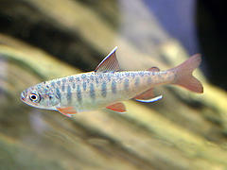
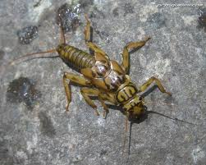
What are aquatic life toxics criteria?
Concentrations of a pollutant at which aquatic life (such as fish, shellfish and aquatic insects) are protected
Toxics criteria are used in wastewater discharge permits, water quality assessments (303(d) list), TMDLs, and the Cleanup Program
Beneficial use protected: fish and aquatic life
Notes:
-quick review of ALC—don’t go into any details here.

Slide 5
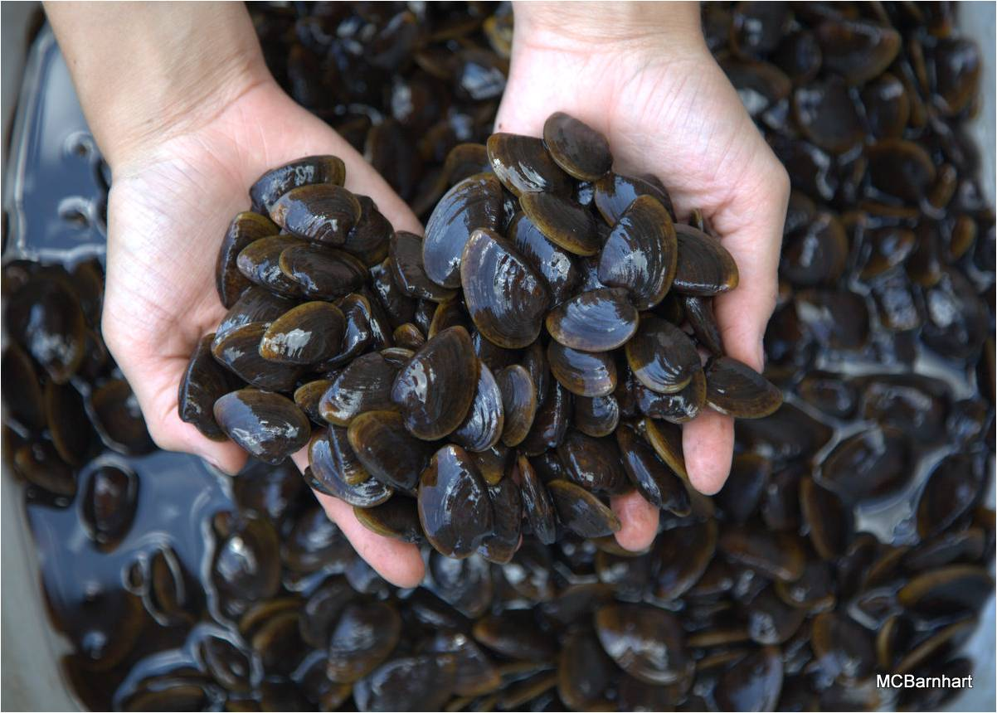
What are aquatic life toxics criteria?
Magnitude
(µg/L)
Frequency
(not to exceed more than once every 3 years)
Duration
(short and long term)
Notes:
Magnitude = concentration of the pollutant
Duration = the time period over which the concentration value is calculated (averaged) to protect against short term (acute) and long term (chronic) impacts to aquatic life
Frequency = how often the concentration value can be exceeded. So, for the majority of ALC, the magnitudes/concentrations associated w/ short and long term exposure periods, cannot be exceeded more than once every 3 years.
* Note that the pesticide corrections in this rulemaking that I’ll shortly be discussing are based on an unclear reading of the duration and frequency components of a WQ criterion.

Slide 6
What criteria did EPA disapprove?
Correct now
11 pesticides
Selenium (freshwater criteria)
Copper (freshwater criteria)
Cadmium (freshwater acute criterion)
Aluminum (freshwater criteria)
Ammonia (freshwater criteria)
Incorrect footnotes and other errors
Correct now
Correct now
Notes:
-There were a number of criteria EPA disapproved in their action. For this rulemaking, DEQ decided to address the straight-forward corrections first and combine the rulemaking with other corrections and clarifications that were needed. **SHOW CIRCLED POLLUTANTS** I’ll provide more information on the pesticide and selenium revisions in the next slide.
Incorrect footnotes and other errors: A few of the pollutants were footnoted incorrectly. Some of the other errors are not relevant anymore since DEQ is correcting the errors by combining toxics tables.
-The other pollutants will be addressed in subsequent rulemakings given the complexities associated with developing revised criteria (e.g. NMFS jeopardy decisions). Again we didn’t want to delay and potentially confuse these complex issues with the straight-forward corrections proposed in this rulemaking. As you are probably aware, the Clean Water Act requires OR to fix the disapprovals or EPA is required to set criteria for Oregon. Therefore, it is likely that DEQ will begin a review of Cu and NH3 criteria next year. EPA is currently developing revised criteria for Cd and Al.
-In the interim, for these disapproved criteria, the criteria revert back to the criteria last approved by EPA (i.e. Table 20).
[On Aug. 15, 2012, NMFS found jeopardy to T&E species from Cd, Cu, and NH3. The U.S. Fish and Wildlife Service (USFWS) completed their Biological Opinion on DEQ’s 2004 aquatic life criteria on July 30, 2012 and did not find jeopardy with OR’s toxics criteria.]
[EPA approved 38 criteria assoc. w/ 14 pollutants, and disapproved 45 criteria associated w/ 16 pollutants—Rulemaking will correct 38 disapproved criteria]

Slide 7
Proposed revisions of disapproved criteria
Pesticides
Revise language in Table 30 to clarify criteria duration and frequency for 11 pesticides
Selenium
Apply conversion factors to express the freshwater criteria as dissolved
The change in criteria is very small
Notes:
Pesticides: Frequency and duration components of most of the pesticide criteria are different than the other aquatic pollutants. DEQ had correctly footnoted these pesticides to clarify the different frequency and duration, but in 2004, DEQ added the general frequency and duration language that applies to all the other pollutants to the intro paragraph of the toxic tables. EPA determined that this addition effectively changed the frequency and duration of the pesticides despite the existing footnote. Therefore, DEQ is proposing to add one sentence to the intro paragraph noting the pesticide frequency and duration exception. This will address the disapproval of 36 pesticide criteria. DEQ will also revise the pesticide footnote to read more clearly. This is not a change from how we have interpreted the criteria, but it will now be more clear to the reader.
(i.e. acute can’t be exceeded any time and the chronic can’t be exceeded based on a 24 hr. average)
Selenium: In 2004, most of the metals changed from a total recoverable expression to a dissolved expression. DEQ erred in calculating the FW criteria for Se by omitting the conversion factors. The conversion factors convert a total recoverable result to a dissolved expression as intended in 2004. The proposed Se criteria now correctly reflect a dissolved criteria expression. [CMC CF=0.996 and CCC CF=0.922]

Slide 8
What other actions is DEQ proposing?
Consolidate toxics criteria tables
Typos, errors, and clarifications
Correct miscellaneous errors, clarifications, formatting changes to toxics tables, and minor corrections to the 2011 human health toxics rulemaking
Re-adopt arsenic and chromium VI criteria
Delete aluminum from criteria table
No replacement criteria
Notes:
Consolidate Toxics Criteria Tables: DEQ proposes to consolidate 3 aquatic life toxics criteria tables into 1 table (Table 30) and delete references to Tables 20, 33A, and 33B in DEQ toxics, bacteria and groundwater rules. The tables were separated as part of the 2004 rulemaking to show which criteria were and were not effective until EPA approval. Now that EPA has taken action, there is no longer a need to separate criteria into 3 different tables.
The last 9 years has been challenging for OR and other users of the aquatic life toxics criteria to figure out which criteria are the correct ones to use
➔ GOOD NEWS! Toxics are complicated---we don’t need to add additional complexity!
[-Table 33A contains criteria more stringent or remained the same as previous criteria and became effective for NPDES permitting Feb. 15, 2005.
-Table 33B contains criteria less stringent than previous criteria and therefore, would only be effective after EPA approval.
-Table 20 contains criteria effective before the 2004 rulemaking and remained effective for all CWA programs, such as 303(d) reporting ]
Arsenic and Chromium VI -FW and SW As criteria and SW Cr VI criteria were inadvertently left off Table 33B as part of a 2007 rulemaking. The As and Cr VI criteria reinstate the same criteria that the EQC adopted in 2004. These criteria underwent Endangered Species Act consultation by the U.S. Fish and Wildlife Service and the National Marine Fisheries Service and were not found to create jeopardy for any ESA-listed species. EPA did not take action on these criteria as part of its action, but noted that the omitted criteria are consistent with EPA’s 304(a) recommendations and recommended that Oregon re-adopt these criteria.
Al: Propose to delete Al because the disapproval renders the criteria ineffective and there are no previous criteria for aluminum.
[HHC Rulemaking: Table 40: typos, clarified arsenic footnote, corrected a criterion to two significant digits (bis 2 Chloroethyl Ether). Also, corrected reference typos in Arsenic Reduction Policy]
[Table 33C: renamed Table 33C to Table 31; corrected a reference in the intro language; and removed arsenic guidance values—regulatory aquatic life criteria already exist]

Slide 9
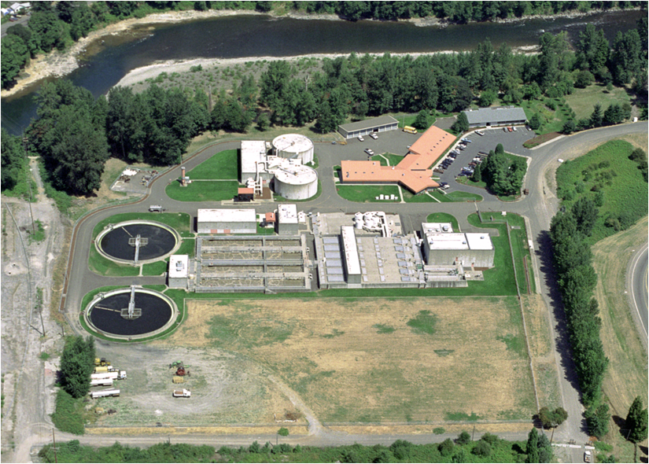
Who’s potentially affected?
Large dischargers required to monitor for toxics
“Primary” industrial dischargers
“Major” municipal dischargers
Generally, DEQ does not expect any significant fiscal or economic effects from revisions proposed in this rulemaking
Notes:
-Advisory committee members for this rulemaking agreed that the fiscal and economic impacts to the regulated community was minimal, if any. Some affected parties may need to conduct minor recordkeeping activities to correctly reference the effective aquatic life toxics criteria
Benefits: DEQ anticipates these changes will provide a benefit to DEQ, the public and to entities subject to toxics water quality criteria by reducing confusion about which criteria are effective and by consolidating all effective aquatic life toxics criteria into one table, rather than in the current three tables. Correcting errors that occurred in 2004, 2007 and 2011 rulemakings will also provide greater clarification to users.
[Industrial permits have a complex process to determine monitoring requirements based on the industrial category and the potential for toxicity in the receiving waterbody. The monitoring requirements at a specific facility are determined based upon factors such as industrial category, pre-existing permit status, hazardous material present, new source performance standards or permit writer discretion. Most, if not all, major wastewater treatment facilities must comply with toxic pollutant monitoring requirements.]
[The proposed rules address the pesticide criteria disapprovals by additional clarification of the frequency and duration components of the criteria (i.e. did not change); revisions to the associated numeric values were not required. The proposed rules include a correction to the selenium criteria that is slightly more stringent (change from a total recoverable form to the dissolved form), but the fiscal impacts of that change were covered in the 2004 rulemaking. This proposal would also readopt freshwater and saltwater criteria for arsenic and saltwater criteria for chromium VI originally adopted by EQC in 2004. DEQ inadvertently omitted these criteria in Table 33B during the 2007 water quality standards rulemaking. Despite this omission, these re-proposed criteria are not considered new water quality criteria for the protection of aquatic life and do not need to undergo an economic analysis because these criteria, like the selenium criteria revisions, were accounted for as part of the 2004 fiscal analysis.]

Slide 10
Who helped DEQ develop this rulemaking?
Advisory Committee Member | Affiliation
1. Curtis Barton | Clackamas Water Environment Services
2. Dianne Barton | Columbia River Inter-Tribal Fish Commission
3. Kathleen Collins | EPA, Region 10
4. Heath Curtiss | Oregon Forest Industries Council
5. Mike Freese | Oregon Farm Bureau
6. Kathryn VanNatta | NW Pulp and Paper Association
7. Travis Williams | Willamette Riverkeeper
Notes:
-DEQ established an advisory committee in January 2013 to provide input on this rulemaking’s potential fiscal impacts and benefits. The rulemaking was delayed and then re-initiated in May 2013. DEQ met with the advisory committee on June 25 and July 11, 2013. The committee included eight members representing industrial, municipal, tribal and environmental organizations. All the Advisory Committee materials and meeting minutes are posted to DEQ’s website.

Slide 11
Public comments
30-day public comment period (Sept. 1 – Sept. 30)
DEQ convened one hearing in Portland on Sept. 18
No attendees
Received two public comments—both supportive
EPA
NW Pulp and Paper Association
One concern was whether EPA would take action on ALL the aquatic life criteria again
NO, only the criteria that change.
Notes:
-EPA has indicated that their action on non-substantive changes to previously approved criteria would not constitute an action on the underlying previously approved criteria.
-EPA will review all proposed changes, but not all revisions are considered WQS

Slide 12
When will these proposed revisions become effective?
All proposed revisions to the Toxics Rule will become effective on April 18, 2014 (and after EPA approval)
EPA anticipates reviewing and approving the adopted revisions before April 18.
Proposed cross-reference revisions to Oregon’s Bacteria and Groundwater Rules become effective upon EQC adoption and filing with the Secretary of State.
Notes:
-DEQ determined the effective date in consultation with EPA. EPA has 90 days to take action on OR’s revised criteria.
-no ESA consultation is required—already done.
-EPA worked closely w/ DEQ on this rulemaking, so we are anticipating prompt EPA approval
-If EPA fails to act on all the criteria by April 18, DEQ can extend the effective date for an additional 180 days by temporary rule.

Slide 13
DEQ’s recommendation
DEQ recommends that the EQC adopt proposed amendments to OAR 340, Divisions 40 and 41 as shown in Attachment A.
Notes:
This is the conclusion of DEQ’s formal presentation on this proposed rule. We would be happy to answer any questions the commissioners may have.

Slide 14
Extra slides if needed

Slide 15
Correct Criteria for 11 Pesticides
Background:
Frequency and duration components of most of the pesticide criteria are different than the other aquatic pollutants
Most of the pesticide criteria were developed prior to the 1985 EPA Guidelines and were developed with an alternate frequency and duration (i.e. acute can’t be exceeded any time and the chronic can’t be exceeded based on a 24 hr. average)
Notes:
11 pesticides:
aldrin - endrin
BHC gamma (lindane) - heptachlor
chlordane - endosulfan alpha (new—no effective criteria now)
DDT 4,4 - endosulfan beta (new)
dieldrin - heptachlor epoxide (new)
endosufan

Slide 16
Correct Criteria for 11 Pesticides
Problem:
DEQ correctly footnoted these pesticides, but by adding the general frequency and duration to the intro paragraph of the toxic tables, EPA determined that this addition effectively changed the frequency and duration of the pesticides despite the existing footnote.
DEQ Proposes To:
Clarify language in the intro paragraph noting the pesticide frequency and duration exception
Revise the pesticide footnote to read more clearly
Notes:
The following two slides show the proposed revisions.

Slide 17
Correct Selenium Criteria
Problem:
DEQ did not apply conversion factors to the freshwater criteria to convert a total recoverable result to a dissolved expression as intended in 2004
The dissolved form of metal is the more bioavailable or toxic form of a metal
DEQ Proposes To:
Apply the correct conversion factors
Notes:
-Note that EPA is developing new criteria for Se—likely fish tissue criterion and water column translator (expected to go out for public comment in summer 2014)

Slide 18
Re-adopt Arsenic and Chromium VI Criteria
Problem:
DEQ inadvertently omitted aquatic life criteria for arsenic and chromium VI from a toxics criteria table during a 2007 rulemaking.
DEQ proposes to:
Re-adopt freshwater and saltwater criteria for arsenic and saltwater criteria for chromium VI as originally proposed as part of the 2004 rulemaking
Notes:
-DEQ inadvertently omitted the criteria from Table 33B during a 2007 water quality standards rulemaking. The arsenic and chromium VI criteria re-proposed here as part of this rulemaking are the same criteria that the commission adopted in 2004.
- As: Dissolved vs. TR—FW magnitudes changed a bit.
- Cr VI: Dissolved vs. TR—magnitudes did not change
-These criteria underwent Endangered Species Act consultation by the U.S. Fish and Wildlife Service and the National Marine Fisheries Service and were not found to create jeopardy for any ESA-listed species. EPA did not take action on these criteria as part of its action, but noted that the omitted criteria are consistent with EPA’s 304(a) recommendations and recommended that Oregon re-adopt these criteria.

Slide 19
Consolidate Aquatic Life Toxics Tables
Problem:
Currently, there are 3 effective toxics criteria tables—confusing to implement
DEQ Proposes To:
Delete Tables 20, 33A and 33B which contain the aquatic life criteria and replace with consolidated new Table 30
Delete references to Tables 20, 33A and 33B in the Toxics Rule and in the Groundwater and Bacteria Rules, and instead reference aquatic life toxics criteria in Oregon’s Toxics Rule (OAR 340-041-0033) instead of a specific table.
Notes:
-Table 33A contains criteria more stringent or remained the same as previous criteria and became effective for NPDES permitting Feb. 15, 2005.
-Table 33B contains criteria less stringent than previous criteria and therefore, would only be effective after EPA approval.
-Table 20 contains criteria effective before the 2004 rulemaking and remained effective for all CWA programs, such as 303(d) reporting
Therefore, the last 9 years has been challenging for OR and other users of the aquatic life toxics criteria to figure out which criteria are the correct ones to use
➔ GOOD NEWS!

Slide 20
Other Corrections and Clarifications
Correct:
Footnote typos and clarifications in aquatic life criteria tables
Table 33C: Aquatic Life Guidance Values for Toxics
rename Table 33C to Table 31
correct a reference in the intro language
remove arsenic guidance values—regulatory aquatic life criteria already exist
Reference typos in Arsenic Reduction Policy
Table 40: Human Health Toxics
typos
clarified arsenic footnote
corrected a criterion to two significant digits
Formatting in Tables 30, 31 and 40 to reflect current DEQ guidelines
Notes:
Footnotes and Clarifications: included footnotes within table instead of just at end of table; include FW equations for NH3; and developed clearer footnotes for the hardness based FW metals and TR vs. dissolved
Table 33C: AL guidance values—guidance values that can be used in application of OR’s Narrative Toxics Criteria (corrected reference in intro language to toxics narrative). Values originated from EPA 1986 Red Book. [Because there was insufficient data to calculate criteria, the LOEL was used.]
As Reduction Policy: Adopted as part of the HHC rule revisions in 2011. The rule incorrectly references the Arsenic Reduction Policy as section 4, rather than section 7. This error occurred during preparation of the final rule when the Arsenic Reduction Policy was moved from section 4 in the proposed rule to section 7 in the final toxics rule.
Table 40: Corrected several typos for arsenic criteria and revised the estimated cancer risk from 2 significant digits to 1 significant digit per EPA guidance; Corrected bis 2 Chloroethyl Ether to reflect two significant digits to be consistent with the other human health criteria; corrected errors for several other pollutants which didn’t accurately reflect whether there was an ALC for that pollutant.

