Slide 1
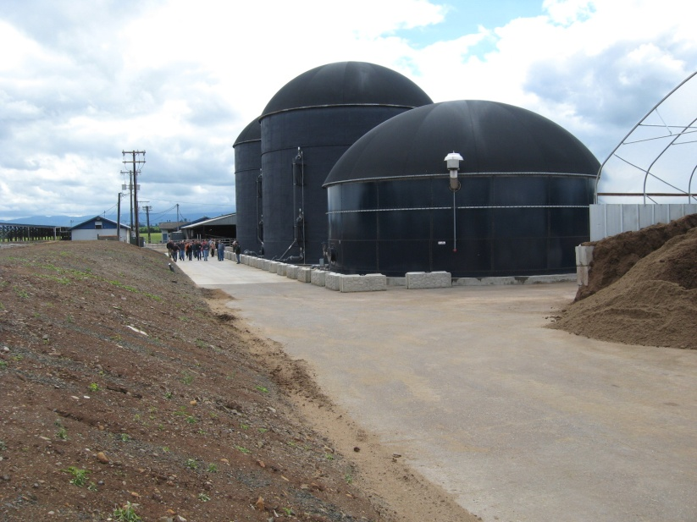
Conversion Technologies
What are CT Facilities?
CT facilities convert “selected” solid wastes into useful products, chemicals and fuels like methane (syngases), fuel oils and biodiesel; often used to produce energy.
Technologies:
  Anaerobic Digestion
  Gasification
  Pyrolysis
  Hydrolysis
  Thermal depolymerization
  Esterification
  Transesterification

Slide 2
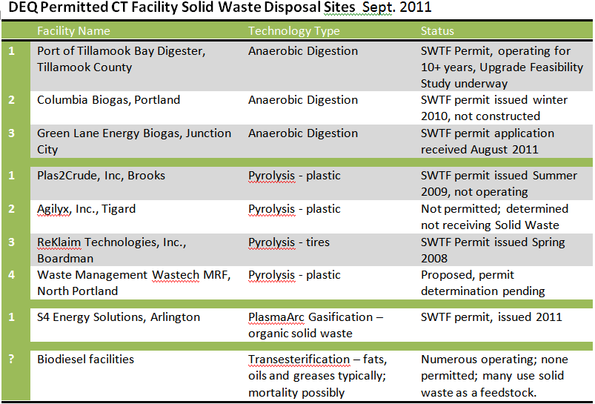
Conversion Technologies
Has DEQ permitted any CT Facilities?

Slide 3
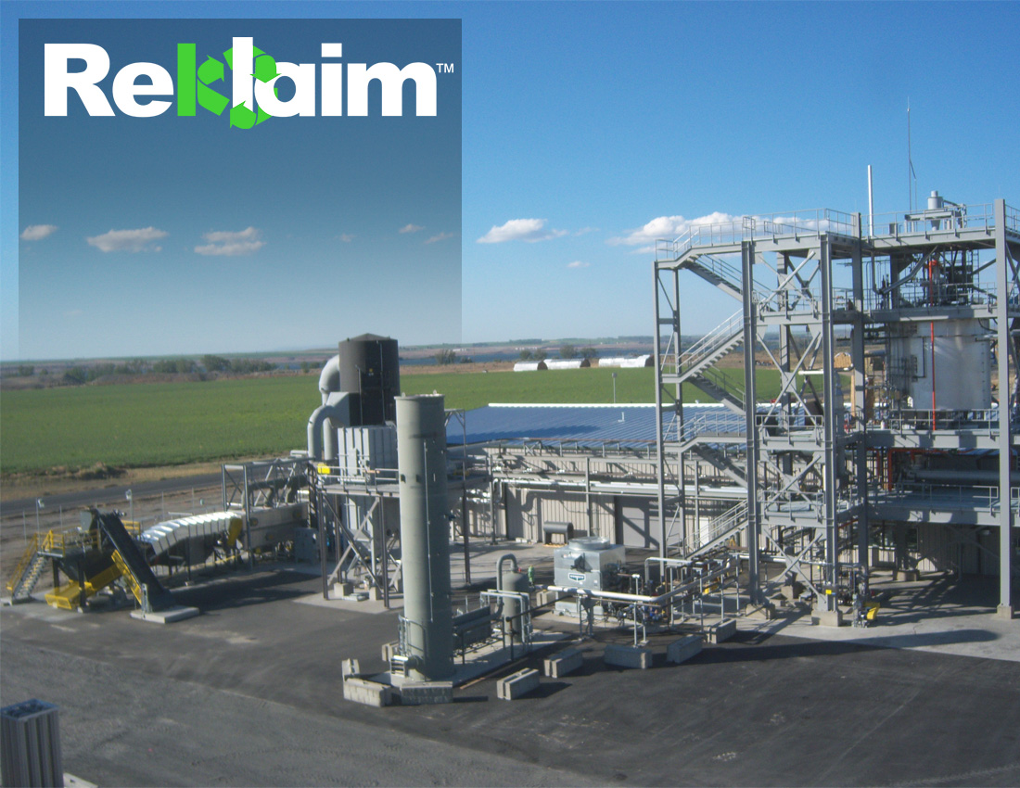
Facility located at the Port of Morrow in Boardman, Oregon (Corp. HQ in Bellevue, Washington)
$50 million tire reclamation facility
Each facility employs approximately 40 FTE
“Ripple effect” creates ~80 jobs in other industries such as construction, transportation, etc.
Reklaim Technologies, Inc.
C O N F I D E N T I A L

Slide 4
Conversion Technologies
Thermal Processing
Heated to 850 degrees Fahrenheit
In oxygen deprived atmosphere
Breaks rubber molecule bonds
Forms gases, carbon and mineral residues

Slide 5
Conversion Technologies
Liquid Products
Gases condensed into #4 heating oil
Oil stored in 25,000 gallon tanks
Transferred from tanks to tanker trucks and transported to markets

Slide 6
Conversion Technologies
Required the oil to be tested using TCLP
The condensed oil from the process passed TCLP but had:
Flashpoint of 70º F
Benzene above 0.5 mg/L

Slide 7
Conversion Technologies
Enter Section 5 of TSCA
The program functions as a "gatekeeper" that can identify conditions, up to and including a ban on production, to be placed on the use of a new chemical before it is entered into commerce.
Chemicals need to be added to the TSCA inventory of chemicals used in commerce through the issuance of a pre-manufacturing notice.

Slide 8
Conversion Technologies
Enter Section 5 of TSCA
Substances on the TSCA Inventory are considered "existing" chemicals in U.S. commerce (i.e. available for sale to the general public)

Slide 9
Conversion Technologies
§ 720.22 Persons who must report
(a)(1) Any person who intends to manufacture a new chemical substance in the United States for commercial purposes must submit a notice unless the substance is excluded under § 720.30.

Slide 10
Conversion Technologies
EPA recently approved the carbon black produced by ReKlaim for inclusion on the TSCA Inventory
Oil was not going to be approved so they withdrew their application

Slide 11
Conversion Technologies
In March, 29,000 gallons of hazardous waste was sent to a boiler and industrial furnace in Kansas

Slide 12
Conversion Technologies
Recent pilot produced oil with a flashpoint of 180-200 degrees Fahrenheit
Received a PMN for their oil

Slide 13
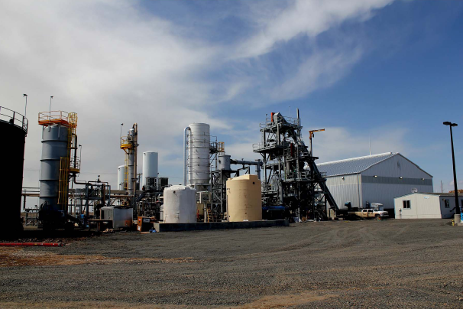
Conversion Technologies
S4 Energy Plasma Arc Gasification Facility

Slide 14
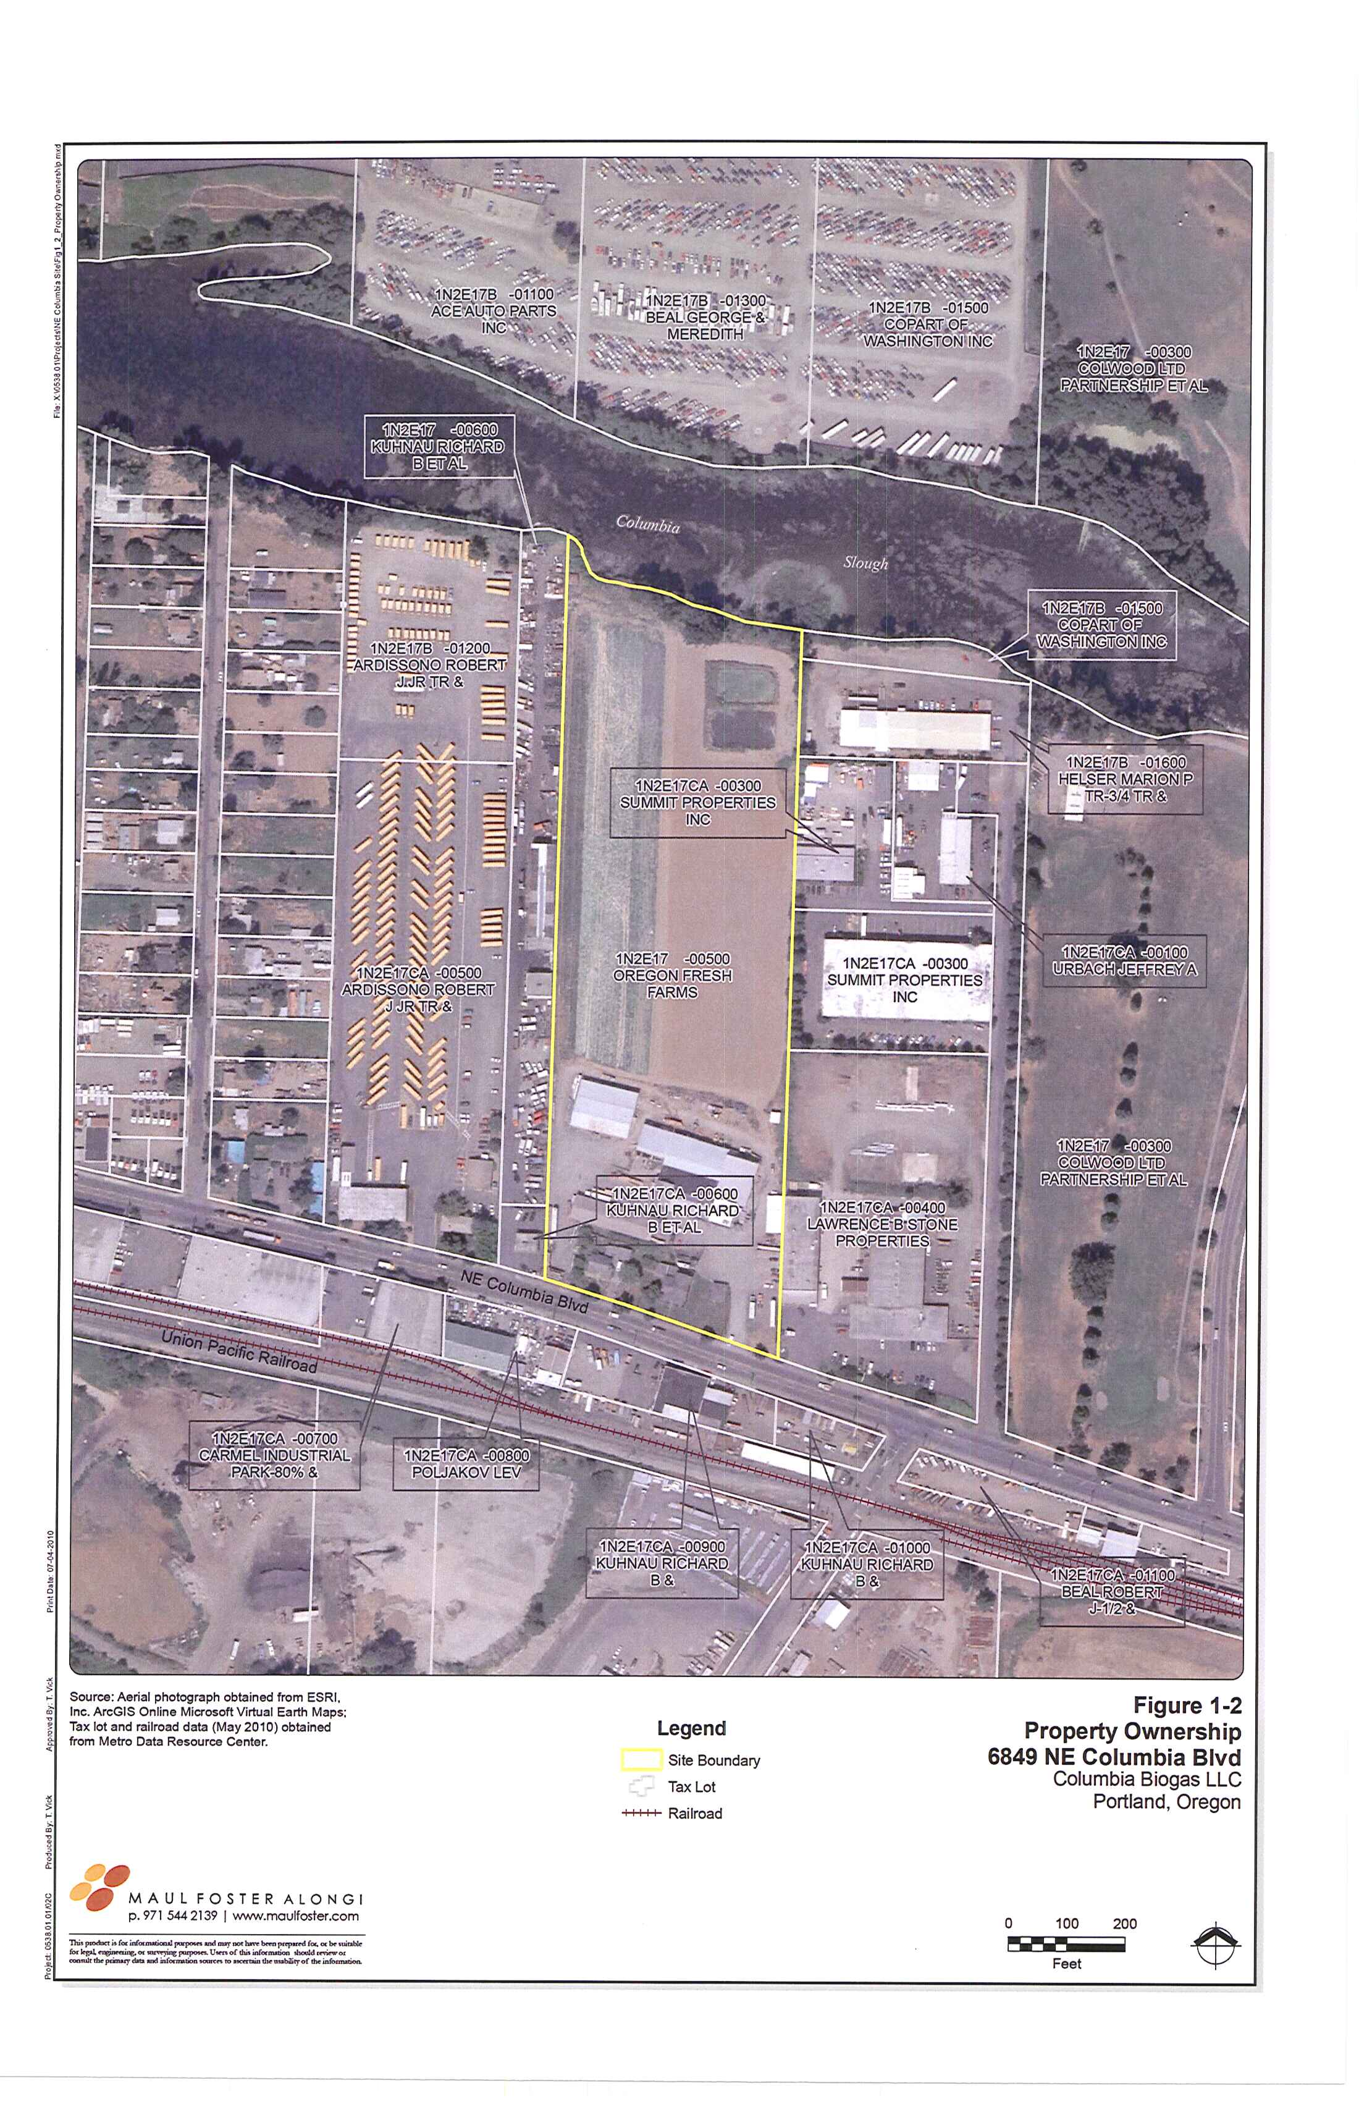
Conversion Technologies
Columbia Biogas: Site Map

Slide 15
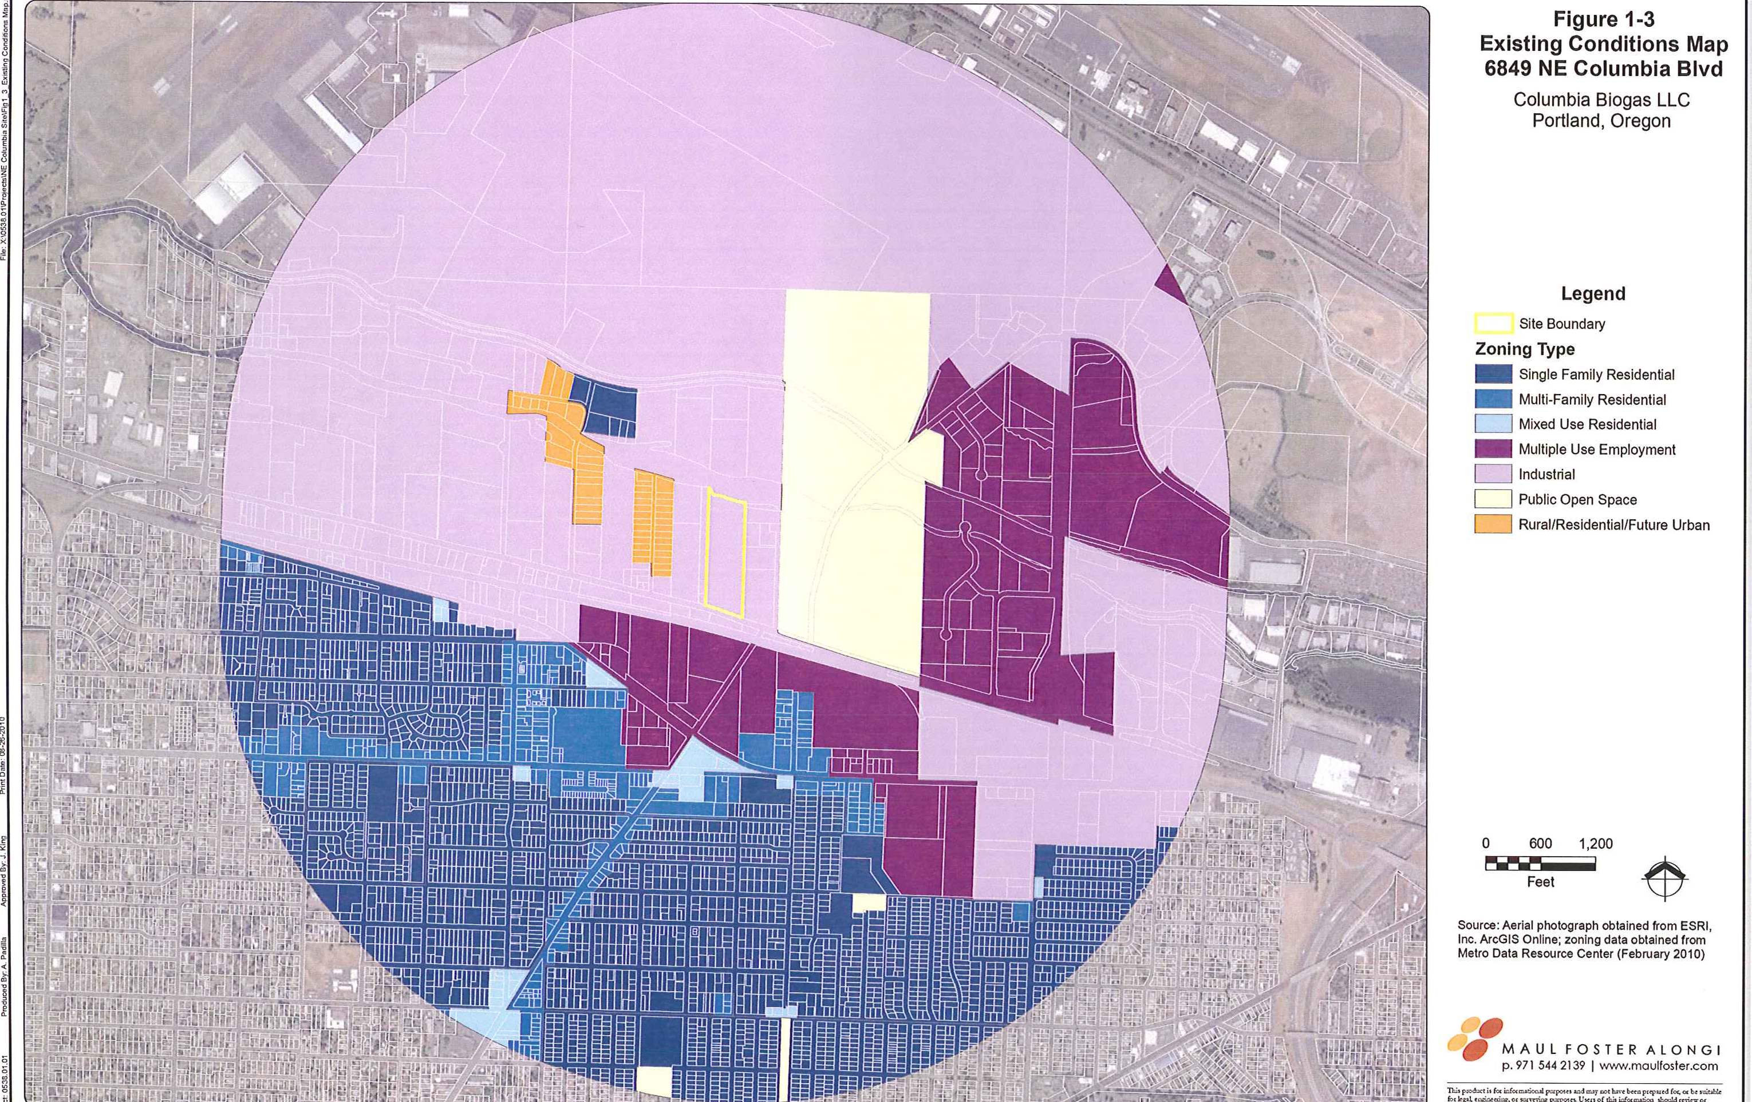
Conversion Technologies
Columbia Biogas: Zoning Map

Slide 16
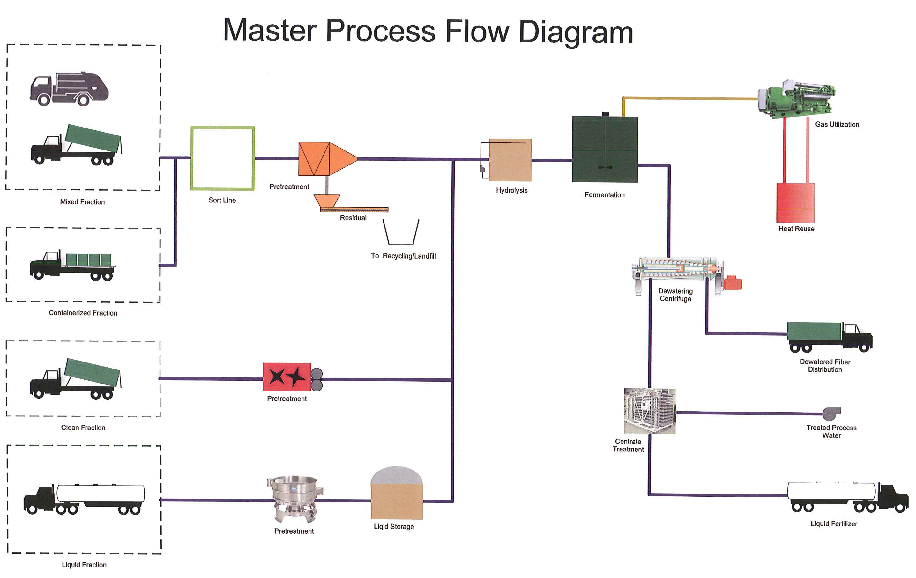
Conversion Technologies
Columbia Biogas

Slide 17
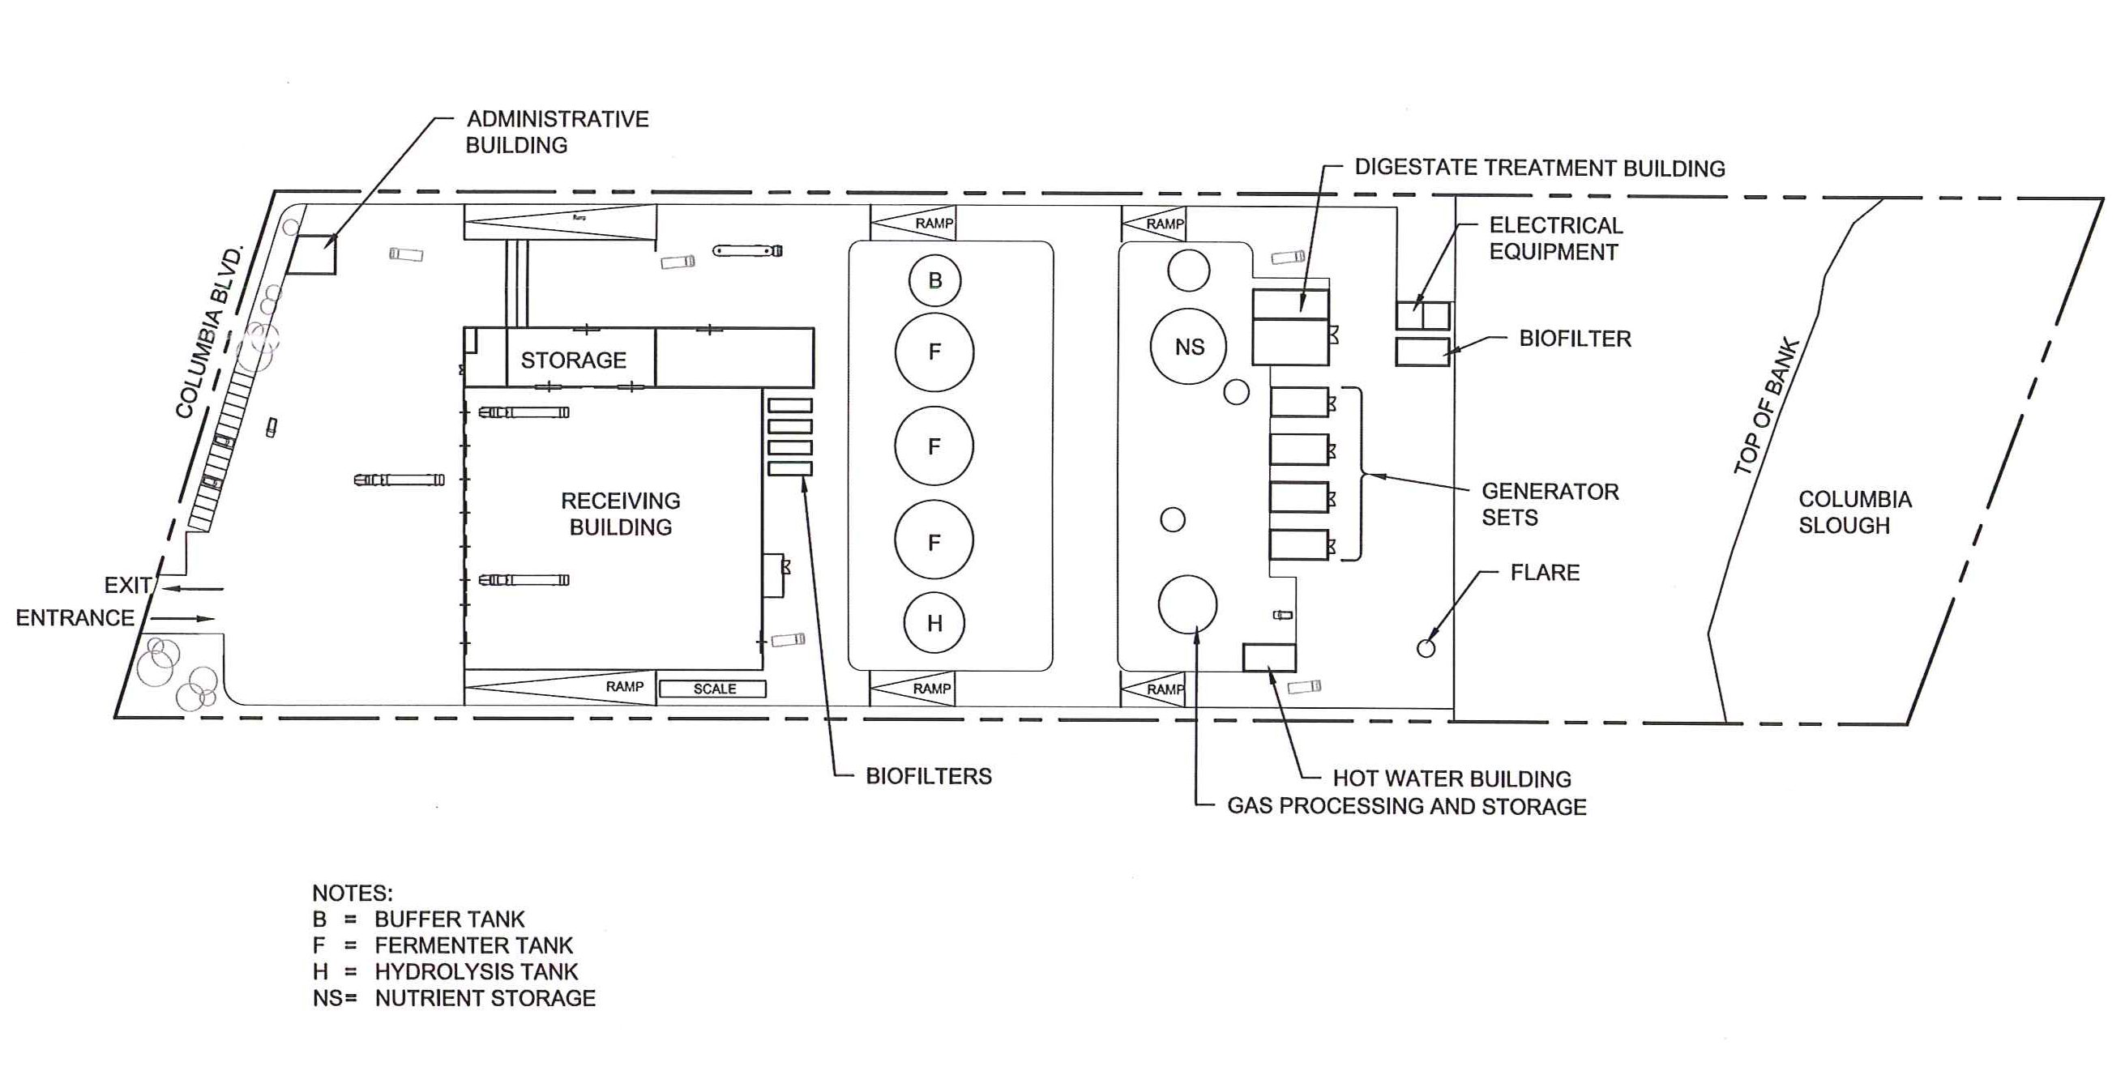
Conversion Technologies
Columbia Biogas: Site Layout

Slide 18
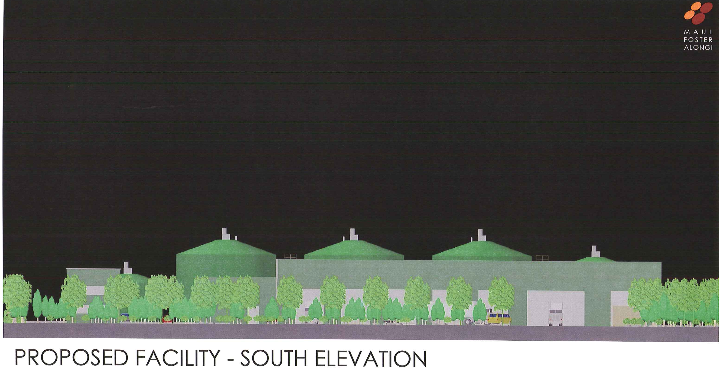
Conversion Technologies
Columbia Biogas

Slide 19
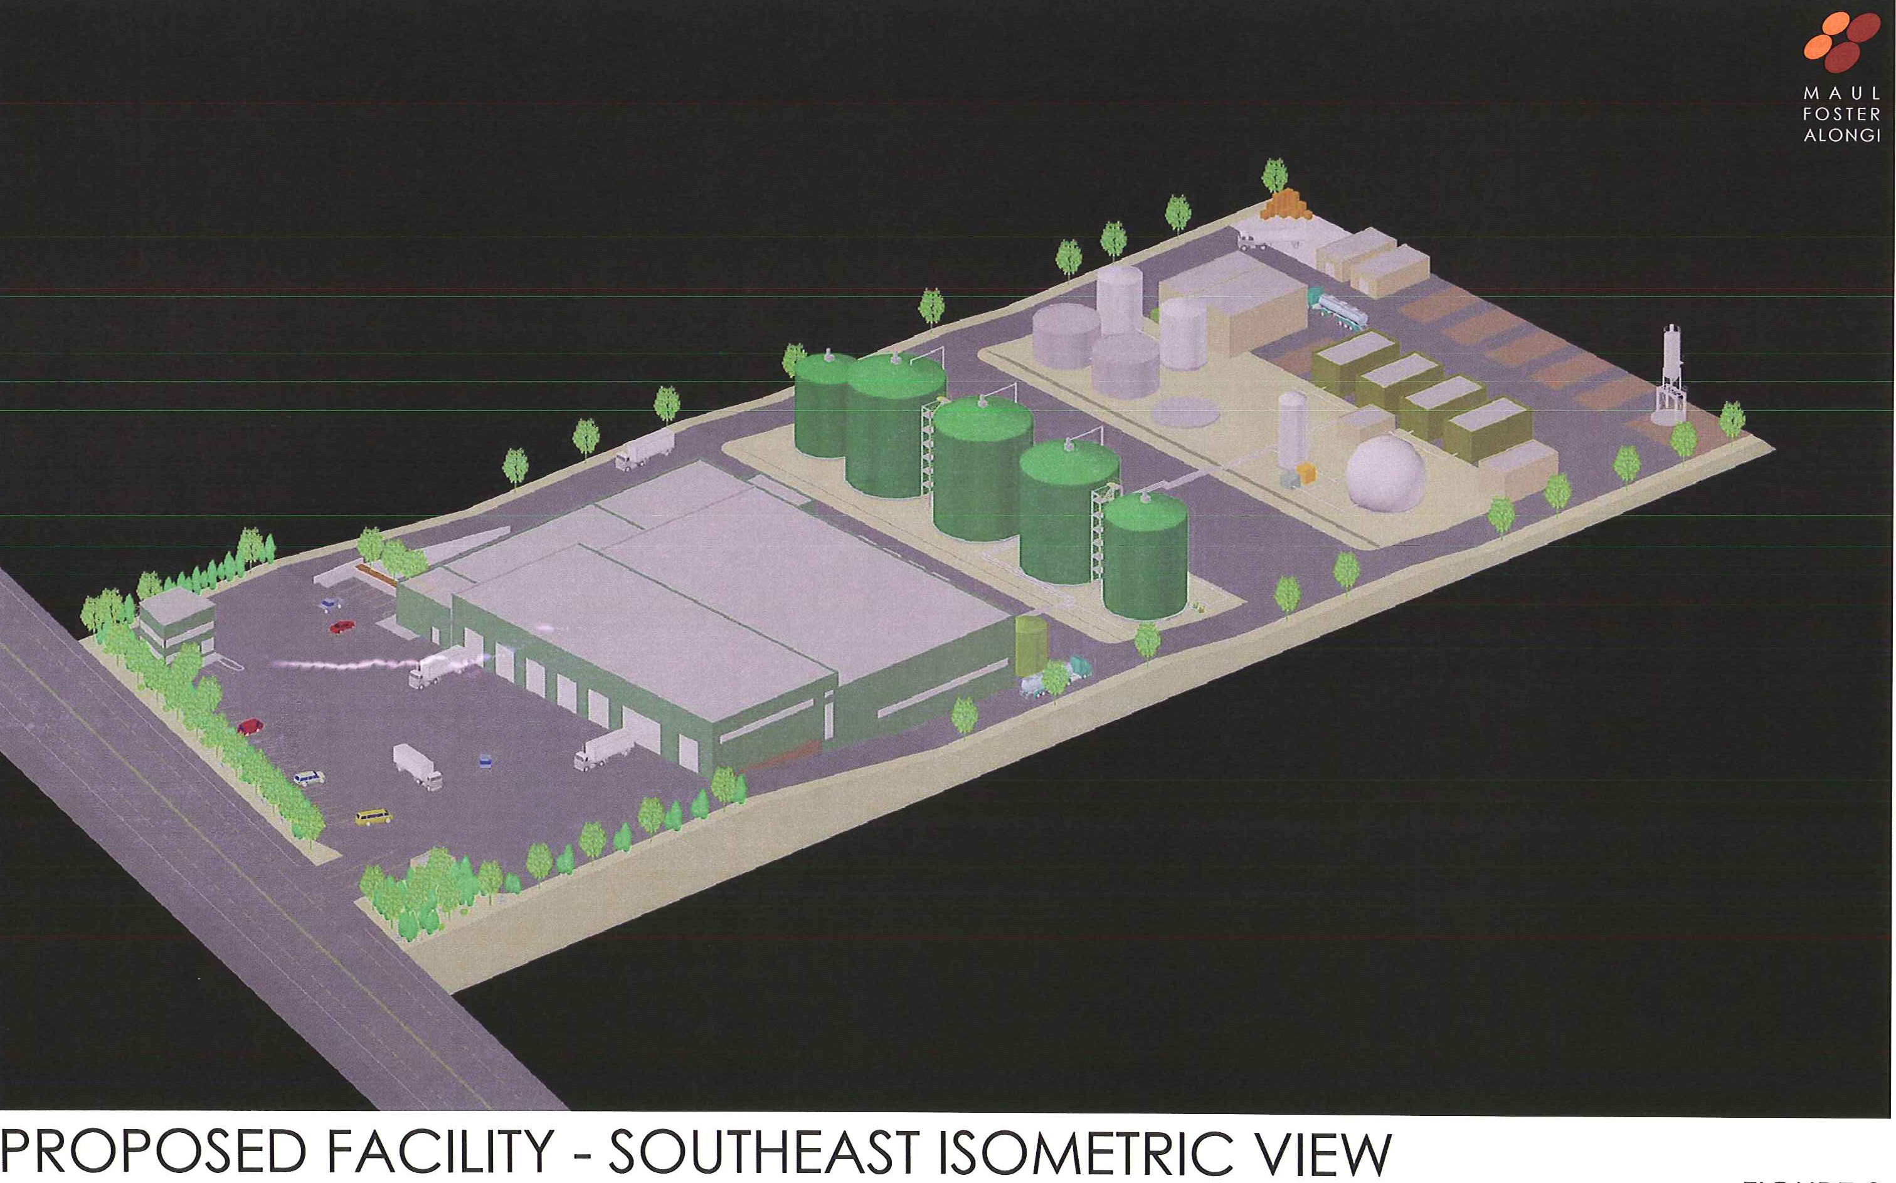
Conversion Technologies
Columbia Biogas

Slide 20
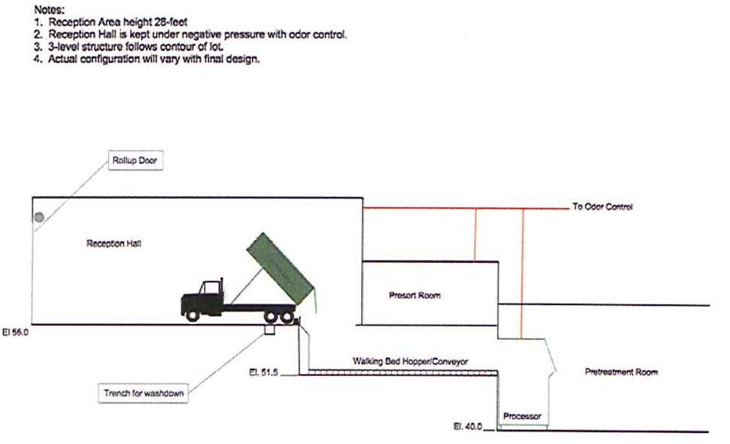
Conversion Technologies
Columbia Biogas

Slide 21
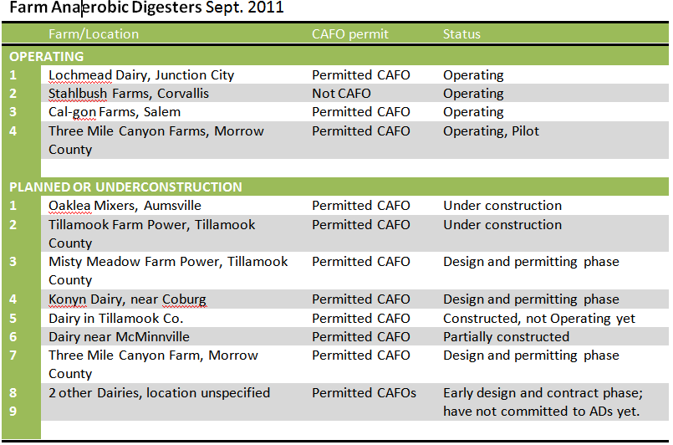
Conversion Technologies
Do Farms Have Anaerobic Digestion Facilities?

Slide 22
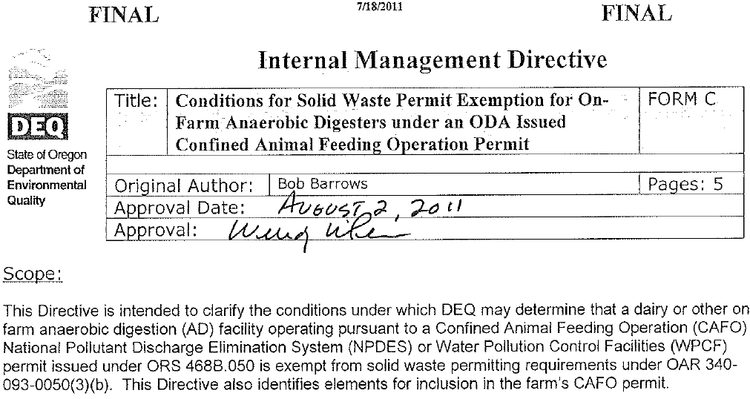
Conversion Technologies
Permit exemption for Farm AD Facilities
IMD describing to DEQ staff how to implement OAR 340-093-0050(3)(b). IMD is stored in Directive Tracker.

Slide 23
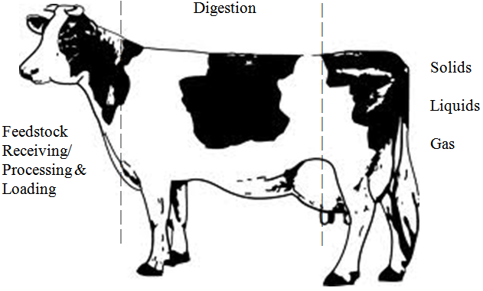
Conversion Technologies
Farm AD IMD Permit Exemption
ODA considers AD accepted form of manure management
Manures - low energy; gas boosted w/ small amts of higher energy wastes
Must be “farm use”. “Commercial-scale” = DEQ permit
ODA & DEQ staff coordination to ensure 10 conditions for protection of water & public health met
AD Chapter of Animal Waste Management Plan important part of CAFO permit

Slide 24
Conversion Technologies
Conversion Technology Facility Rules
Bill Fuller lead Manager; Rules Design Team appointed; losing Tom Roick as staff lead
Start Rulemaking Proposal adopted January 2010
Will use Sharepoint Rulemaking “Blueprint” which is under development
Project Plan established including timeline and list of issues in and out of scope
Next - scope out project further and refine Project Plan; refine stakeholder list; schedule stakeholder meetings; prepare for meetings

