Slide 1
Conversion Technology Rule Development
2013 SWANA Winter Forum
Lane Community College
January 17, 2013
Bob Barrows
Solid Waste Policy Analyst
Oregon Department of Environmental Quality

Slide 2
Overview of Proposed Conversion Technology Rule Amendments
Division 93
Definitions
Permit applications for most permits including conversion technology facilities (but not composting facilities)
Permit exemptions
Division 96
Amendments to composting rules to include anaerobic digestion, plus other adjustments
New conversion technology rules
Division 97
New fee categories for conversion technology facilities and other fee clarifications.
Division 64 – Tire management fixes and updates
Division 95 – Financial assurance housekeeping fixes
Notes:
DEQ is currently soliciting public comment for the proposed Conversion Technology rule amendments. The comment period opened on December 14 and is open until 5 PM, January 22. A public hearing for these rules was held yesterday, January 16 in Portland. Listed here are the specific rule Divisions being proposed for amending and the topics areas being amended. These rules sit within Oregon Administrative Rules Chapter 340.
This rulemaking would establish performance standards and solid waste permit requirements for conversion technology facilities and anaerobic digestion facilities to: 1) assure environmental protection, 2) establish appropriate permitting requirements for specific conversion technology facilities, 3) establish an appropriate fee schedule for the new conversion technology facility permit category and 4) provide regulatory certainty for emerging technology providers and DEQ staff. This rulemaking also proposes changes to existing Oregon rules that include grammar, rule reference corrections to solid waste rules, exempts certain low-risk facilities from solid waste disposal permit requirements, and makes adjustments to composting and waste tire rules.
This presentation will focus on the rule amendments more directly related to anaerobic digestion and conversion technology facilities in Division 93, 96 and 97. The changes in the Waste Tire Rules (Division 64) and the Financial Assurance rules (Division 95) are primarily to fix grammatical errors or correct rule citations and won’t be addressed.
This presentation will be more of a summary, given the time allotted. For more detail or to see the rules please see me after the presentation or go to the website listed at the end of this presentation.

Slide 3
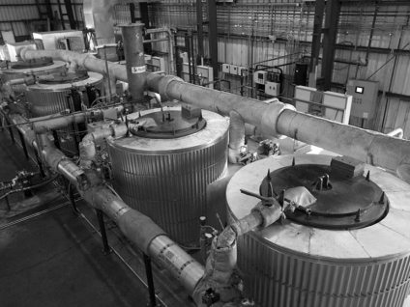
What are Conversion Technology Facilities?
Convert solid wastes into useful products, chemicals and fuels like methane, syngases, fuel oils and biodiesel
Technologies include:
Gasification
Pyrolysis
Hydrolysis
Transesterification (Biodiesel)
Anaerobic Digestion (but see proposal)
Agilyx Plastics Pyrolysis Facility
Tigard, Oregon
currently no permit required
Notes:
Conversion technology facilities use chemical or thermal processes to convert solid waste to chemicals, fuels or other useful products. Anaerobic digestion facilities use biological processes to digest solid waste and create methane that can be used to create electricity or transportation fuels. In most cases, processing solid waste through conversion technology facilities or anaerobic digesters is a more sustainable practice than landfilling or burning solid waste.
Conversion technology facilities and anaerobic digestion facilities are currently classified as "solid waste treatment facilities." This rulemaking proposes to classify facilities using anaerobic digestion as “composting facilities” and create a new classification of solid waste disposal site called “conversion technology facilities”.

Slide 4
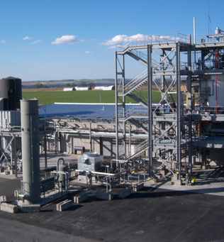
Why a New Conversion Technology Permit?
Existing solid waste permits don’t fit conversion technology well
Solid Waste Treatment: made for disposal of contaminated material, not recovery
Material Recovery Facility: for recycling from mixed waste – using simple mechanical methods
Reklaim Tire Pyrolysis Facility
Boardman, Oregon
Has solid waste treatment permit
(2008), but not fully operating yet
Notes:
The development and use of various types of conversion technologies and anaerobic digesters is new to Oregon and the U.S., and existing solid waste rules don’t provide performance standards or permit requirements that are appropriate for these types of facilities.
The existing solid waste permitting scheme is based on disposal of solid wastes and did not contemplate permitting solid waste facilities that convert solid wastes to useful products; except for material recovery facility permits which were intended for mechanical separation for recycling purposes. MRF permits are not appropriate for conversion technology facilities.

Slide 5
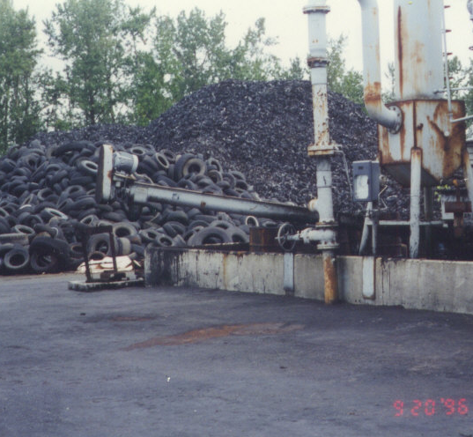
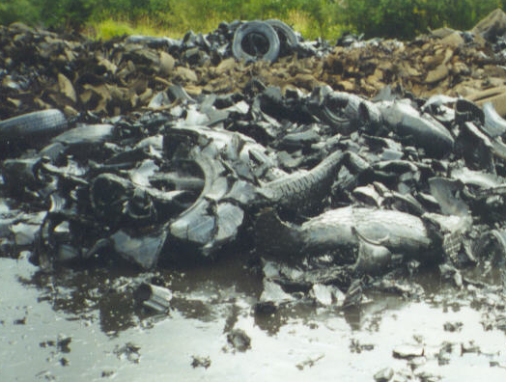
Not all conversion technology facilities have worked out.
RMAC Tire Pyrolysis Facility cost Oregon more than $1 million to clean up.
Notes:
Oregon has had some experience with conversion technology facilities in the past and not all have worked out. Most have come and gone. I heard a story from an older guy that during and right after world war II some mills used to convert wood waste to combustion or vehicle fuels. He said they were gasification units. Once the war-related fuel shortage went away, these units disappeared because they were expensive and inefficient.
The tire pyrolysis facility depicted here operated unsuccessfully in the late 1990’s.

Slide 6
Proposal: Processing Technology Ties to Permit Type
Processing Type | Processing Methods Examples | Permit Type
Mechanical (recycling) | Hand-Sorting, Screens, Shredding | MRF or no permit
Biological | Aerobic Composting Anaerobic Digestion | Composting or no permit
Thermal and/or Chemical | Pyrolysis, Gasification, Distillation, Hydrolysis, Thermal Depolymerization | Conversion Technology or no permit
Notes:
In the proposed rules we’ve tied permit type to processing technology, similar to how solid waste disposal permits are classified by the type of disposal activity - Landfill permits, transfer station permits or incinerator permits.
Mechanical processing involves hand sorting using screens or shredding; will have a material recovery facility permit.
Biological processing using primarily micro organisms to decompose organic matter through composting or anaerobic digestion will have a composting permit.
Thermal or chemical processing through pyrolysis, gasification, distillation or other means will have a conversion technology facility permit.
The rules also propose permit exemptions under certain conditions for different types of facilities.

Slide 7
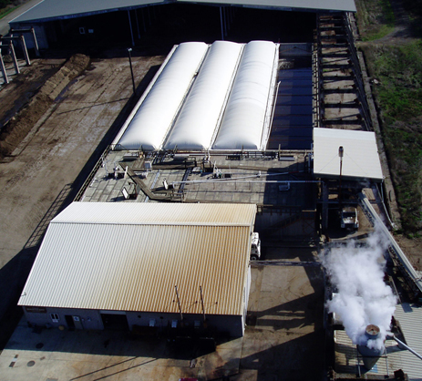
Anaerobic Digestion Propose to include in composting rules
Both use biological decomposition
Composting rules already control:
pathogen reduction
odor management
feedstock definitions
water/leachate management
storage limitations
Rules need amending to add provisions concerning biogas and liquid digestate management and make other small fixes
Port of Tillamook Bay
Anaerobic Digester
Solid Waste Treatment Permit since 2002
Notes:
These rules propose to address anaerobic digestion facilities within the Composting regulations primarily because of the similarity in the processes and regulatory issues both types of operations present. Composting and anaerobic digestion facilities both employ micro organisms to decompose organic matter. The composting rules already address issues of concern for anaerobic digestion facilities:
Pathogen reduction
Odor management
Feedstock definitions
Water/ leachate management and
Storage limitations
Concerns particular to anaerobic digestion include biogas collection and storage and liquid digestate management. The composting rules have been amended to address those issues.
7

Slide 8
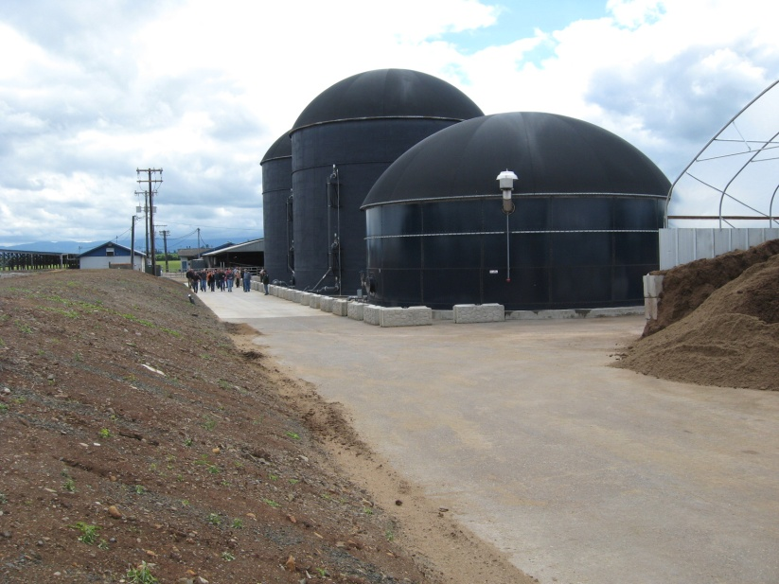
What is Anaerobic Digestion (AD)?
Similar to composting
AD uses biological organisms to breakdown organic material, but in the absence of oxygen.
Unlike composting
AD is intended to create and collect methane (gas) for use as a product
Products of AD are:
Methane used for energy production
Liquid and solid digestate used for soil fertility purposes
Lochmead Dairy Anaerobic Digester
Junction City
Oregon Dept. of Agriculture oversight; no DEQ solid waste permit
Notes:
What is anaerobic digestion? Similar to composting anaerobic digestion uses biological organisms to decompose organic material. Composting facilities generally are designed to encourage the growth of oxygen-loving organisms. Anaerobic conditions in a composting pile are not a desirable situation.
On the other hand, anaerobic digesters are designed and operated to create anaerobic conditions to encourage the growth of organisms that thrive in that environment and create and contain methane gas. Digesters collect the methane for use as a fuel source; either directly burning the methane to create electricity or treating the methane for either injection into a natural gas pipeline or creating compressed natural gas fuels.
8

Slide 9
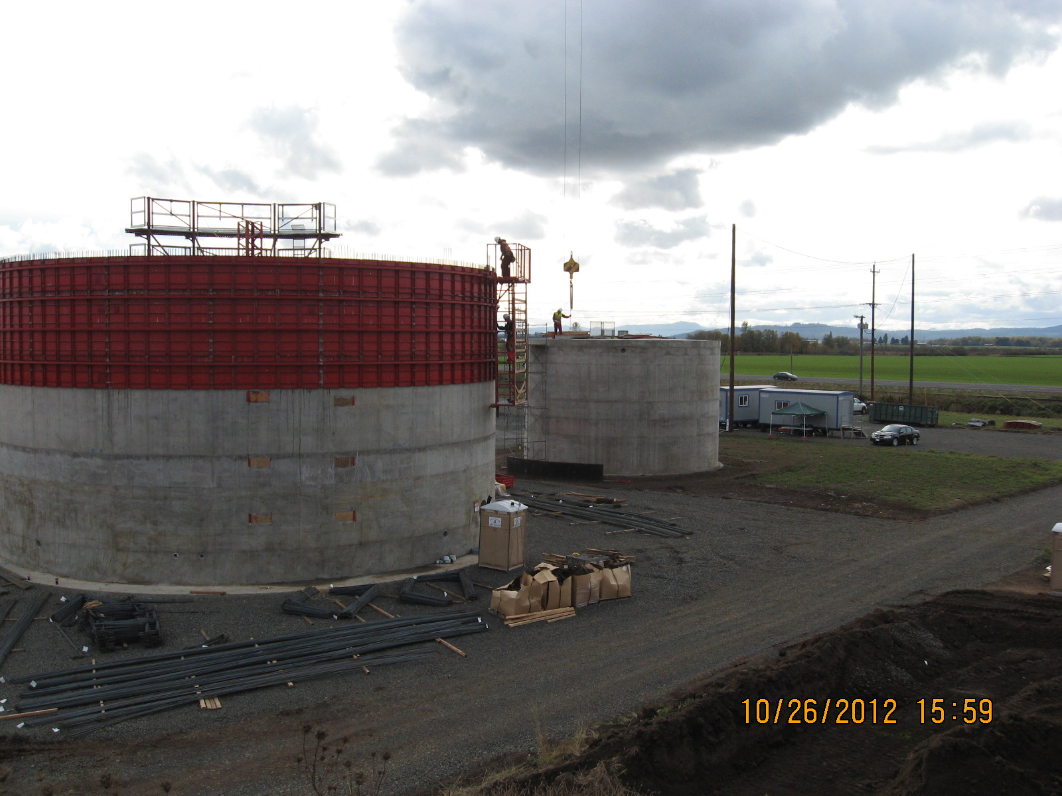
Incorporating anaerobic digestion in composting facility rules
Composting rules amended to include AD specific issues:
New definitions
Amended existing definitions
Added type 4 feedstock
Farm AD units permit exemption under conditions
Adjusted performance standards
Pathogen reduction standards for digestate; including type 4 feedstocks
Unacceptable odors amended
JC Biomethane Anaerobic Digester
Junction City
Has solid waste treatment permit
(2012), under construction
Notes:
The composting rules have been amended to address anaerobic digestion issues:
New definitions were added, such as anaerobic digestion, biogas and digestate.
Existing definitions were amended composting, composting facility and feedstock.
A new type 4 feedstock was added to types 1, 2 and 3; to address the environmental and public health risk posed by materials that can cause Bovine Spongiform Encephalitis (Mad Cow Disease).
Similar to composting facilities, the proposed rules exempt farm anaerobic digestion units from the requirement to obtain a DEQ permit, under certain conditions and when the facility is under Oregon Dept. of Agriculture regulation
Adjusted composting facility performance standards to address anaerobic digestion issues such as biogas and digestate management
Amended composting facility pathogen reduction standards to address anaerobic digester operations, conditions and products. Required composted material and digestate derived from type 4 feedstock to be disposed in a landfill unless DEQ approves a safe alternative use.
Amended unacceptable odor section to address anaerobic digestion
9

Slide 10
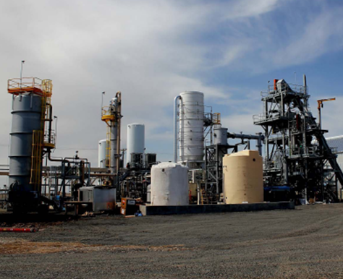
Chemical, Thermal Processes to be covered under new Conversion Technology Rules & Permit
Pyrolysis, Gasification, Hydrolysis, Distillation, other
Performance standards for all facilities
Permitting based on level of environmental risk posed
Exemptions from permitting under certain conditions
Registration requirements for low-risk
Full permit requirements for facilities that may pose some risks; Operations Plan approval
S4 Energy Plasma Arc Gasification Facility
Accepts Mixed or Separated Solid Waste
R&D Facility
Solid Waste Treatment Permit
Notes:
New conversion technology rules address permitting issues for a new class of solid waste disposal site called a conversion technology facility. The conversion technology rules are added at the end of Division 96, starting with OAR 340-096-0160: Special Rules Pertaining to Conversion Technology: Applicability. These rules address facilities that process solid waste using chemical or thermal processes such as pyrolysis, gasification or hydrolysis.
The conversion technology rules were constructed in a manner similar to the composting rules. These rules have a set of performance standards that all facilities must meet, regardless of whether they have a permit. The type of permit a conversion technology facility receives is based on the level of potential environmental risk the facility poses. Certain facilities may be exempted from needing a conversion technology permit if they meet established criteria. The rules describe registration requirements for low-risk facilities and permitting requirements for facilities that pose some risk, including an Operations Plan approval requirement.
10

Slide 11
Permit vs. Registration (similar to composting rules)
Conversion Technology Facility Permit
For facilities that pose more than a minimal risk
Requires submittal and approval of operation plan, including paying operation plan review fees
More public notice requirements for application
Conversion Technology Facility Registration (a permit classification for low-risk facilities)
No submittal of operation plan required (or operation plan review fee).
Less public notice requirements for application
Must still follow performance standards in rules
Same annual compliance fee as conversion technology permits.
Notes:
The proposed conversion technology rules establish requirements for Conversion Technology Facility permits and Conversion Technology Facility Registrations. Both are permits, the Registration is for facilities considered low-risk while the Permit is for facilities that pose a risk. Facilities that pose a risk have a few more regulatory requirements than a Registration. Facilities that pose a risk must submit an Operations Plan for DEQ approval and pay the Plan Review Fee. Low-Risk facilities do not submit an Operations Plan for review to obtain a Registration. The public notification requirements for facilities that pose a risk are greater than those for low-risk facilities. All conversion technology facilities must meet the performance standards. All permitted conversion technology facilities (Registration and Full Permit) pay the same annual compliance fee.
11

Slide 12

Level of Regulation Depends on Evaluation of Potential Risk Factors
Impact on groundwater or surface water
Impact on soil (contamination)
Odor
Materials produced by facility potentially threaten human health or the environment when used “as directed”
Other risks to human health or the environment
Abandonment requiring public response or cleanup
Notes:
The level of permit regulation depends on an evaluation of potential risk factors, which are identified in the proposed rule. Upon submittal of an application for a conversion technology facility permit, DEQ will evaluate the following risk factors to make a determination on the level of potential risk a facility poses:
Impact on groundwater or surface water from facility design and operations
Potential to contaminate soil
Potential to release unacceptable odors that will impact neighbors
Potential that materials produced by the facility could threaten human health or the environment when the material is used or distributed “as directed”; ie: “…when used in ways the material may reasonably be expected to be used..”
The facility is not likely to be abandoned and require cleanup by public agencies; includes four evaluation criteria in rule for this factor
Other risks to human health or the environment.

Slide 13
Permit Exemptions
Facilities receiving less than 20 tons/year
Facilities meeting all the following criteria:
Less than1% of waste received is putrescible
Only receives separated materials, not mixed waste
Less than 10% by weight of incoming feedstock is disposed of
Facility has appropriate air and water permits (or no discharges)
Facility does not routinely charge a tip fee for feedstocks
Facility can demonstrate it will meet performance standards
Registered used oil processors (exemption only for oil)
Facilities mainly processing crops grown just for energy; receiving small amounts of solid waste
Facilities holding valid animal rendering license from Oregon Department of Agriculture
Biodiesel facilities that satisfy certain requirements
Notes:
The Conversion Technology rules include criteria for exemptions from solid waste permitting for conversion technology facilities that pose very little risk or are regulated in other ways.
Facilities receiving less than 20 tons of solid waste /year
Facilities meeting all the following criteria:
Less than1% of waste received is putrescible
Only receives separated materials, not mixed solid waste
Less than 10% by weight of incoming feedstock is disposed of
Facility has appropriate air and water permits (or no discharges)
Facility does not routinely charge a tip fee for feedstocks
Facility can demonstrate it will meet conversion technology facility performance standards
Registered used oil processors (exemption only for oil processing)
Facilities mainly processing crops grown just for energy; and receiving small amounts of solid waste; amounts are identified in rule
Rendering facilities holding valid animal rendering license from Oregon Department of Agriculture
Biodiesel facilities that satisfy certain requirements identified in rule
13

Slide 14
Proposed Performance Standards
Proper management of storm-water, process water and leachate
Odor and dust minimization
Prevent vector propagation
Collect and store biogas or syngas properly
Incoming material screening requirements
Training requirements
Limited storage time for incoming feedstocks and outgoing products
Proper characterization of waste streams per hazardous waste rules
Hazardous substances in material produced by facility must meet at least one of the following:
Do not significantly exceed concentrations in comparable raw materials or commercial products
Will not exceed acceptable risk levels when used in ways the material may reasonably be expected to be used
Facility must allow DEQ access to the facility and to facility records to determine compliance with the rules.
Notes:
This is a list of proposed Conversion Technology facility performance standards:
Proper management of storm-water, process water and leachate
Odor and dust minimization
Prevent vector propagation
Collect and store biogas or syngas properly
Incoming material screening requirements to remove materials incompatible with the facility or that may pose environmental or human health risks when incorporated into products
Staff training requirements for technology operation and material screening
Limited storage time for incoming feedstocks and outgoing products
Proper characterization of waste streams per hazardous waste rules
Hazardous substances in material produced by facility must meet at least one of the following:
Do not significantly exceed concentrations in comparable raw materials or commercial products
Will not exceed acceptable risk levels when used in ways the material may reasonably be expected to be used
Facility must allow DEQ access to the facility and to facility records to determine compliance with the rules.

Slide 15

Permitting Fees
Anaerobic digestion facilities will be
subject to a less-expensive composting permit instead of a solid waste treatment facility permit
A new set of application, operations plan review, and annual compliance fees are added for conversion technology facilities (less expensive than equivalent solid waste treatment permit fees)
Fee rules adjusted to clarify that tip fees and recycling act fees are paid on mixed solid wastes that are processed by a conversion technology facility or composted, but not separated solid waste handled by these facilities.
Notes:
Proposed conversion technology facility permitting fees summary:
Anaerobic digestion facilities will be subject to a less-expensive composting permit instead of a solid waste treatment facility permit
A new set of application, operations plan review, and annual compliance fees are added for conversion technology facilities (less expensive than equivalent solid waste treatment permit fees)
Fee rules adjusted to clarify that tip fees and recycling act fees are paid on mixed solid wastes that are processed by a conversion technology facility or composted, but not separated solid waste handled by these facilities.

Slide 16
DEQ Soliciting Public Comment
Public Comment Period closes
5 PM, January 22, 2013
For a copy of proposed rules and to submit comments go to: http://www.deq.state.or.us/regulations/proposedrules.htm
Questions? Contact me:
Bob Barrows
DEQ Waste Policy Analyst
Eugene
541/ 687-7354
barrows.bob@deq.state.or.us

