Slide 1
Suspended and Bedded Sediment and Toxic Pollutants
Presentation to the non-NPDES Workgroup
March 31, 2010

Slide 2
Overview
Review sediment regimes and human influences
Interaction between sediment and toxic substances and effects on beneficial uses
Discuss turbidity rule revisions and bedded sediment benchmarks

Slide 3
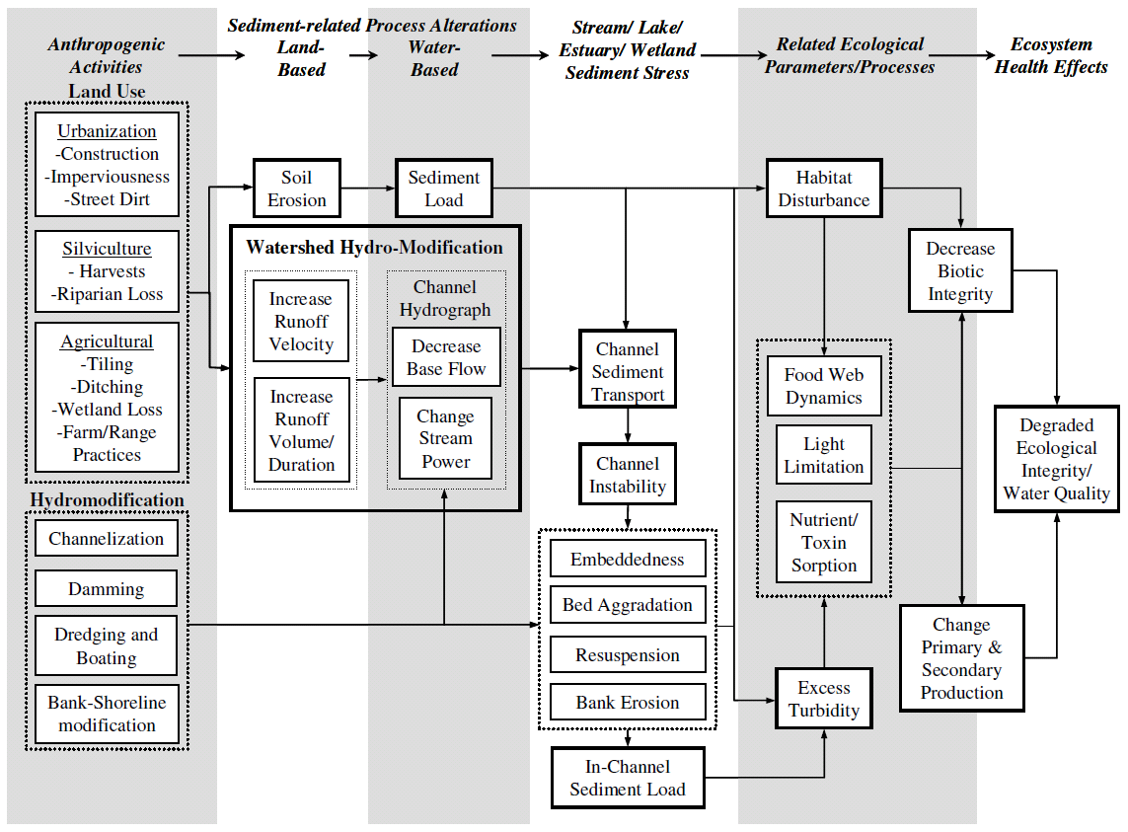
Sediment Processes
Source: U.S. Environmental Protection Agency. 2006. Framework for developing suspended and bedded sediments (SABS) water quality criteria. EPA-822-R-06-001. Office of Water and Office of Research and Development, Washington, DC.

Slide 4
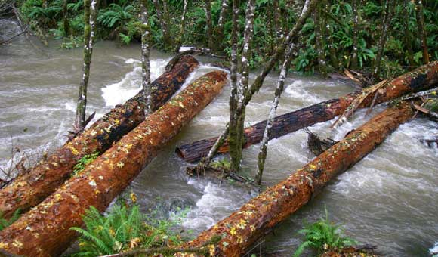
Episodic Sediment Delivery: Benefits
Sediment delivery to bodies of water is a key part of natural ecosystems
Slides on forested lands deliver key components to aquatic ecosystems
Large woody debris (LWD)
Gravel and cobbles
Short-term negative impacts with long-term gains in ecosystem productivity
e.g. Reeves et al 1995

Slide 5
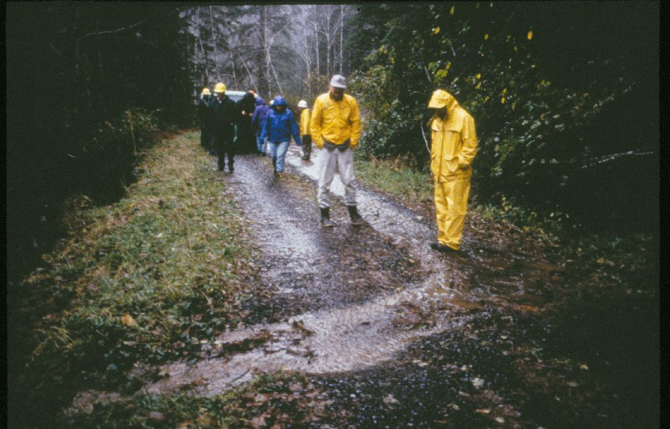
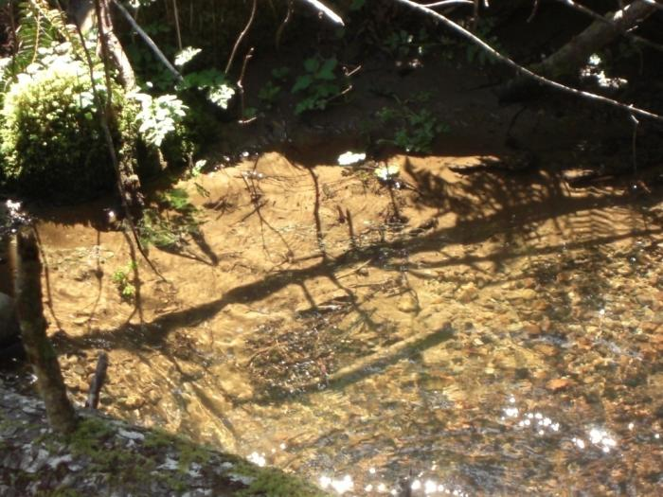
Chronic Sources of Fine Sediment: Potentially Harmful
Chronic sources like road runoff create constant stress on aquatic ecosystems
These sources lack the legacy that creates long-term benefits (no LWD or gravel)

Slide 6
Sediment Delivery and Toxics
Toxics have varying solubility in water which affects their movement.
Water soluble toxics (such as diazinon, atrazine, & some heavy metals) can be transported in surface water or ground water
Less soluble toxics can bind to soil particles (such as Pyrethroids, DDT, PCBs, dioxins/furans)
Erosion and transport of soil to waterbodies can carry soil-bound toxic chemicals
But, certain types and delivery of sediment is important for proper stream function

Slide 7
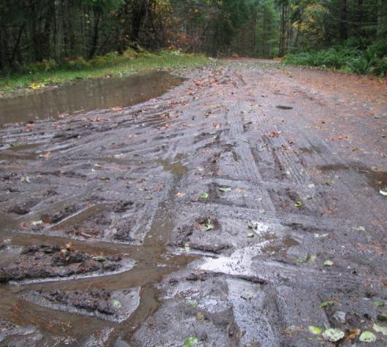
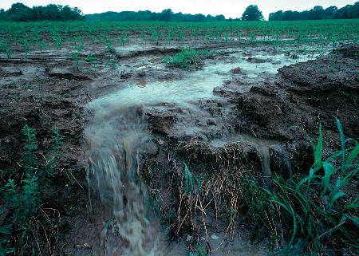
Sediment Delivery and Toxics (cont.)
Nonpoint Sources of fine sediment and toxics:
Roads (Heavy metals, PAHs, petroleum products)
Urban Stormwater (Pesticides, metals, petroleum)
Rural residential (Pesticides, petroleum products, chemicals)
Agricultural lands (Pesticides, petroleum products)
Forest operations (Pesticides, road runoff)

Slide 8
Sediment Delivery and Toxics (cont.)
Toxics that bind to sediment are generally hydrophobic (lipophilic)
Water chemistry (redox and pH) can mediate release of toxics from sediment
Sediment Water Aquatic life (incl. fish)
Hydrophobic chemicals can bioaccumulate and biomagnify
Ecological and human health effects are possible

Slide 9
Reducing transport of sediment and bound toxics to waterbodies
Stream Buffers
Sedimentation Basins/Constructed Wetlands
Road design/maintenance
LID/Construction stormwater
Tillage
Irrigation practices
Individual efforts (household level)

Slide 10
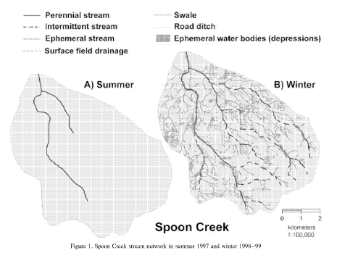
Limitations of buffers?
Stream networks expand greatly in the winter.
Buffers on all perennial and intermittent streams has benefits.
Sediment transport still a problem.
Wigington, PJ et al. 2005. Stream network expansion: a riparian water quality factor. Hydrol. Process 19: 1715-1721.

Slide 11
Current Turbidity Standard (OAR 340-041-0036)
“Turbidity (Nephelometric Turbidity Units, NTU): No more than a ten percent cumulative increase in natural stream turbidities may be allowed, as measured relative to a control point immediately upstream of the turbidity causing activity…”

Slide 12
Scope of revision
From U.S. EPA. 2006. Framework for developing suspended and bedded sediments (SABS) water quality criteria. EPA-822-R-06-001. Office of Water and Office of Research and Development, Washington, DC.

Slide 13
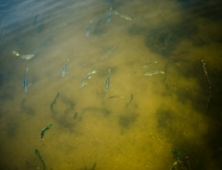
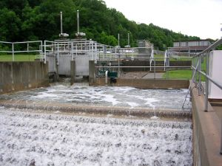
Effects of turbidity on beneficial uses
Reduced growth of algae and other aquatic vegetation
Impacts to zooplankton and invertebrates
Reduced ability for fish to see/catch prey
Recreation
Higher water treatment costs/shutdowns

Slide 14
Development of Sediment Benchmarks for Use in CWA 303(d)/305(b) Integrated Report
Statewide Narrative Criteria OAR 340-041-0007(12)
“The formation of appreciable bottom or sludge deposits or the formation of any organic or inorganic deposits deleterious to fish or other aquatic life or injurious to public health, recreation, or industry, may not be allowed.”
DEQ has listed ~100 streams as water quality limited due to excess fine sediment.

Slide 15
Beneficial uses – aquatic life
Use and depend on habitat provided by healthy stream beds
Native fish species are sensitive to sediment conditions in stream beds
Salmonids especially sensitive during the spawning cycle (e.g., embryo survival)
Bottom-dwelling aquatic macroinvertebrates (bugs) form an important aquatic community

Slide 16
Sediment benchmark efforts
Draft approach for benchmarks to identify water quality-limited streams due to excess fine sediment.
Association between sediment conditions and poor biological indicators.
Does not address toxics.
Targeting 2012 Integrated Report cycle for implementation

Slide 17
Toxics are Part of Sediment Story
Excessive fine sediment can
Disrupt aquatic ecosystems
Interfere with drinking water treatment
Create nutrient problems (phosphorous)
Transport toxic substances

