Slide 1
Current Nonpoint Source
(Non-NPDES) Authorities

Slide 2
NPS authorities under State and Federal Laws
EQC has broad authority to protect waters from NPS pollution
Rules must be adopted to establish requirements to prevent and control NPS pollution
The State Legislature and EQC have delegated Nonpoint Source Authorities to DEQ and other agencies with oversight by DEQ

Slide 3
Questions to Consider
What are the impediments to reducing pollutant loads from Non-NPDES sources?
What are the impediments to implementing TMDLs for Non-NPDES sources?
What should be included in Implementation Ready TMDLs?
How should these approaches be institutionalized: Guidance; IMD; OARs; ORSs?

Slide 4
Total Maximum Daily Load
Point Sources
Nonpoint Sources
TMDL =
WLA + LA_{np} + LA _{bs} + MOS + RC
Waste Load Allocation
Load Allocation
Non-point Source
Background Source
Margin of Safety
Reserve
Capacity

Slide 5
Current TMDL Implementation
DEQ calculates TMDLs, sets allocations
to reach water quality compliance
Carry out WQMPs
Ag WQ Mang’t Act (SB1010)
Plans & Rules
(ODA) (MOA btwn ODA & DEQ)
Point Source Permits
(DEQ)
Other
urban and rural NPS management
(Local Government)
Forest Practices Act
Forestry prescriptions
(ODF) (MOA btwn ODF & DEQ)
Federal Land Management Agencies (BLM/FS/COE)
Notes:
Agriculture
AgWQM Area Plans and Rules – SB 1010
SB 502
ODA is the lead, but DEQ retains regulatory authority for water quality on Ag lands
Outcome based – no specific buffers or BMPs required
Forestry
State and private land management
Forest Practices Act - Specific BMPs required
Statutory relationship between EQC and BOF
Federal forestland management
Resource Management Plans
National Forest Management Plans
Water Quality Goals met through Implementation of MOU/MOA between DEQ and Fed Agencies

Slide 6
Identified Gaps for Addressing Non-NPDES Sources
Lack of understanding on what needs to happen on the ground (or in-stream) to meet TMDL Load Allocations
Lack of Water Quality Standards
Outreach challenges
Enforcement challenges
Funding for restoration projects

Slide 7
Proposed TMDL Process Implementation Ready TMDLs
Additional analysis to identify sources of pollution and estimate loading based on land use, crop type, or ownership
Load allocations given to each DMA, land owner, or Sector
Translation of surrogate load allocations to implementation measures
Prioritization of restoration activities
Evaluate whether ODA and ODF Rules are adequate to meet load allocations

Slide 8
Existing MOAs between DEQ & ODA; DEQ & ODF
Load allocations for agricultural nonpoint sources will be provided by DEQ to ODA which will then begin developing an AWQMAP or modifying an existing AWQMAP to address the load allocation.
Where water quality impairments are due to nonfederal forest activity and DEQ & ODF can not agree that current rules or BMPs are adequate then monitoring is initiated to determine adequacy
If DEQ & ODF agree that current rules do not address pollutant impairment then rules are modified

Slide 9
Implementation Ready TMDLs Example Concept (DDT)
TMDLs and Water Quality Management Plans (WQMP) would be developed to:
Identify the sources of the pollutant;
Identify loading capacity to meet the DDT WQS;
Use a surrogate for the load allocation (for example, suspended sediment) to meet the DDT WQS;
Assign load allocations to specific public and private sources identified in the TMDL;

Slide 10
Implementation Ready TMDLs Example Concept (cont.)
Identify the environmental condition needed to meet the Load Allocation (for example, vegetation targets within a riparian management area);
Identify BMPs that could be used to meet the load allocation;
Require TMDL Implementation Plans from all sources assigned a load allocation, sources would be required to identify in their plan how they will meet their load allocation, use of TMDL BMPs or approaches to meet the Load Allocations.

Slide 11
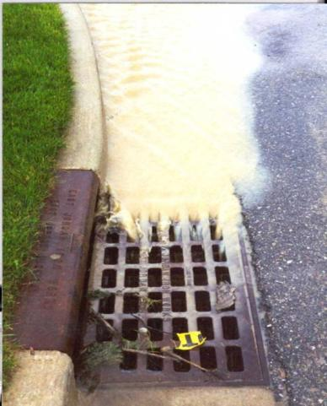
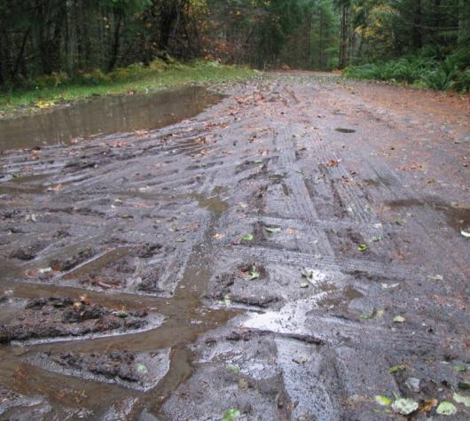
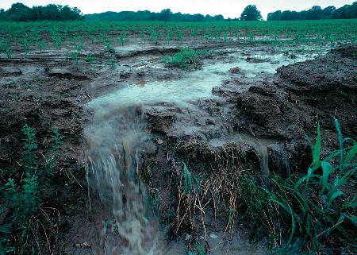
Existing TMDLs That Address Toxic Chemicals

Slide 12
Current Toxics TMDLs Strategy
Example: Mollala-Pudding TMDL
Correlation found in Previous Studies
Willamette River Basin Water Quality Study (WRBWQS)
In-stream DDT concentrations in the Willamette Basin correlate with suspended solids concentrations (Anderson, et al,1996)
Mollala-Pudding Subbasin TMDL Appendix J
Notes:
Since much of the sediment which enters streams comes from sediment washed off fields during storm events, pesticides associated with sediment may be controlled by reducing surface erosion.

Slide 13
Current Toxics TMDLs Strategy
Example: Mollala-Pudding TMDL
Chapter 4, Pesticides TMDL
DDT
Chlordane
Dieldrin
Load allocations for DDT and dieldrin are expressed as a percent reduction.
Total suspended solids (TSS) concentration target is used as a surrogate measure
Notes:
Historically, DDT, dieldrin, and chlordane were used extensively as agricultural insecticides and to control insect disease vectors such as mosquitoes. The use of these compounds has been banned in the United States for decades (DDT since 1972, chlordane since 1988, and dieldrin since 1970) but they are long-lived in soils.

Slide 14
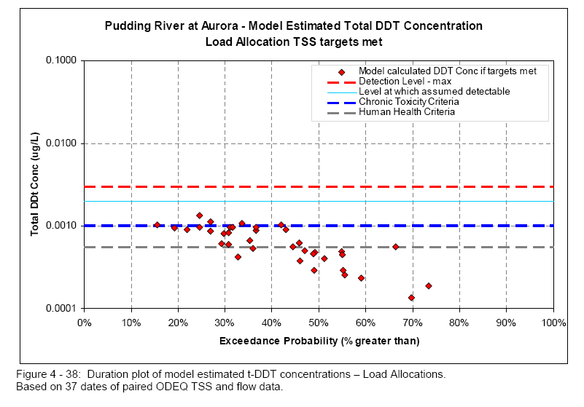
Mollala-Pudding Subbasin TMDL Chapter 4
Notes:
Model calculated concentrations in the Pudding River for these load allocations are presented in the form
of a concentration duration plot in Figure 4 - 38. As shown, if the TSS targets are met, the model
indicates that the chronic criterion for t-DDT should not be exceeded more than 10% of the time in the
Pudding River. Furthermore, t-DDT should rarely if ever be detected in the stream.

Slide 15
Current Toxics TMDLs Strategy
Example: Mollala-Pudding TMDL
Chapter 7, Water Quality Management Plan
Directs DMAs to
Reduce sediment delivered to streams by various means
Identify and investigate potential hot spots

Slide 16
Current Toxics TMDLs Strategy
Example: Lower Yakima River TMDL
1998: Load Allocations were set
DDT
Turbidity 25 NTU
2003: 3 out of 4 tributaries met Load Allocation for Turbidity
2006: Fish Tissue study showed significant reduction in contaminant levels – fish consumption advisory related to DDT lifted
Notes:
The Lower Yakima River Suspended Sediment and DDT TMDL was developed to reduce suspended sediment, turbidity, and the pesticide, DDT, in the lower reaches of the Yakima River. TMDL implementation is scheduled over 20 years with interim targets set at five-year intervals.
The fifth-year (2003) targets included meeting Washington State water quality criterion for turbidity in the lower Yakima River during the irrigation season. Also included was the requirement that non-Yakama Reservation tributaries to the lower mainstem – especially the major tributaries of Moxee Drain, Granger Drain, Sulphur Creek, and Spring Creek – achieve a maximum 90th percentile turbidity of 25 NTU at their mouths during the irrigation season. This report presents an assessment of the turbidity within the project area and the effectiveness of the TMDL in reducing agriculturally related sediment.
Sampling during the 2003 irrigation year demonstrated that sediment loads have been reduced in the agricultural drains and river, but improvement is needed to meet all of the targets. Of the four major agricultural drains, three met the criteria for turbidity, while the fourth failed to do so even though it had a sediment load reduction of approximately 80%. Mainstem turbidity requirements at the TMDL compliance point of Kiona Gauge did not meet the state water quality criterion of “5 NTU over background,” and neither did the intermediate mainstem sampling sites at Sunnyside-Mabton Road and Euclid Bridge. However, comparing suspended sediment data at the Kiona site collected during 1995 and 2003, both loads and concentrations were greatly reduced in 2003.
Page 3

Slide 17
Current Toxics TMDLs Strategy
Example: Lower Yakima River TMDL
Implementation Efforts
Encouraged growers to adopt BMPs aimed at reducing erosion from fields and drains through cost-share programs and technical assistance
State Revolving Fund Low Interest Loan program allowed conversion to non-erosive irrigation methods
Notes:
Encouraged to switch from furrow irrigation to more
efficient drip and sprinkler systems. Local
irrigation and conservation districts delivered
education programs and monitoring irrigation
returns to measure improvements to water clarity.
In addition, the agencies helped farmers find
resources to help pay for these irrigation changes.

Slide 18
Current Toxics TMDLs Strategy
Oregon Department of Agriculture
Example

Slide 19
Proposed TMDLs Strategy
TMDLs and Water Quality Management Plans (WQMP) are currently developed to:
Identify loading capacity to meet a WQS (for example, DDT);
Use a surrogate for the load allocation (for example, suspended sediment) to meet the WQS;

Slide 20
Proposed TMDLs Strategy
In Addition, take the following steps to clarify TMDL goals and facilitate Implementation
Assign load allocations in the TMDL
More thorough source identification
Include Air sources if appropriate
Determine the environmental condition needed to meet the Load Allocation (for example, vegetation targets along streams) during TMDL development
Notes:
If permitted facilities are identified as sources in TMDLs, then AQ Division would incorporate the WLA or LA into the permit. Depending on the pollutant, AQ may develop rules or put policy statements in place. The issuance of the Willamette Basin Mercury TMDL led to a new permit condition for a permitted facility (Ashgrove Cement Co. in eastern Oregon) For NPS, i.e. cars, there are also certain tools available

Slide 21
Proposed TMDLs Strategy
Identify “safe harbor” BMPs (including geographical scope and frequency) that could be used to meet the load allocation. Specify where and how often they are needed
Require sources to include benchmarks in the TMDL implementation plan to show how and when they will meet their load allocation.

