Slide 1
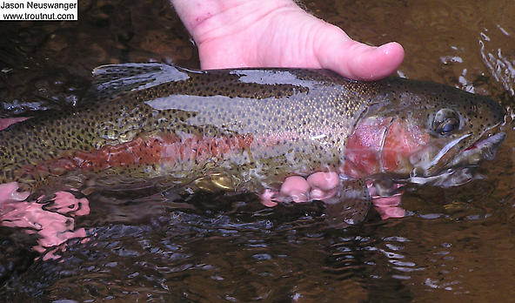
Rule Revisions to Clarify NPS Regulation
July 15th Non-NPDES Meeting
Presented by Gene Foster

Slide 2
Overview
Clarify forest activities that are subject to Water Quality Standards
Clarify rule for forestry nonpoint sources
340-041-0007(5)
340-041-0061(11)
340-042-0080(2)
Clarify rule for agricultural nonpoint sources
340-041-0061(12)
340-042-0080(2)
Clarify rule for other media
340-042-0040(4)(h)

Slide 3
Clarify forest activities that are subject to WQS
DEQ will clarify through a memo instead of rule
Many details are hard to capture in rule
AG advised to clarify in a separate document
DEQ and ODF worked on clarifying jurisdictions for forest conversion in an MOA (2007)

Slide 4
Forestry – Summary
Clarify rule for forestry nonpoint sources
340-041-0007(5)Statewide Narrative Criteria
340-041-0061(11) Other implementation of Water Quality Criteria
340-042-0080 (2) Implementing a Total Maximum Daily Load

Slide 5
Forestry
340-041-0007 Statewide Narrative Criteria
Statewide narrative criteria – no numeric values
logging and forest management activities must meet the water quality standards
Different from 6/30 language
Broader statement that addresses federal forestland in addition to private and state forestland
Language that describes the existing statutes related to state and private forestlands

Slide 6
Forestry
340-041-0061(11) Other implementation of Water Quality Criteria
Section in a rule that describes how forestry will implement WQ criteria
Different from 6/30 language
Describes generally how water quality standards are implemented on private and state forestland
Clarifies that private and state forest activities are subject to TMDL load allocations

Slide 7
Forestry
340-042-0080(2) Implementing a Total Maximum Daily Load
Explains how ODF and DEQ will implement TMDLs on private and state forestland
Different from 6/30 language
FPA BMPs are the mechanism unless TMDLs indicate otherwise
Clarifies DEQ could impose additional BMPs if FPA is not adequate for TMDL implementation

Slide 8
3. Agriculture - Summary
Clarify rule for agricultural nonpoint sources
340-041-0061(12) Other implementation of Water Quality Criteria
340-042-0080 (2) Implementing a Total Maximum Daily Load

Slide 9
3. Agriculture
340-041-0061(12) Other implementation of Water Quality Criteria
Section in a rule that describes how agriculture will implement WQ criteria
Different from 6/30 language
Describes generally how water quality standards are implemented on agricultural and rural lands
Clarifies that agricultural activities are subject to TMDL load allocations
Notes:
Next we clarify that forest operations are subject to TMDL LA.
We propose to use this language for 340-041-0007 statewide narrative criteria and 340-041-0061 other implementation of water quality criteria.
We are not proposing to change 340-041-0028 since it deals only with temperature.

Slide 10
3. Agriculture
340-042-0080 (2) Implementing a Total Maximum Daily Load
Explains how ODA and DEQ will implement TMDLs on rural and agricultural lands
Different from 6/30 language
AgWQMA plans and rules are the mechanism unless TMDLs indicate otherwise
Clarifies DEQ could impose additional BMPs if AgWQMAP is not adequate for TMDL implementation
Notes:
Next we clarify that forest operations are subject to TMDL LA.
We propose to use this language for 340-041-0007 statewide narrative criteria and 340-041-0061 other implementation of water quality criteria.
We are not proposing to change 340-041-0028 since it deals only with temperature.

Slide 11
4. Other Media
340-42-0040 Establishing Total Maximum Daily Load
Clarify DEQ’s authority to assign an individual load allocation to air and land sources in TMDLs.
The mechanism for addressing TMDL allocations through other media programs still needs to be defined and described.
Different from 6/30 language
Specifies sources, i.e. runoff, deposition, soil contamination and groundwater discharges
Notes:
Next we clarify that forest operations are subject to TMDL LA.
We propose to use this language for 340-041-0007 statewide narrative criteria and 340-041-0061 other implementation of water quality criteria.
We are not proposing to change 340-041-0028 since it deals only with temperature.

Slide 12
Rule Revisions to Clarify NPS Regulation
Proposed revisions
Do not directly reduce nonpoint sources of toxic pollution, but…
Facilitate WQS compliance and TMDL implementation by clarifying how nonpoint sources are regulated

