Slide 1
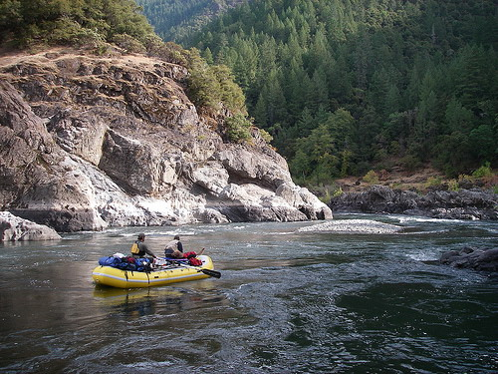
Rulemaking: Revising Human Health Water Quality Standards for Toxic Pollutants
Hearings for Public Comment
Bend, Eugene, Medford, Coos Bay, Ontario, Pendleton, Portland, Portland EQC, Salem
February 1 – March 7, 2011
Andrea Matzke | Water Quality Standards Specialist

Slide 2
What Will this Rulemaking Do?
Revises human health criteria for 114 toxic pollutants based on a fish consumption rate that is higher than the rate currently used
Proposes several point source implementation tools
Revises DEQ rules to clarify that ODA and ODF resource management objectives to protect water quality must meet water quality standards (i.e. make consistent with state statutes)

Slide 3
Presentation will highlight:
  Background
  Purpose
  Rulemaking Development
  Summary of Proposed Rulemaking
    Human Health Criteria
    Point Source Implementation Tools
    Nonpoint Source revisions
  How to Submit Comments
  Opportunity for Questions

Slide 4
What are Toxic Pollutants?
What?
-some are naturally occurring (e.g. arsenic, mercury)
-many are human-made (DDT, PCBs)
Effects
Cancer
Non-cancer effects: immune system, reproductive, nervous, endocrine, developmental effects
Where?
-point sources (industry, wastewater treatment plants)
-nonpoint sources (agriculture, forestry, urban)
-Oregon currently has water quality impairments for toxics
Notes:
-some toxics can remain in the environment for a very long time— banned long ago, but are still present (legacy pollutants)

Slide 5
Non-Point Sources
Point Sources
Notes:
-This graphic helps illustrate where toxics can come from
-point sources (industry, wastewater treatment plants)
-nonpoint sources (agriculture, forestry, urban)

Slide 6
Toxics Reduction Strategy
Examples of Current DEQ Programs
Air Toxics Program
Water Quality Toxics
Interagency Efforts
Lab Toxics Monitoring Program
Land Quality Toxics
Federal NESHAP
State Sector-based Reduction Strategies
Community Air Toxics Reduction Projects
SB 737 / Priority Persistent Pollutant List
Water Quality Toxics Criteria Rulemaking
Water Quality Pesticide Management Team
Ecological Business (ECO-BIZ) Program
Pesticide Stewardship Partnerships
Willamette Toxics Monitoring
Air Toxics Monitoring
Toxics Use Reduction Program
Toxics Cleanup Programs
Household Hazardous Waste Programs
Notes:
-This graphic illustrates DEQ’s Toxics Reduction Strategy
-This rulemaking is one part of this overall strategy to reduce toxics in the environment

Slide 7
Beneficial Uses
(e.g. Public water supply, fishing, recreation)
Antidegradation
(maintain & protect existing uses)
Criteria to Protect Use
(concentration or narrative)
Water Quality Standards
Notes:
-What are WQS?
Beneficial Uses
—protection of propagation of fish, public water supply, recreation
-protect the most sensitive use
-If beneficial use cannot be met, you can re-examine the appropriateness of the use
Criteria to Protect uses
-concentration, level, or narrative statement
-DEQ typically adopts criteria based on EPA nationally recommended criteria
Antidegradation
-to maintain and protect existing WQ
-Tier II: WQ exceeds goals and shall be protected—can be lowered to accommodate important economic development

Slide 8
Water Quality Standards
Establish Source Controls (point source and NPS)
Implement and Monitor
Evaluate and Identify Impaired Waters
(303d List)
Additional Measures and Control
(TMDLs, WLAs, LAs)
Water Quality Standards
Notes:
-This is where WQS fit into the CWA programs
- Establish source controls
TBELs required for point sources
NPSs: Ag WQ Management Area Plan and Rules and ODF Forest Practices Act Rules
303(d)
-Clean Water Act requires DEQ to review all available data and report on the conditions of Oregon’s waters every 2 years
-Key aspect is comparing water quality data and information to Oregon’s water quality standards to determine whether they are being met.
-As part of that analysis, DEQ identifies those waters not meeting water quality standards (i.e., those that are “impaired”) and that need a Total Maximum Daily Load (TMDL) developed. This is also known as the 303(d) list.

Slide 9
Why is DEQ Proposing These Rules?
Protect Oregonians from toxics present in water and fish
DEQ’s current human health criteria do not provide adequate protection for Oregonians who regularly eat fish and shellfish
  In June 2010, EPA disapproved criteria submitted in 2004 based on a fish consumption rate of 17.5 g/day—causing Oregon to revert back to old criteria based on 6.5 g/day
Notes:
-generally, people who eat more fish and shellfish have a higher risk of health effects from pollutants accumulated there
- 17.5 g/day: The nationally recommended criteria relied on a study which included both consumers and non-consumers of fish.
-6.5 is 27x less than 175

Slide 10
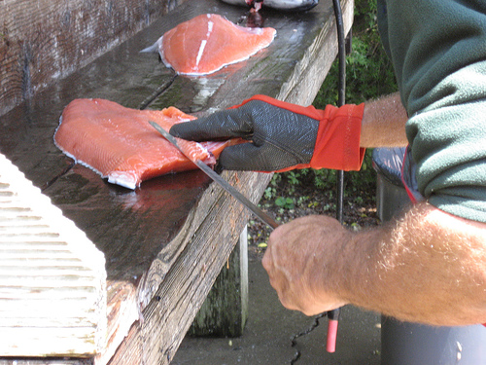
  This rule addresses EPA’s disapproval by proposing to adopt criteria based on 175 g/day
The EQC directed DEQ to use 175 g/day based on relevant regional fish consumption studies
  175 g/day = 23 8-ounce servings of fish per month
  6.5 g/day = less than 1 8-ounce serving of fish per month
Notes:
based on fish consumption studies: CRITFC (4 Columbia River Tribes), tribes in Puget Sound area in WA, an Asian and Pacific Islander study, and a national study
175 protects 90 – 95% of people who regularly consume fish and shellfish
-acknowledge that not everyone eats this amount of fish, but it protects those individuals who do eat a lot of fish—e.g. OR tribes, Asian Americans, sport fishermen
- CTUIR: 389 g/day
--Warm Springs: 170 g/day
-demonstration w/ salmon can

Slide 11
How Does the Fish Consumption Rate Factor into the Criteria?
Equation for linear dose-response carcinogens:
Generally, as the FCR increases, the WQ criteria will decrease—i.e. become more stringent
Criterion = (Risk Level x BW)
[CSF x (DI + (FCR x BCF))]
FCR = fish consumption rate
Notes:
If BCF high, the FCR has a bigger impact on the criteria equation
- As a matter of policy, the EQC has chosen to protect Oregonians at a risk level of 10-6
Risk Level = Risk Level (unitless)
CSF = Cancer slope factor (mg/kg-day)
BW = Human body weight (kg) =70 kg
DI = Drinking water intake (L/day) = 2 L/day
FCR = Fish consumption rate (kg/d) = 0.175 g/d
BCF = Bioconcentration factor (L/kg)

Slide 12
Rulemaking Development
2006-2011
Development of fish consumption rate (2006 - 2008)
  Human Health Focus Group (HHFG)
  7 public workshops
Cost analysis (2008)
  Fiscal Impact & Implementation Advisory Committee (FIIAC)
NPDES Implementation (Winter 2008 – Fall 2010)
  Rulemaking Workgroup
Non-NPDES Implementation (Fall 2009 – Fall 2010)
  Non-NPDES Workgroup
Notes:
- HHFG: Panel of experts—public health and toxicologists to examine scientific basis of selection a FCR and what studies were credible

Slide 13
Rulemaking Workgroup
CTUIR
Ryan Sudbury/Rick George
EPA
Jannine Jennings
ACWA
Dave Kliewer
League of Oregon Cities
Peter Ruffier
Northwest Pulp and Paper
Kathryn Van Natta
Industrial Dischargers
Michael Campbell
Associated Oregon Industries
Rich Garber or alternate Myron Burr
Northwest Environmental Advocates
Nina Bell
Northwest Environmental Defense Center
Andrew Hawley
Columbia Riverkeeper
Lauren Goldberg

Slide 14
Non-NPDES Workgroup
CTUIR
Ryan Sudbury/Rick George
EPA
Jannine Jennings
ACWA
Dave Kliewer
League of Oregon Cities
Peter Ruffier
Northwest Pulp and Paper
Kathryn Van Natta
Industrial Dischargers
Michael Campbell
Associated Oregon Industries
Rich Garber or alternate Myron Burr
Northwest Environmental Advocates
Nina Bell
Columbia Riverkeeper
Lauren Goldberg
NW Environmental Defense Center
Andrew Hawley
Department of Forestry
Peter Daugherty
Department of Agriculture
Dave Wilkinson/Ellen Hammond
Oregonians for Food and Shelter
Terry Witt
OR Farm Bureau
Jennifer Shmikler
OR Forest Industries Council
Chris Jarmer
Assn. of OR Counties
Emily Ackland
OR Small Woodlands Assn.
David Ford

Slide 15
Rulemaking Process
Stakeholder Workgroup Meetings
Public Comment Period
Ends Mar. 21, 2011
DEQ Review of Comments
Revise rules if needed
EQC Action
June 2011
EPA Action
Fall 2011
Concluded in October 2010

Slide 16
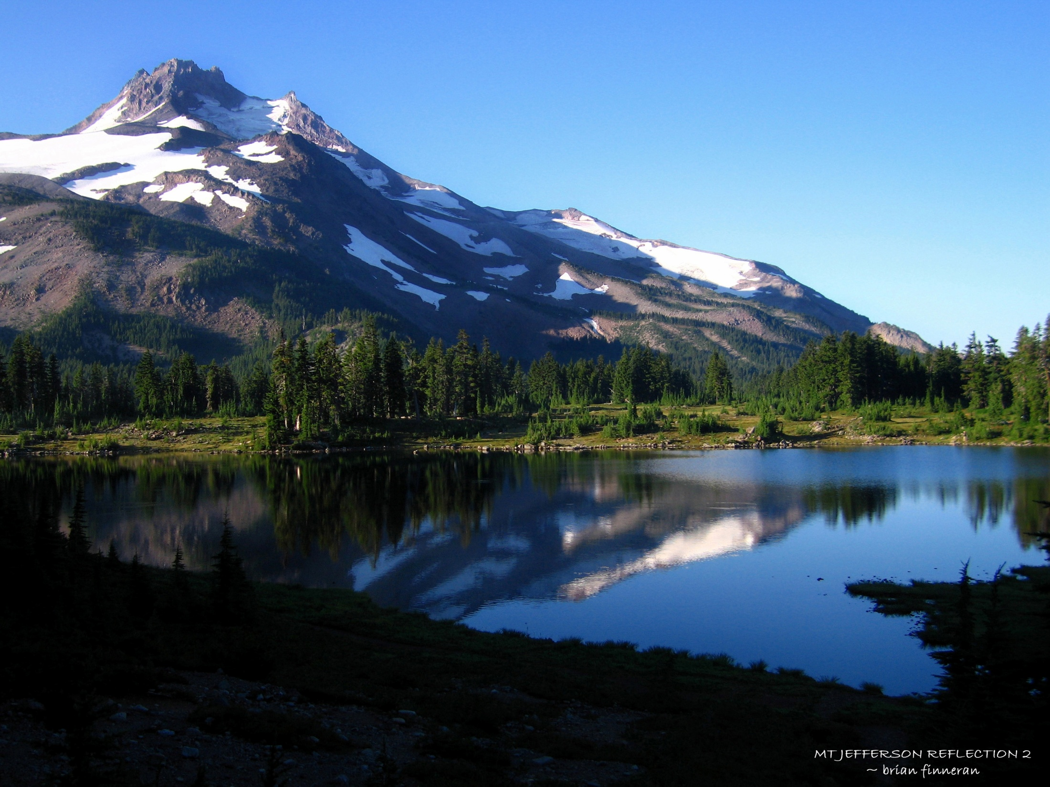
Summary of Draft
Human Health Criteria
Revisions

Slide 17

Criteria Revision History
2004: DEQ revised toxics criteria based on 17.5 g/day
2005-2008: Based on concerns raised by EPA, Tribes, DEQ evaluated appropriate fish consumption rate

Slide 18
History (cont.)
June 2010: EPA disapproved 2004 criteria as not sufficiently protective
  Effect of disapproval was to revert back to previous criteria adopted in 1980s based on 6.5 g/day and remove criteria for new pollutants added in 2004 (approx. 43)
Current Rulemaking: Proposing 114 “new” and revised criteria based on 175 g/day
  Key revision to address EPA’s disapproval
  Consequence: EPA will promulgate toxics criteria for OR if rulemaking does not proceed
Notes:
Current criteria: 81 pollutants
Proposing to withdraw some general classes of pollutants and propose more toxic specific chems of that family

Slide 19
Proposed Point Source Implementation Tools

Slide 20
Who Does this Rulemaking Affect?
Mainly NPDES point sources
  wastewater treatment plants and industrial facilities
Stormwater permits do not incorporate human health criteria limits
Criteria become effective after EPA approval
Criteria incorporated into permit at their scheduled renewal

Slide 21
Individual NPDES Permitting Demographics
Facility Type * | No.
Major Domestic | 49
Minor Domestic | 154
Major Industrial | 19
Minor Industrial | 130
Total | 352
Toxic criteria compliance apply to both individual and general permits
Determined by various federal and state requirements
Industrial permits have a complex process to determine monitoring requirements based on industrial category and potential for toxicity
* From DEQ wastewater permits database
Notes:
- The SB737 list of municipalities included Bend City, Redmond, and Sunriver Environmental which are not considered major NPDES sources (these are WPCFs—i.e. > 1 MGD), but were included in 737 rulemaking (that’s why they have a total # of 52 in the 737 list)
-The permitting program uses the following variables to define the status of an industrial facility (major/minor):
type of power plant, SIC code, Flow rates, BOD, TSS, Nitrogen, location and toxic group
Major industrials: many are pulp and paper industries (9) (others are smelting industries, electronics, and food processors
Minor industrials: mix of timber and wood products, food and beverage processing, dairies, fish hatcheries, and large category of “other”
Likelihood that effluent contain toxics ->priority pollutant scans
SIC code, flow rate
Influences major/minor categorization
-The only general permit impacted by HHC is the 1500A permit for hydrocarbon cleanup from SW or GW

Slide 22
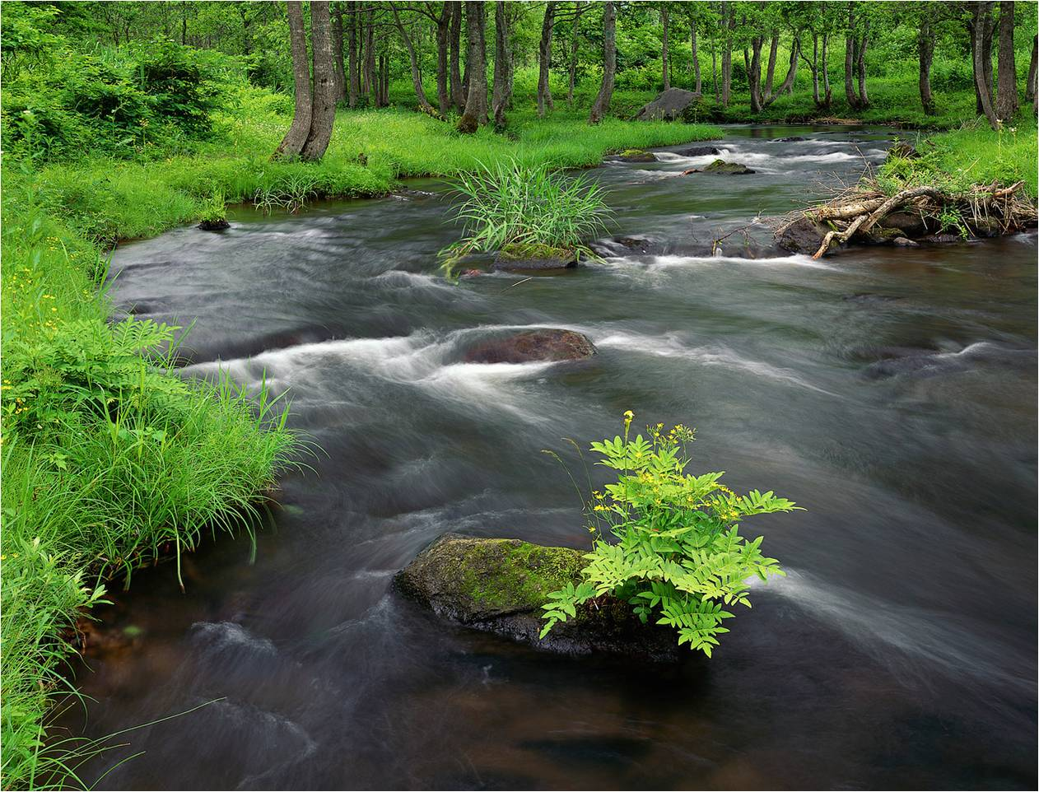
Background Pollutants in Oregon
There are toxic pollutants already present in OR waters
    Natural
    Human-caused
  Point source tools developed to account for their presence
Notes:
-some dischargers use water that is already exceeding WQS

Slide 23
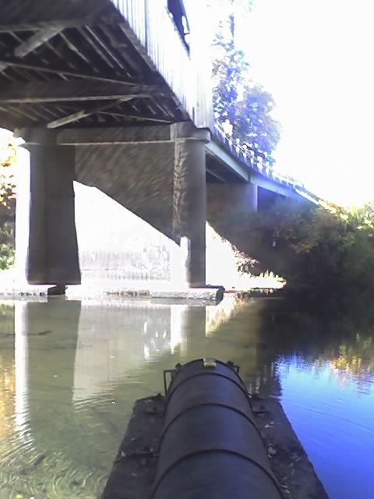
Proposed Intake Credit Rule
  New Rule for toxic pollutants
  Allows facilities to account for pollutants already present in the intake water
  The facility cannot increase mass or concentration of the pollutant at the point of discharge
Notes:
-100 percent of the intake water containing the pollutant is withdrawn from the same body of water into which the discharge is made;

Slide 24
Intake Credit Example
intake
1 ug/L
100 g/day
Process / Cooling
effluent
≤ 1 ug/L
≤ 100 g/day
Notes:
-cannot increase mass or concentration at end of pipe
-- If coming in at 1 ug/L, will need to treat down to intake concentration, as opposed to criterion if lower
-most of the time, mass is reduced thru treatment or water filtration

Slide 25
Proposed Background Pollutant Allowance
  New rule for human health toxics criteria only
  Facilities could potentially use this tool where the criterion is exceeded upstream of the discharge point
  Propose to allow a 3% increase in concentration of the toxic pollutant in the receiving stream from that of the upstream concentration
  Cannot increase the mass load in the receiving water
  Innovative tool for addressing pollutants already present in water bodies
  Only applies to carcinogens and receiving water cannot exceed a 1 in 10,000 risk level
Notes:
-Need to protect the most sensitive population at a risk level of 10-4 (at least)

Slide 26
Background Pollutant Allowance Example
1 ug/L
100 g/day
intake
Evaporation
Process / Cooling
≤ 1.03 ug/L
≤ 100 g/day
Notes:
-represents a 3% increase above background concentration

Slide 27
Revised Variance Rule with Pollutant Reduction Plan-- What is it?
  Establishes and applies alternative water quality standards for a specific pollutant(s) to a NPDES permitted facility for a specified duration
  Used when a facility cannot meet effluent limits based on a water quality standard
  Maintains underlying water quality standard
Notes:
-

Slide 28
Revised Variance Rule with Pollutant Reduction Plan-- What is it?
  Demonstration that facility cannot meet WQS-based requirements for one or more reasons:
    Natural conditions
    Human caused pollution
    Use of treatment technology is infeasible
  Allowed and governed by federal and state water quality standards regulations
Notes:
- Other states are using variances that are being approved by EPA : approx. 15 states—for both HHC and ALC

Slide 29
Variance with Pollutant Reduction Plan
Proposed Rule
  Revises and enhances existing rule
    Variance duration aligns with NPDES permit
    Variance requests approved by DEQ Director and EPA
  Applicable to all pollutants
  Pollutant Reduction Plan required: Provides a mechanism for achieving WQ improvements when underlying WQS cannot be met in the short term
Notes:
-pollutant reduction plans: e.g. source reduction, pollutant trading upstream, treatment optimization

Slide 30
Point Source Compliance Strategies
intake credits
background pollutant allowance
Yes
compliance schedule
  Meet WQS as soon as possible
Yes
Can facility meet effluent limits?
Will the facility be able to comply in the near term with effluent limits?
No
variances
Pollutant Reduction Plans
correct beneficial use
site specific criterion
No
Notes:
-this is assuming the facility has reasonable potential to exceed effluent limits

Slide 31
Proposed Nonpoint Source Changes
Gene Foster | Nonpoint Source Manager
Koto Kishida | Nonpoint Source Specialist
Notes:
Proposed NPS Rule Changes

Slide 32
Water Quality Standards
Establish Source Controls (point source and NPS)
Implement and Monitor
Evaluate and Identify Impaired Waters
(303d List)
Additional Measures and Control
(TMDLs, WLAs, LAs)
Water Quality Standards
Notes:
- When WQSs are established, sources put action in place with meeting WQSs in mind.

Slide 33
Nonpoint Sources
Water Quality Standards
Urban sources
Regulated by DEQ and local jurisdictions
DEQ regulations and Local Ordinances
Agricultural sources
Regulated by Department of Agriculture
Area Plans and Rules
Forestry sources
Regulated by Department of Forestry
Forest Practices Act Rules
Notes:
Depending on the land use WQSs are implemented differently.
Agricultural NPS – AgWQM Area Plans and Rules
Forestry – Forest Practices Act Rules
Urban – DEQ programs and local jurisdictions
The goal is the same for all sources – to meet WQSs

Slide 34
Water Quality Standards Rule Revision
Current Rules
Describe other agencies’ involvement in meeting water quality standards
ODF for private & state forest lands
ODA for agricultural lands
Proposed Rules
Clarify water quality goals for agriculture and forestry
Clarify other agencies’ involvement in meeting water quality standards
Notes:
The proposed rules explicitly state that WQS is the goal for agriculture and forestry.
This is already in statute, but is not explicit in current regulations.
The proposed rules also describe in more detail how DEQ will interact with ODA and ODF as they implement their programs.
These changes do not establish new DEQ authorities or transfer authority from ODA and ODF to DEQ.

Slide 35
Water Quality Standards
Establish Source Controls (point source and NPS)
Implement and Monitor
Evaluate and Identify Impaired Waters
(303d List)
Additional Measures and Control
(TMDLs, WLAs, LAs)
Water Quality Standards
Notes:
Other circumstance we are addressing with proposed rule revisions is how DEQ interacts with ODA and ODF when developing and implementing TMDL.

Slide 36
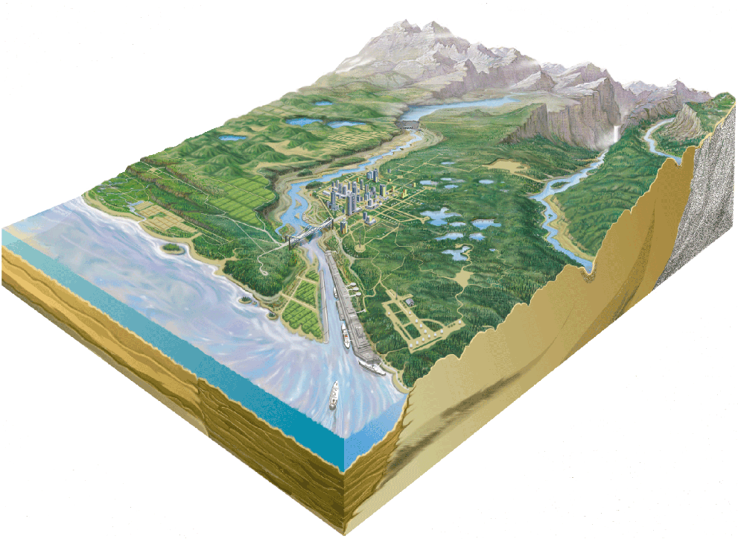
TMDL = WLA + LA_{nps}+ LA_{bg}+ MOS + RC
Waste Load Allocation
Load Allocation
Nonpoint Source
Load Allocation
Background
Margin of Safety
Reserve
Capacity
Notes:
Explain TMDL
When WQS is not met, DEQ further investigates the cause of the impairment by collecting additional monitoring information, through modeling efforts, and working with local experts on land use and sources.
Based on the investigation, DEQ assigns budget allocation to sources. WLA to PS and LA for NPS.
* Q: what happens when numeric criteria cannot be met. A: DEQ reflects what can be met in TMDL WLA and LA (i.e. natural thermal condition/ shade curve reflecting fire regime)

Slide 37
TMDL/Watershed Plan Rule Revision
Current Rules
Describe TMDL requirements for ODA and ODF
Describe requirements for others responsible for controlling sources
Proposed Rules
No change for other sources, since their goals and roles are clear
Clarify DEQ interaction for TMDLs with ODA and ODF to develop load allocations
Notes:
Following TMDL, Area Plans and Rules as well as FPA rules may need to be updated.
The proposed rules explain in detail DEQ’s interaction with ODA and ODF to develop and implement load allocations.
In addition, the proposed rule explains that, DEQ is authorized to develop TMDL and assign load allocations on finer scale and may do so where we have sufficient information. Currently DEQ give LAs to all NPS over a large part of watershed.

Slide 38
TMDL/Watershed Rule Revision
Current Rules
Explain what sources could be included in the watershed plan
Proposed Rules
Clarify that air and land quality sources could be included in the watershed plan
Notes:
In addition DEQ is proposing another rule revision.
Under the state law, DEQ has the authority to assign load allocations to significant air and land sources such as clean up sites and landfills. Current rules do not state the authority explicitly. This revision clarifies that DEQ has the authority to assign load allocations as needed to address those sources of pollution.
If in the course of the TMDL process deposition of a pollutant of concern from the air is identified as a contributor to the water quality violation, the air program will be notified and provided with a load allocation for air sources. The air program will approach this situation much as it would for a violation of an ambient air quality standard. An inventory of sources within the physical boundaries of the study area that are emitting that pollutant will be determined. An air quality dispersion model will use that inventory, along with appropriate meteorology, physical and chemical characteristics of the pollutant, and other factors to quantify deposition within the study area. The contribution of each air permitted source, as well as non-permitted stationary and mobile sources, to the total deposition will be estimated. Regional and global contributions will be estimated as well. The air program will then work with the water program to identify emissions reduction strategies to meet the load allocation.

Slide 39
What do these rule revisions mean for Departments of Agriculture and Forestry?
Current Rules
Water Quality Standards: Implemented through ODA and ODF’s programs and regulations
TMDLs: Implemented through ODA and ODF’s programs and regulations
Proposed Rules
TMDLs: Implemented through ODA and ODF’s programs and regulations
Water Quality Standards: Implemented through ODA and ODF’s programs and regulations
Notes:
These revisions do not change DEQ, ODA, and ODF’s respective authorities and responsibilities. The intent is to make clear who does what and when in order to meet the WQS and LAs.

Slide 40
What does this mean for landowners?
Current Rules
Water Quality Standards: Implemented through ODA and ODF’s programs and regulations
TMDLs: Implemented through ODA and ODF’s programs and regulations
Proposed Rules
TMDLs: Implemented through ODA and ODF’s programs and regulations
Water Quality Standards: Implemented through ODA and ODF’s programs and regulations
Notes:
The bottom line is that DEQ will continue to work with, and rely on ODA and ODF programs to achieve WQS.
As with the case today, if we have data and information that indicate that current actions are not enough to meet WQS, DEQ will work through these processes to support ODA and ODF in identifying changes to Area Plans and Rules and FPA rules.

Slide 41

DEQ Welcomes Your Comments!
E-mail: ToxicsRuleMaking@deq.state.or.us
Mail: Andrea Matzke
Oregon DEQ
Water Quality Division
811 SW 6th Avenue
Portland, OR 97204
FAX: (503) 229-6037
**All comments must be received by DEQ by 5:00 p.m. Wednesday, March 21, 2011**

Slide 42
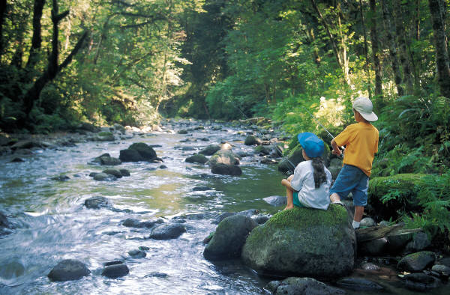
Questions?
For more information:
http://www.deq.state.or.us/wq/standards/humanhealthrule.htm

