Slide 1
Human Health Water Quality Standards for Toxic Pollutants
Update
Presentation to the Environmental Quality Commission
Portland
August 18, 2010
Neil Mullane, Jennifer Wigal, Gene Foster
Notes:
Neil

Slide 2
Introduction
Presentation will cover:
Status of process and timeline
Metals rulemaking (As, Fe, Mn)
Toxics rulemaking
NPDES elements
Non-NPDES elements
Other topics considered for rule changes
Approach to fiscal impact
What DEQ has heard from stakeholders
Notes:
Neil

Slide 3
Process and Timeline
Work group meetings
Last meeting Sept. 22 to discuss fiscal impacts
2010
2011
Notes:
Neil

Slide 4
Metals Rulemaking Estimated Timeline
Public Comment Period
Late August to September 30
Response to Comments and Final Proposed Rules
October
EQC staff report
November
EQC adoption
December
EPA approval
February or March, 2011 (estimated)
Notes:
We do not expect a lot of comment on these rules.
Narrow
Pretty good agreement

Slide 5
Proposed Human Health Criteria for Arsenic, Iron and Manganese (µg/l)
Pollutant | Water + Fish Ingestion |  | Fish Consumption Only
 | Current Criteria | Proposed Criteria | Current Criteria | Proposed Criteria
Arsenic | 0.0022 | 2.3 inorganic arsenic | 0.0175 | 2.7 inorganic arsenic
Iron | 300 | None | None | None
Manganese | 50 | None | 100 | 100 for marine waters
Notes:
Notes:
1) Current criteria are currently effective federal criteria from Table 20 of the OARs.
2) Proposed arsenic criteria are for total inorganic arsenic.
3) The manganese criterion is for total manganese.
4) The aquatic life criterion for iron is 1000µg/l. There are no aquatic life criteria for arsenic or manganese.
DEQ proposes to withdraw the water + organism criteria for iron and manganese; and the organism only criterion for manganese as it applies to freshwaters, leaving in place the organism only criterion as applicable to marine waters.
The new criteria are for the inorganic form of arsenic, which is the form that present human toxicity concerns.
Arsenic criteria are calculated based on EPA method, but with Oregon-specific values for:
BCF
fish consumption rate;
addition of an inorganic arsenic factor of 10 %
higher risk level (10-4) for the water + fish criterion for arsenic.
This risk level is acceptable given the presence of naturally occurring levels of arsenic in Oregon waters.
Also, it is also consistent with EPA guidance to use a higher risk level in conjunction with a higher or “subsistence” level fish consumption rate.

Slide 6

Arsenic Reduction Policy
Purpose:
Minimize human health risk associated
with arsenic in fish tissue and drinking
water to the extent feasible
Targets:
Anthropogenic sources with the potential to increase inorganic arsenic concentrations in drinking water source waters
Requires:
Specified dischargers to propose measures to reduce arsenic in their effluent, an implementation schedule, and monitoring and reporting
Notes:
Requires the discharger to:
Propose feasible measures to reduce arsenic in their effluent and an implementation schedule
Propose monitoring and reporting requirements to demonstration progress in plan implementation and arsenic load reductions
Requires DEQ to:
Include the proposed plan as a requirement of the NPDES permit
Obtain public comment on the requirements together with comment on the permit

Slide 7

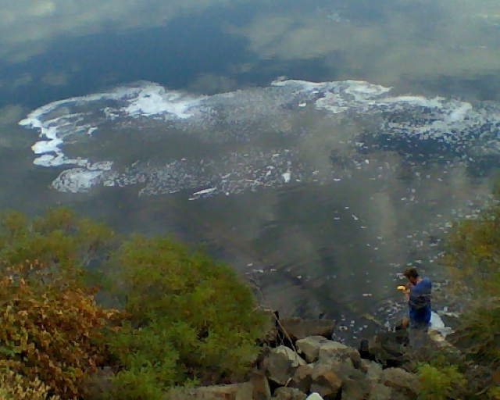
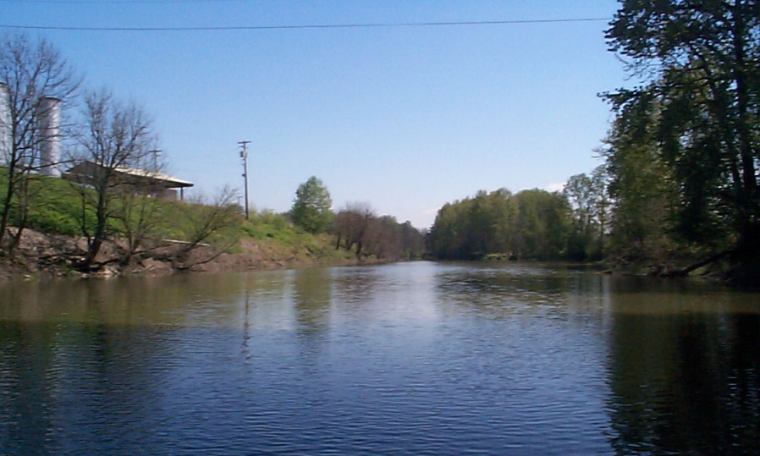
Toxics Rulemaking
NPDES
Elements

Slide 8
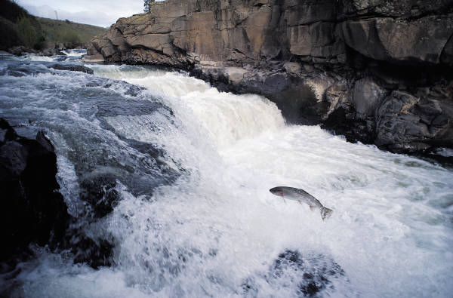
Toxics Rulemaking Revised Toxics Criteria for Human Health – Div. 41
More protective of human health
Based on a fish consumption rate of 175 grams/day
Criteria that do not bioaccumulate will
not be affected by a higher fish consumption rate
Criteria to become
effective upon EPA
approval
Notes:
Permittees will not be affected by the criteria changes until after EPA has approved the criteria and at the time their permit is up for renewal
approximately 9 criteria are not dependent on the FCR

Slide 9
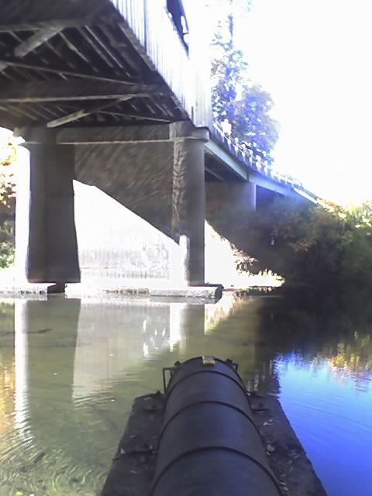
Toxics Rulemaking Permit Implementation
Intake Credit Rule – Div. 45
New Rule for toxic pollutants
Allows facilities to pass through
pollutants found in the intake
water to their effluent without requiring treatment
The facility cannot increase mass or concentration of the pollutant at the point of discharge
It is uncertain how many facilities will be able to use this tool
Notes:
-100 percent of the intake water containing the pollutant is withdrawn from the same body of water into which the discharge is made;

Slide 10
Intake Credit Example
1 ug/L
100 g/day
intake
Evaporation
Process / Cooling
effluent
≤ 1 ug/L
≤ 100 g/day
Notes:
-cannot increase mass or concentration at end of pipe
-most of the time, mass is reduced thru treatment or water filtration
-intake credits can be used for both determining if there is a water quality violation or as an offset to the calculated effluent limit

Slide 11
Toxics Rulemaking Permit Implementation
Background Pollutant Allowance – Div. 41
New Rule for human health toxics criteria only
Facilities could potentially use this tool where the criterion is exceeded upstream of the discharge point
Propose to allow a 3% increase of the toxic pollutant concentration in the receiving stream from that of the upstream concentration (more conservative for Willamette and Columbia Rivers)
Cannot increase the mass load in the receiving water
Innovative tool for addressing pollutants already present in water bodies

Slide 12
Background Pollutant Allowance Example
intake
1 ug/L
100 g/day
Evaporation
Process / Cooling
≤ 1.03 ug/L
≤ 100 g/day
Notes:
-represents a 3% increase above background concentration

Slide 13
Toxics Rulemaking Permit Implementation
Variance with Pollutant Reduction Plan – Div. 41
Revises and enhances existing rule
Applicable to all pollutants
Provides a mechanism for achieving WQ improvements when underlying WQS cannot be met in the short term
Pollutant reduction plan required
Improved administrative process
New source variance request would be approved by EQC
Notes:
Improved administrative process:
-Variance duration aligns with the NPDES permit
-Variance requests approved by DEQ Director and EPA

Slide 14
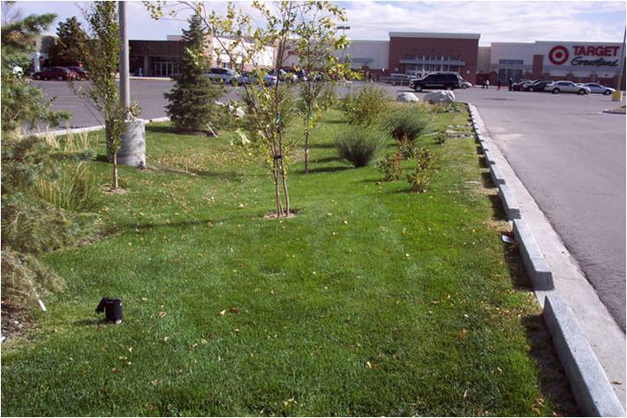
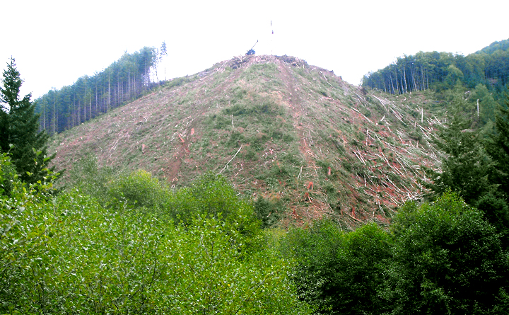
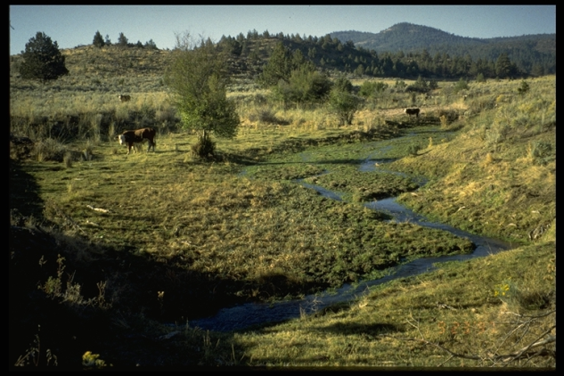
Toxics Rulemaking
Non-NPDES
Elements

Slide 15
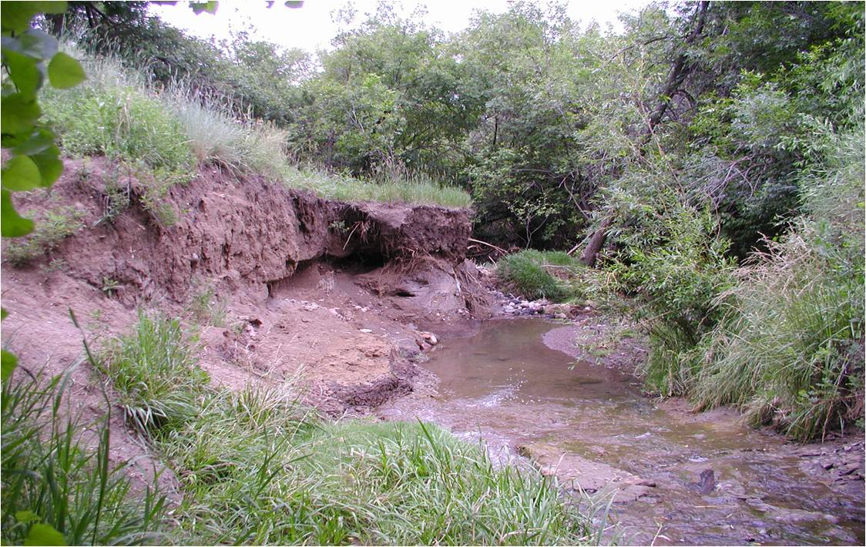
Toxics Rulemaking Discussion Topics
EQC Directed DEQ to propose
strategies to reduce toxics
from sources not regulated
under NPDES permits
DEQ solicited input from stakeholders on:
Regulatory authority on NPS pollution
Reasonable Assurance for on-the-ground improvement (Implementation-Ready TMDLs)
Toxics associated with sediments
Antidegradation
Notes:
Gene’s talking points
Emphasize EQC Directive
Met three times since last EQC update (April) Met 7 times total with workgroup

Slide 16
Toxics Rulemaking Regulatory Authority: NPS Pollution
Issues with current language around NPS pollution
Rules related to NPS do not explain how regulatory authorities of state agencies interact and are applied in practice
TMDL rules do not explicitly state if load allocations are applicable to air and land sources
Revise Divisions 41 (WQS) and 42 (TMDLs) to clarify regulatory authorities and mechanisms around NPS pollution
Explain in rule how statutes and rules for agriculture and forestry work together with water quality standards and TMDLs
State that load allocations can be assigned to air and land sources

Slide 17
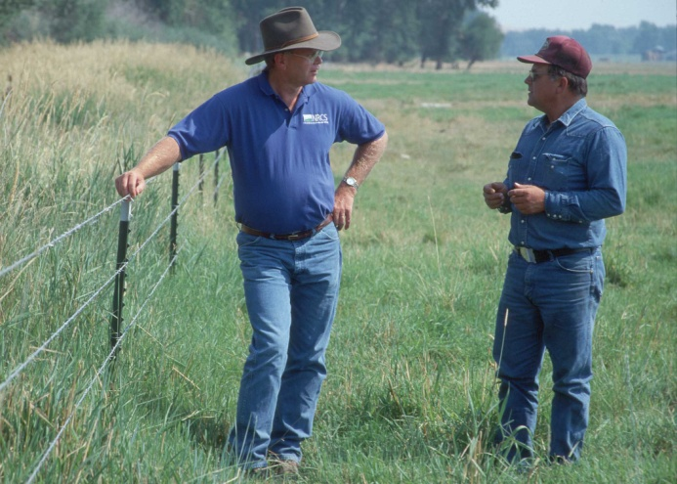
Toxics Rulemaking Implementation-Ready TMDLs
Key issue with implementing current TMDLs
Not clear what nonpoint sources need to do to meet load allocations
Provide Reasonable Assurance that water quality will improve by developing “Implementation-Ready” TMDLs
Integrate the implementation plan
development and implementation
directly into the TMDL process
Collaborate with state and local
partners to develop specific guidance
and priorities to meet the TMDL load
allocation

Slide 18
Toxics Rulemaking Other Topics Considered for Rule Changes
Toxic Pollutants associated with Sediments
Maintain current efforts to address sediment and not pursue additional revisions specific to sediment and toxics through the current rulemaking process
Antidegradation
Revise DEQ’s Antidegradation Implementation Internal Management Directive to address how antidegradation applies to stormwater and NPS pollution

Slide 19

Approach to Fiscal Analysis
Required for rulemaking
The fiscal impact analyzes
incremental costs based on
proposed criteria changes –
not costs associated with existing criteria
Describes impacts to small and large businesses, local government, the general public, other state agencies, and DEQ

Slide 20
Components of the Fiscal Analysis
Assess potential fiscal impacts through: NPDES permits (POTWs, industry) and other CWA programs, such as 401 certifications, section 303(d), and TMDLs
Impacts associated with criteria changes
Depend on:
Criteria most likely to affect sources
Quantitation Levels (QL) of criteria--lowest conc. at which a method can quantify a pollutant
Monitoring costs
Impacts associated with implementation tools
Evaluate extent to which implementation tools mitigate the costs of meeting criteria
Administrative and other costs to sources and DEQ
Notes:
-The SAIC report identified three pollutants where additional controls may be needed to achieve lower criteria: (1) arsenic; (2) Bis(2-ethylhexyl)phthalate; and (3) mercury. However, as part of the 2004 rule revision, Oregon withdrew its national CWA § 304(a) human health criterion for total mercury and replaced these criteria with a new fish tissue-based “organism only” human health criterion for methylmercury. DEQ does not have a current criterion for methylmercury, although a new criterion will be proposed as part of this toxics rulemaking. Consequently, until data on methylmercury are collected and analyzed, it is unclear what the state of compliance will be. For arsenic, DEQ is currently proposing a higher criterion than what was reflected in the SAIC report. Therefore, some of the compliance issues associated with arsenic may be minimized.
-Roughly half of pollutants have QLs higher than the criteria. The QL becomes the compliance point

Slide 21
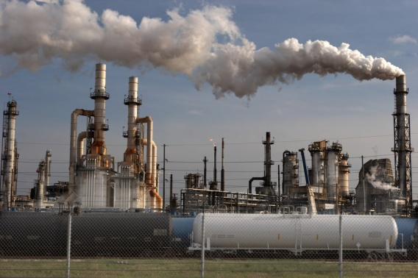
Sources of Information for Fiscal Analysis
DEQ will partly rely on a 2008 EPA-contracted report (i.e. SAIC report) which provided estimates of the potential cost of compliance with increased fish consumption rates
Selection of facilities:
- Reviewed 1 minor steel mill and 4
largest facilities (municipalities, one
of which is dominated by industrial
wastewater)
- Representative random sample of 15 additional facilities (both municipal and industrial)

Slide 22
Sources of Information for Fiscal Analysis
Fiscal Impact and Implementation Advisory Committee (FIIAC) 2008 Memo – Experts convened to discuss fiscal impacts due to a higher fish consumption rate
Internal DEQ sources
August and September work group discussions on fiscal impact

Slide 23
What DEQ Has Heard From Stakeholders – NPDES
Need for cost effective implementation tools
Assurances of DEQ and EPA timely approval
Concerns of how dischargers will meet any of the justification factors for variances
Concerns of whether providing greater flexibilities to permittees erode WQS regulations
Some stakeholders have stated that the background pollutant allowance is key to supporting this rulemaking

Slide 24
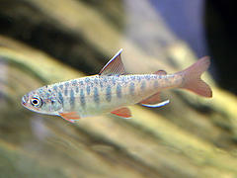
What DEQ Has Heard From Stakeholders – Non-NPDES
DEQ is proposing to go beyond its authority to regulate NPS
The package does not include enough changes to reduce toxics from non-NPDES sources
DEQ may not have adequate
resources to implement changes
It is not clear how rule revision
will affect air sources

Slide 25

Next Steps
Sept. 22: Final workgroup meeting
Oct. 21-22: EQC Director’s Dialogue
Oct. 27: Draft proposed rules
Nov. 17: Draft rule package for SOS

