Slide 1
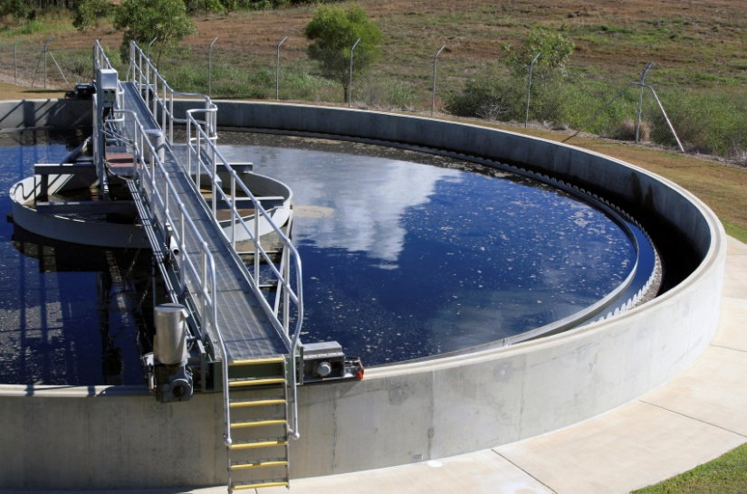

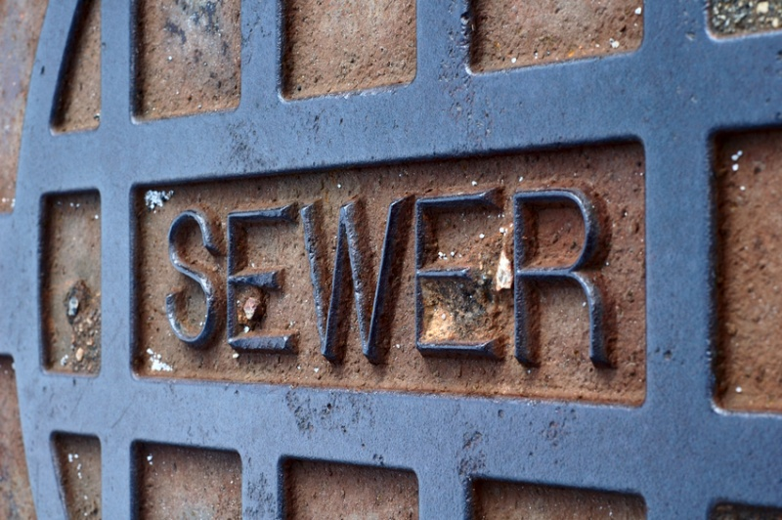

City of The Dalles,
Oregon
Wastewater Plan: Financial Element
City Council Meeting
John Ghilarducci
November 26, 2012
4380 SW Macadam Avenue, Suite 220, Portland, OR 97239  503-841-6543

Slide 2
Presentation Outline
Rate Findings
  Background
  Key Assumptions
  Rate Scenarios
SDC Findings
  Background
  SDC Calculation Summary
  Comparable SDCs

Slide 3
What Should Rates Do?
Generate sufficient revenues to sustain the utility system
Charge for services provided
Recover costs equitably
Achieve City objectives
  Revenue stability
  Maintain minimum fund balances
  and meet other fiscal policies

Slide 4
Key Assumptions
Annual cost escalation
  5.1% for personal services (historical rate)
  3.2% for materials and services (CPI)
  3.1% for capital outlay (ENR CCI)
Operating fund maintains 45-90 days of expenditures
Minimum revenue bond coverage ratio of 1.25
New debt modeled at 4.0% for 20 years
Notes:
There is purposefully no mention of growth assumptions.

Slide 5
Rate Scenario 1

Slide 6
Rate Scenario 2

Slide 7
Rate Scenario 3

Slide 8
Scenario Comparison

Slide 9
SDC Background
Key Characteristics
SDCs are one-time charges, not ongoing rates.
SDCs are for capital only, in both their calculation and in their use.
Properties which are already developed do not pay SDCs unless they “redevelop”.
SDCs include both future and existing cost components.
SDCs are for general facilities, not “local” facilities.
ORS 223.297 - 314, defines “a uniform framework for the imposition of” SDCs, “to provide equitable funding for orderly growth and development in Oregon’s communities”

Slide 10
SDC Methodology
Reimbursement
Fee
Improvement
Fee
System Development
Charge
Eligible cost or value of unused capacity
in existing facilities
Growth in system capacity demand
Eligible cost of planned capacity increasing
facilities
Growth in system capacity demand
per unit of capacity

Slide 11
SDC Calculation Summary

Slide 12
Comparable SDCs

